Slide 1
EU-OSHA Stakeholder Survey
2022 results and 2014-2022 trends
Prepared by ICF for EU-OSHA
June 2022

Slide 2
Overview of the survey
Survey sample:
OSHmail subscribers and HWC newsletter subscribers
Other respondents
Management Board and Focal points members
Partners included in the Agency’s contact database
Total of 918 responses
Email
Website
Social media
End of survey link
468
404
13
33
Base: 918 respondents

Slide 3
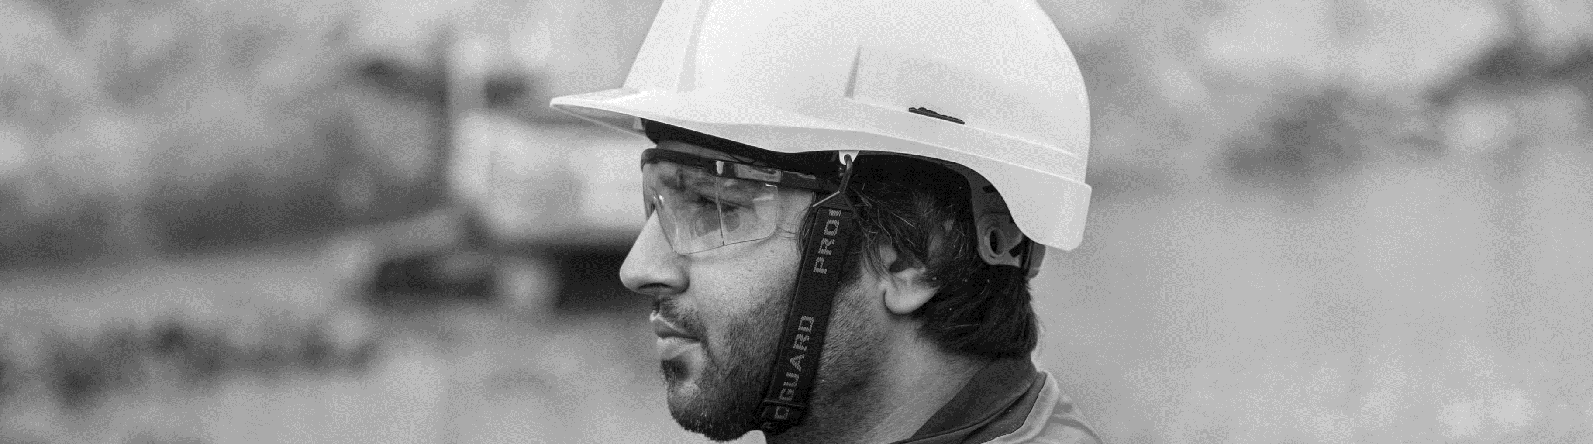
Most respondents
Work in
work at
work as
Italy, Spain
and Portugal
National, regional or local public body or large enterprise
Employee
44%
38%
46%

Slide 4

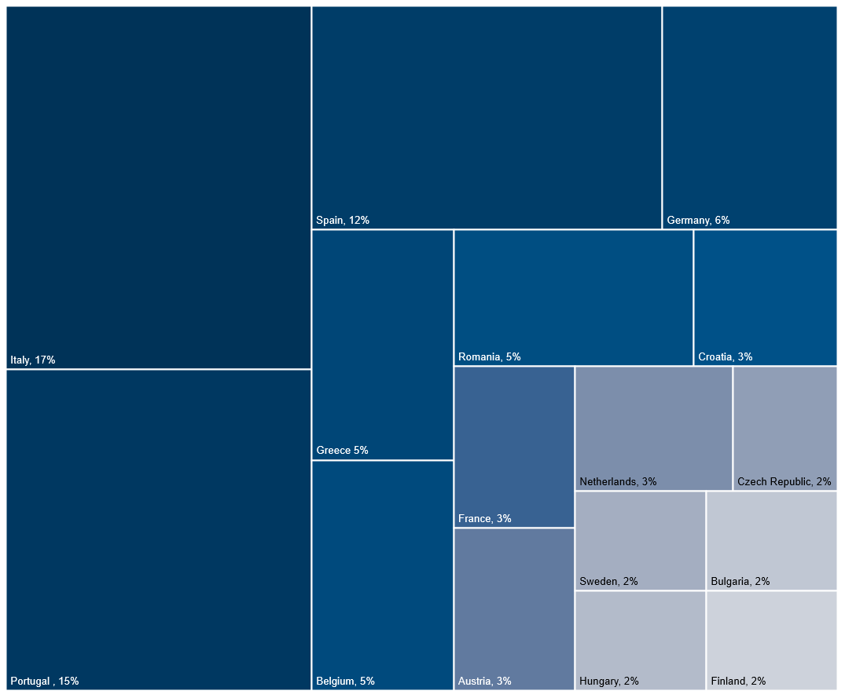
Across 2014 to 2020, consistently most respondents work in Italy, Spain and Portugal
2022 data. Base: 918 respondents

Slide 5

Most respondents work at private enterprises or national public bodies
Base: 918 respondents

Slide 6
Most respondents work as an employee…
… and in relation to OSH, most function as OSH intermediaries
Base: 907 respondents

Slide 7

Satisfaction with EU-OSHA’s work…
is an overwhelming 86%
increased between 2014 and 2016
across the different stakeholders
and has since remained consistent
Base: 904 (2022), 1,751 (2020), 1,728 (2018), 1,549 (2016), 2,882 (2014).
2014,2020 and 2022 included “don’t know” option. 2014 and 2016 did not.

Slide 8
Satisfaction with EU-OSHA’s work when excluding don’t know
is an overwhelming 93%
when removing “don’t know”
across the different stakeholders
shows an increase from 2018 to 2020
Base: 904 (2022), 1,751 (2020), 1,728 (2018), 1,549 (2016), 2,882 (2014).
Respondents who said “don’t know” in 2014, 2020 and 2022 have been excluded.

Slide 9




88%
87%
84%
84%
The work of EU-OSHA addresses the right priorities on OSH
EU-OSHA provides access to relevant research and
knowledge on OSH
The work of EU-OSHA adds value to the work on OSH done by others
EU-OSHA guides me
to the knowledge I need on OSH
Attitudes towards EU-OSHA are positive across stakeholder groups
Policy-maker
Researcher
OSH intermediary
Policy maker and Researcher
Those who do not fit in a stakeholder group more often said they ‘don’t know’ and less often said they ‘agree’ or ‘strongly agree’
Base: 4861 (policy-makers), 515 (researchers),
1487 (workplace intermediaries), 1296 (Policy maker and Researcher)

Slide 10

92%
88%
87%
84%
83%
EU-OSHA
performs well
as an organisation
The work of EU-OSHA addresses the right priorities on OSH
EU-OSHA provides access to relevant research and
knowledge on OSH
The work of EU-OSHA adds value to the work on OSH done by others
EU-OSHA guides me
to the knowledge I need on OSH
Focal points and members of the management board more often responded positively
Focal point
Management board
Neither EU-OSHA's focal point nor management board members
This includes 'don't know'
Base: 134 (Focal point), 143 (Management board), 3384 (Neither)
*This statement of the question was only asked to Focal point and members of the management board, hence why this accounts to 0%.

Slide 11

Perceived performance by key stakeholders
Focal point
92%
Management board
EU-OSHA
performs well
as an organisation
This includes 'don't know'
Base: 134 (Focal point), 143 (Management board), 3384 (Neither)

Slide 12
Perceptions over time are stable
EU-OSHA provides access to relevant research-based knowledge on OSH
The work of EU-OSHA adds value to the work on OSH done by others
EU-OSHA
performs well
as an organisation
The work of EU-OSHA addresses the right priorities on OSH
EU-OSHA guides me
to the knowledge I need on OSH
Base: 902 (2022), 1,751 (2020), 1,728 (2018), 1,549 (2016). No “don’t know” option in 2016 and 2018.

Slide 13
Perceptions over time are stable when excluding “don’t know” responses
EU-OSHA provides access to relevant research-based knowledge on OSH
The work of EU-OSHA adds value to the work on OSH done by others
EU-OSHA
performs well
as an organisation
The work of EU-OSHA addresses the right priorities on OSH
EU-OSHA guides me
to the knowledge I need on OSH
Decrease
Increase
Exclusion of “don’t know” from 2020 also lead to a decrease in the proportion of respondents who disagree
Disagree
Base: 902 (2022), 1,751 (2020), 1,728 (2018), 1,549 (2016).
Respondents who said 'don't know in 2020 and 2022 have been excluded.

Slide 14
Respondents widely agree that EU-OSHA contributes to
Increased awareness about
occupational safety and health risks
Increased awareness of solutions to occupational safety and health risks
Improved occupational safety and health
in the workplace
94%
91%
88%
Policy-maker
Researcher
OSH intermediary
Policy-maker and researcher
Base: 633 (policy-makers), 381 (researchers),
1106 (workplace intermediaries), and 954 (Policy maker and researcher)

Slide 15
The proportion of respondents who agree that EU OSHA contributes to
Awareness about occupational safety and health risks
Awareness of solutions to occupational safety and health risks
Improved occupational safety and health in the workplace
increased between 2016 and 2020
Base: 903 (2022), 1,751 (2020), 1,728 (2018), 1,549 (2016).
No “don’t know” option in 2016 and 2018.

Slide 16
The proportion of respondents (excluding ‘don’t knows’) who agree that EU OSHA contributes to
Increased awareness
about occupational safety
and health risks
Increased awareness of solutions to occupational
safety and health risks
Improved occupational safety and health in
the workplace
increased with each survey year
Base:903 (2022), 1,751 (2020), 1,728 (2018), 1,549 (2016).
Respondents who said “don’t know” in 2020 and 2022 have been excluded

Slide 17
Overall, EU-OSHA’s work is used for…
Address occupational safety and health issues at enterprise or workplace level
Talked with others about it
Further research
Awareness raising purposes at European, national or enterprise level
Guidance to information from other sources than EU-OSHA
Policy-making at national, regional or local level
Something else
Policy-making at European level
Did not use
Mapped according to the overall comment
Base: 903 (overall), 212 (policy-makers), 126 (researchers), 369 (workplace intermediaries), 318 (Policy maker & researchers)

Slide 18
EU-OSHA’s work is used for…
Policy-makers
Researchers
Workplace
intermediary
Policy-makers & researchers
Address occupational safety and health issues at enterprise or workplace level
Talked with others about it
Further research
Awareness raising purposes at European, national or enterprise level
Guidance to information from other sources than EU-OSHA
Policy-making at national, regional or local level
Policy-making at European level
Something else
Did not use
Mapped according to the overall comment
Base: 903 (overall), 212 (policy-makers), 126 (researchers), 369 (workplace intermediaries), 318 (Policy maker & researchers)

Slide 19
Purpose of use over time
Base: 903 (2022), 1,751 (2020), 1,728 (2018). In 2018, policy-making at national-level did not refer to regional or local

Slide 20
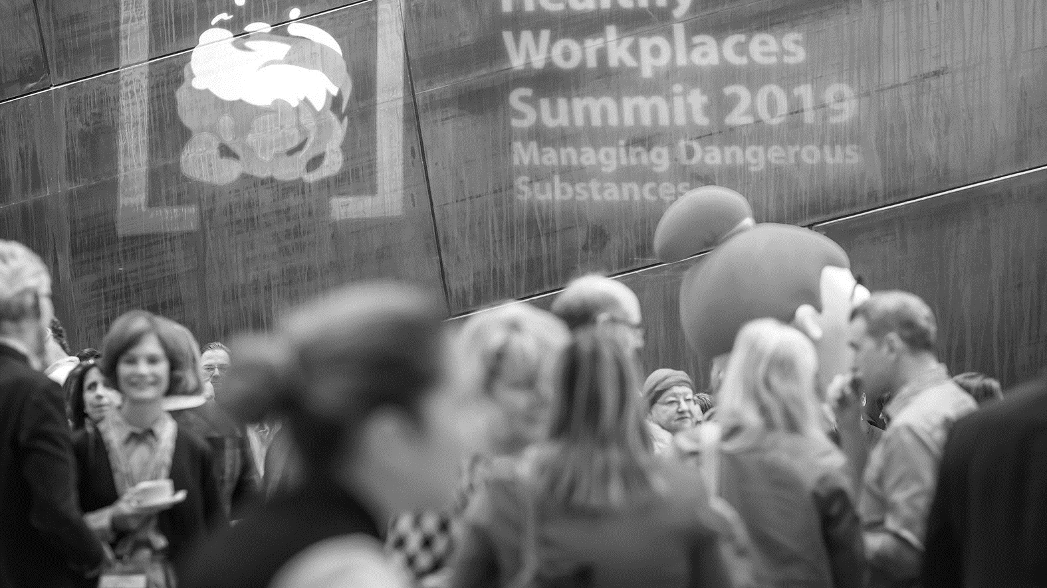
EU-OSHA’s activities

Slide 21
Overall results on the familiarity of activities
Musculoskeletal disorders and Healthy Workplaces Campaign Lighten the load
OiRA
OSH and digitalisation
OSH Barometer
Emerging risks/foresight
OSHwiki
Enterprise survey ESENER
█ I know this activity well and/or have actively engaged with EU-OSHA's work related to it
█ I have heard of this activity and know something about it
Base: 907 (overall)

Slide 22
Familiarity with activities
Policy-makers
more familiar with the Musculoskeletal disorders campaign
Researchers
more familiar with the OSHwiki, Micro and small enterprises, ESENER and the Emerging risks/ foresight studies
Workplace intermediary
Somewhat less familiar with ESENER
Policy maker & Researcher
Somewhat less familiar with ESENER
Musculoskeletal disorders and Healthy Workplaces Campaign Lighten the load
OSHwiki
OiRA
OSH Barometer
OSH and digitalisation
Enterprise survey ESENER
Emerging risks/foresight
█ I know this activity well and/or have actively engaged with EU-OSHA's work related to it
█ I have heard of this activity and know something about it
Base: 907 (overall)

Slide 23
Overview of familiarity over time
Increased
Decreased
Base:907 (2022), 1,751 (2020), 1,728 (2018), 1,549 (2016).

Slide 24
Respondents’ familiarity towards previous (2016-2020) and new activities (2022)
Previous activities
New activities
Base:907 (2022), 1,751 (2020), 1,728 (2018), 1,549 (2016).

Slide 25






Purpose of engagement for the activities
ESENER often used for research and to inform decisions
Information on Musculoskeletal and Healthy Workplaces Campaign often used to address OSH issues at enterprise or workplace level
ESENER often used for awareness raising
 | Emerging risks/foresight on Circular economy | Enterprise survey ESENER | OSH and digitalisation | OSH barometer | Musculoskeletal and Healthy Workplaces Campaign Lighten the Load
Address OSH issues at enterprise or workplace level | 42% | 34% | 47% | 34% | 50%
Research purposes | 16% | 21% | 16% | 17% | 15%
Awareness raising purposes | 16% | 22% | 21% | 17% | 18%
Inform/influence policy decisions or priorities at the national, regional or local level | 8% | 12% | 11% | 6% | 6%
Inform/influence policy decisions or priorities at the European level | 3% | 5% | 4% | 2% | 1%
Did not use | 26% | 36% | 27% | 36% | 25%
Base: 907 (overall)
Light blue represents the highest percentage across the statements on ‘purpose and use’

Slide 26
Overall satisfaction with activities
Emerging risks
Musculoskeletal disorders and Healthy Workplaces Campaign Lighten the load
ESENER
OSHwiki
OiRA
OSH and digitalisation
ESENER
Emerging risks
OSH barometer
Base: 907 (overall)

Slide 27
Satisfaction with activities
Policy-makers
Researchers
Workplace
intermediary
Policy maker & Researcher
Emerging risks
ESENER
OSH and digitalisation
OSH barometer
OiRA
OSHwiki
Musculoskeletal disorders and Healthy Workplaces Campaign Lighten the load
Base: 907 (overall)

Slide 28
Overview of the proportion of satisfied respondents over time (including ‘don’t knows’)
OSHwiki
Enterprise survey ESENER
OiRA
However, the proportion who were dissatisfied also decreased.
Both decreases are due to introduction of the “don’t know” option
All other activities do not match previous years
Base: 907 (2022), 1,751 (2020), 1,728 (2018), 1,549 (2016), 2,882 (2014). No “don’t know” option in 2016 and 2018

Slide 29
The proportion of respondents who are satisfied increased
across activities when removing the “don’t know” option (excluding OSHwiki)
OSHwiki
Enterprise survey ESENER
OiRA
All other activities are different to previous years (cannot compare)
Base: 907 (2022), 1,751 (2020), 1,728 (2018), 1,549 (2016), 2,882 (2014). For 2014
and 2020 proportions, respondents who said “don’t know” have been excluded

Slide 30
The respondents
agree that EU-OSHA’s activities add value
Those who are more familiar with the activity more often agree it adds value
Overall
OSH and digitalisation
ESENER
Emerging risks
Musculoskeletal disorders and Healthy Workplaces Campaign Lighten the load
OSH barometer
Base: 907 respondents

Slide 31
The respondents
agree that EU-OSHA’s activities add value
Those who are more familiar with the activity more often agree it adds value
I know this activity well and
have been actively engaged with
EU-OSHA's work related to it
I know this activity quite well
I have heard of this activity and know something about it
Emerging risks
ESENER
OSH and digitalisation
OSH barometer
Musculoskeletal disorders and Healthy Workplaces Campaign Lighten the load
Base: 907 respondents

Slide 32

Awareness raising

Slide 33
Board Members and Focal points are satisfied with EU-OSHA’s awareness raising actions*
Overall satisfaction
Relevance to national needs
Relevance to different groups of intermediaries
Overall
Focal Point
Board Member
Base: 55 (overall), Base: 27 (Focal point), 29 (Management Board)
*This question was only asked to Focal points and members of the Management Board

Slide 34
EU-OSHA and COVID-19

Slide 35
Overall, 323 responses indicated they had used the COVID-19 information and products.
36 responses indicated they did not use the information and products
To inform or influence policy decisions or priorities at EU level
To inform or influence policy decisions or priorities at national, regional or local level
To improve management of COVID-19 at enterprise or workplace level
To raise awareness of OSH issues at European, national or enterprise level
To conduct or inform research
Other, please specify:
I didn't use the information
Base: 907 respondents

Slide 36
COVID-19 types of engagement
Policy-makers
Researchers
Workplace
intermediary
Policy maker & Researcher
To inform or influence policy decisions or priorities at EU level
To inform or influence policy decisions or priorities at national, regional or local level
To improve management of COVID-19 at enterprise or workplace level
To raise awareness of OSH issues at European, national or enterprise level
To conduct or inform research
Other, please specify:
I didn't use the information
Base: 356 (overall), 90 (policy-makers), 51 (researchers), 143 (workplace intermediaries), 96 (none of the above)

Slide 37
Overall, the work of EU-OSHA has filled a gap in the activities and knowledge available at a national level
Strongly disagree
Disagree
Agree
Strongly agree
Don’t know
Base: 907 respondents

Slide 38
EU-OSHA has filled a gap in the activities and knowledge available at a national level
Policy-makers
Researchers
Workplace
intermediary
Policy maker & Researcher
Strongly disagree
Disagree
Agree
Strongly Agree
Don’t know
Base: 356 (overall), 90 (policy-makers), 51 (researchers), 143 (workplace intermediaries), 96 (none of the above)

Slide 39

For further information contact:
Miranda.McMinn@icf.com
Benjamin.Firth@icf.com

