Slide 1
Health and Social Care (HeSCare) sector - OSH in figures
Worker participation in OSH management in the HeSCare sector
PPT 6

Slide 2
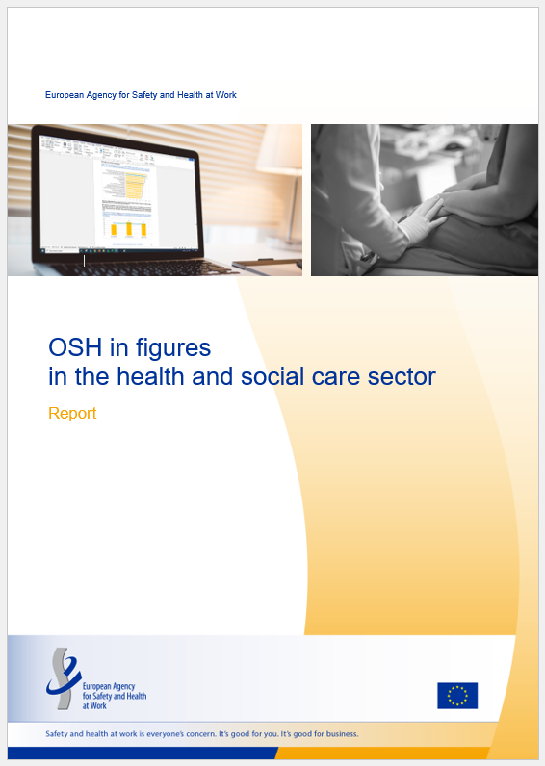
Introduction
This PPT is based on the following report:
  EU-OSHA, OSH in figures in the health and social care sector (Chapter 6), 2024.
  https://osha.europa.eu/en/publications/osh-figures-health-and-social-care-sector

Slide 3
Introduction: related PPTs
Characterisation of the HeSCare sector – PPT 1
  https://osha.europa.eu/en/publications/characterisation-health-and-social-care-sector
OSH risks in the HeSCare sector – PPT 2
  https://osha.europa.eu/en/publications/osh-risks-health-and-social-care-sector
Work-related health outcomes in the HeSCare sector – PPT 3
  https://osha.europa.eu/en/publications/work-related-outcomes-health-and-social-care-sector
OSH Management in the HeSCare sector – PPT 4
  https://osha.europa.eu/en/publications/osh-management-health-and-social-care-sector
Main drivers and barriers for OSH Management in the HeSCare sector – PPT 5
  https://osha.europa.eu/en/publications/main-drivers-and-barriers-osh-management-health-and-social-care-sector

Slide 4
Introduction: data sources / surveys
European Survey of Enterprises on New and Emerging Risks (ESENER)

Slide 5
Main subsectors comprising health and social care activities
(NACE rev 2)
Source: Eurostat’s NACE classification
Notes:
The HeSCare sector is an important job generator in the EU economy. According to Eurostat Labour Force Survey statistics, in 2022, over 21,500,000 people were employed in the HeSCare sector (NACE Q). Most of these employees work in the healthcare subsector, with around 12.5 million employees. The residential care subsector is much smaller with around 4.1 million people employed. The social work subsector is also much smaller than the healthcare subsector, with around 5.1 million people working in this sector. As can be seen from the table below, the levels of employment in the HeSCare sector have been steadily increasing over the past 10 years, which can be seen across all subsectors. The HeSCare sector accounts for 11% of all employment across the total economy.

Slide 6
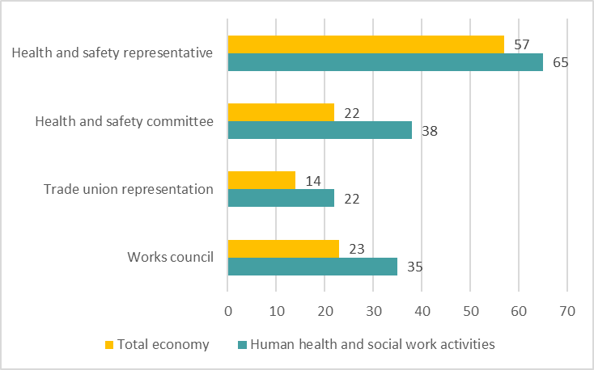
Percentage of establishments indicating forms of employee participation by sector, EU-27, 2019 (%)
Source: Panteia based on ESENER-2019
Base: All establishments in the EU-27.

Slide 7
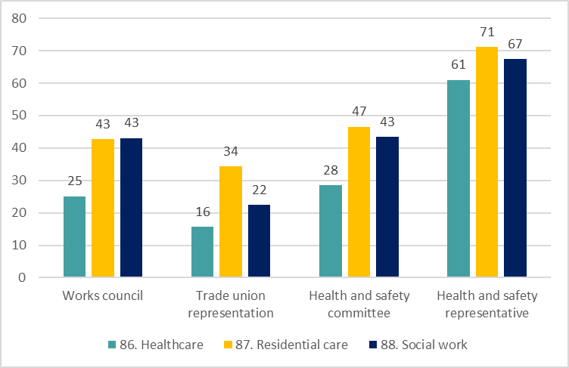
Percentage of HeSCare sector establishments indicating forms of employee participation, by subsector, EU-27, 2019 (%)
Source: Panteia based on ESENER-2019
Base: All HeSCare sector establishments in the EU-27.

Slide 8
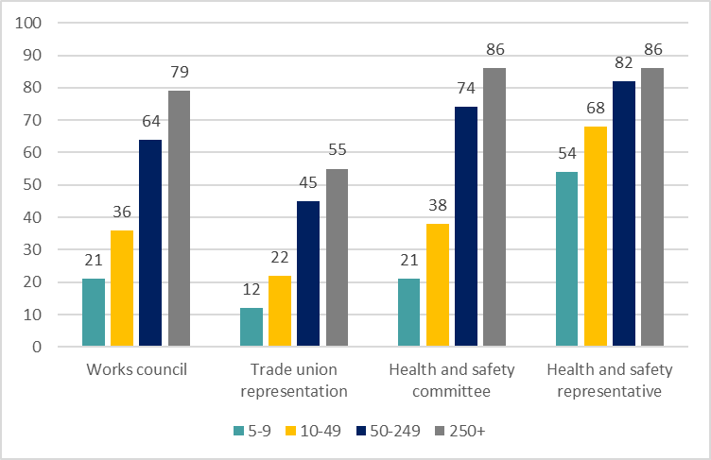
Percentage of HeSCare sector establishments indicating forms of employee participation, by size, EU-27, 2019 (%)
Source: Panteia based on ESENER-2019
Base: All HeSCare sector establishments in the EU-27.

Slide 9
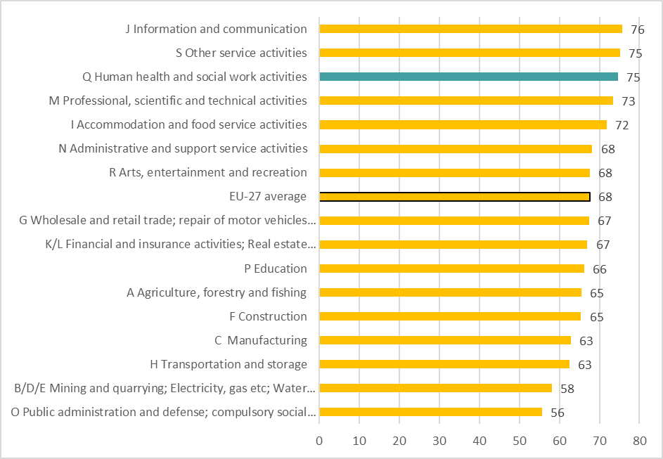
Percentage of establishments allowing employees to take more decisions on how to do their job, by sector, EU-27, 2019 (%)
Source: Panteia based on ESENER-2019
Base: All sector establishments in the EU-27.

Slide 10
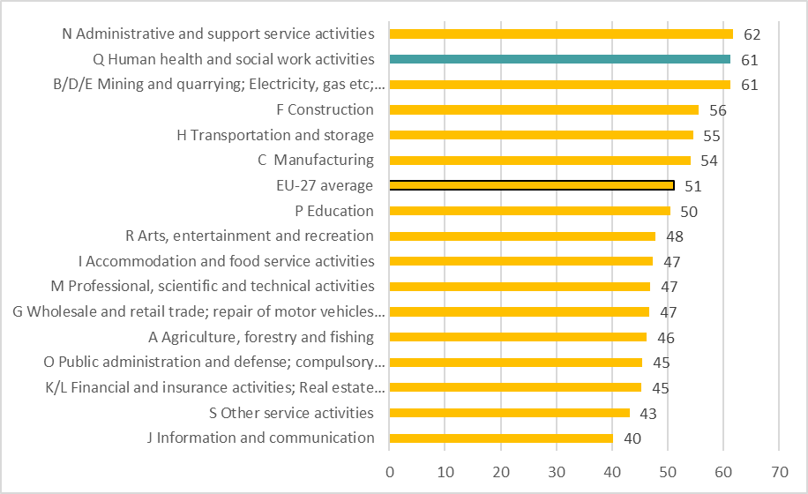
Percentage of establishments that indicate that health and safety is regularly discussed between employee representatives and the management, by sector, EU-27, 2019 (%)
Source: Panteia based on ESENER-2019
Base: Only establishments with a works council, a trade union, a health and safety committee or another type of health and safety representative in the EU-27.

Slide 11
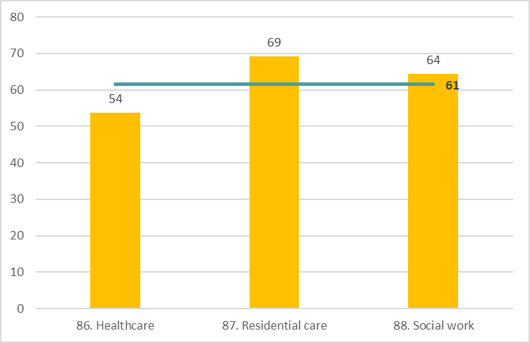
Percentage of HeSCare establishments that indicate that health and safety is regularly discussed between employee representatives and the management by subsector, EU-27, 2019 (%)
Source: Panteia based on ESENER-2019
Base: Only HeSCare sector establishments with a works council, a trade union, a health and
safety committee or another type of health and safety representative in the EU-27.
The horizontal line indicates the HeSCare (NACE Q) EU-27 average.

Slide 12
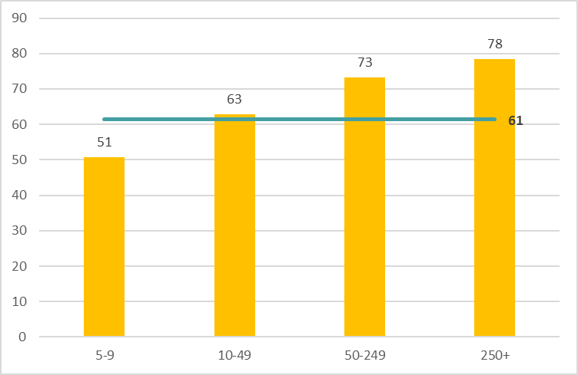
Percentage of HeSCare establishments that indicate that health and safety is regularly discussed between employee representatives and the management, by size, EU-27, 2019 (%)
Source: Panteia based on ESENER-2019
Base: Only HeSCare sector establishments with a works council, a trade union, a health and
safety committee or another type of health and safety representative in the EU-27.
The horizontal line indicates the HeSCare (NACE Q) EU-27 average.

Slide 13
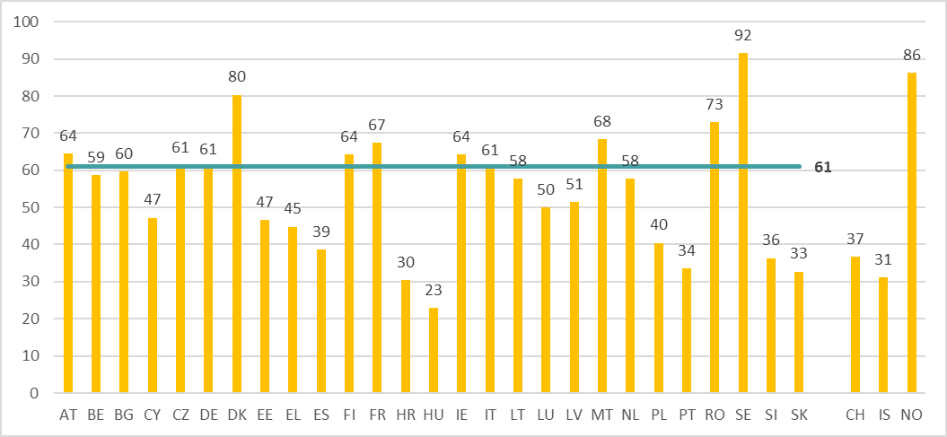
Percentage of HeSCare establishments that indicate that health and safety is regularly discussed between employee representatives and the management by country, EU-27 (+ CH, IS and NO), 2019 (%)
Source: Panteia based on ESENER-2019
Base: Only HeSCare sector establishments with a works council, a trade union, a health and safety committee or another type of health and safety representative in the EU-27, Switzerland, Iceland and Norway.
The horizontal line indicates the HeSCare (NACE Q) EU-27 average.

Slide 14
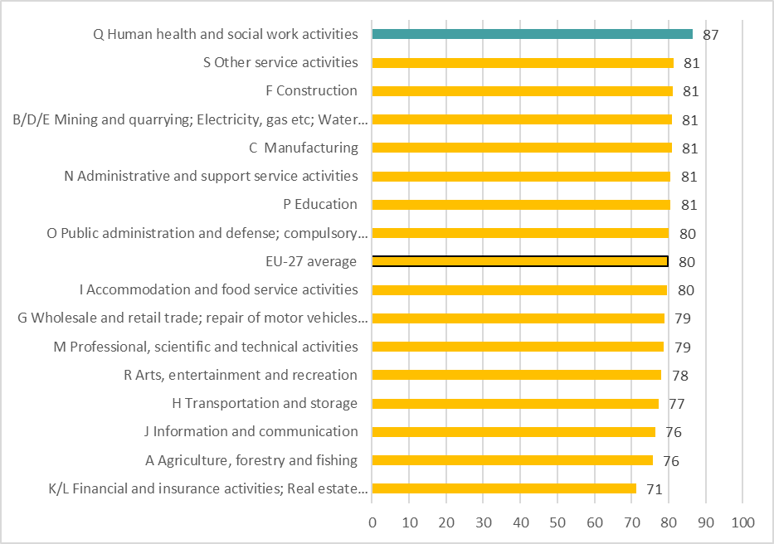
Percentage of establishments indicating that employees are involved in the design and implementation of OSH related measures following a risk assessment, by sector, EU-27, 2019 (%)
Source: Panteia based on ESENER-2019
Base: Responses only of those establishments that regularly carry out workplace risk assessments
in the EU-27.

Slide 15
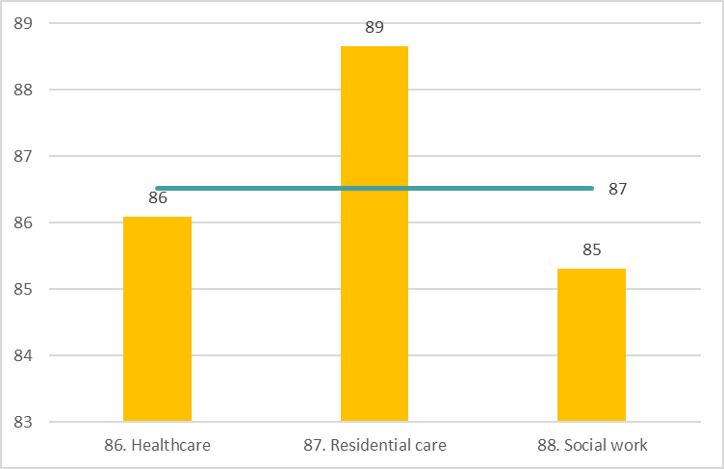
Percentage of HeSCare sector establishments where employees are usually involved in the design and implementation of OSH related measures following a risk assessment by subsector, EU-27, 2019 (%)
Source: Panteia based on ESENER-2019
Base: Responses only of those HeSCare sector establishments that regularly carry out
workplace risk assessments in the EU-27.
The horizontal line indicates the HeSCare (NACE Q) EU-27 average.

Slide 16
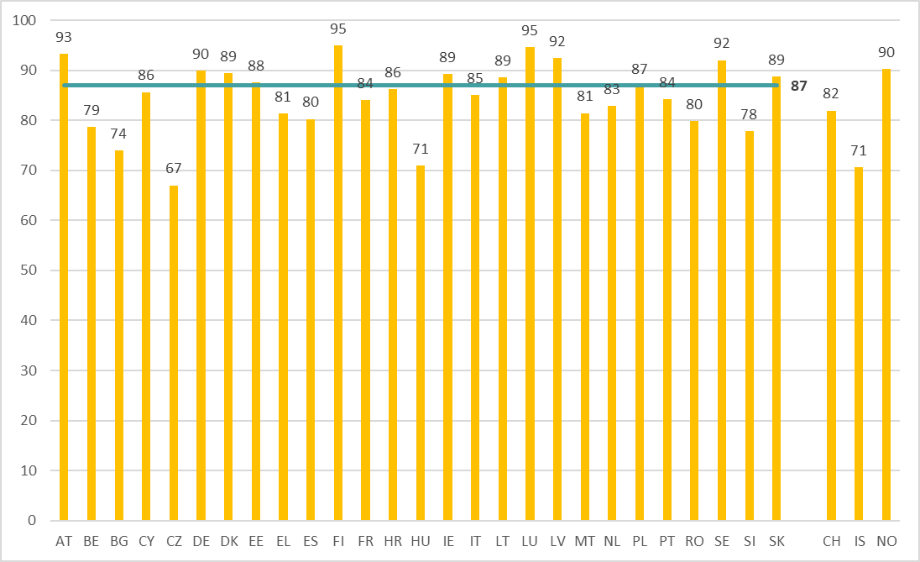
Percentage of HeSCare establishments indicating that employees are involved in the design and implementation of OSH related measures following a risk assessment by country, EU-27 (+ CH, IS and NO), 2019 (%)
Source: Panteia based on ESENER-2019
Base: All HeSCare sector establishments in the EU-27.
The horizontal line indicates the HeSCare (NACE Q) EU-27 average.

Slide 17
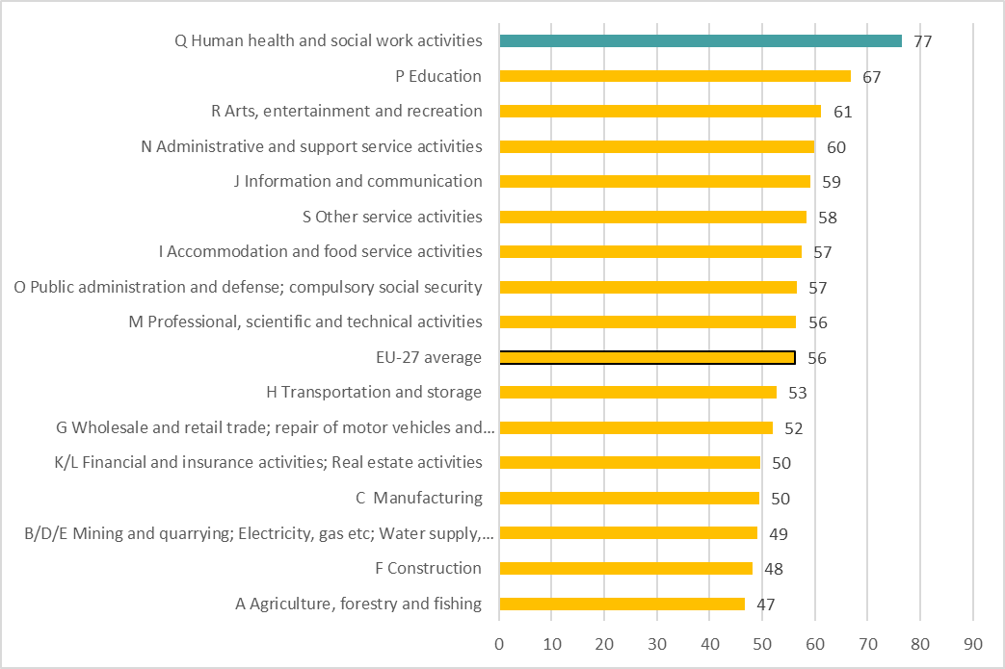
Percentage of establishments where employees have a role in the design and set-up of measures to address psychosocial risks, by sector, EU-27, 2019 (%)
Source: Panteia based on ESENER-2019
Base: All establishments in the EU-27.

Slide 18
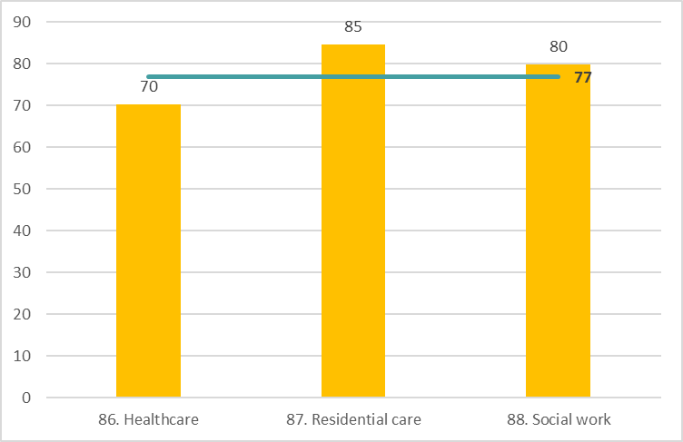
Percentage of HeSCare establishments where employees have a role in the design and set-up of measures to address psychosocial risks, by subsector, EU-27, 2019 (%)
Source: Panteia based on ESENER-2019
Base: Responses only of those HeSCare sector establishments that have introduced
different measures to prevent psychosocial risks in the EU-27.
The horizontal line indicates the HeSCare (NACE Q) EU-27 average.

Slide 19
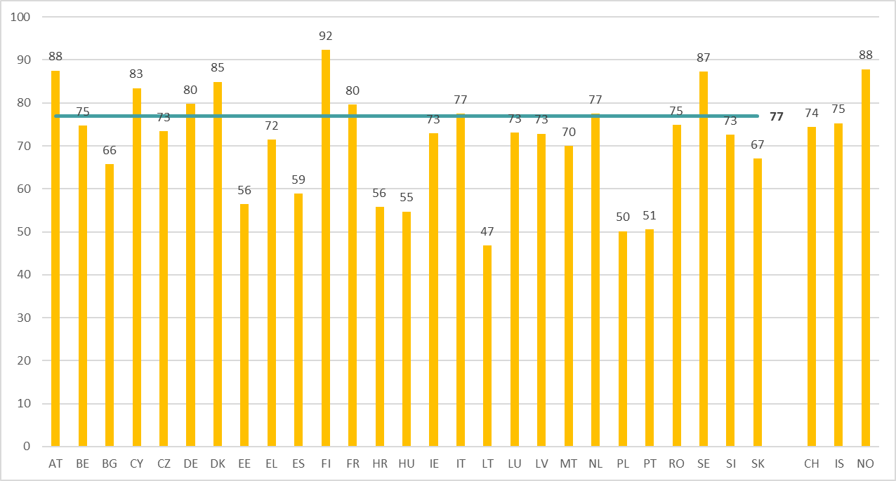
Percentage of HeSCare establishments where employees have a role in the design and set-up of measures to address psychosocial risks, by country, EU-27 (+CH, IS and NO), 2019 (%)
Source: Panteia based on ESENER-2019
Base: Responses only of those HeSCare sector establishments that have introduced different measures to prevent psychosocial risks in the EU-27, Switzerland, Iceland and Norway.
The horizontal line indicates the HeSCare (NACE Q) EU-27 average.

Slide 21
Authors: Paul Vroonhof, Martin Clarke, Jacqueline Snijders, Jan de Kok, Marijke Beulen (Panteia), Peter van Scheijndel, Pim van Dorst (vhp Human Performance), Iñigo Isusi, Jessica Duran (IKEI Research and Consultancy), Swenneke van den Heuvel (TNO).
Project management: Lorenzo Munar, Kate Palmer – European Agency for Safety and Health at Work (EU-OSHA).
Neither the European Agency for Safety and Health at Work nor any person acting on behalf of the Agency is responsible for the use that might be made of the following information.
© European Agency for Safety and Health at Work, 2024
Reproduction is authorised provided the source is acknowledged.
For any use or reproduction of photos or other material that is not under the copyright of the European Agency for Safety and Health at Work, permission must be sought directly from the copyright holders.

