Slide 1
SAFE AND HEALTHY WORK IN THE DIGITAL AGE
Healthy Workplaces Campaign 2023-25
Worker management through artificial intelligence (AI): implications for occupational safety and health (OSH)

Slide 2

Overview
Definitions and uses
Facts and figures
Risks to OSH
Opportunities for OSH
Success factors for OSH – real life cases
EU regulatory framework
Key pointers for prevention

Slide 3
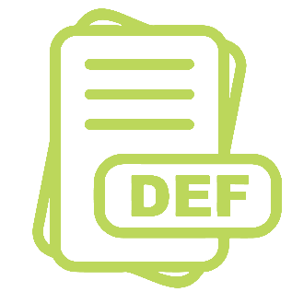
Definitions
Algorithmic/AI-based worker management (AIWM): digital system that gathers work-related data, also on workers, to make automated/semi-automated decisions using algorithms/AI.
Automated decision-making: (subject to legal provisions) AIWM systems decide autonomously.
Semi-automated systems: provide information and recommendations to employers, managers, HR managers, and sometimes workers to make decisions.
Notes:
Worker management systems gather data through a large variety of digital technologies, often in real-time, from the workspace, workers, and the work they do. The data is then processed by algorithms or AI, which draw unprecedented inferences that allow to make recommendations, predictions, and decisions on worker management. These are then communicated to other digital systems (automated decision-making process – subject to regulation) or human actors (semi-automated decision-making process) - such as HR managers, employers, line managers, sometimes workers - that act upon them to manage workers with the objective to improve work organisation, productivity, HR management, worker performance, worker motivation, and possibly worker safety, health, and well-being.

Slide 4
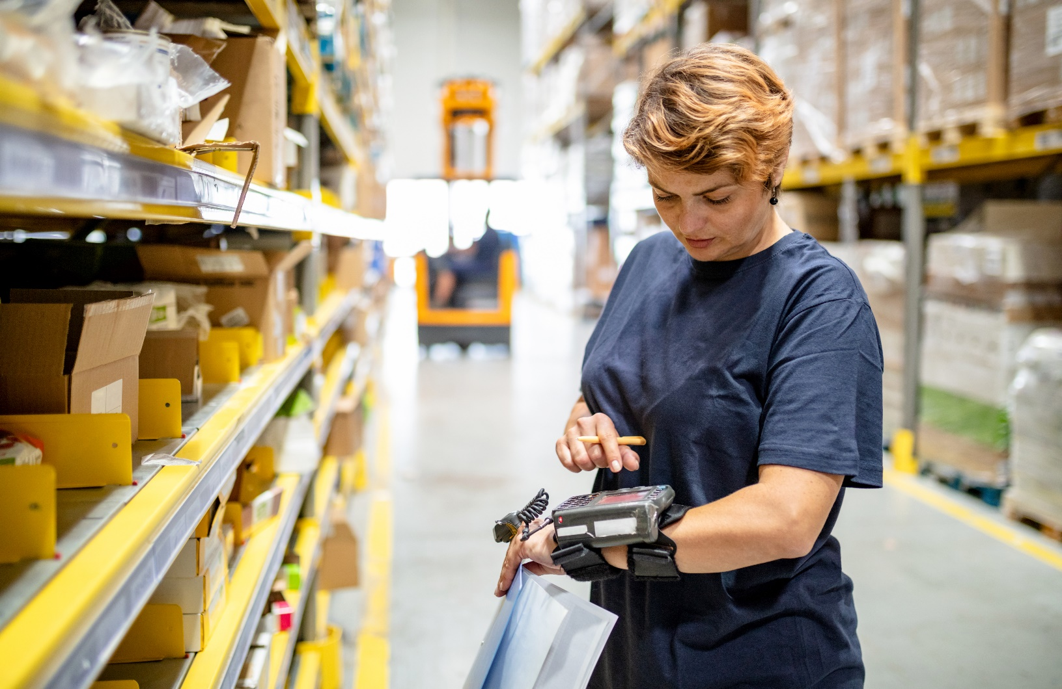
Examples of where AIWM is used
To ensure optimal labour coverage of work shifts by assigning tasks and work schedules to specific workers automatically.
To evaluate worker performance and productivity and provide recommendations on how it can be improved.
© iStockphoto / zoranm
Notes:
Example 1: AI tool measures how quickly workers complete tasks and suggests ways to speed them up.
Example 2: AI tool forecasts customer demand based on the weather forecast. It provides recommendations on how many workers should be in the shift, and on who should be scheduled for a particular task based on skills and experience.

Slide 5
Facts and figures – use of digital technologies
Workers report that their organisation uses digital technologies to:
Determine speed of work (52%)
Increase surveillance (37%)
Allocate tasks, working times, or shifts (30%)
Have performance rated by 3rd parties (27%)
Supervise/monitor work or behaviour (25%)
Monitor vital signs (7%)
Source: OSH pulse 2022 - EU-27 (n=25,683)
Notes:
Source: EU-OSHA, ‘OSH Pulse – Occupational safety and health in post-pandemic workplaces’, 2022 (https://osha.europa.eu/en/facts-and-figures/osh-pulse-occupational-safety-and-health-post-pandemic-workplaces).
EU-OSHA commissioned the ‘Flash Eurobarometer – OSH Pulse’ survey with the aim of gaining insights into the state of occupational safety and health (OSH) in post-pandemic workplaces.
A representative sample of more than 27,000 employed workers were interviewed in April and May 2022 in all EU countries, plus Iceland and Norway. They were asked about the mental and physical health stresses they face and the importance of OSH measures in their workplace.
The survey also asked about the work-related use of digital technologies and its impact on workers’ well-being.

Slide 6

Facts and figures – uptake of AIWM systems
Mainly in larger companies
Mainly in jobs with manual/repetitive routine tasks
  Relatively low uptake but growing across the EU27
  Sharp increase in worker-monitoring software (COVID-19)
  Increased number of patents for AIWM technologies
© iStockphoto / FG Trade
Notes:
According to EU-OSHA’s research, larger companies are more likely to employ technologies related to AIWM than smaller workplaces due to their need to manage, and often control, a large workforce.
AIWM seems to be more frequently used in sectors where jobs have a lot of manual or repetitive tasks that are routine in nature.
AIWM is more frequently used on blue-collar workers who have a lot of routine tasks – for example in transportation and warehousing, manufacturing, healthcare, professional cleaning, etc.
However, white-collar jobs, especially those that involve more routine tasks, are also subject to AIWM. This includes, for example, individuals working in banking, call centres, teleworkers, etc.

Slide 7
Facts and figures: digital technologies & psychosocial risks
Where technology is present, it is more probable that psychosocial risks are mentioned
EU-OSHA, ESENER 2019
Workplaces reporting psychosocial risks by presence of digital technology, EU27
Personal computers at fixed workplaces | Not present
 | Present
Laptops, tablets, smartphones, or other mobile computer devices | Not present
 | Present
Robots interacting with workers | Not present
 | Present
Machines, systems, or computers determining the content or pace of work | Not present
 | Present
Machines, systems, or computers monitoring workers’ performance | Not present
 | Present
Wearable devices | Not present
 | Present
Notes:
Source: EU-OSHA, ‘Third European Survey of Enterprises on New and Emerging Risks’ (ESENER 3), 2019. Available at: https://osha.europa.eu/en/publications/esener-2019-overview-report-how-european-workplaces-manage-safety-and-health
Weighted data (weight: estex)

Slide 8
Facts and figures – exposure to psychosocial risks
Where digital technologies…
allocate tasks, working time, shifts automatically
supervise/monitor work/behavior
… then psychosocial risks are more reported:
    Severe time pressure/work overload (51% / 55%)
    Working alone (48% / 49%)
    Poor communication within the organisation (32% / 35%)
    Reduced work autonomy (25% / 27%)
Source: OSH Pulse 2022 - EU-OSHA
Notes:
Source: EU-OSHA, ‘OSH Pulse – Occupational safety and health in post-pandemic workplaces’, 2022 (https://osha.europa.eu/en/facts-and-figures/osh-pulse-occupational-safety-and-health-post-pandemic-workplaces).

Slide 9

OSH risks and challenges associated with AIWM
Constant monitoring of workers
Reduced worker autonomy and job control
Increased performance pressure/time pressure
Increased work intensity
Reduced/no human intervention in decision-making
Reduced interactions with managers and peers
  Reduced/no opportunities for feedback/negotiation
  Lack of transparency
Information imbalance
Privacy/data protection issues
Notes:
Constant monitoring, direction and control result in increased micromanagement, which is a known risk factor contributing to work-related stress. Increased performance monitoring and rating are also used to nudge and penalise/discipline workers.
According to ESENER-2019, increased work intensity or time pressure is the impact on workers’ safety and health most discussed by establishments using digital technologies to monitor workers’ performance. As a consequence, workers may be unable to take (mini-)breaks when needed, resulting in stress, fatigue, and increased risks of accidents, musculoskeletal disorders, etc.
Reduced human interactions: managers play a key role in mitigating stress in jobs with high demands and low job control (Karasek’s Job-Demand-Control model).
The lack of transparency on how AIWM works and is used results in an imbalance of information and power, making workers´ participation very difficult in practice. AIWM should be designed, implemented and managed in a transparent, understandable, and empowering way guaranteeing workers’ equal access to information and participation.
OSH outcomes associated with AIWM found in the literature: stress, fatigue, exhaustion, anxiety, burnout, musculoskeletal disorders, cardiovascular disorders, disorders of the urinary system, accidents.

Slide 10

Potential benefits of AIWM for OSH
Better allocation of tasks and workload to workers
Risk monitoring; alerting to various psychosocial risks
Personalised digital counselling for workers
Data to support workplace risk assessment
Input into OSH training programmes
  So far OSH improvements through AIWM remain limited in practice
Notes:
AIWM could be used to monitor risks, and provide (real-time) alerts and recommendations on how to prevent them.
For example, AIWM systems could detect high workloads, risk of bullying, stress, burnout, etc., when using real-time videos or analysis of emails or speech contents.
Most AIWM patents focus on increasing efficiency and productivity and improving decision-making (often involving worker monitoring, rating, and evaluation) but not on improving OSH. However, the adoption, use, and OSH impacts of AIWM technologies are not predetermined.
Corporate culture and management decisions about AIWM technologies can shape their impacts on OSH.

Slide 11
Worker participation: a cornerstone of OSH prevention
Confirmed by case studies:
It is essential to inform workers and engage them in their design and use.
For this, AIWM should be transparent and understandable.
Lack of transparency about how AIWM works and is used
Imbalance of power
Worker participation hindered
Workers are isolated from each other
Prevents collective representation
Prevents social dialogue
Notes:
Worker participation is key at all stages, from design, ex-ante assessment, implementation, workplace risk assessment, and decision-making (workers should have a say in AI-based decisions).
The lack of transparency about how AIWM works and is used results in an imbalance of information and power. This makes worker participation very difficult in practice.
When workers are isolated from each other, collective worker representation and collective bargaining/social dialogue are prevented, which are key to OSH.
AIWM should be designed, implemented, and managed in a transparent, understandable, and empowering way that guarantees workers have equal access to information and participation.
Co-governance of AIWM must be guaranteed.

Slide 12

Key success factors for OSH – real-life cases
AIWM in production, maintenance, and logistics in a company producing parts for the automotive industry:
  enhanced productivity, reduced stress, improved work-life balance
  supports skilled operators to manage the process and adapt to changes using real-time data and automated task assignments
Notes:
AIWM systems are improving demand prediction, shift scheduling, and task assignment based on worker capabilities, thus contributing to workers’ safety, health, and well-being.
For example, an Italian company that produces parts for the automotive industry has implemented AIWM in production, maintenance, and logistics, enhancing productivity, reducing stress, and improving work-life balance. The AIWM system supports skilled operators to manage the process and adapt to changes using real-time data and automated task assignments.
A Belgian car manufacturer has optimised its assembly line with AIWM systems to address health and safety risks, especially in the final stages where parts are assembled onto freshly painted car bodies.
Extensive training and data monitoring ensure a balance between efficiency, job quality, and OSH considerations, benefiting operators and team leaders.
These real-life cases confirm that worker participation, a sound OSH policy and OSH management system in place in the organisation, and transparency about data collection and use are key success factors to the safe and healthy use of AIWM systems.

Slide 13

Key success factors for OSH – real-life cases
AIWM in the assembly line at a car manufacturer:
  optimised assembly line by addressing health and safety risks, especially in the final, more demanding stages.
  extensive training and data monitoring ensure balance between efficiency, job quality, and OSH, benefiting operators and team leaders.

Slide 14
Key success factors for OSH – AIWM in the workplace
sound OSH policy and OSH management system
transparency about data collection and use
worker participation

Slide 15

EU regulatory framework applicable to AIWM
  EU OSH Framework Directive 89/391/EEC
  Specific ‘daughter’ directives
  AI Act
  Directive on digital labour platforms
  General Data Protection Regulation (GDPR)
Notes:
Directive 89/391/EEC – the Framework Directive:
‘The employer shall have a duty to ensure the safety and health of workers in every aspect related to the work.’
Supported by more specific Directives on work equipment, display screen equipment, specific work environments, specific hazards, specific worker groups.
AI Act – aspects relevant to AIWM and OSH:
- Safe deployment of AI systems, prohibiting some of them while casting others as ‘high-risk,’ requiring more safeguards for their design, development, and use.
- The proposed list of ‘high-risk’ systems includes AI systems used for recruitment or selection of workers, and AI systems used for making decisions on the promotion and termination of work-related contractual relationships, for task allocation, and for monitoring and evaluating performance and behaviour of workers.
- Proposes compliance with mandatory requirements for high-risk AI systems, e.g. establishing and maintaining risk management systems throughout the life cycle of AI systems, training these systems with human oversight.
Directive on improving working conditions of persons working through digital labour platforms:
Workers cannot be fired based on a decision taken by an algorithm (human oversight)
Workers’ data to be better protected (no collecting certain types of personal data)
General Data Protection Regulation (GDPR):
Includes extensive provisions preventing organisations from abusing private data. According to Art. 22: ‘Preventing decision based solely on automated processing, including profiling, which produces legal effects concerning him or her or similarly significantly affects him or her.’

Slide 16
Key pointers for OSH prevention
Enforcement of relevant regulations
Holistic and dynamic workplace risk assessment
Transparency and understandability
Equal access to information and worker participation
Preserving workers’ job control and autonomy
Minimisation of workers’ data collected
Humans in command
Increased awareness of mental health impacts of AIWM
Notes:
Workplace risk assessment should be dynamic given the evolving nature of AI systems.
AIWM should be designed, implemented, and managed in a transparent, understandable, and empowering way to guaranteeing workers’ equal access to information and participation.
Data collection to be balanced against the rights to privacy and to safety and health.

Slide 17



Resources
Consult all publications on the topic:
https://osha.europa.eu/en/publications-priority-area/ai-and-worker-management

Slide 18
Copyright
© European Agency for Safety and Health at Work, 2024
Reproduction is authorised provided the source is acknowledged.
For reproduction or use of any photo under any other copyright than EU-OSHA, permission must be sought directly from the copyright holder.
Neither the European Agency for Safety and Health at Work nor any person acting on behalf of the agency is responsible for the use that might be made of the following information.

