Slide 1
Health and Social Care (HeSCare) sector - OSH in figures
Work-related health outcomes in the HeSCare sector
PPT 3

Slide 2
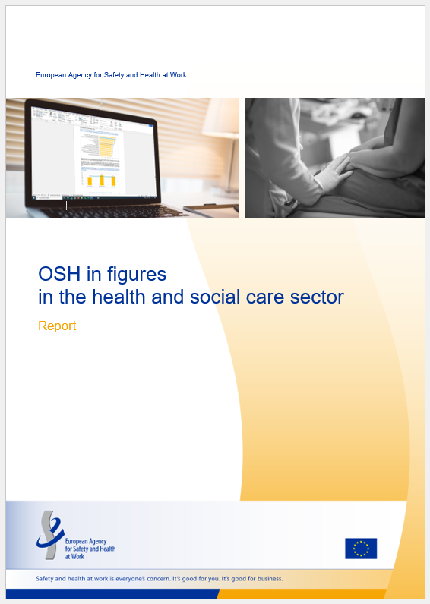
Introduction
This PPT is based on the following report:
  EU-OSHA, OSH in figures in the health and social care sector (Chapter 3), 2024.
  https://osha.europa.eu/en/publications/osh-figures-health-and-social-care-sector

Slide 3
Introduction: related PPTs
Characterisation of the HeSCare sector – PPT 1
https://osha.europa.eu/en/publications/characterisation-health-and-social-care-sector
OSH risks in the HeSCare sector – PPT 2
  https://osha.europa.eu/en/publications/osh-risks-health-and-social-care-sector
OSH management in the HeSCare sector – PPT 4
  https://osha.europa.eu/en/publications/osh-management-health-and-social-care-sector
Main drivers and barriers for OSH management in the HeSCare sector – PPT 5
  https://osha.europa.eu/en/publications/main-drivers-and-barriers-osh-management-health-and-social-care-sector
Worker participation in the HeSCare sector – PPT 6
  https://osha.europa.eu/en/publications/worker-participation-osh-management-health-and-social-care-sector

Slide 4
Introduction: data sources / surveys
European Survey of Enterprises on New and Emerging Risks (ESENER)
European Working Conditions Telephone Survey (EWCTS)
EU Labour Force Survey (LFS)
EU-OSHA – OSH Pulse survey 2022
European Statistics on Accidents at Work (ESAW)

Slide 5
Main subsectors comprising health and social care (HeSCare) activities
(NACE rev 2)
Source: Eurostat’s NACE classification
Notes:
The HeSCare sector is an important job generator in the EU economy. According to Eurostat Labour Force Survey statistics, in 2022, over 21,500,000 people were employed in the HeSCare sector (NACE Q). Most of these employees work in the healthcare subsector, with around 12.5 million employees. The residential care subsector is much smaller with around 4.1 million people employed. The social work subsector is also much smaller than the healthcare subsector, with around 5.1 million people working in this sector. As can be seen from the table below, the levels of employment in the HeSCare sector have been steadily increasing over the past 10 years, which can be seen across all subsectors. The HeSCare sector accounts for 11% of all employment across the total economy.

Slide 6
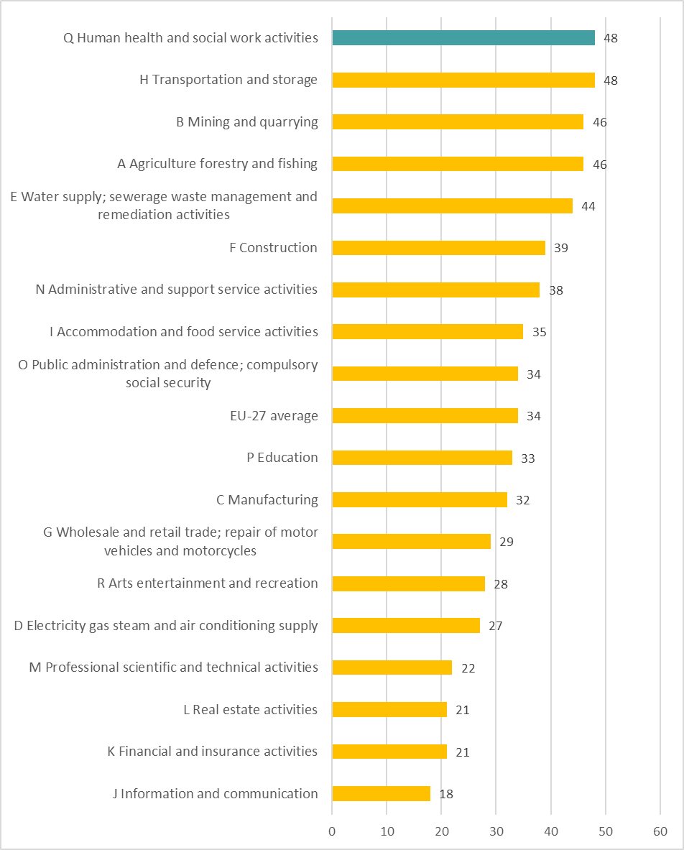
Percentage of workers reporting that their health or safety is at risk because of work by sector, EU-27, 2021 (%)
Source: TNO based on the EWCTS-2021
Base: All workers in the EU-27.

Slide 7
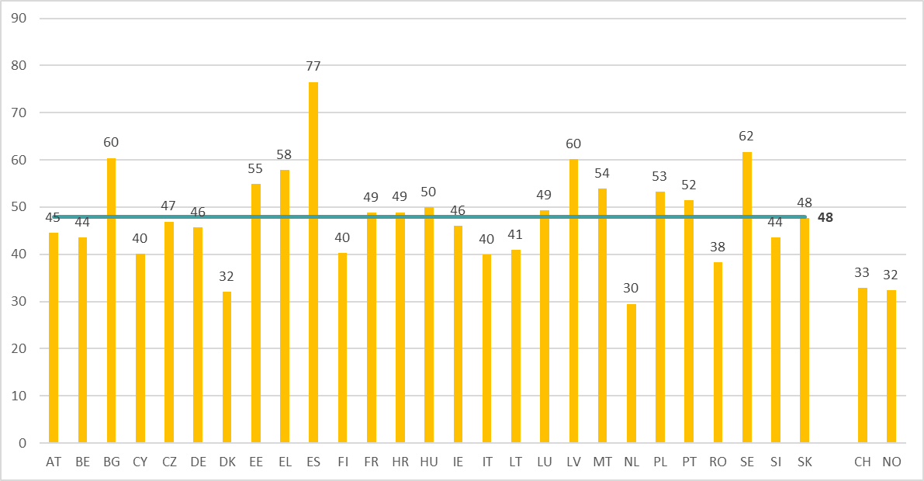
Percentage of HeSCare workers reporting that their health or safety is at risk because of work, by country (+ CH and NO), EU-27, 2021 (%)
Source: TNO based on the EWCTS-2021
Base: All HeSCare workers in the EU-27, Switzerland and Norway.
The horizontal line indicates the HeSCare (NACE Q) EU-27 average.

Slide 8
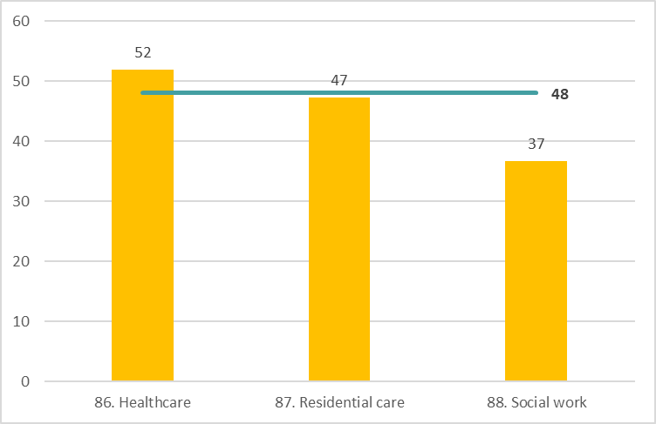
Percentage of workers reporting that their health or safety is at risk because of work, by subsector, EU-27, 2021 (%)
Source: TNO based on the EWCTS-2021
Base: All HeSCare workers in the EU-27.
The horizontal line indicates the HeSCare (NACE Q) EU-27 average.

Slide 9
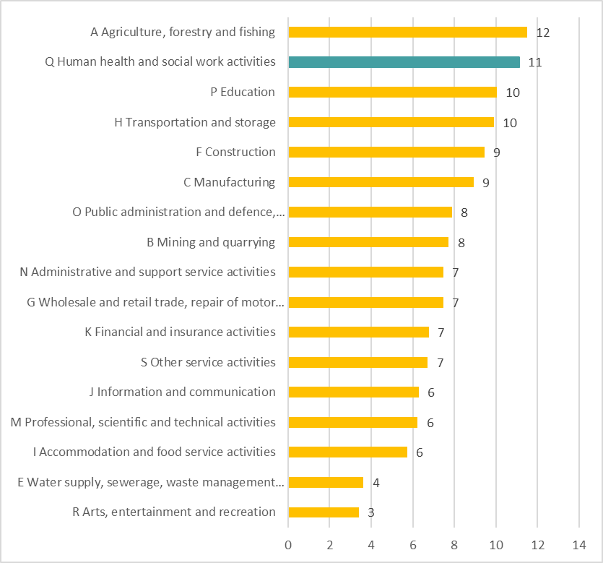
Persons reporting a work-related health problem by sector, EU-27, 2020 (%)
Source: EU Labour Force Survey, 2020
Base: % of total employed, age group 15-64.

Slide 10
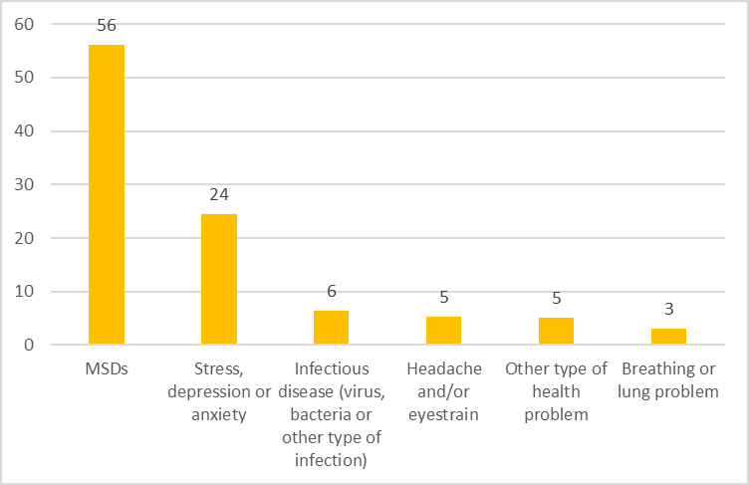
Persons reporting a work-related health problem by type of problem in the HeSCare sector, EU-27, 2020 (%)
Source: EU Labour Force Survey, 2020
Base: % of total employed in the HeSCare sector, age group 15-64.

Slide 11
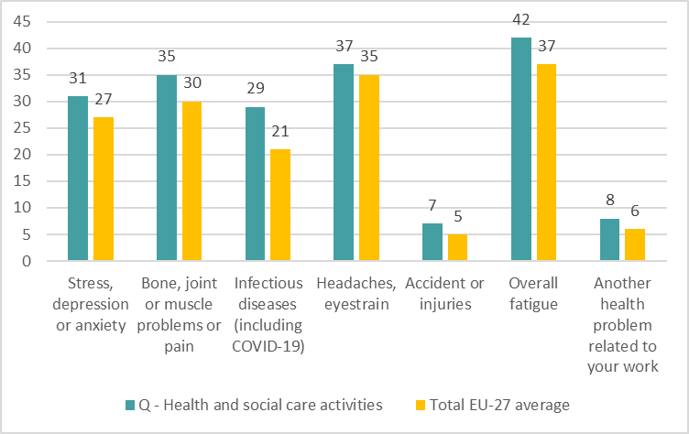
Percentage of workers indicating health problems caused or made worse by work in the past 12 months, by sector, EU-27, 2022 (% indicating yes)
Source: Panteia, based on ‘OSH Pulse 2022 – Occupational safety and health in post-pandemic workplaces’
Base: All respondents.

Slide 12
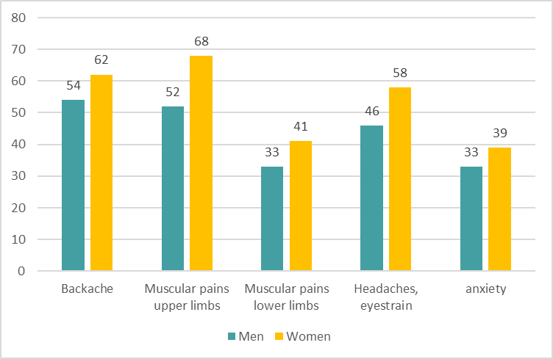
Percentage of HeSCare workers reporting health problems over the last 12 months, by gender, EU-27, 2021 (% indicating yes)
Source: TNO based on the EWCTS-2021
Base: All HeSCare workers in the EU-27.

Slide 13
Percentage of HeSCare workers reporting health problems over the last 12 months, by subsector, EU-27, 2021 (% indicating yes)
Source: TNO based on the EWCTS-2021
Base: All HeSCare workers in the EU-27.

Slide 14
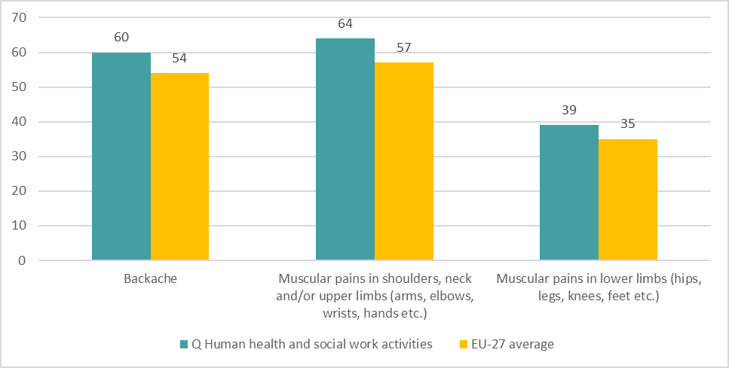
Percentage of workers reporting health problems over the last 12 months by sector, EU-27, 2021 (% indicating yes)
Source: TNO based on the EWCTS-2021
Base: All workers in the EU-27.

Slide 15
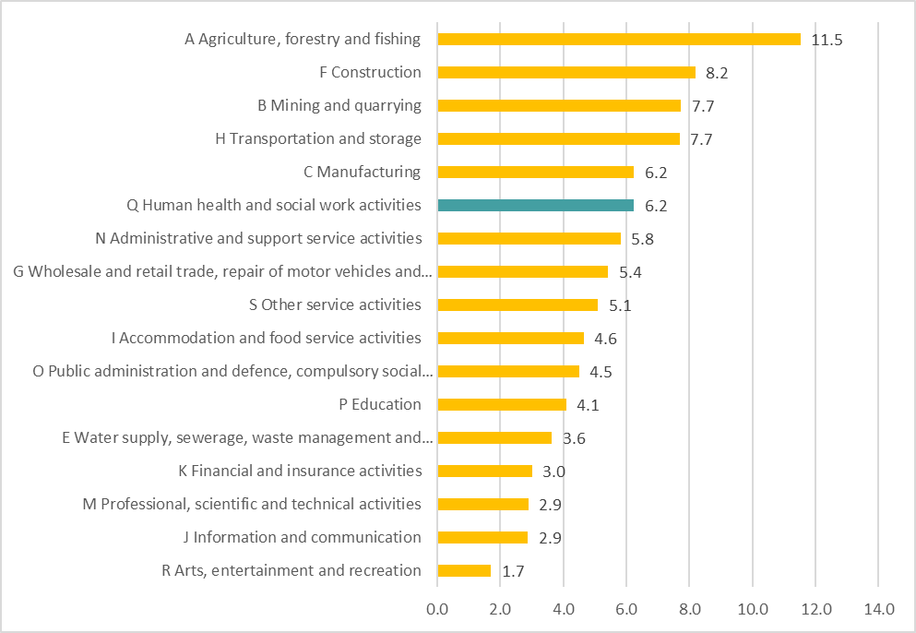
Persons reporting a work-related MSD problem by sector that recorded more tan 50.000 cases, EU-27, 2020 (%)
Source: EU Labour Force Survey, 2020
Base: in % of total employed, age group 15-64.

Slide 16
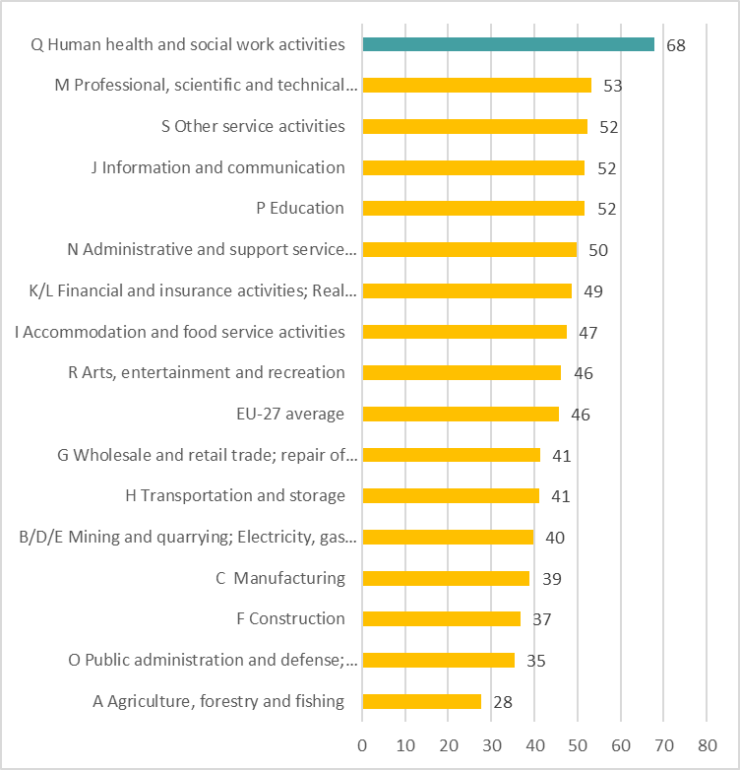
Percentage of establishments indicating work-related stress being identified by sector, EU-27, 2019 (%)
Source: Panteia based on ESENER-2019
Base: All establishments in the EU-27.

Slide 17
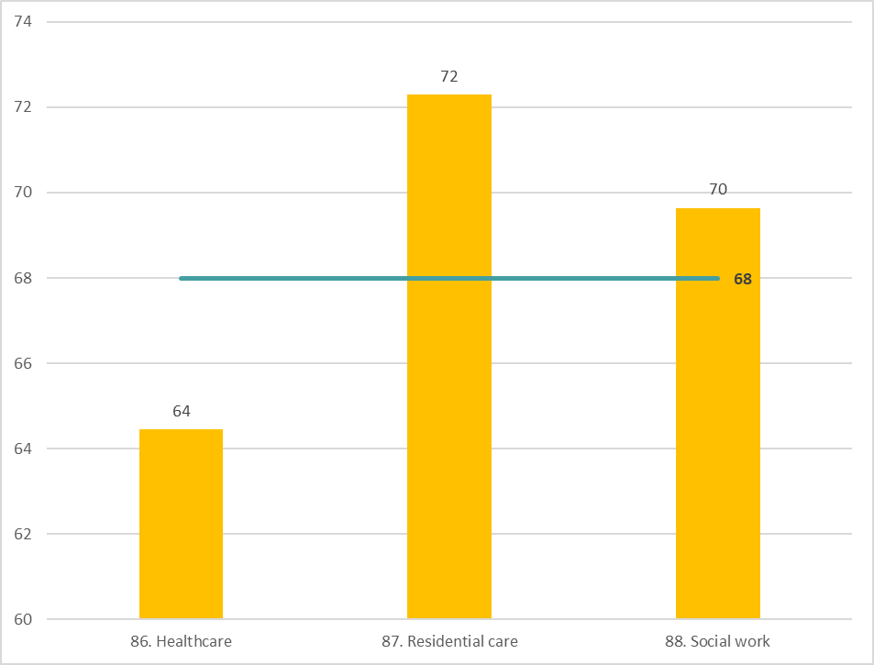
Percentage of HeSCare sector establishments indicating work-related stress being identified, by sector, EU-27, 2019 (% indicating yes)
Source: Panteia based on ESENER-2019
Base: All HeSCare sector establishments in the EU-27.
The horizontal line indicates the HeSCare (NACE Q) EU-27 average.

Slide 18
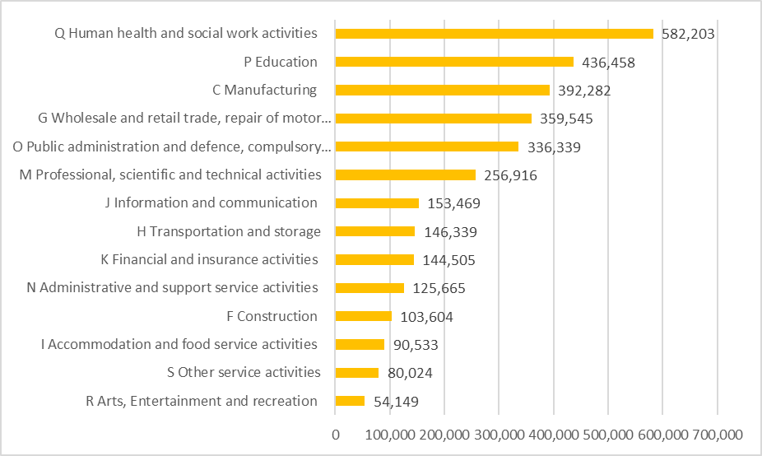
Number of persons reporting work-related stress, depression or anxiety by sector, EU-27, 2020 (age group 15-64)
Source: EU Labour Force Survey, 2020
Base: Employed, age group 16-64.

Slide 19
Number of fatal accidents at work in relation to all the sectors and the HeSCare sector and subsectors, 2011-2021
Source: Panteia, based on European Statistics on Accidents at Work (ESAW), 2023

Slide 20
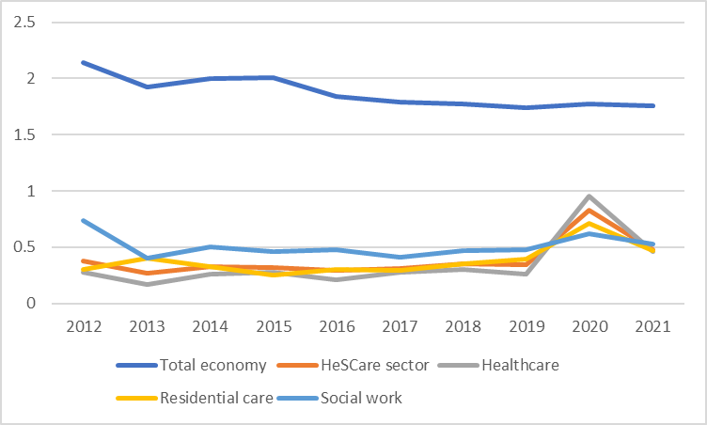
Incidence rate of fatal accidents at work in relation to all the sectors and the HeSCare sector and subsectors, EU-27, 2011-2021
Source: Panteia, based on European Statistics on Accidents at Work (ESAW), 2023

Slide 21
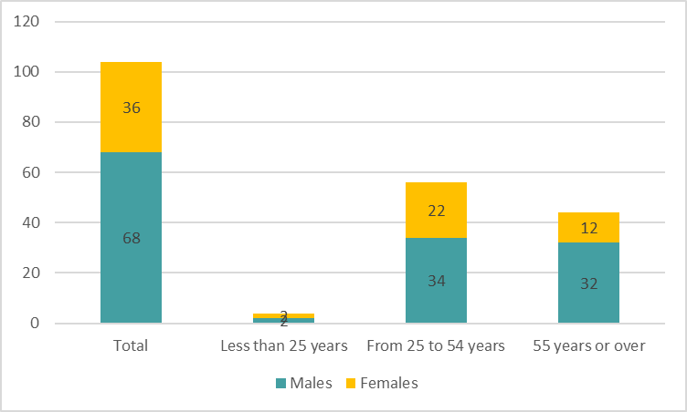
Number of non-fatal accidents at work in the HeSCare sector by gender and age category, EU-27, 2021
Source: Panteia, based on European Statistics on Accidents at Work (ESAW), 2023

Slide 22
Persons reporting at least one accident at work, including sectors that recorded more than 100.000 cases, EU-27, 2020
Source: EU Labour Force Survey, 2020
Base: Employed, age group 15-64.

Slide 23
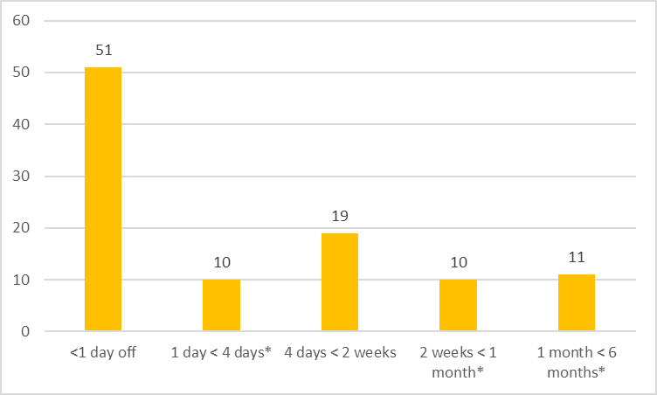
Persons reporting an accident at work resulting in time off work in the HeSCare sector, EU-27, 2020 (%)
Source: EU Labour Force Survey, 2020
Base: % of total employed that had an accident at work, age group 15-64.

Slide 24
Number of non-fatal accidents at work in relation to all the sectors and the HeSCare sector and subsectors, 2011-2021
Source: Panteia, based on European Statistics on Accidents at Work (ESAW), 2023

Slide 25
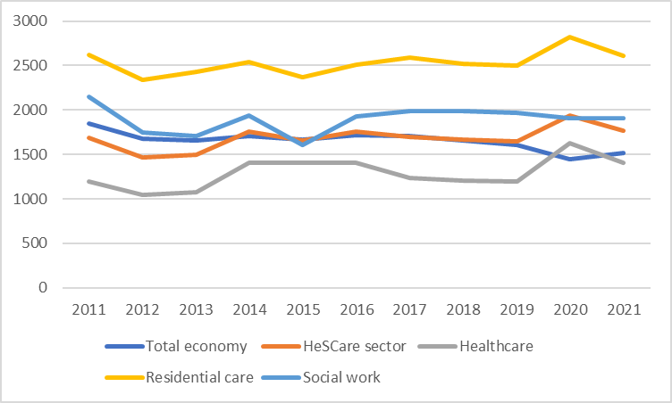
Incidence rate of non-fatal accidents at work in relation to the total economy and the HeSCare sector and subsectors, EU-27, 2011-2021
Source: Panteia, based on European Statistics on Accidents at Work (ESAW), 2023

Slide 26
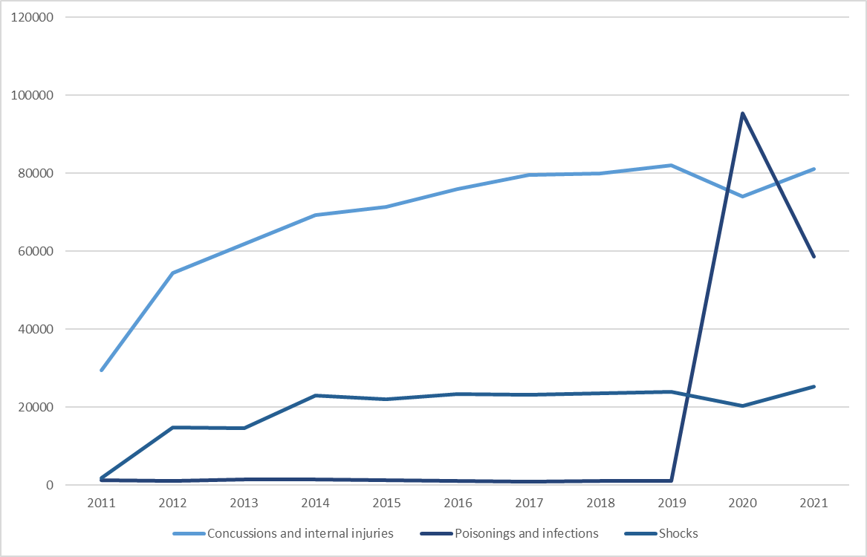
Number of accidents at work (total severity) for the HeSCare sector by type of injury (selection of injuries with the largest increase over the period 2011-2021), EU-27
Source: Panteia, based on European Statistics on Accidents at Work (ESAW), 2023

Slide 27
Number of accidents at work by days lost (4 days and over) in relation to all the sectors and the HeSCare sector and subsectors, EU-27, 2011-2021
Source: Panteia, based on European Statistics on Accidents at Work (ESAW), 2023

Slide 28
Number of accidents at work by days lost (permanente incapacity or 183 days or over) in relation to all the sectors and the HeSCare sector and subsectors, EU-27, 2011-2021
Source: Panteia, based on European Statistics on Accidents at Work (ESAW), 2023

Slide 29
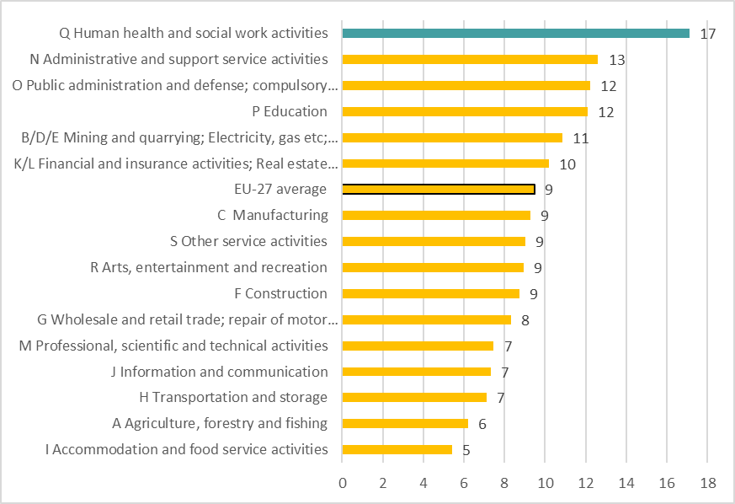
Establishments indicating absence due to sickness has increased over the past 3 years, by sector, EU-27, 2019 (% indicating yes)
Source: Panteia based on ESENER-19
Base: All establishments in the EU-27.

Slide 30
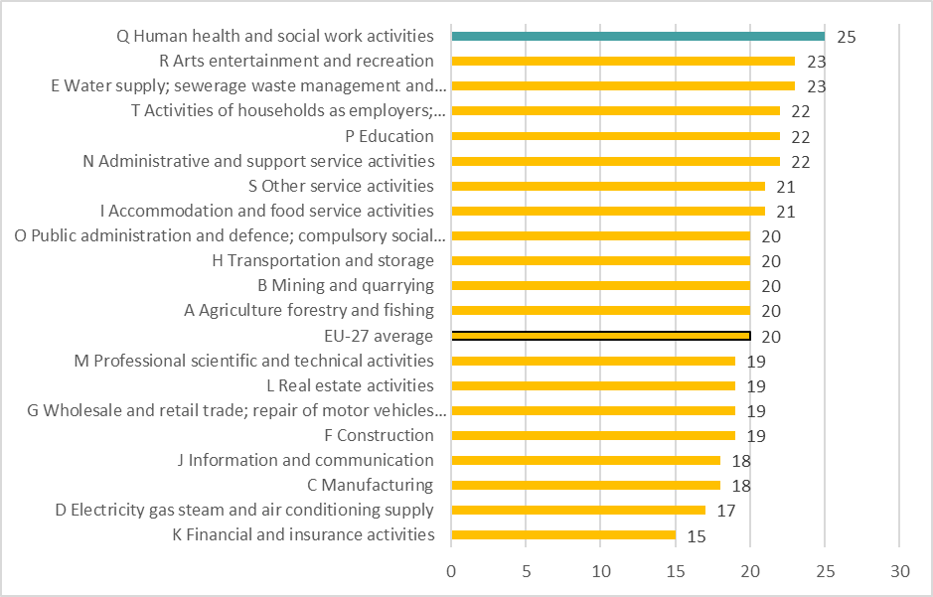
Percentage of workers with an illness or health probrem which has lasted, or is expected to last, for more than 6 months, by sector, EU-27, 2021 (% indicating yes)
Source: TNO based on the EWCTS-2021
Base: All workers in the EU-27.

Slide 31
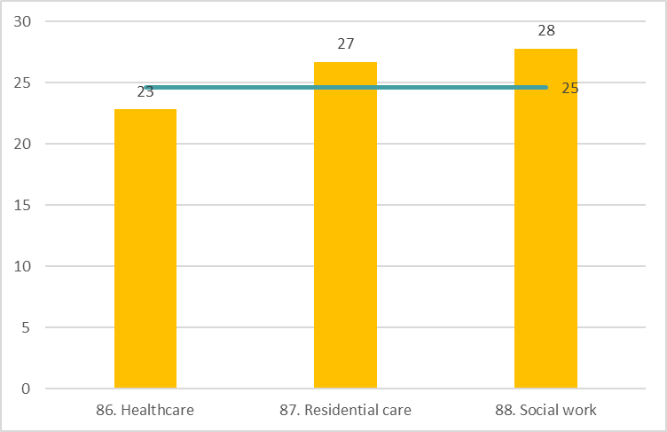
Percentage of HeSCare workers with an illness or health probrem which has lasted, or is expected to last, for more than 6 months, by subsector, EU-27, 2021 (% indicating yes)
Source: TNO based on the EWCTS-2021
Base: All HeSCare workers in the EU-27.
The horizontal line indicates the HeSCare (NACE Q) EU-27 average.

Slide 32
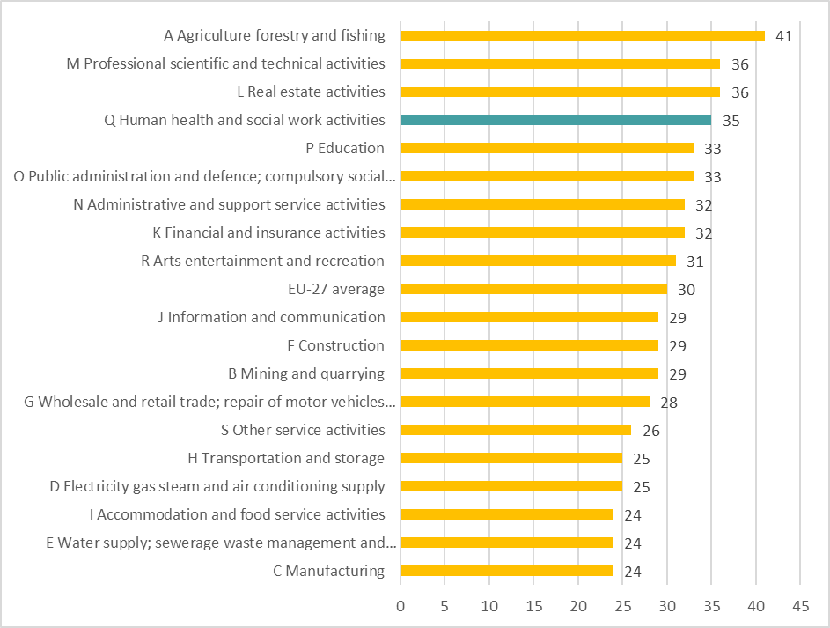
Percentage of workers reporting working sick over the 12 months by sector, EU-27, 2021 (% indicating yes)
Source: TNO based on the EWCTS-2021
Base: All workers in the EU-27.

Slide 33
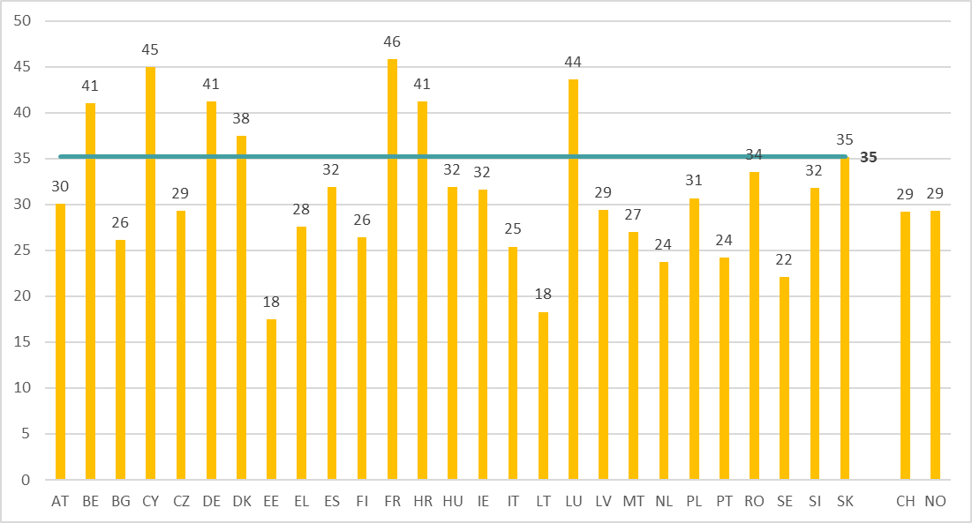
Percentage of HeSCare workers reporting working sick over the 12 months by country (+ CH and NO), EU-27, 2021 (% indicating yes)
Source: TNO based on the EWCTS-2021
Base: All HeSCare workers in the EU-27 Switzerland and Norway.
The horizontal line indicates the HeSCare (NACE Q) EU-27 average.

Slide 34
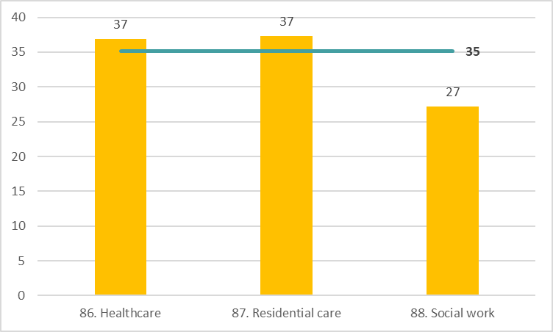
Percentage of HeSCare workers reporting working sick over the 12 months by subsector, EU-27, 2021 (% indicating yes)
Source: TNO based on the EWCTS-2021
Base: All HeSCare workers in the EU-27.
The horizontal line indicates the HeSCare (NACE Q) EU-27 average.

Slide 35
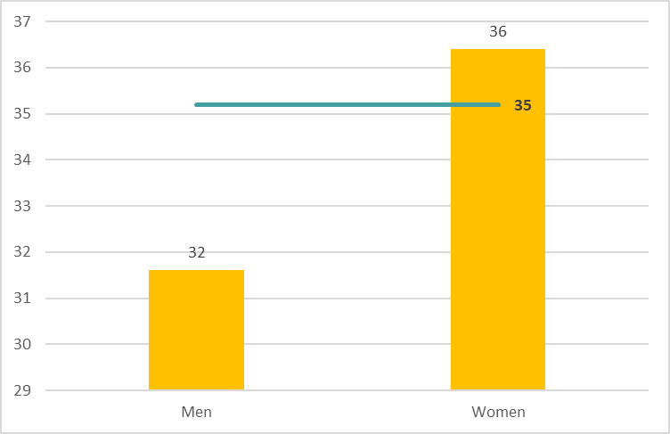
Percentage of HeSCare workers reporting working sick over the 12 months by gender, EU-27, 2021 (% indicating yes)
Source: TNO based on the EWCTS-2021
Base: All HeSCare workers in the EU-27.
The horizontal line indicates the HeSCare (NACE Q) EU-27 average.

Slide 37
Authors: Paul Vroonhof, Martin Clarke, Jacqueline Snijders, Jan de Kok, Marijke Beulen (Panteia), Peter van Scheijndel, Pim van Dorst (vhp Human Performance), Iñigo Isusi, Jessica Duran (IKEI Research and Consultancy), Swenneke van den Heuvel (TNO).
Project management: Lorenzo Munar, Kate Palmer – European Agency for Safety and Health at Work (EU-OSHA).
Neither the European Agency for Safety and Health at Work nor any person acting on behalf of the Agency is responsible for the use that might be made of the following information.
© European Agency for Safety and Health at Work, 2024
Reproduction is authorised provided the source is acknowledged.
For any use or reproduction of photos or other material that is not under the copyright of the European Agency for Safety and Health at Work, permission must be sought directly from the copyright holders.

