Slide 1

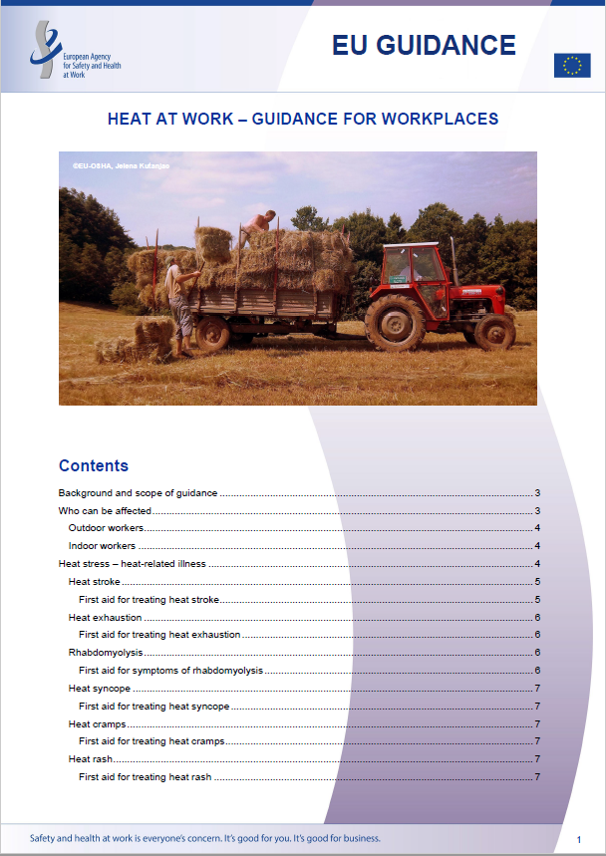

Protection of workers in the context of climate change:
EU-OSHA activities
Elke Schneider*, Emmanuelle Brun, Annick Starren, Nadia Vilahur*
European Agency for Safety and Health at Work (EU-OSHA)
https://osha.europa.eu/en
Background
The consequences of climate change on occupational safety and health (OSH) are already taking effect. Workers and workplaces are suffering from extreme and unpredictable weather events, such as droughts, heatwaves, heavy rain, floods and gales. Workers in nearly all sectors may be affected, although those in agriculture and forestry, transport, construction or emergency services (e.g. firefighters, health care workers and first responders) are particularly exposed.
Some of the direct effects commonly described are related with heat stress, changes in air quality, increased occurrence of allergens or workplace accidents in extreme weather conditions. Mental health effects linked with climate change have been reported. Indirect effects have also been identified, for example due to changes in the range of disease vectors (e.g. mosquitoes), waterborne pathogens or an increased use of pesticides. The transition to a more climate change resilient economy under the European Green Deal initiative may also bring new risks to workers, for instance working at height under difficult conditions on windmills, or exposure to moulds and contaminants in natural or re-used construction materials.
There are considerable knowledge gaps on the climate change consequences on workers safety and health, including on vulnerable groups (e.g. ageing workers, those with pre-existing diseases, women workers, migrant workers).
The European Agency for Safety and Health at Work (EU-OSHA), works on climate change and OSH-related impacts in three areas: anticipating future challenges, providing guidance, and generating new evidence to support workplaces adaptation and mitigation to climate change.
ANTICIPATING CHANGE
PROVIDING GUIDANCE
Review of the future of agriculture and forestry and OSH
https://data.europa.eu/doi/10.2802/769257
Emergency services: occupational safety and health risks
  https://data.europa.eu/doi/10.2802/54768
Foresight projects (future scenarios): https://osha.europa.eu/en/emerging-risks
  green jobs
  circular economy
  climate change
Heat at Work: Guidance for Workplaces:
Indoor workers
Outdoor workers
Vulnerable workers
https://osha.europa.eu/en/publications/heat-work-guidance-workplaces
Conclusions
OSH implications of climate change, including vulnerable groups and sectors, should not be overlooked when defining a holistic research strategy on climate change and health, to support adaptation and mitigation actions and policies.
Research activities at EU-OSHA addressing climate change and OSH will substantially contribute to the key objectives of the 2021-2027 EU OSH Strategic Framework to anticipate and manage change in the context of green, digital and demographic transitions and to increase preparedness to respond to future health crises.
Knowledge gaps in research, risk assessment and practice will be identified. This will also include the effects of climate change mitigating measures e.g. in the energy sector, in construction and in agriculture and forestry.
GENERATING EVIDENCE
OSH Research Overview Activity on Climate Change (2025-2029) addressing:
  Health and safety related impacts on workers
  Workplace interventions and good practices to mitigate and adapt to climate change
* schneider@osha.europa.eu; vilahur@osha.europa.eu

