Slide 1
Health and Social Care (HeSCare) sector - OSH in figures
OSH Management in the HeSCare sector
PPT 4

Slide 2
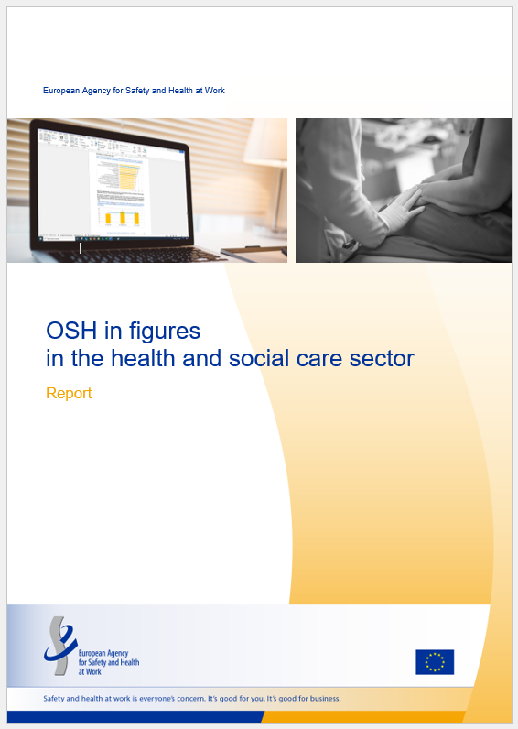
Introduction
This PPT is based on the following report:
  EU-OSHA, OSH in figures in the health and social care sector (Chapter 4), 2024.
  https://osha.europa.eu/en/publications/osh-figures-health-and-social-care-sector

Slide 3
Introduction: related PPTs
Characterisation of the HeSCare sector – PPT 1
  https://osha.europa.eu/en/publications/characterisation-health-and-social-care-sector
OSH risks in the HeSCare sector– PPT 2
  https://osha.europa.eu/en/publications/osh-risks-health-and-social-care-sector
Work-related health outcomes in the HeSCare sector – PPT 3
  https://osha.europa.eu/en/publications/work-related-outcomes-health-and-social-care-sector
Main drivers and barriers for OSH management in the HeSCare sector – PPT 5
  https://osha.europa.eu/en/publications/main-drivers-and-barriers-osh-management-health-and-social-care-sector
Worker participation in the HeSCare sector – PPT 6
  https://osha.europa.eu/en/publications/worker-participation-osh-management-health-and-social-care-sector

Slide 4
Introduction: data sources / surveys
European Survey of Enterprises on New and Emerging Risks (ESENER)
EU-OSHA – OSH Pulse survey 2022

Slide 5
Main subsectors comprising health and social care activities
(NACE rev 2)
Source: Eurostat’s NACE classification
Notes:
The HeSCare sector is an important job generator in the EU economy. According to Eurostat Labour Force Survey statistics, in 2022, over 21,500,000 people were employed in the HeSCare sector (NACE Q). Most of these employees work in the healthcare subsector, with around 12.5 million employees. The residential care subsector is much smaller with around 4.1 million people employed. The social work subsector is also much smaller than the healthcare subsector, with around 5.1 million people working in this sector. As can be seen from the table below, the levels of employment in the HeSCare sector have been steadily increasing over the past 10 years, which can be seen across all subsectors. The HeSCare sector accounts for 11% of all employment across the total economy.

Slide 6
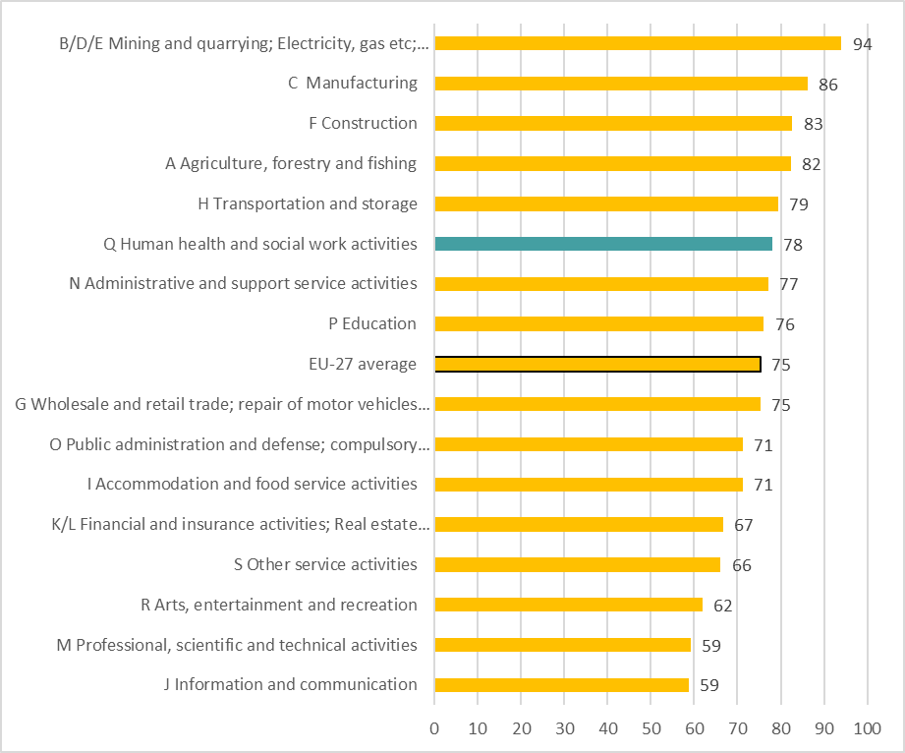
Percentage of establishments that regularly carry out workplace risk assessments, by sector, EU-27, 2019 (%)
Source: Panteia based on ESENER-2019
Base: All establishments in the EU-27.

Slide 7
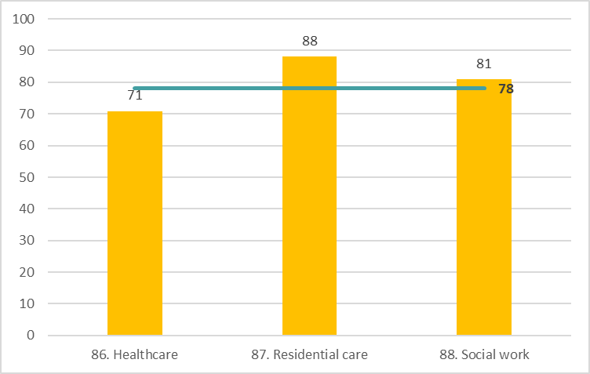
Percentage of HeSCare sector establishments that regularly carry out workplace risk assessments, by subsector, EU-27, 2019 (%)
Source: Panteia based on ESENER-2019
Base: All HeSCare sector establishments in the EU-27.
The horizontal line indicates the HeSCare (NACE Q) EU-27 average.

Slide 8
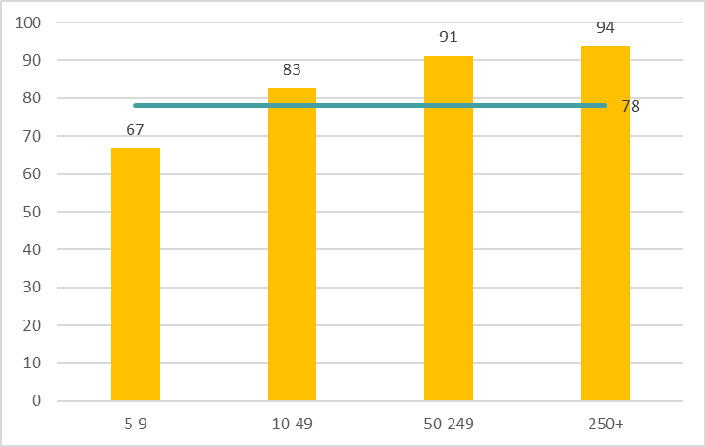
Percentage of HeSCare sector establishments that regularly carry out workplace risk assessments, by size, EU-27, 2019 (%)
Source: Panteia based on ESENER-2019
Base: All HeSCare sector establishments in the EU-27.
The horizontal line indicates the HeSCare (NACE Q) EU-27 average.

Slide 9
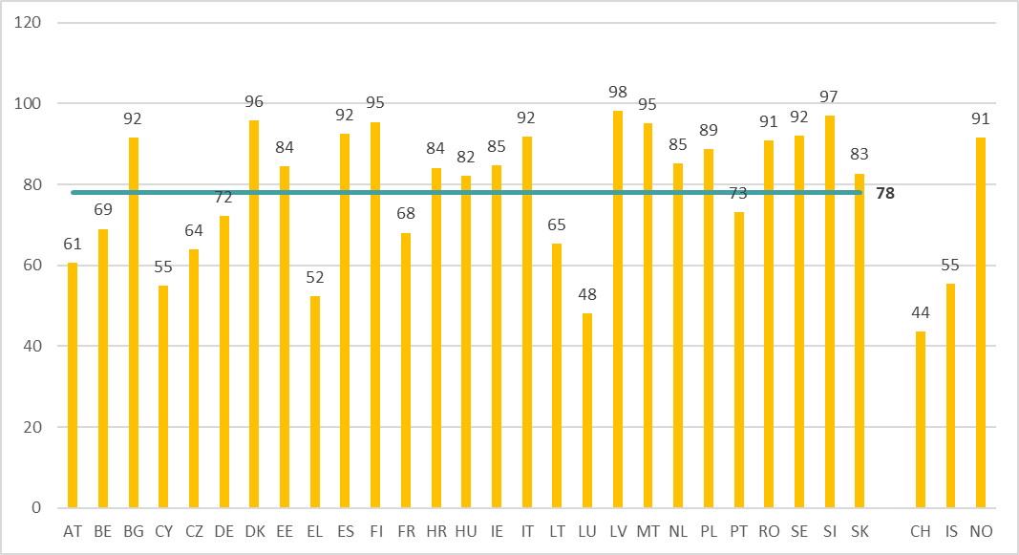
Percentage of HeSCare sector establishments that regularly carry out workplace risk assessments, by country, EU-27 (+ CH, IS and NO), 2019 (%)
Source: Panteia based on ESENER-2019
Base: All establishments in the EU-27, Switzerland, Iceland and Norway.
The horizontal line indicates the HeSCare (NACE Q) EU-27 average.

Slide 10
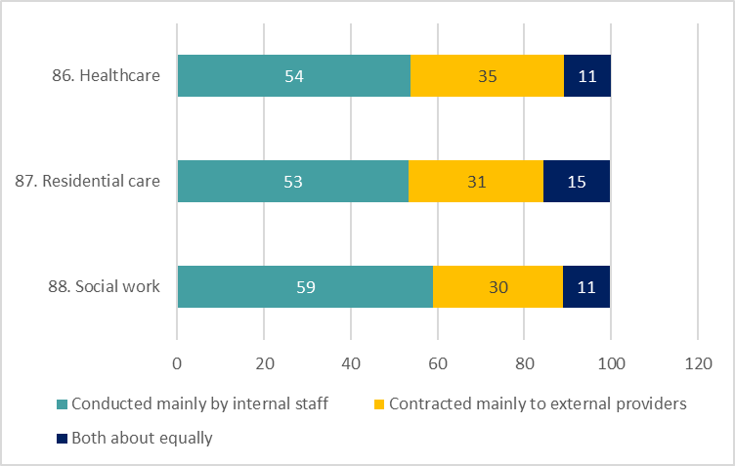
Responsibility within HeSCare sector establishments for conducting workplace risk assessments, by subsector, EU-27, 2019 (%)
Source: Panteia based on ESENER-2019
Base: Information from HeSCare sector establishments that carry out regularly risk assessment.

Slide 11
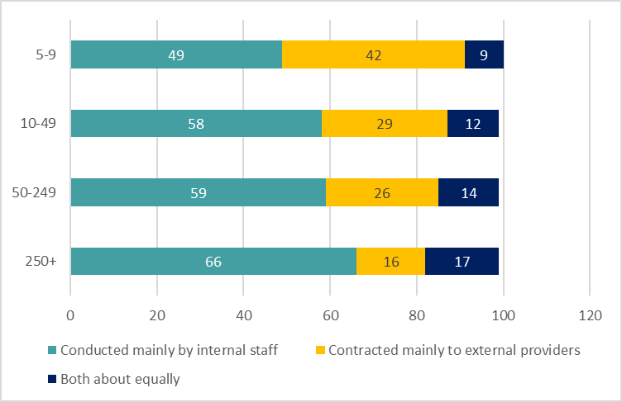
Responsibility within HeSCare sector establishments for conducting workplace risk assessments, by size, EU-27, 2019 (%)
Source: Panteia based on ESENER-2019
Base: Information from HeSCare sector establishments that carry out regularly risk assessments.

Slide 12
Topics that are routinely evaluated in HeSCare sector establishements workplace risk assessments, by subsector, EU-27, 2019 (%)
Source: Panteia based on ESENER-2019
Base: Information from HeSCare sector establishments that carry out regularly risk assessments.

Slide 13
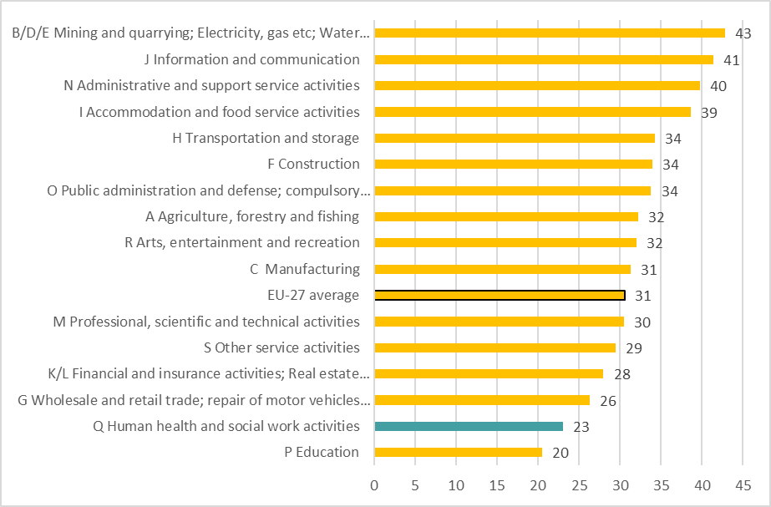
Percentage of establishments that indicate risk assessments cover workplaces at home, by sector, EU-27, 2019 (%)
Source: Panteia based on ESENER-2019
Base: Information from HeSCare sector establishments that carry out regularly risk assessments and indicate any of the employee regularly work from home.

Slide 14
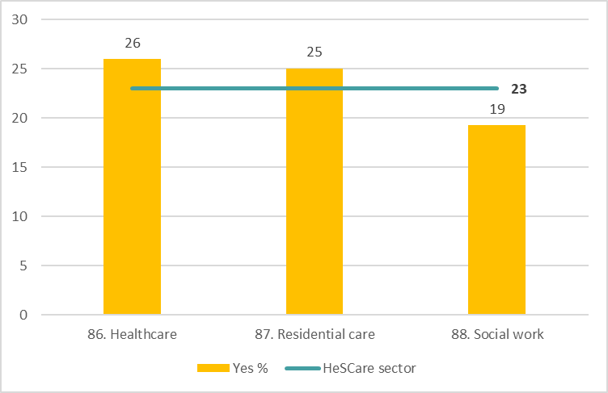
Percentage of HeSCare sector establishments that indicate risk assessments cover workplaces at home, by subsector, EU-27, 2019 (%)
Source: Panteia based on ESENER-2019
Base: Information from HeSCare sector establishments that carry out regularly risk assessments and indicate any of the employee regularly work from home.
The horizontal line indicates the HeSCare (NACE Q) EU-27 average.

Slide 15
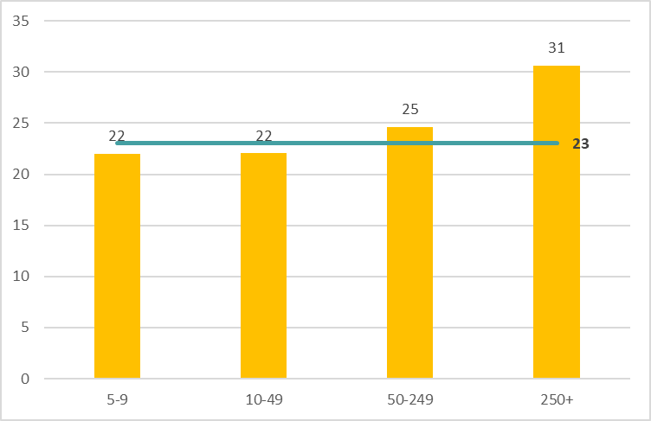
Percentage of HeSCare sector establishments that indicate risk assessments cover workplaces at home, by size, EU-27, 2019 (%)
Source: Panteia based on ESENER-2019
Base: Information from HeSCare sector establishments that carry out regularly risk assessments and indicate any of the employee regularly work from home.
The horizontal line indicates the HeSCare (NACE Q) EU-27 average.

Slide 16
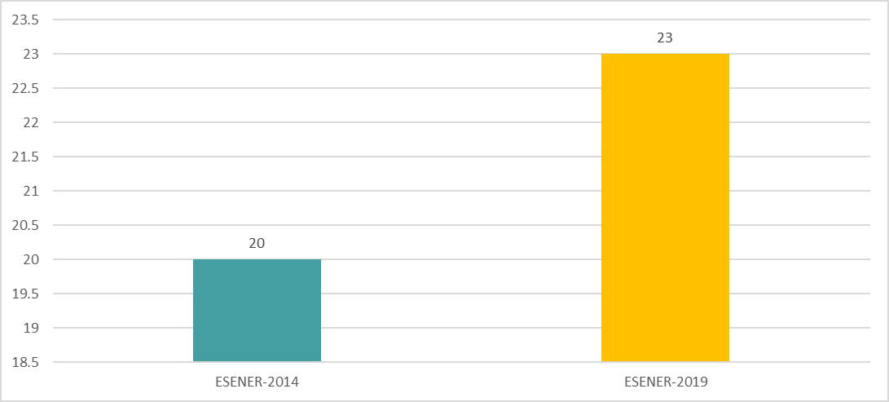
Percentage of HeSCare sector establishments that indicate risk assessments cover workplaces at home, by size, EU-27, 2014 and 2019 (%)
Source: Panteia based on ESENER-2019
Base: Information from HeSCare sector establishments that carry out regularly risk assessments and indicate any of the employee regularly work from home.

Slide 17
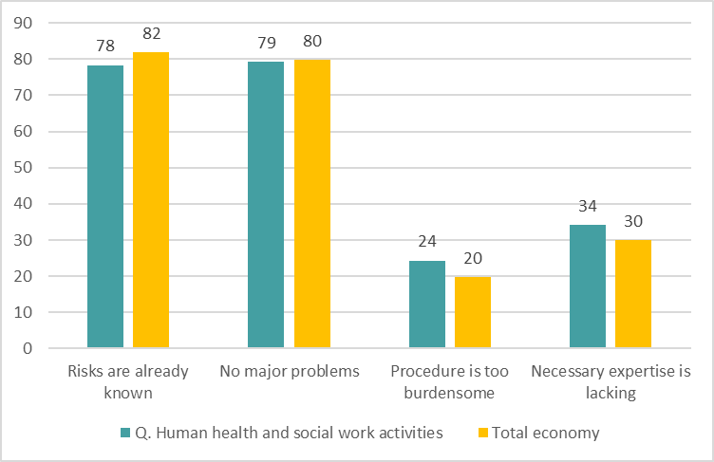
Reasons why workplace risk assessments are not regularly carried out by sector, EU-27, 2019 (%)
Source: Panteia based on ESENER-2019
Base: Responses only of those HeSCare sector establishments that do not carry out regularly workplace risk assessments.

Slide 18
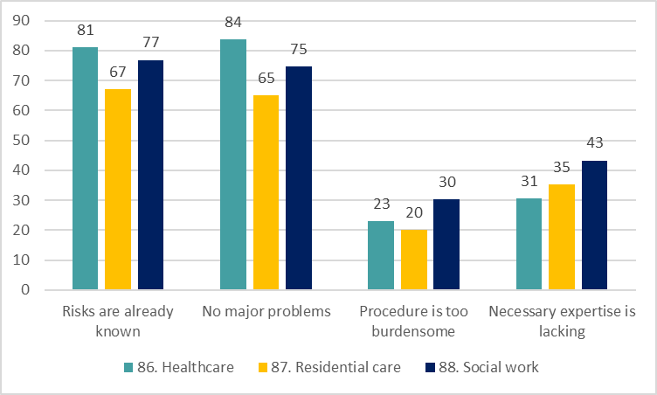
Reasons why workplace risk assessments are not regularly carried out by subsector, EU-27, 2019 (%)
Source: Panteia based on ESENER-2019
Base: Responses only of those HeSCare sector establishments that do not carry out
regularly workplace risk assessments.

Slide 19
Prevention measures for MSDs taken by HeSCare sector establishments in the last 3 years, by subsector, EU-27, 2019
Source: Panteia based on ESENER-2019
Base: All establishments in the EU-27.

Slide 20
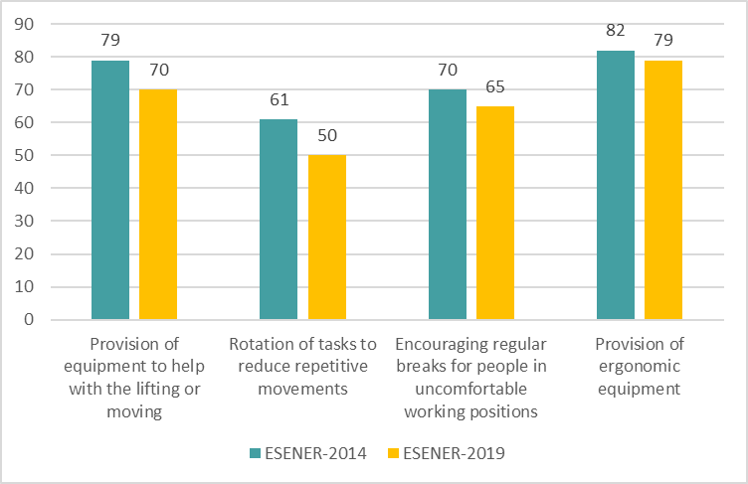
Prevention measures for MSDs taken by HeSCare sector establishments in the last 3 years, EU-27, 2014 and 2019 (%)
Source: Panteia based on ESENER-2019
Base: All HeSCare sector establishments in the EU-27.

Slide 21
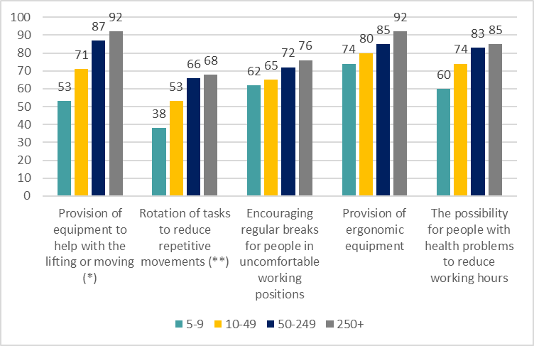
Prevention measures for MSDs taken by HeSCare sector establishments in the last 3 years, by size, EU-27, 2019 (%)
Source: Panteia based on ESENER-2019
Base: All HeSCare establishments in the EU-27.
*) Only referred to HeSCare establishments reporting the presence of “lifting or moving heavy loads”.
(**) Only referred to HeSCare establishments reporting the presence of “repetitive hand or arm movements”.

Slide 22
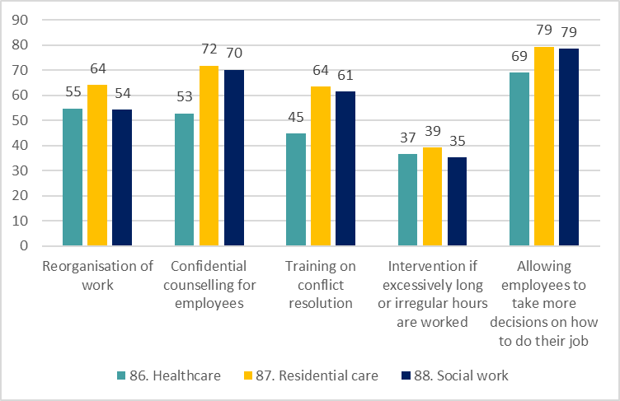
Prevention measures taken by HeSCare sector establishments to prevent psychosocial risks in the last 3 years, by subsector, EU-27, 2019 (%)
Source: Panteia based on ESENER-2019
Base: All HeSCare sector establishments in the EU-27.

Slide 23
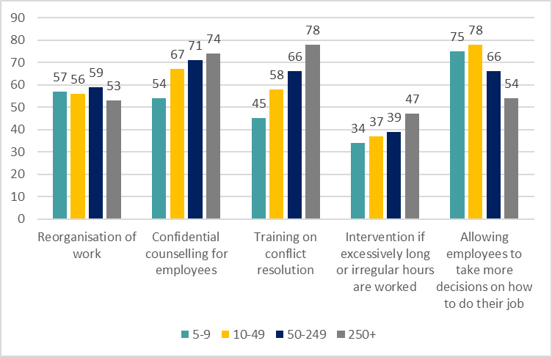
Prevention measures taken by HeSCare sector establishments to prevent psychosocial risks in the last 3 years, by size, EU-27, 2019 (%)
Source: Panteia based on ESENER-2019
Base: All HeSCare sector establishments in the EU-27.

Slide 24
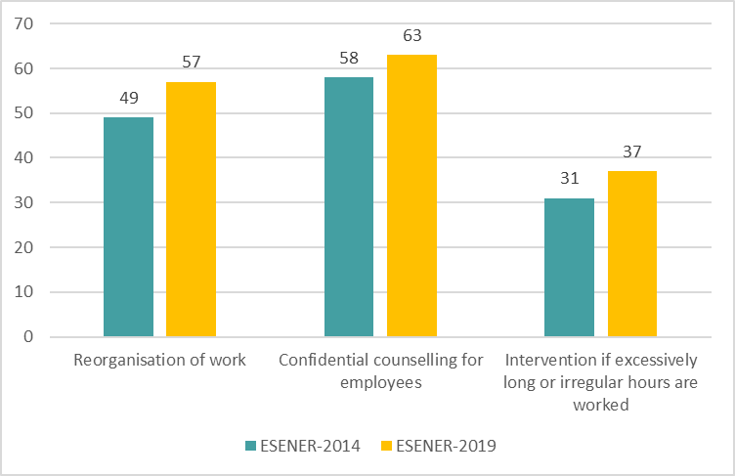
Prevention measures taken by HeSCare sector establishments in the last 3 years EU-27, 2014 and 2019 (%)
Source: Panteia based on ESENER-2014 and ESENER-2019
Base: All Hescare sector establishments in the EU-27.

Slide 25
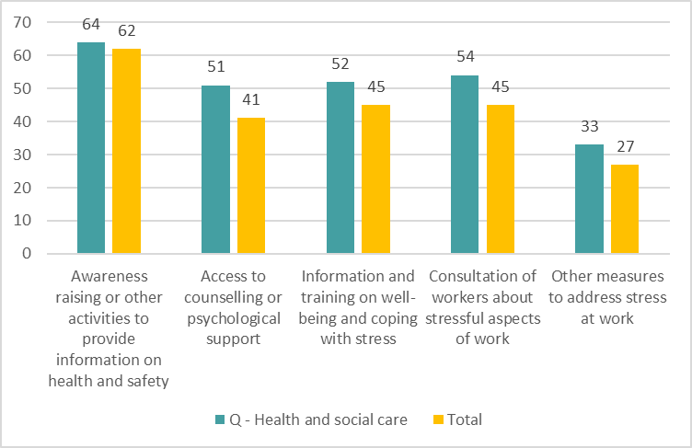
Percentage of workers indicating the following initiatives were available at their workplace, by sector, EU-27, 2022
Source: Panteia, based on ‘OSH Pulse 2022 – Occupational safety and health in post-pandemic workplaces’
Base: All respondents.

Slide 26
Formal procedures taken by HeSCare sector establishments to prevent psychosocial risks, by subsector, EU-27, 2019 (%)
Source: Panteia based on ESENER-19
Base: HeSCare sector establishments with 20 or more employees.

Slide 27
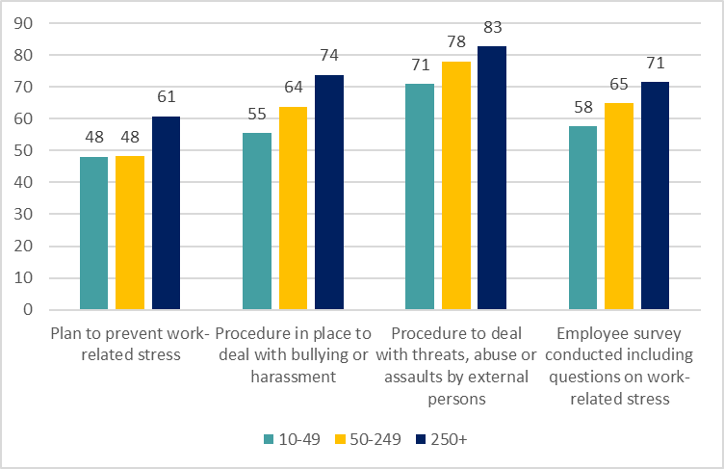
Formal procedures taken by HeSCare sector establishments to prevent psychosocial risks, by size, EU-27, 2019 (%)
Source: Panteia based on ESENER-19
Base: HeSCare sector establishments with 20 or more employees.

Slide 28
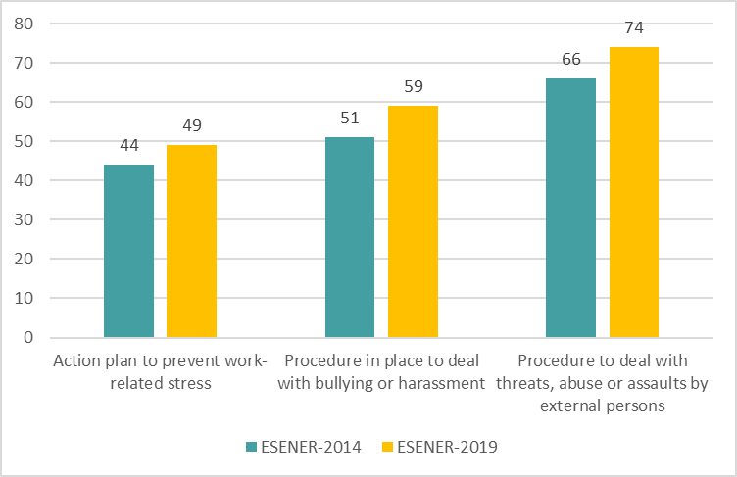
Formal procedures taken by HeSCare sector establishments to prevent psychosocial risks, by size, EU-27, 2014 and 2019 (%)
Source: Panteia based on ESENER-14 and ESENER-19
Base: HeSCare sector establishments with 20 or more employees.

Slide 29
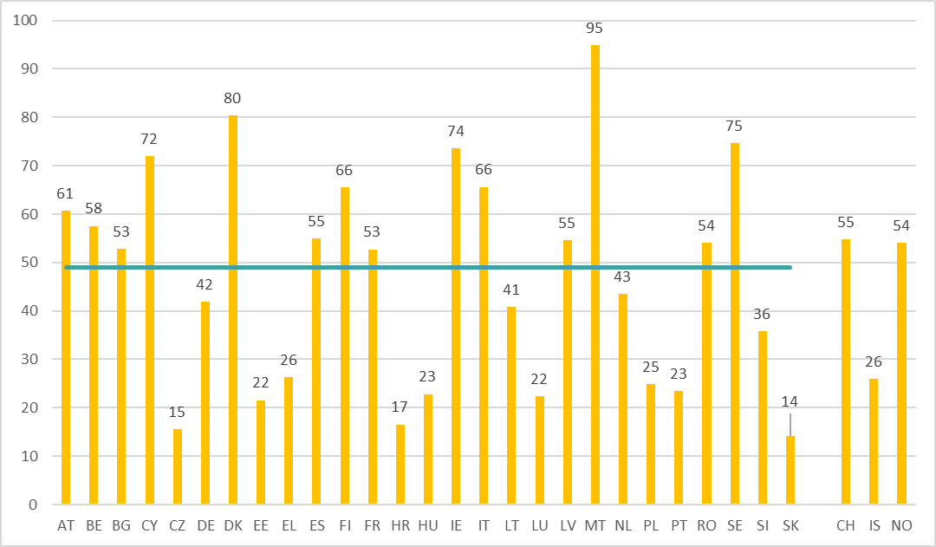
Percentage of HeSCare sector establishments with a presence of a plan to prevent work-related stress, by country, EU-27 (+ CH, IS and NO), 2019 (%)
Source: Panteia based on ESENER-19
Base: HeSCare sector establishments with 20 or more employees in the EU-27, Switzerland, Iceland and Norway.
The horizontal line indicates the HeSCare (NACE Q) EU-27 average.

Slide 30
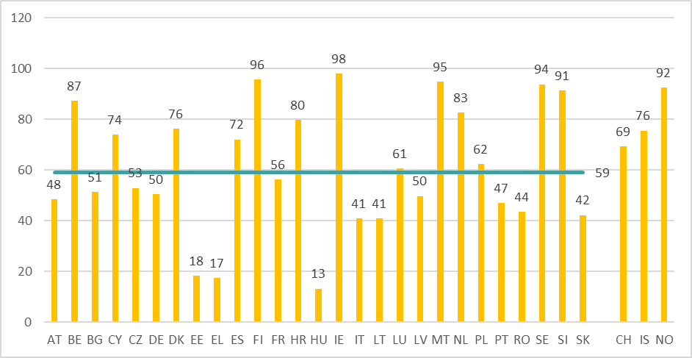
Percentage of HeSCare sector establishments with a procedure to deal with cases of bullying and harassment, by country, EU-27 (+CH, IS and NO), 2019 (%)
Source: Panteia based on ESENER-19
Base: HeSCare sector establishments with 20 or more employees in the EU-27, Switzerland, Iceland and Norway.
The horizontal line indicates the HeSCare (NACE Q) EU-27 average.

Slide 31
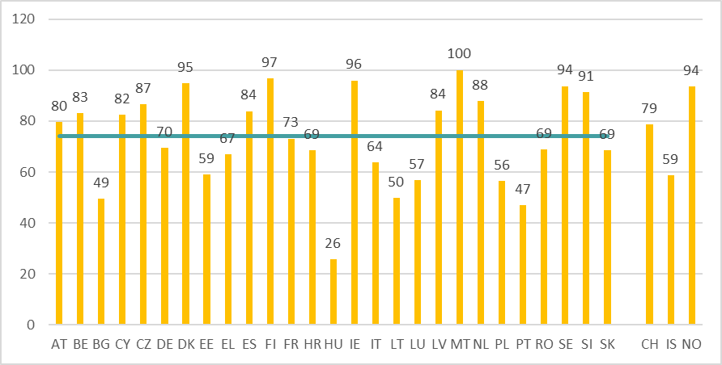
Percentage of HeSCare sector establishments with a procedure to deal with cases of threats, abuse or assaults by external persons by country, EU-27 (+CH, IS and NO), 2019 (%)
Source: Panteia based on ESENER-19
Base: HeSCare sector establishments with 20 or more employees in the EU-27, Switzerland, Iceland
and Norway.
The horizontal line indicates the HeSCare (NACE Q) EU-27 average.

Slide 32
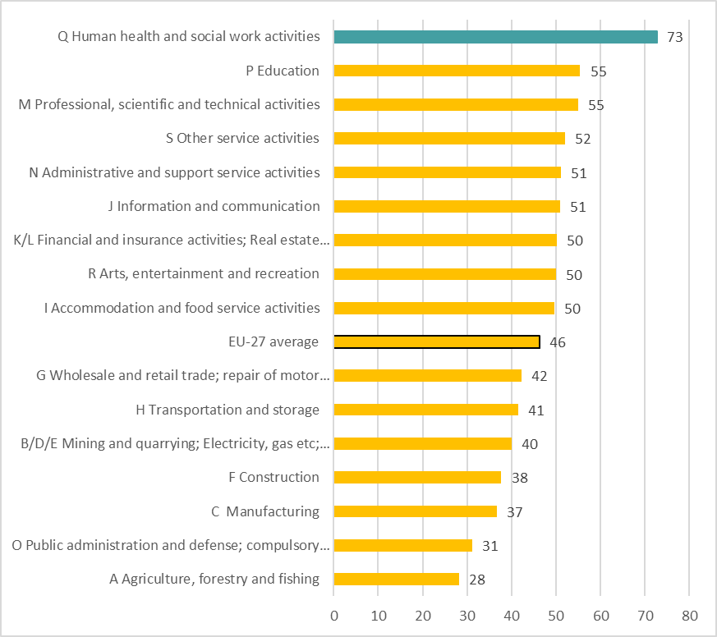
Percentage of establishments in which employees have been involved in identifying measures to reduce work-related stress, by sector, EU-27, 2019 (%)
Source: Panteia based on ESENER-19
Base: All establishments in the EU-27.

Slide 33
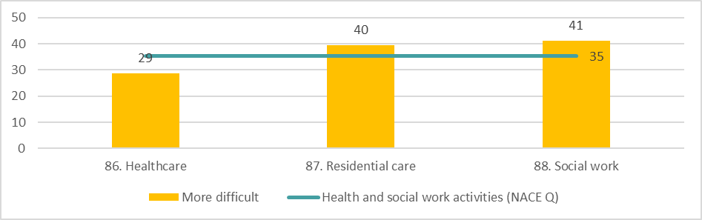
Percentage of HeSCare sector establishments that suggest that psychosocial risks are more difficult to address than other risks, by subsector, EU-27, 2019 (%)
Source: Panteia based on ESENER-2019
Base: Responses only of those establishments in the HeSCare sector that have identified one or more psychosocial risks.
The horizontal line indicates the HeSCare (NACE Q) EU-27 average.

Slide 34
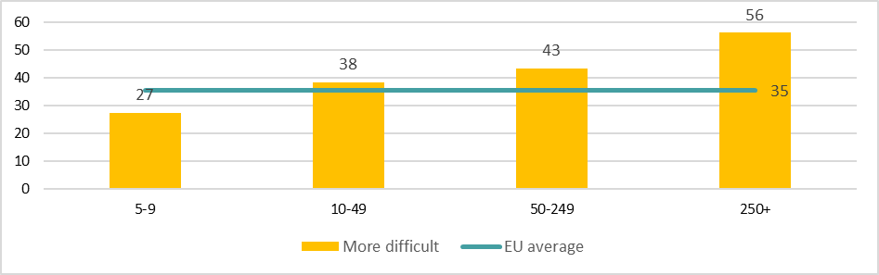
Percentage of HeSCare sector establishments that suggest that psychosocial risks are more difficult to address than other risks, by size, EU-27, 2019 (%)
Source: Panteia based on ESENER-2019
Base: Responses only of those establishments in the HeSCare sector that have identified one or more psychosocial risks.
The horizontal line indicates the HeSCare (NACE Q) EU-27 average.

Slide 35
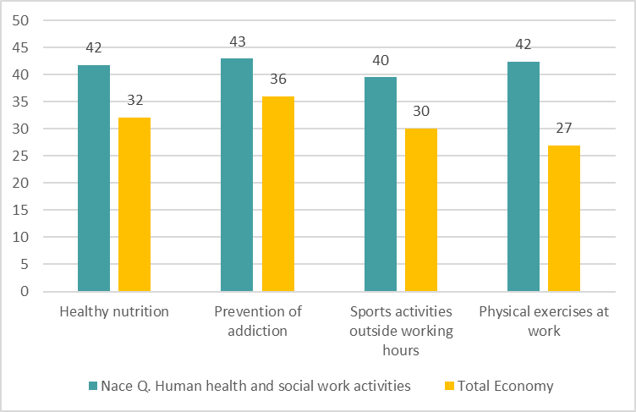
Establishments indicating measures for health promotion by sector, EU-27, 2019 (%)
Source: Panteia based on ESENER-2019
Base: All establishments in the EU-27.

Slide 36
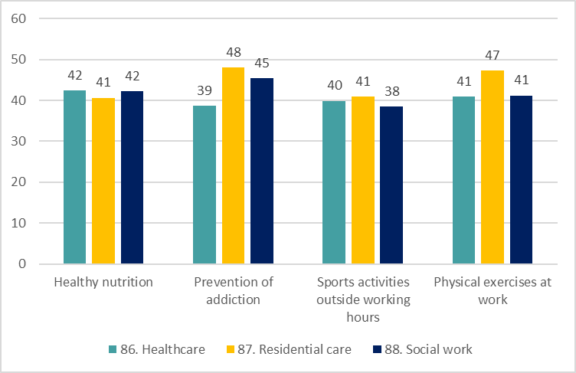
HeSCare sector establishments indicating measures for health promotion by subsector, EU-27, 2019 (%)
Source: Panteia based on ESENER-2019
Base: All HeSCare sector establishments in the EU-27.

Slide 37
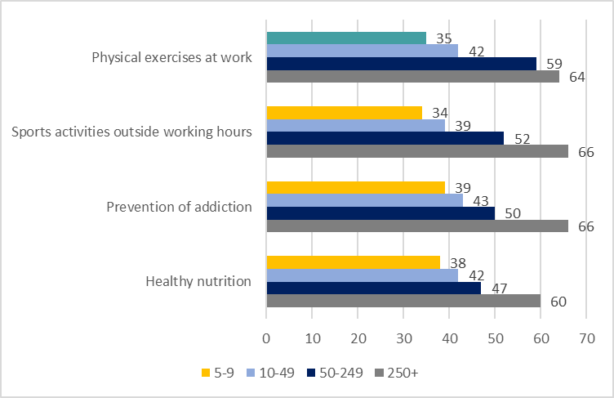
HesCare sector establishments indicating measures for health promotion by size, EU-27, 2019 (%)
Source: Panteia based on ESENER-2019
Base: All HeSCare sector establishments in the EU-27.

Slide 38
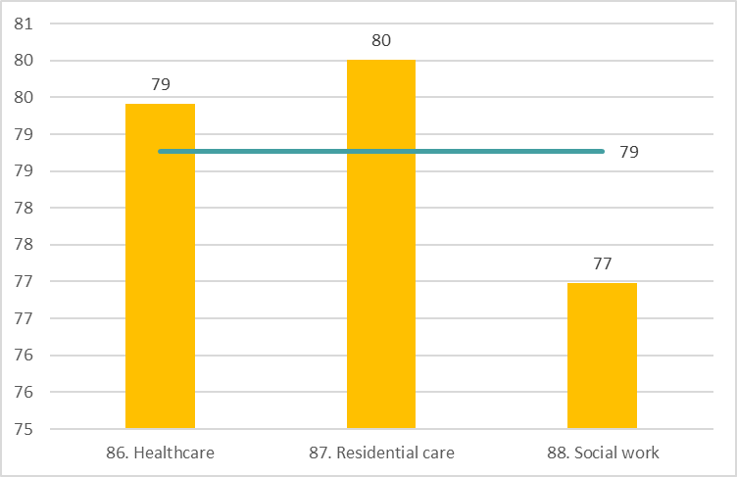
Percentage of HeSCare sector establishments that arrange regular medical examinations to monitor the health of employees, by subsector, EU-27, 2019 (%)
Source: Panteia based on ESENER-2019
Base: All HeSCare sector establishments in the EU-27.
The horizontal line indicates the HeSCare (NACE Q) EU-27 average.

Slide 39
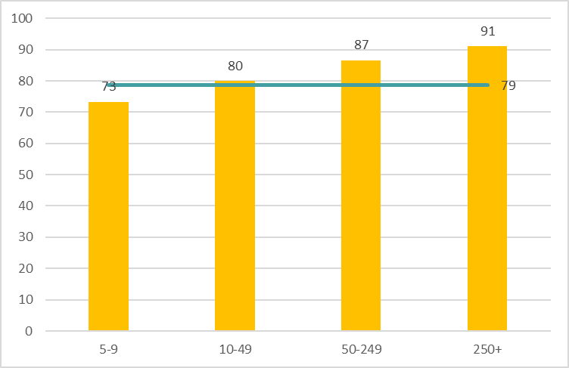
Percentage of HeSCare sector establishments that arrange regular medical examinations to monitor the health of employees, by size, EU-27, 2019 (%)
Source: Panteia based on ESENER-2019
Base: All HeSCare sector establishments in the EU-27.
The horizontal line indicates the HeSCare (NACE Q) EU-27 average.

Slide 40
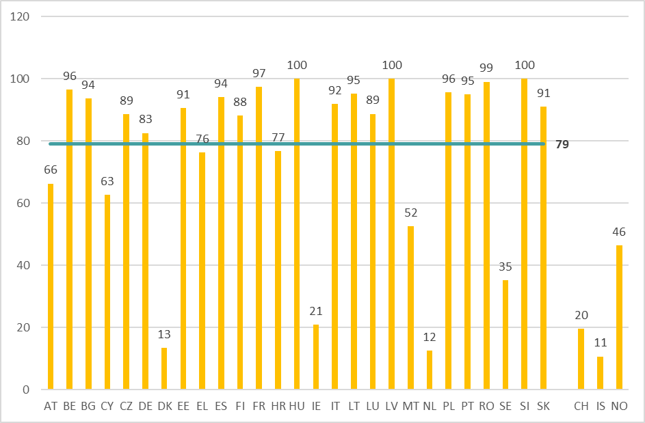
Percentage of HeSCare sector establishments that arrange regular medical examinations to monitor the health of employees, by country, EU-27 (+CH, IS and NO), 2019 (%)
Source: Panteia based on ESENER-2019
Base: All HeSCare sector establishments in the EU-27, Switzerland, Iceland and Norway.
The horizontal line indicates the HeSCare (NACE Q) EU-27 average.

Slide 41
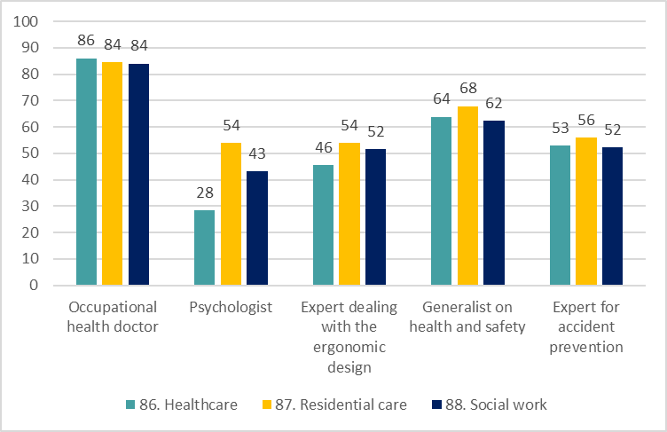
Percentage of HeSCare sector establishments which indicate health and safety services used (in-house or contracted externally), by subsector, EU-27, 2019 (%)
Source: Panteia based on ESENER-2019
Base: All HeSCare sector establishments in the EU-27.

Slide 42
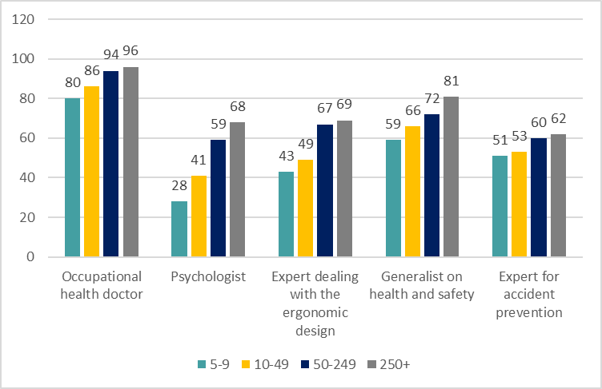
Health and safety services used (in-house or contracted externally) by HeSCare sector establishments, by size, EU-27, 2019 (%)
Source: Panteia based on ESENER-2019
Base: All HeSCare sector establishments in the EU-27.

Slide 43
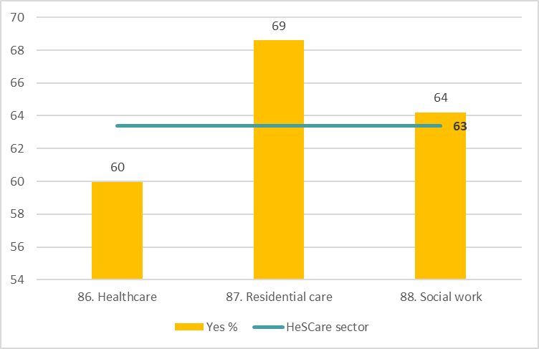
Percentage of HeSCare establishments that have used the services of any external provider to support them in their health and safety tasks in the last three years, by size, EU-27, 2019 (%)
Source: Panteia based on ESENER-2019
Base: All HeSCare sector establishments in the EU-27.
The horizontal line indicates the HeSCare (NACE Q) EU-27 average.

Slide 44
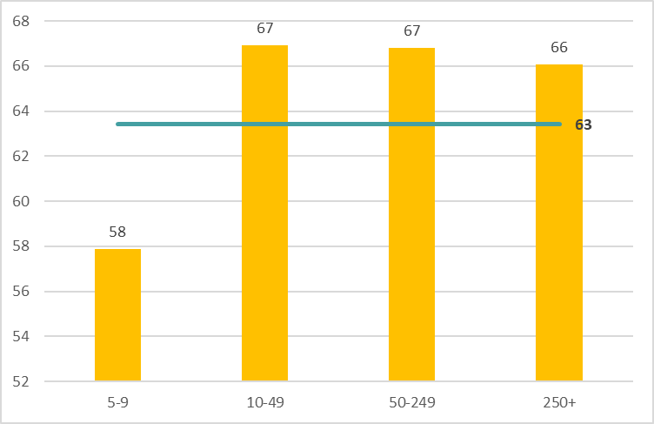
Percentage of HeSCare establishments that have used the services of any external provider to support them in their health and safety tasks in the last three years, by size, EU-27, 2019 (%)
Source: Panteia based on ESENER-2019
Base: All HeSCare sector establishments in the EU-27.
The horizontal line indicates the HeSCare (NACE Q) EU-27 average.

Slide 45
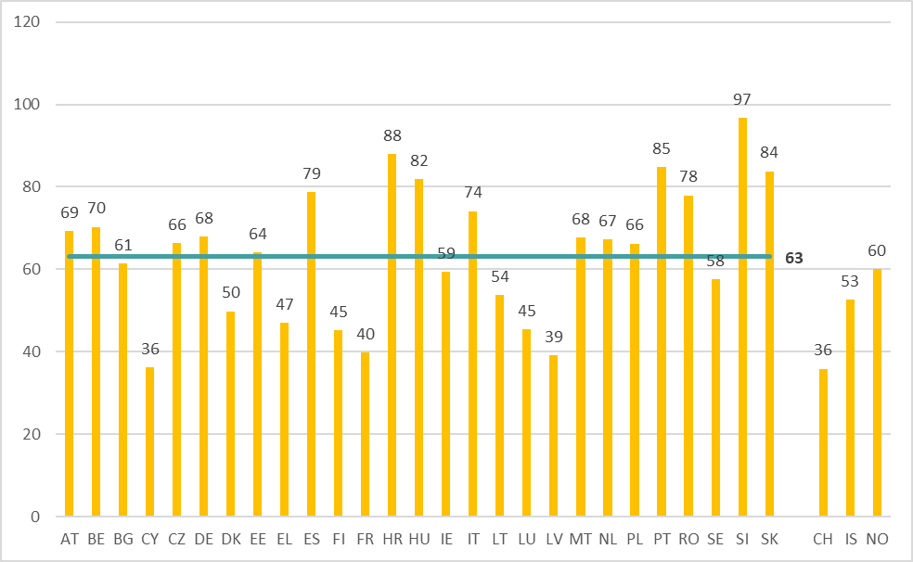
Percentage of HeSCare sector establishments that have used the services of any external provider to support them in their health and safety tasks, by country, EU-27 (+ CH, IS and NO), 2019 (%)
Source: Panteia based on ESENER-2019
Base: All HeSCare sector establishments in the EU-27, Switzerland, Iceland and Norway.
The horizontal line indicates the HeSCare (NACE Q) EU-27 average.

Slide 46
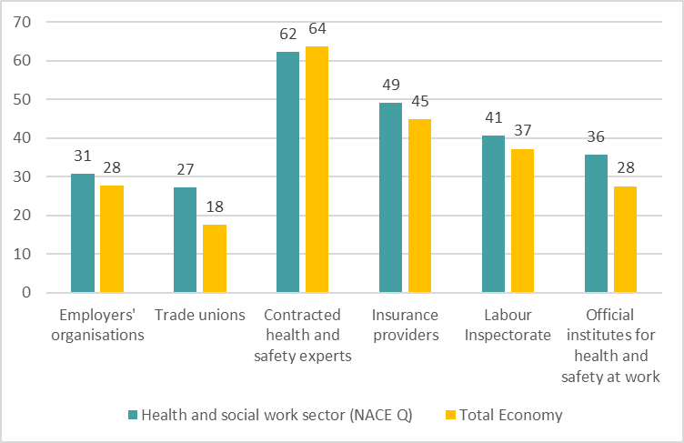
Percentage of HeSCare sector establishments that used health and safety information from external organisations, by organisation, EU-27, 2019 (%)
Source: Panteia based on ESENER-2019
Base: All establishments in the EU-27.

Slide 47
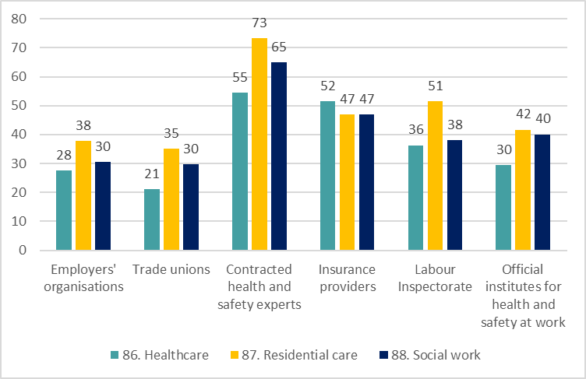
Percentage of HeSCare sector establishments that used health and safety information from external organisations, by subsector, EU-27, 2019 (%)
Source: Panteia based on ESENER-2019
Base: All HeSCare sector establishments in the EU-27.

Slide 48
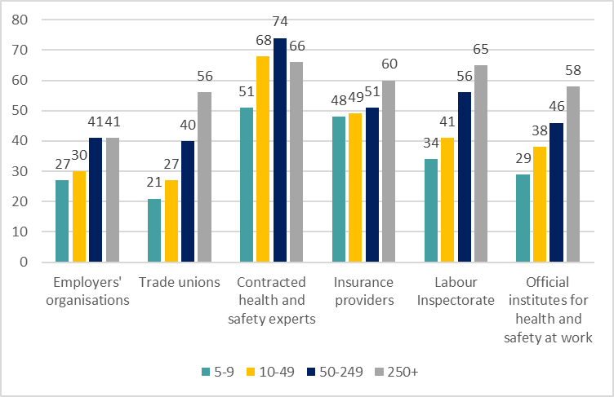
Percentage of establishments in the HeSCare sector that used health and safety information from external organisations, by size, EU-27, 2019 (%)
Source: Panteia based on ESENER-2019
Base: All HeSCare sector establishments in the EU-27.

Slide 49
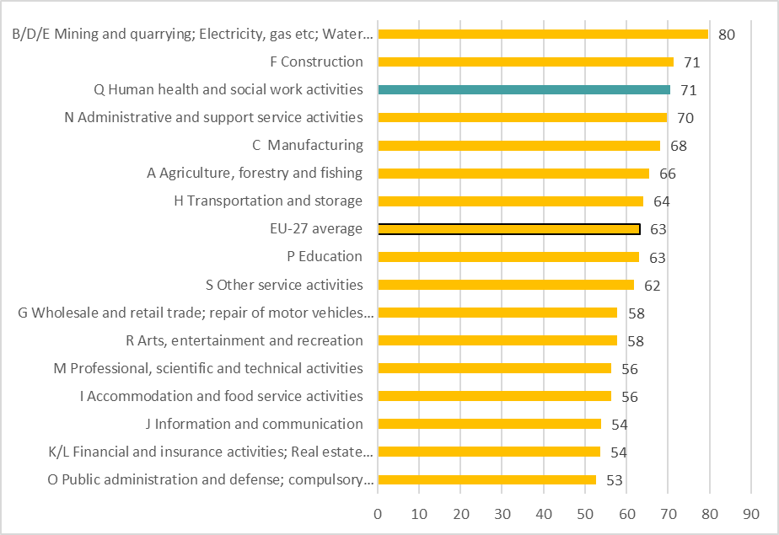
Percentage of establishments in which health and safety issues are discussed regularly at the top level of management, by sector, EU-27, 2019 (%)
Source: Panteia based on ESENER-19
Base: Only establishments with 20 or more employees in the EU-27.

Slide 50
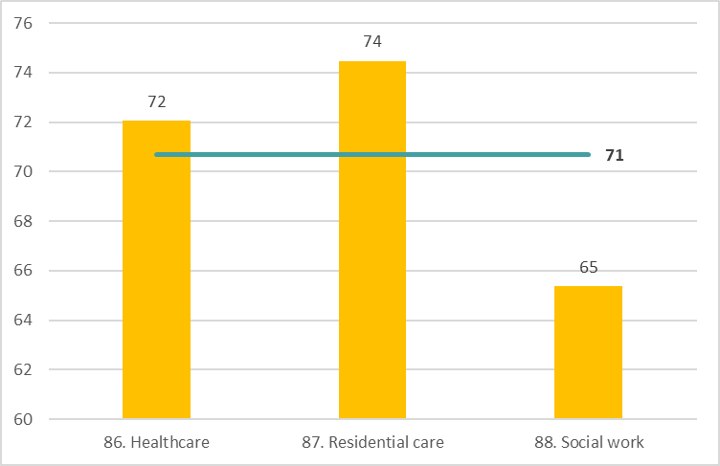
Percentage of HeSCare sector establishments tin which health and safety issues are discussed regularly at the top level of management, by subsector, EU-27, 2019 (%)
Source: Panteia based on ESENER-2019
Base: Only HeSCare sector establishments with 20 or more employees in the EU-27.
The horizontal line indicates the HeSCare (NACE Q) EU-27 average.

Slide 51
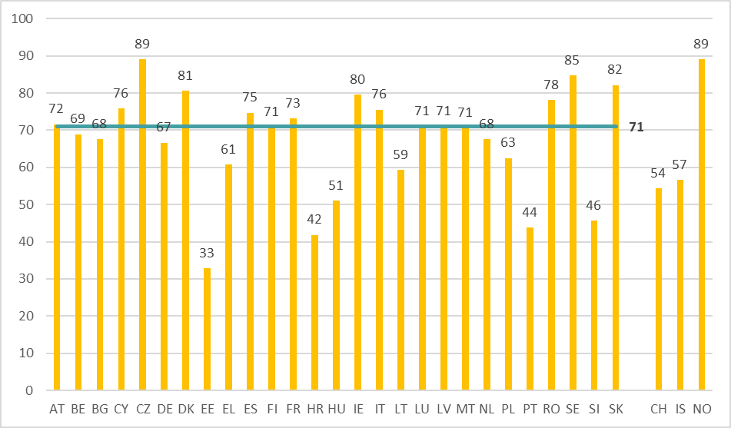
Percentage of HeSCare sector establishments in which health and safety issues are discussed regularly at the top level of management, by country, EU-27 (+CH, IS and NO), 2019 (%)
Source: Panteia based on ESENER-2019
Base: Only HeSCare sector establishments with 20 or more employees in the EU-27, Switzerland, Iceland and Norway.
The horizontal line indicates the HeSCare (NACE Q) EU-27 average..

Slide 52
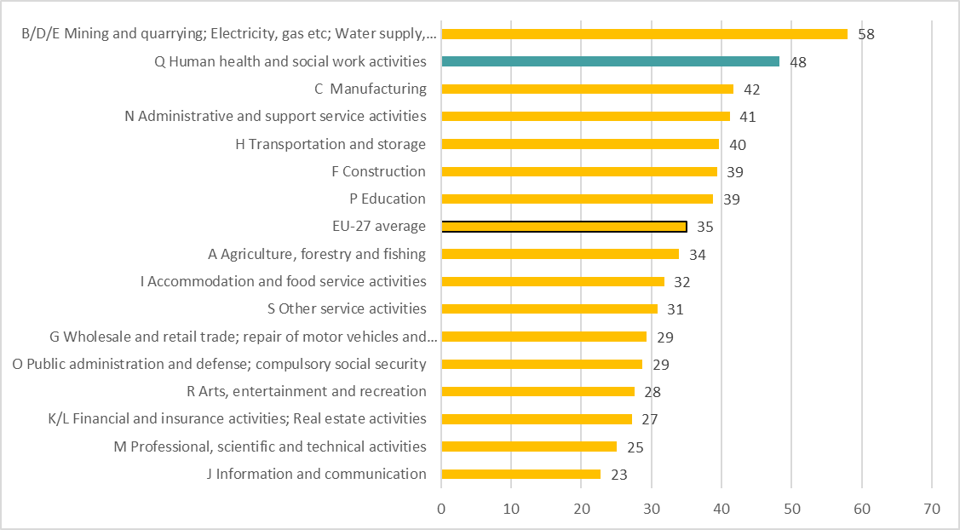
Percentage of establishments in which health and safety issues are discussed regularly in staff or team meetings, by sector, EU-27, 2019 (%)
Source: Panteia based on ESENER-19
Base: Only establishments with 20 or more employees in the EU-27.

Slide 53
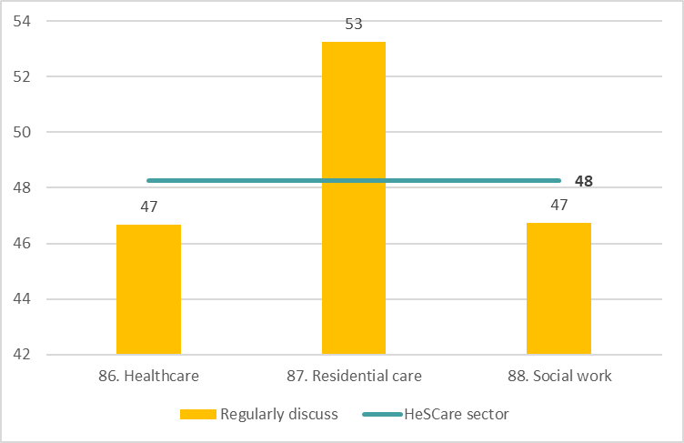
Percentage of HeSCare sector establishments in which health and safety issues are discussed regularly in staff or team meetings, by subsector, EU-27, 2019 (%)
Source: Panteia based on ESENER-19
Base: Only HeSCare establishments with 20 or more employees in the EU-27.
The horizontal line indicates the HeSCare (NACE Q) EU-27 average.

Slide 54
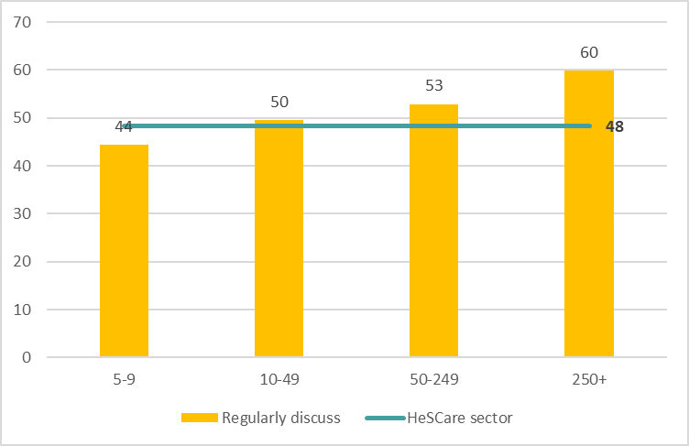
Percentage of HeSCare sector establishments in which health and safety issues are discussed regularly in staff or team meetings, by size, EU-27, 2019 (%)
Source: Panteia based on ESENER-19
Base: Only HeSCare establishments with 20 or more employees in the EU-27.
The horizontal line indicates the HeSCare (NACE Q) EU-27 average..

Slide 55
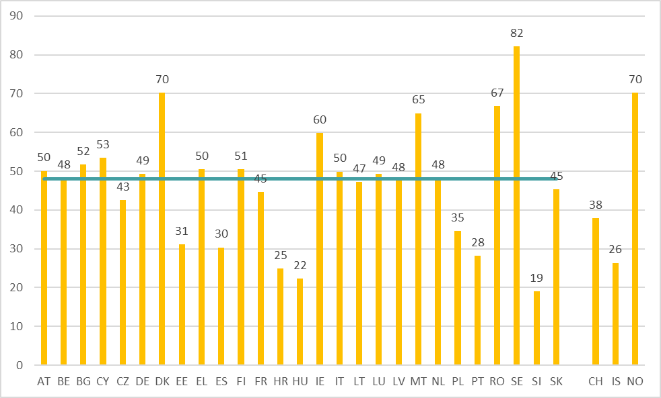
Percentage of HeSCare sector establishments in which health and safety issues are discussed regularly in staff or team meetings, by country, EU-27 (+ CH, IS and NO), 2019 (%)
Source: Panteia based on ESENER-19
Base: All HeSCare establishments with 20 or more employees in the EU-27, Switzerland, Iceland and Norway.
The horizontal line indicates the HeSCare (NACE Q) EU-27 average.

Slide 56
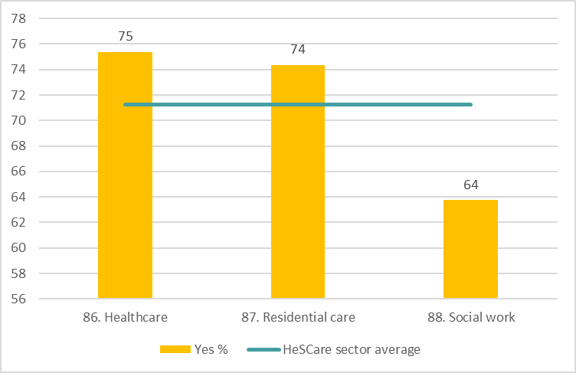
Percentage of HeSCare sector establishments in which team leaders and line managers receive any training on how to manage health and safety in their teams by subsector, EU-27, 2019 (%)
Source: Panteia based on ESENER-19
Base: All HeSCare sector establishments with 20 or more employees in the EU-27.
The horizontal line indicates the HeSCare (NACE Q) EU-27 average.

Slide 57
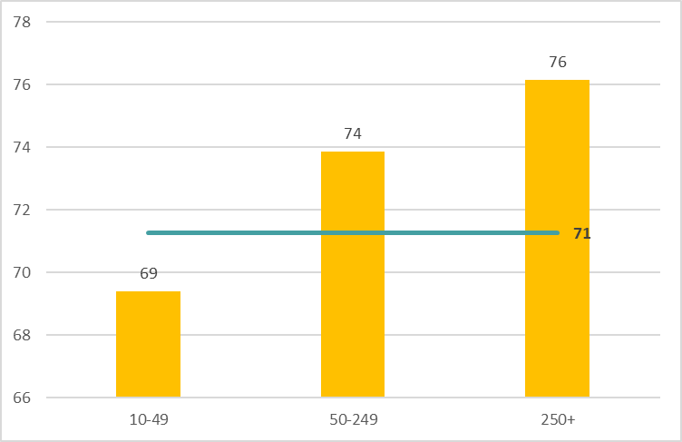
Percentage of HeSCare sector establishments in which team leaders and line managers receive any training on how to manage health and safety in their teams by size, EU-27, 2019 (%)
Source: Panteia based on ESENER-19
Base: All HeSCare establishments with 20 or more employees in the EU-27.
The horizontal line indicates the HeSCare (NACE Q) EU-27 average.

Slide 58

Percentage of HeSCare sector establishments in which team leaders and line managers receive any training on how to manage health and safety in their teams by country, EU-27 (+CH, IS and NO), 2019 (%)
Source: Panteia based on ESENER-19
Base: All HeSCare establishments with 20 or more employees in the EU-27, Switzerland, Iceland and Norway.
The horizontal line indicates the HeSCare (NACE Q) EU-27 average.

Slide 59

Percentage of HeSCare sector establishments where the health and safety representatives were provided with any training during work time to help them perform their health and safety duties, by subsector, EU-27, 2019 (%)
Source: Panteia based on ESENER-19
Base: Only HeSCare with health and safety representatives in the EU-27.
The horizontal line indicates the HeSCare (NACE Q) EU-27 average.

Slide 60

Percentage of HeSCare sector establishments where the health and safety representatives were provided with any training during work time to help them perform their health and safety duties, by size, EU-27, 2019 (%)
Source: Panteia based on ESENER-19
Base: Only HeSCare with health and safety representatives in the EU-27.
The horizontal line indicates the HeSCare (NACE Q) EU-27 average.

Slide 61

OSH-related topics on which training has been provided to employees by sector, EU-27, 2019 (%)
Source: Panteia based on ESENER-2019
Base: All establishments in the EU-27.
(*) Base: Only HeSCare sector establishments exposed to “chemical or biological substances”.
(**) Base: Only HeSCare sector establishments exposed to “lifting or moving heavy loads”.

Slide 62

OSH-related topics on which training has been provided to employees in the HeSCare sector establishments, by subsector, EU-27, 2019 (%)
Source: Panteia based on ESENER-2019
Base: All HeSCare establishments in the EU-27.
(*) Base: Only HeSCare sector establishments exposed to “chemical or biological substances”.
(**) Base: Only HeSCare sector establishments exposed to “lifting or moving heavy loads”.

Slide 63

OSH-related topics on which training has been provided to employees in HeSCare sector establishments, by size, EU-27, 2019 (%)
Source: Panteia based on ESENER-2019
Base: All HeSCare establishments in the EU-27.
(*) Base: Only HeSCare sector establishments exposed to “chemical or biological substances”.

Slide 64

Whether training to employees on OSH-related topics is provided in other languages by sector, EU-27, 2019 (%)
Source: Panteia based on ESENER-2019
Base: All establishments in the EU-27.

Slide 65

Whether training to employees in HeSCare sector establishments on OSH-related topics is provided in other languages, EU-27, 2019 (%)
Source: Panteia based on ESENER-2019
Base: All HeSCare sector establishments in the EU-27.

Slide 67
Authors: Paul Vroonhof, Martin Clarke, Jacqueline Snijders, Jan de Kok, Marijke Beulen (Panteia), Peter van Scheijndel, Pim van Dorst (vhp Human Performance), Iñigo Isusi, Jessica Duran (IKEI Research and Consultancy), Swenneke van den Heuvel (TNO).
Project management: Lorenzo Munar, Kate Palmer – European Agency for Safety and Health at Work (EU-OSHA).
Neither the European Agency for Safety and Health at Work nor any person acting on behalf of the Agency is responsible for the use that might be made of the following information.
© European Agency for Safety and Health at Work, 2024
Reproduction is authorised provided the source is acknowledged.
For any use or reproduction of photos or other material that is not under the copyright of the European Agency for Safety and Health at Work, permission must be sought directly from the copyright holders.

