Slide 1
Health and Social Care (HeSCare) sector - OSH in figures
Main drivers and barriers for OSH management in the HeSCare sector
PPT 5

Slide 2
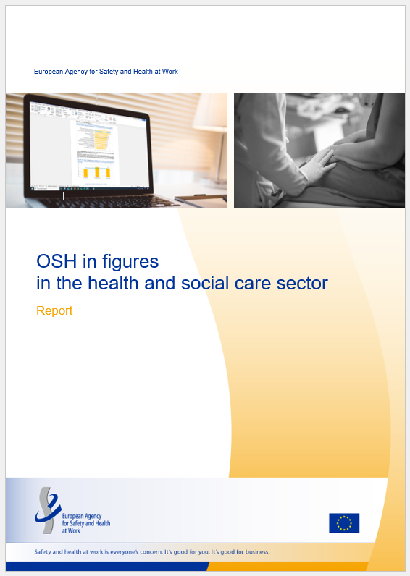
Introduction
This PPT is based on the following report:
  EU-OSHA, OSH in figures in the health and social care sector (Chapter 5), 2024.
  https://osha.europa.eu/en/publications/osh-figures-health-and-social-care-sector

Slide 3
Introduction: related PPTs
Characterisation of the HeSCare sector – PPT 1
  https://osha.europa.eu/en/publications/characterisation-health-and-social-care-sector
OSH risks in the HeSCare sector – PPT 2
  https://osha.europa.eu/en/publications/osh-risks-health-and-social-care-sector
Work-related health outcomes in the HeSCare sector – PPT 3
  https://osha.europa.eu/en/publications/work-related-outcomes-health-and-social-care-sector
OSH management in the HeSCare sector – PPT 4
  https://osha.europa.eu/en/publications/osh-management-health-and-social-care-sector
Worker participation in OSH Management the HeSCare sector – PPT 6
  https://osha.europa.eu/en/publications/worker-participation-osh-management-health-and-social-care-sector

Slide 4
Introduction: data sources / surveys
European Survey of Enterprises on New and Emerging Risks (ESENER)
European Working Conditions Telephone Survey (EWCTS)
EU-OSHA – OSH Pulse survey 2022

Slide 5
Main subsectors comprising health and social care activities
(NACE rev 2)
Source: Eurostat’s NACE classification
Notes:
The HeSCare sector is an important job generator in the EU economy. According to Eurostat Labour Force Survey statistics, in 2022, over 21,500,000 people were employed in the HeSCare sector (NACE Q). Most of these employees work in the healthcare subsector, with around 12.5 million employees. The residential care subsector is much smaller with around 4.1 million people employed. The social work subsector is also much smaller than the healthcare subsector, with around 5.1 million people working in this sector. As can be seen from the table below, the levels of employment in the HeSCare sector have been steadily increasing over the past 10 years, which can be seen across all subsectors. The HeSCare sector accounts for 11% of all employment across the total economy.

Slide 6
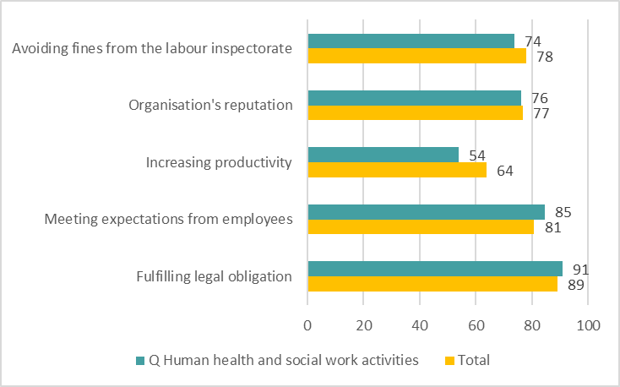
Reasons given by establishments for addressing health and safety by sector, EU-27, 2019 (% indicating major reason)
Source: Panteia based on ESENER-2019
Base: All establishments in the EU-27.

Slide 7
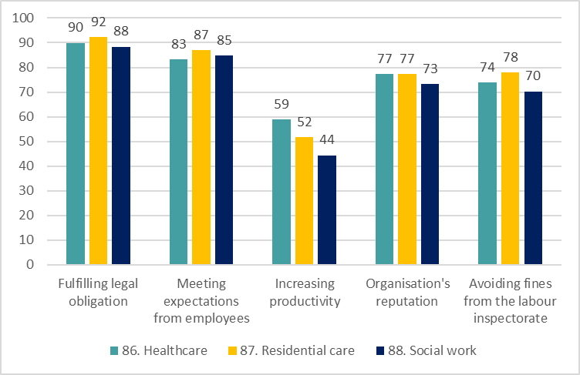
Reasons given by HeSCare sector establishments for addressing health and safety, by subsector, EU-27, 2019 (% indicating major reason)
Source: Panteia based on ESENER-2019
Base: All HeSCare sector establishments in the EU-27.

Slide 8
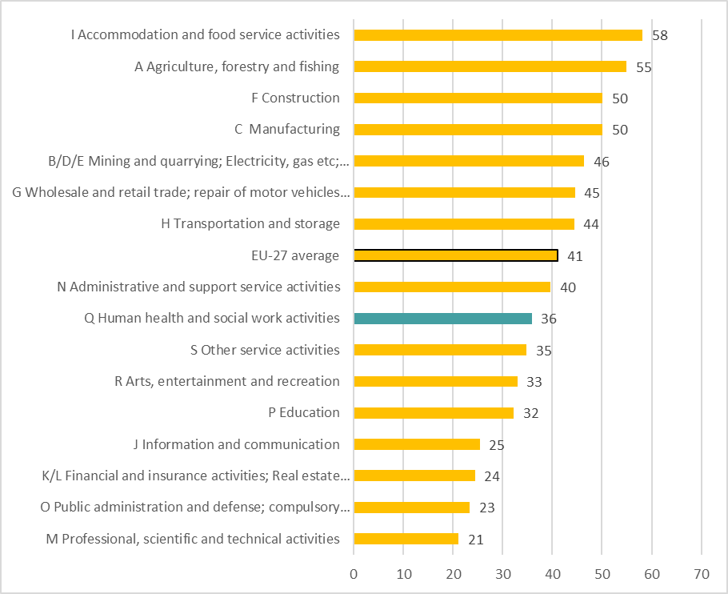
Percentage of establishments indicating they have been visited by the labour inspectorate in the last three years, by sector, EU-27, 2019 (%)
Source: Panteia based on ESENER-2019
Base: All establishments in the EU-27.

Slide 9
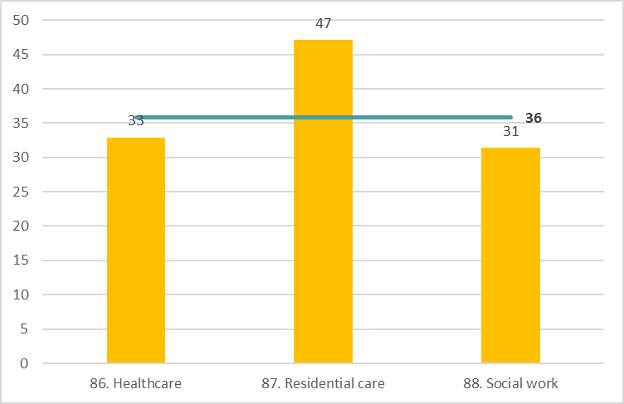
Percentage of HeSCare sector establishments indicating they have been visited by the labour inspectorate in the last three years, by subsector, EU-27, 2019 (%)
Source: Panteia based on ESENER-2019
Base: All HeSCare sector establishments in the EU-27.
The horizontal line indicates the HeSCare (NACE Q) EU-27 average.

Slide 10
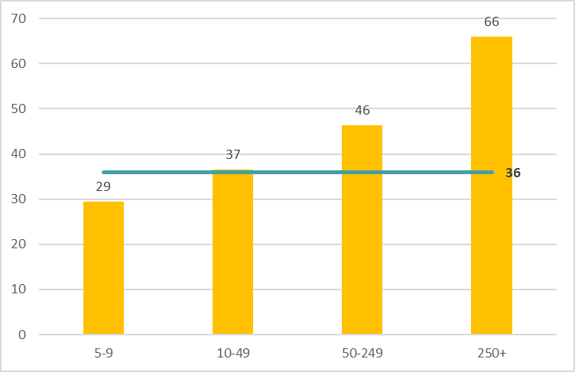
Percentage of HeSCare sector establishments indicating they have been visited by the labour inspectorate in the last three years, by size, EU-27, 2019 (%)
Source: Panteia based on ESENER-2019
Base: All HeSCare sector establishments in the EU-27.
The horizontal line indicates the HeSCare (NACE Q) EU-27 average.

Slide 11
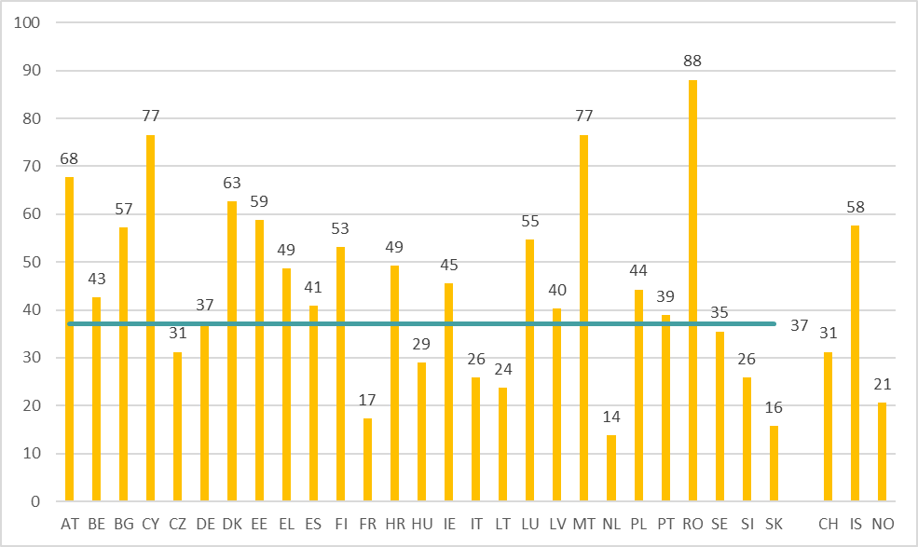
Percentage of HeSCare sector establishments indicating they have been visited by the labour inspectorate in the last three years, by country, EU-27 (+ CH, IS and NO), 2019 (%)
Source: Panteia based on ESENER-2019
Base: All establishments in the EU-27, Switzerland, Iceland and Norway.
The horizontal line indicates the HeSCare EU-27 average.

Slide 12
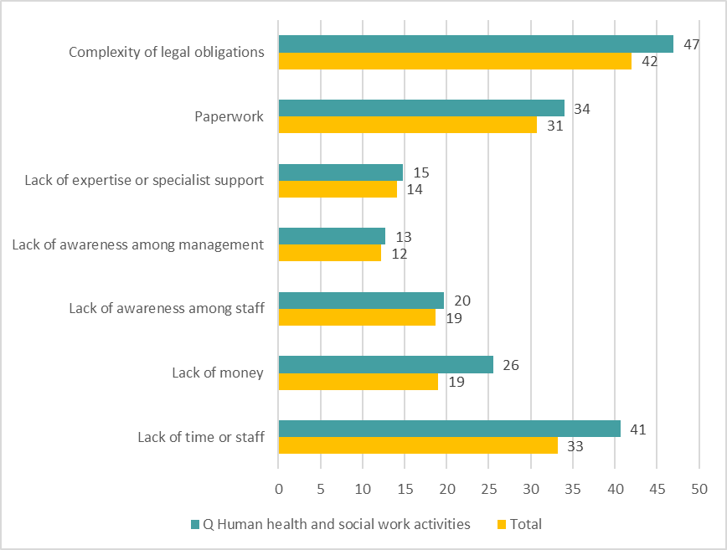
Difficulties for establishments to address health and safety by sector, EU-27, 2019 (% indicating major reason)
Source: Panteia based on ESENER-2019
Base: All establishments in the EU-27.

Slide 13
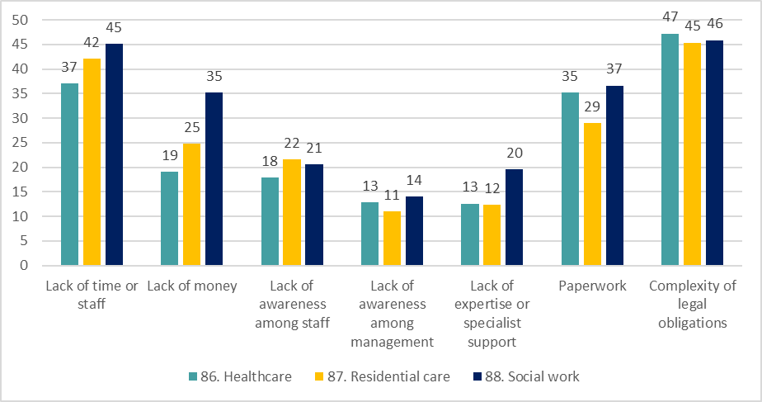
Difficulties for HeSCare sector establishments to address health and safety by subsector, EU-27, 2019 (% indicating major reason)
Source: Panteia based on ESENER-2019
Base: All HeSCare sector establishments in the EU-27.

Slide 14
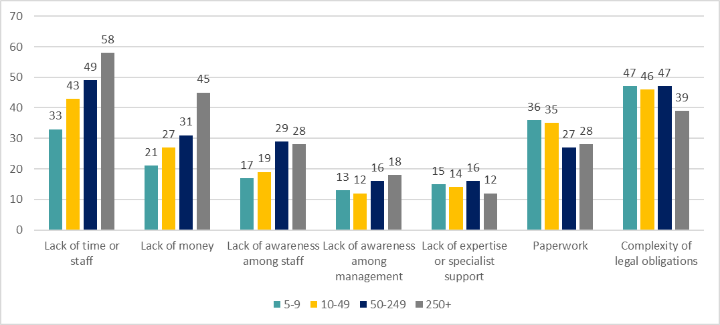
Difficulties for HeSCare sector establishments to address health and safety by size, EU-27, 2019 (% indicating major reason)
Source: Panteia based on ESENER-2019
Base: All HeSCare sector establishments in the EU-27.

Slide 15
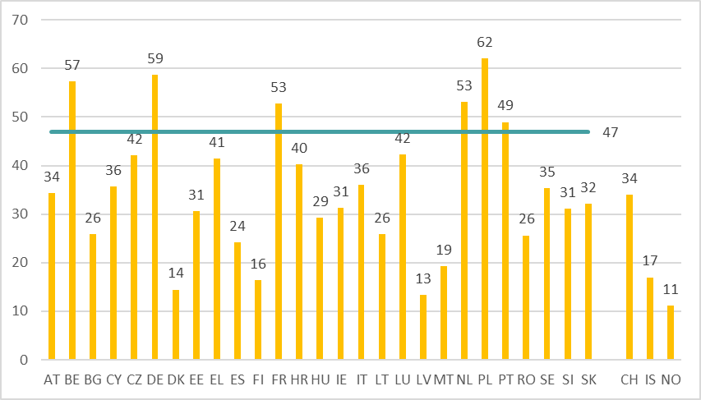
Percentage of HeSCare sector establishments indicating “complexity of legal obligations” as a major difficulty in addressing ealth and safety by country, EU-27 (+CH, IS and NO), 2019 (%)
Source: Panteia based on ESENER-2019
Base: All HeSCare sector establishments in the EU-27, Switzerland, Iceland and Norway.
The horizontal line indicates the HeSCare EU-27 average.

Slide 16
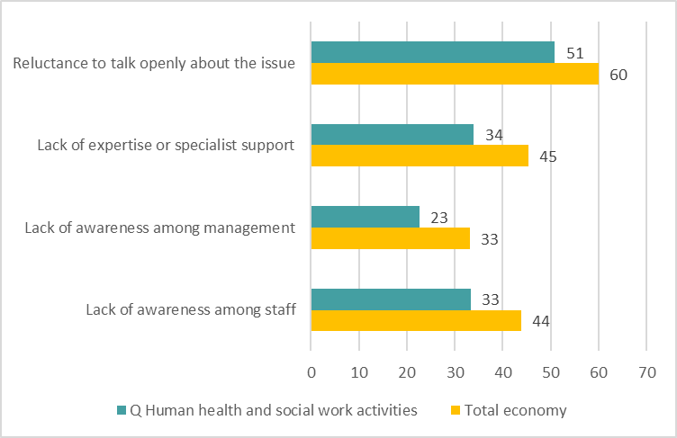
Main obstables to dealing with psychosocial risks in the establishments by sector, EU-27, 2019, (%)
Source: Panteia based on ESENER-2019
Base: Responses only of those establishments that have identified one or more psychosocial risk
and report that psychosocial risks are more difficult to address than other risks.

Slide 17
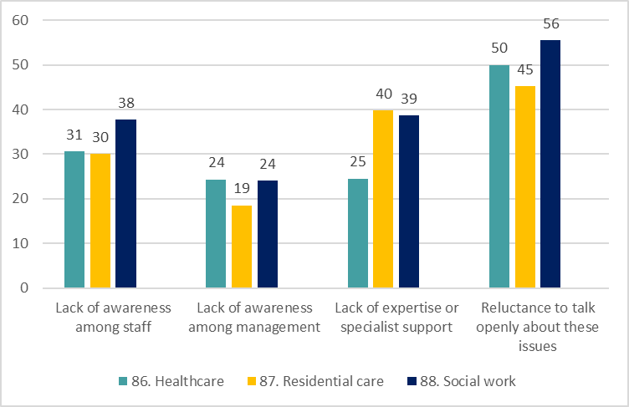
Main obstables to dealing with psychosocial risks in the establishments by subsector, EU-27, 2019, (%)
Source: Panteia based on ESENER-2019
Base: Responses only of those establishments that have identified one or more
psychosocial risks and report that psychosocial risks are more difficult
to address than other risks.

Slide 18
Percentage of EU-27 HesCare sector establishments reporting major reasons and difficulties related to addressing OSH in ESENER-14 and ESENER-19 (%)
 | 2014 | 2019
Reasons to address health and safety (reported as major reason):
..fulfilling legal obligation * | 88 | 90
..meeting expectations from employees * | 82 | 85
..increasing productivity * | 56 | 53
..organisation’s reputation | 78 | 76
..avoiding fines from the labour inspectorate | 72 | 74
Difficulties in addressing health and safety (reported as major difficulty):
..lack of time or staff * | 29 | 41
..lack of money * | 26 | 26
..lack of awareness among staff * | 19 | 20
..lack of awareness among management * | 13 | 13
..lack of expertise or specialist support | 13 | 15
..paperwork * | 31 | 34
..complexity of legal obligations * | 40 | 46
Source: Panteia based on ESENER-14 and ESENER-19
* Difference between 2014 and 2019 is statistically significant at the 0.05 level.

Slide 19
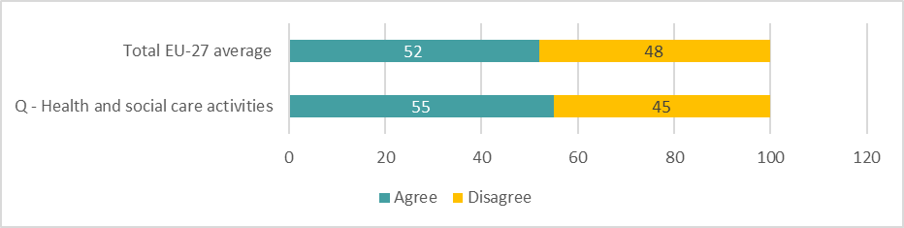
Percentage of workers indicating work stress has increased as a result of the COVID-19 pandemic, by sector, EU-27, 2022 (% agree / disagree)
Source: Panteia, based on ‘OSH Pulse 2022 – Occupational safety and health
in post-pandemic workplaces’
Base: All respondents

Slide 20
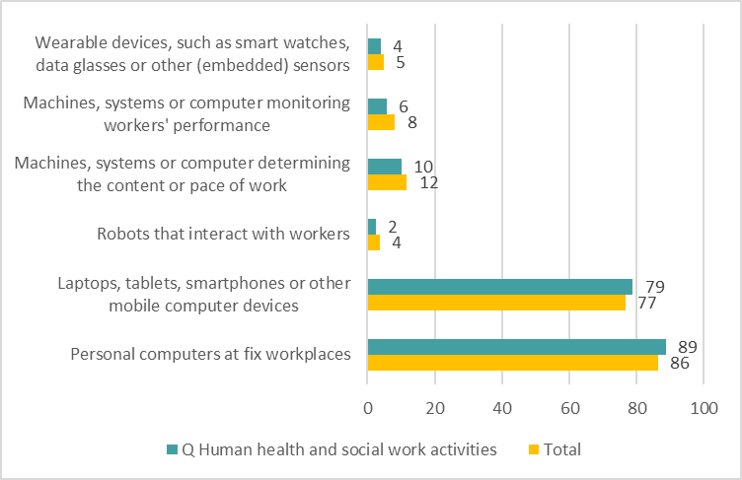
Percentages of establishments indicating they have used digital technologies for work, by sector, EU-27, 2019 (%)
Source: Panteia based on ESENER-2019
Base: Responses only of those establishments that have used digital technologies for work in the EU-27.

Slide 21
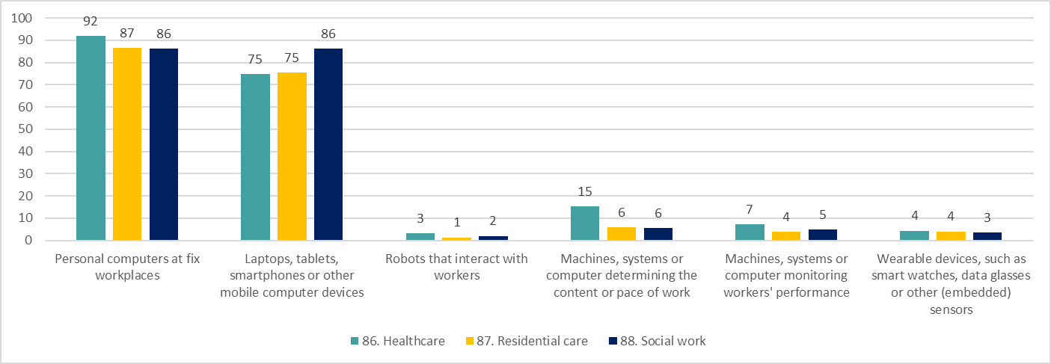
Percentages of HeSCare sector establishments indicating they have used digital technologies for work, by subsector, EU-27, 2019 (%)
Source: Panteia based on ESENER-2019
Base: Responses only of those HeSCare establishments that have used digital technologies for work in the EU-27.

Slide 22
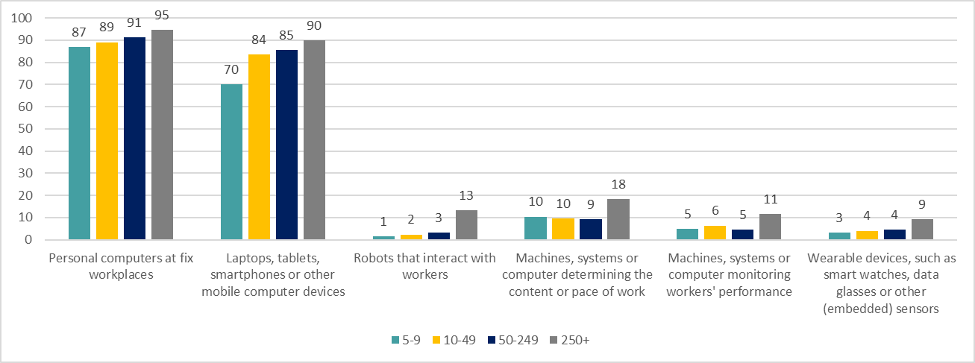
Percentages of HeSCare sector establishments indicating they have used digital technologies for work, by size, EU-27, 2019 (%)
Source: Panteia based on ESENER-2019
Base: Responses only of those HeSCare establishments that have used digital technologies for work in the EU-27.

Slide 23
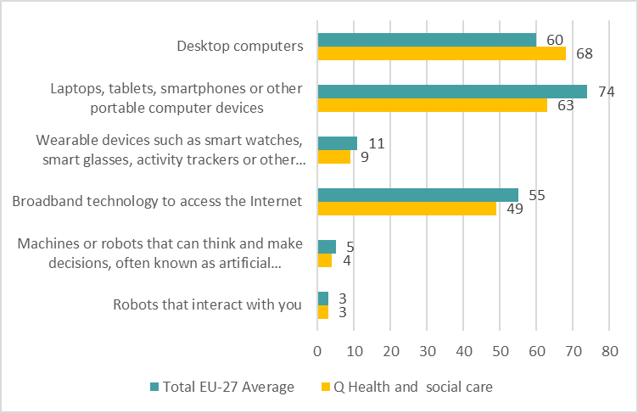
Percentage of workers indicating they use the following digital devices for the main job, EU-27, 2022 (%)
Source: Panteia, based on ‘OSH Pulse 2022 – Occupational safety and health
in post-pandemic workplaces’
Base: All respondents

Slide 24
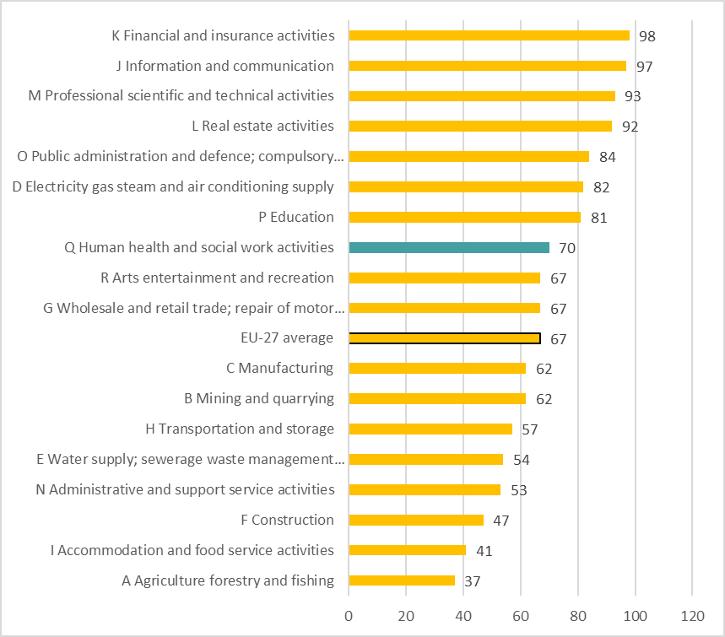
Percentage of workers performing often/always work with a computer, laptop, tablet or smartphone, by sector, EU-27, 2021 (%)
Source: TNO based on the EWCTS-2021
Base: All workers in the EU-27.

Slide 25
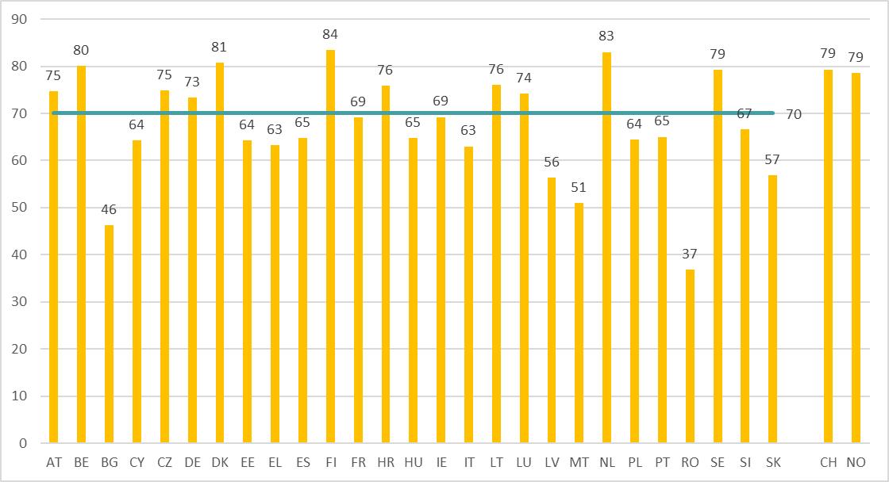
Percentage of HeSCare workers performing often/always work with a computer, laptop, tablet or smartphone, by country, EU-27 (+ CH and NO), 2021 (%)
Source: TNO based on the EWCTS-2021
Base: All workers in the EU-27.
The horizontal line indicates the EU-27 average.

Slide 26
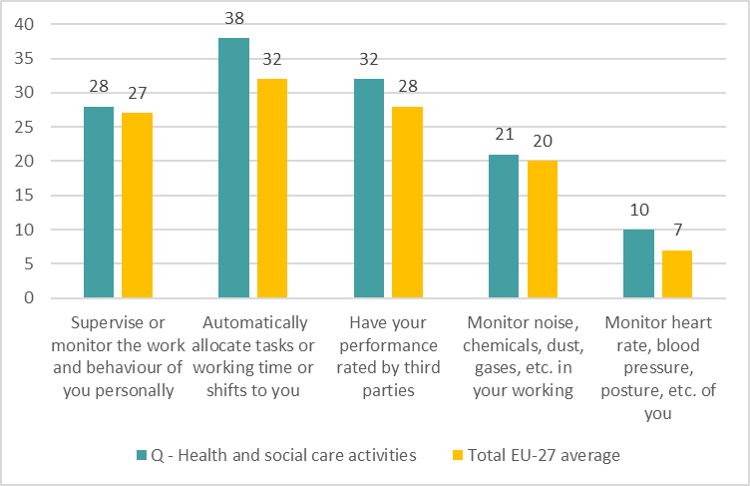
Percentage of workers indicating (to their knowledge) the use of the following digital devices by their organisations, by sector, EU-27, 2022 (%)
Source: Panteia, based on ‘OSH Pulse 2022 – Occupational safety and health
in post-pandemic workplaces’
Base: All respondents

Slide 27
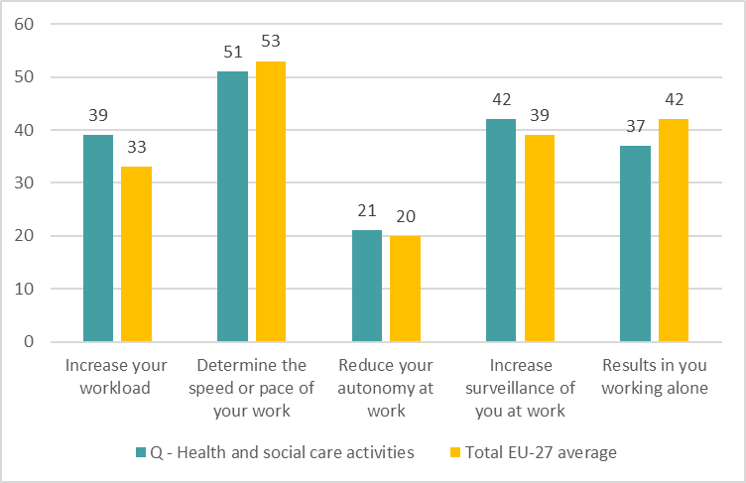
Main consequences identified by workers and derived from the use of digital devices at work, by sector, EU-27, 2022 (%)
Source: Panteia, based on ‘OSH Pulse 2022 – Occupational safety and health
in post-pandemic workplaces’
Base: All respondents

Slide 28
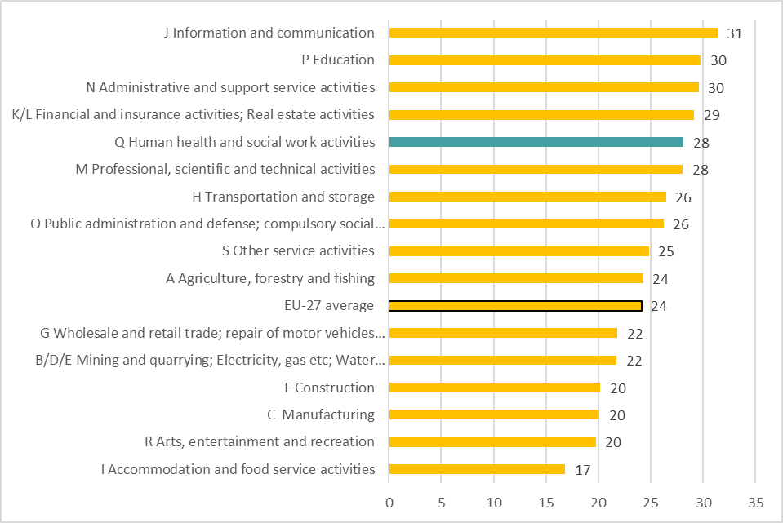
Percentage of establishments that have discussed the possible impacts of the use of digitalisation technologies on the health and safety of employees, by sector, EU-27, 2019 (%)
Source: Panteia based on ESENER-2019
Base: Responses only of those establishments that used digital technologies for work in the EU-27.

Slide 29
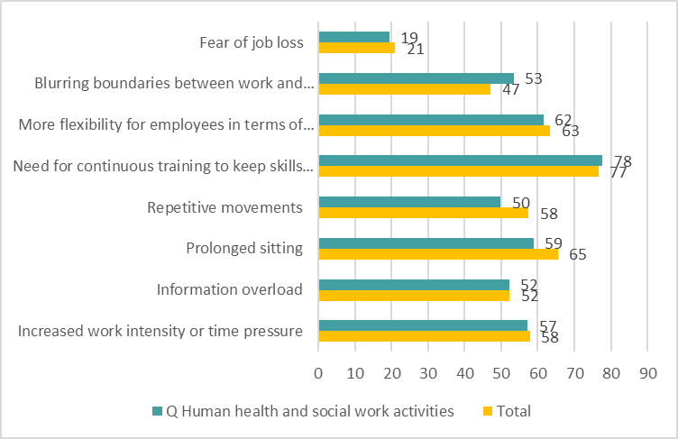
Possible impacts of digitalisation as indicated by establishments by sector, EU-27, 2019 (% indicating yes)
Source: Panteia based on ESENER-2019
Base: Responses only of those establishments that have used digital technologies for work and
have discussed the possible impacts of the use of such technologies on the health and safety
of employees in the EU-27.

Slide 30
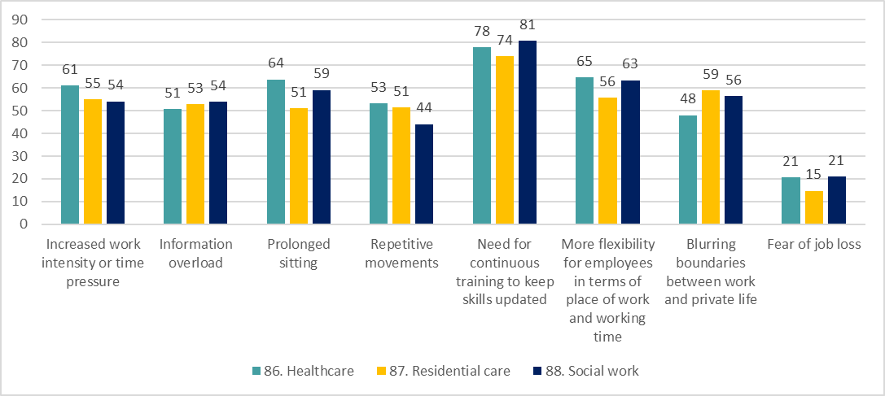
Impacts discussed in the context of use of digital technologies within HeSCare sector establishments, by subsector, EU-27, 2019 (%)
Source: Panteia based on ESENER-2019
Base: Responses only of those HeSCare establishments that have used digital technologies for work and
have discussed the possible impacts of the use of such technologies on the health and safety
of employees in the EU-27.

Slide 31
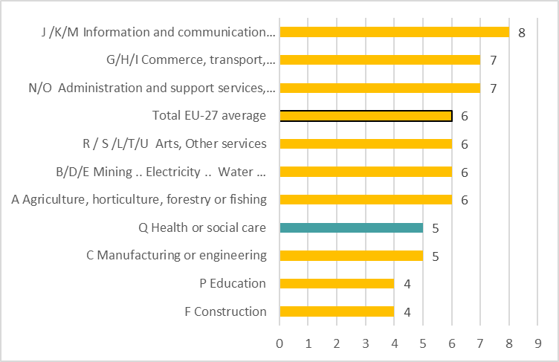
Percentage of individuals who earn most or at least part of their income working for a digital platform, by sector, EU-27, 2022 (%)
Source: Panteia, based on ‘OSH Pulse 2022 – Occupational safety and health in
post-pandemic workplaces’
Base: All respondents

Slide 32
Percentage of EU-27 HesCare sector establishments reporting presence of economic, social and organisational factors in ESENER-14 and ESENER-19 (%)
Source: Panteia based on ESENER-14 and ESENER-19

Slide 34
Authors: Paul Vroonhof, Martin Clarke, Jacqueline Snijders, Jan de Kok, Marijke Beulen (Panteia), Peter van Scheijndel, Pim van Dorst (vhp Human Performance), Iñigo Isusi, Jessica Duran (IKEI Research and Consultancy), Swenneke van den Heuvel (TNO).
Project management: Lorenzo Munar, Kate Palmer – European Agency for Safety and Health at Work (EU-OSHA).
Neither the European Agency for Safety and Health at Work nor any person acting on behalf of the Agency is responsible for the use that might be made of the following information.
© European Agency for Safety and Health at Work, 2024
Reproduction is authorised provided the source is acknowledged.
For any use or reproduction of photos or other material that is not under the copyright of the European Agency for Safety and Health at Work, permission must be sought directly from the copyright holders.

