Slide 1
Health and Social Care (HeSCare) sector - OSH in figures
Characterisation of the HeSCare sector
PPT 1

Slide 2
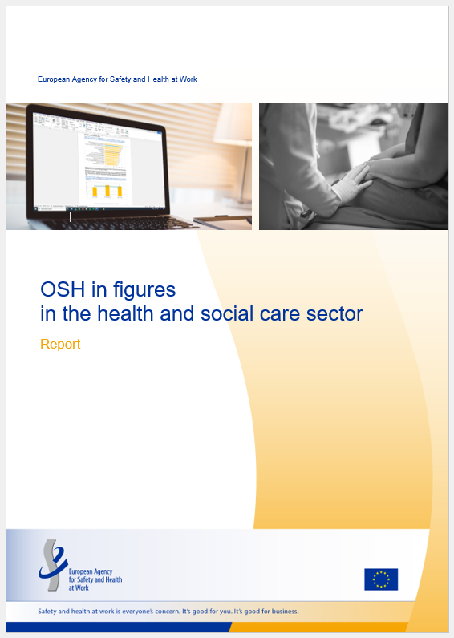
Introduction
This PPT is based on the following report:
  EU-OSHA, OSH in figures in the health and social care sector (Chapter 2), 2024.
  https://osha.europa.eu/en/publications/osh-figures-health-and-social-care-sector

Slide 3
Introduction: related PPTs
OSH risks in the HeSCare sector – PPT 2
https://osha.europa.eu/en/publications/osh-risks-health-and-social-care-sector
Work-related health outcomes in the HeSCare sector – PPT 3
  https://osha.europa.eu/en/publications/work-related-outcomes-health-and-social-care-sector
OSH management in the HeSCare sector – PPT 4
  https://osha.europa.eu/en/publications/osh-management-health-and-social-care-sector
Main drivers and barriers for OSH management in the HeSCare sector – PPT 5
  https://osha.europa.eu/en/publications/main-drivers-and-barriers-osh-management-health-and-social-care-sector
Worker participation in OSH management in the HeSCare sector – PPT 6
  https://osha.europa.eu/en/publications/worker-participation-osh-management-health-and-social-care-sector

Slide 4
Introduction: data sources / surveys
European Survey of Enterprises on New and Emerging Risks (ESENER)
European Working Conditions Telephone Survey (EWCTS)
EU Labour Force Survey (LFS)

Slide 5
Main subsectors comprising health and social care (HeSCare) activities
(NACE rev 2)
Source: Eurostat’s NACE classification
Notes:
The HeSCare sector is an important job generator in the EU economy. According to Eurostat Labour Force Survey statistics, in 2022, over 21,500,000 people were employed in the HeSCare sector (NACE Q). Most of these employees work in the healthcare subsector, with around 12.5 million employees. The residential care subsector is much smaller with around 4.1 million people employed. The social work subsector is also much smaller than the healthcare subsector, with around 5.1 million people working in this sector. As can be seen from the table below, the levels of employment in the HeSCare sector have been steadily increasing over the past 10 years, which can be seen across all subsectors. The HeSCare sector accounts for 11% of all employment across the total economy.

Slide 6
Employment in the HeSCare sector in the EU27
2013 – 2022 (thousand people)
Source: Panteia, based on information from Eurostat (EU Labour Force Survey)
Notes:
The HeSCare sector is an important job generator in the EU economy. According to Eurostat Labour Force Survey statistics, in 2022, over 21,500,000 people were employed in the HeSCare sector (NACE Q). Most of these employees work in the healthcare subsector, with around 12.5 million employees. The residential care subsector is much smaller with around 4.1 million people employed. The social work subsector is also much smaller than the healthcare subsector, with around 5.1 million people working in this sector. As can be seen from the table below, the levels of employment in the HeSCare sector have been steadily increasing over the past 10 years, which can be seen across all subsectors. The HeSCare sector accounts for 11% of all employment across the total economy.

Slide 7
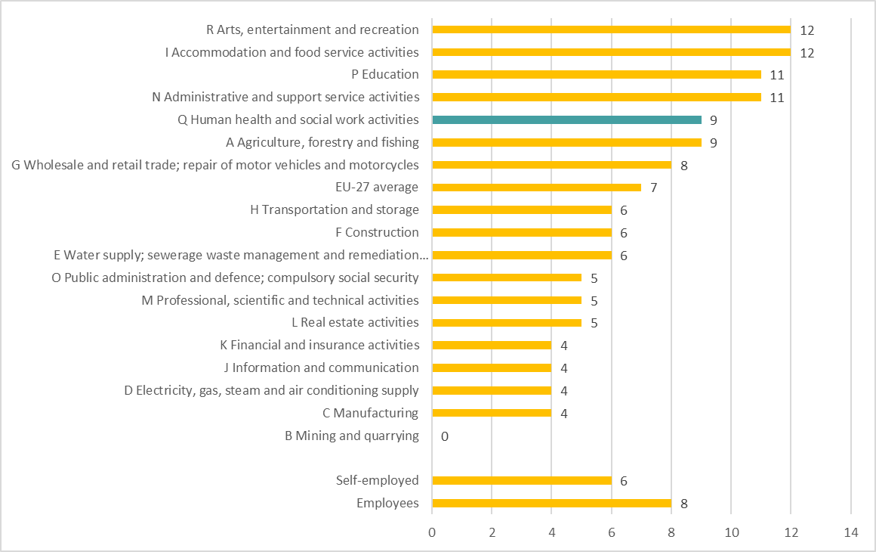
Percentage of workers with precarious employment conditions* by sector, EU-27, 2021 (%)
Source: TNO based on the EWCTS-2021
Base: All workers in the EU-27.
(*) Precariousness defined as: part-time or fixed-term job, and difficulty making ends meet
or multiple jobs.

Slide 8
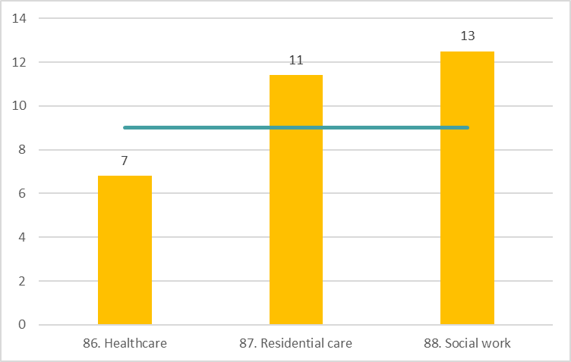
Percentage of HeSCare workers with precarious employment conditions* by subsector, EU-27, 2021 (%)
Source: TNO based on the EWCTS-2021
Base: All HeSCare sector workers in the EU-27.
(*) Precariousness defined as: part-time or fixed-term job, and difficulty making ends meet
or multiple jobs.
The horizontal line indicates the HeSCare (NACE Q) EU-27 average.

Slide 9
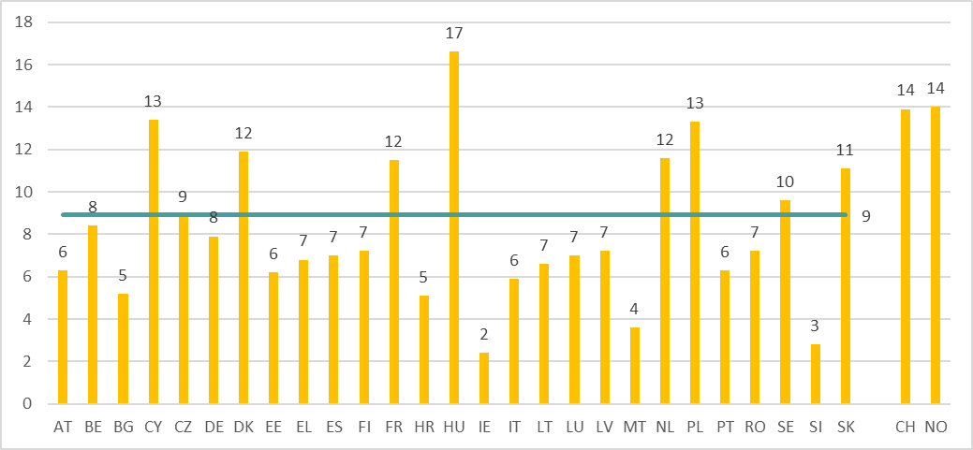
Percentage of HeSCare workers with precarious employment conditions* by country, EU-27 (+ CH and NO), 2021 (%)
Source: TNO based on the EWCTS-2021
Base: All HeSCare sector workers in the EU-27, Switzerland and Norway.
(*) Precariousness defined as: part-time or fixed-term job, and difficulty making ends meet or multiple jobs.
The horizontal line indicates the HeSCare (NACE Q) EU-27 average.

Slide 10
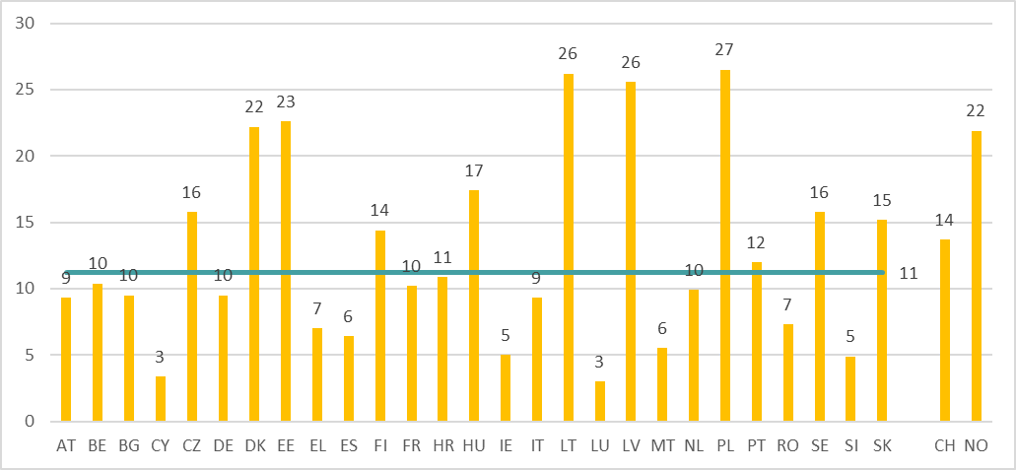
Percentage of HeSCare workers holding multiple jobs by country, EU-27 (+ CH and NO), 2021 (%)
Source: TNO based on the EWCTS-2021
Base: All HeSCare sector workers in the EU-27, Switzerland and Norway.
The horizontal line indicates the HeSCare (NACE Q) EU-27 average.

Slide 11
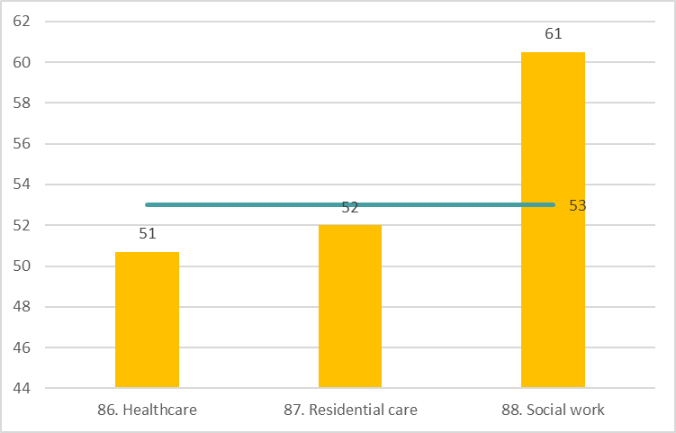
Percentage of HeSCare workers with few jobs prospects for career advancement, by subsector, EU-27, 2021 (%)
Source: TNO based on the EWCTS-2021
Base: All HeSCare workers in the EU-27.
The horizontal line indicates the HeSCare (NACE Q) EU-27 average.

Slide 12
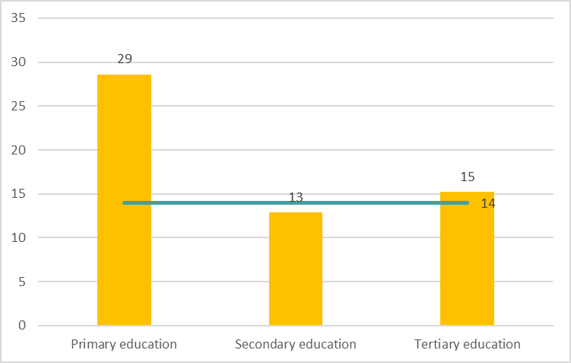
Percentage of HeSCare sector workers with little learning opportunities by education level, EU-27, 2021 (%)
Source: TNO based on the EWCTS-2021
Base: All HeSCare workers in the EU-27.
The horizontal line indicates the HeSCare (NACE Q) EU-27 average.

Slide 13
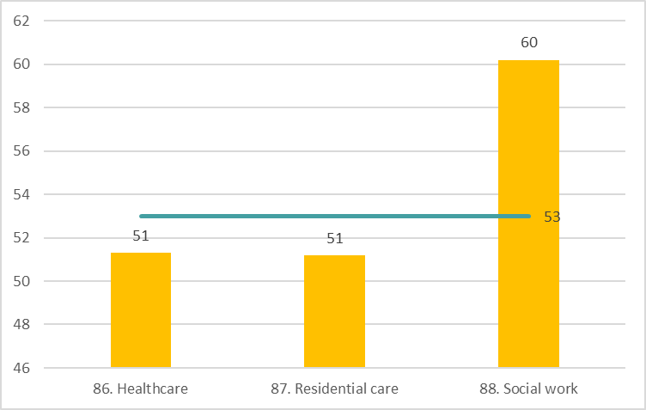
Percentage of HeSCare sector workers that received no training paid for or provided by employer over past 12 months, by subsector, EU-27, 2021 (%)
Source: TNO based on the EWCTS-2021
Base: All HeSCare workers in the EU-27.
The horizontal line indicates the HeSCare (NACE Q) EU-27 average.

Slide 14
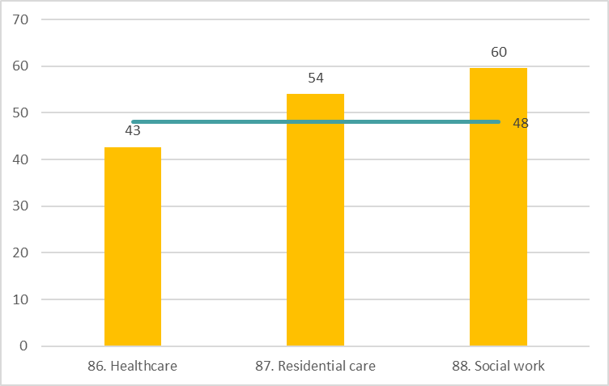
Percentage of HeSCare workers that received non “on-the-job training”
(co-workers, supervisors) over past 12 months, by subsector, EU-27, 2021 (%)
Source: TNO based on the EWCTS-2021
Base: All HeSCare workers in the EU-27.
The horizontal line indicates the HeSCare (NACE Q) EU-27 average.

Slide 15
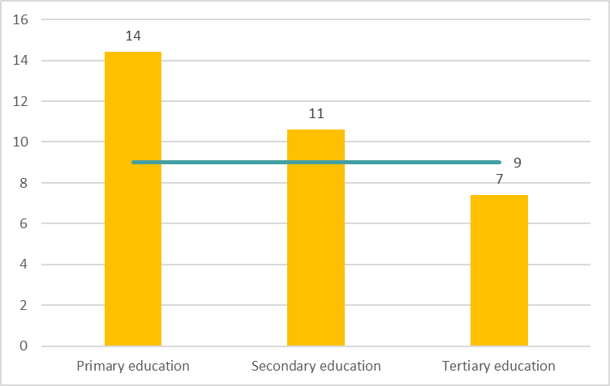
Percentage of HeSCare workers with precarious employment conditions* by education level, EU-27, 2021 (%)
Source: TNO based on the EWCTS-2021
Base: All HeSCare workers in the EU-27.
(*) Precariousness defined as: parttime or fixed-term job, and difficulty making ends meet or multiple jobs.
The horizontal line indicates the HeSCare (NACE Q) EU-27 average.

Slide 16
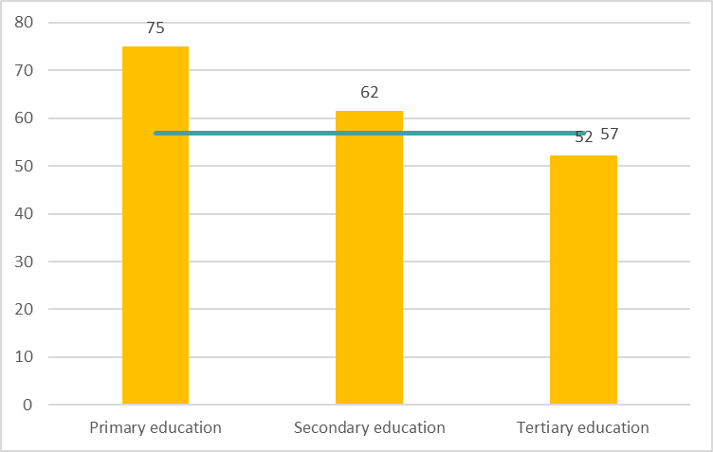
Mean scores of HeSCare workers with low task autonomy* by education level, EU-27, 2021 (%)
Source: TNO based on the EWCTS-2021
Base: All HeSCare workers in the EU-27.
(*) Deciding never/rarely/sometimes yourself on 'order of tasks'; 'methods'; 'speed or rate of work'.
The horizontal line indicates the HeSCare (NACE Q) EU-27 average.

Slide 17
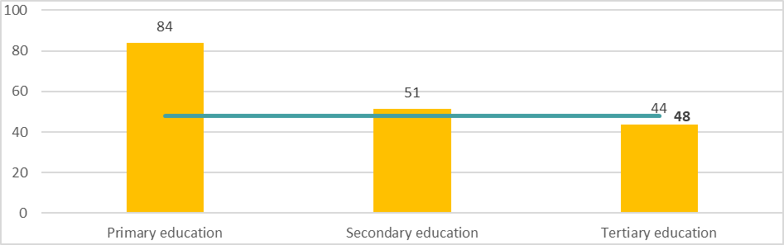
Mean scores of HeSCare workers with low organisational participation* by education level, EU-27, 2021 (%)
Source: TNO based on the EWCTS-2021
Base: All HeSCare workers in the EU-27.
(*) Never/rarely/sometimes 'can influence decisions'; 'consulted about objectives'; 'involved in improving work organisation/processes'.
The horizontal line indicates the HeSCare (NACE Q) EU-27 average.

Slide 18
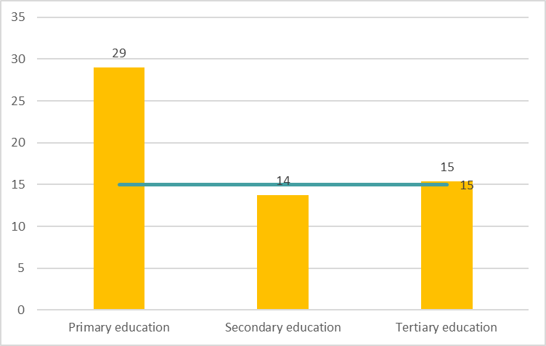
Percentage of HeSCare workers that have been discriminated at work over past 12 months at work, by education level, EU-27, 2021 (%)
Source: TNO based on the EWCTS-2021
Base: All HeSCare workers in the EU-27.
The horizontal line indicates the HeSCare (NACE Q) EU-27 average

Slide 19
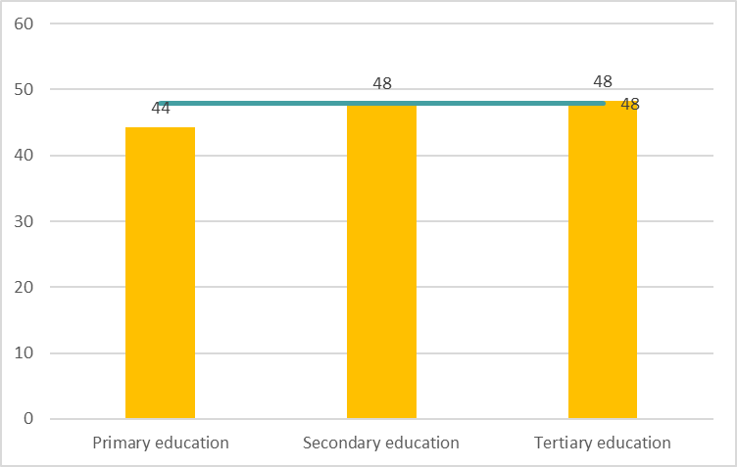
Percentage of HeSCare workers reporting that their health and safety is at risk because of work, by education level, EU-27, 2021 (%)
Source: TNO based on the EWCTS-2021
Base: All HeSCare workers in the EU-27.
The horizontal line indicates the HeSCare (NACE Q) EU-27 average.

Slide 20
Characteristics of the HeSCare employment (NACE Q) and total economy
EU-27 (%)
Sources: Eurostat (2022) (Temporary employment and part-time work, year 2022),
Special Eurobarometer 498: Undeclared work in the European Union (2019) (Undeclared work)

Slide 21
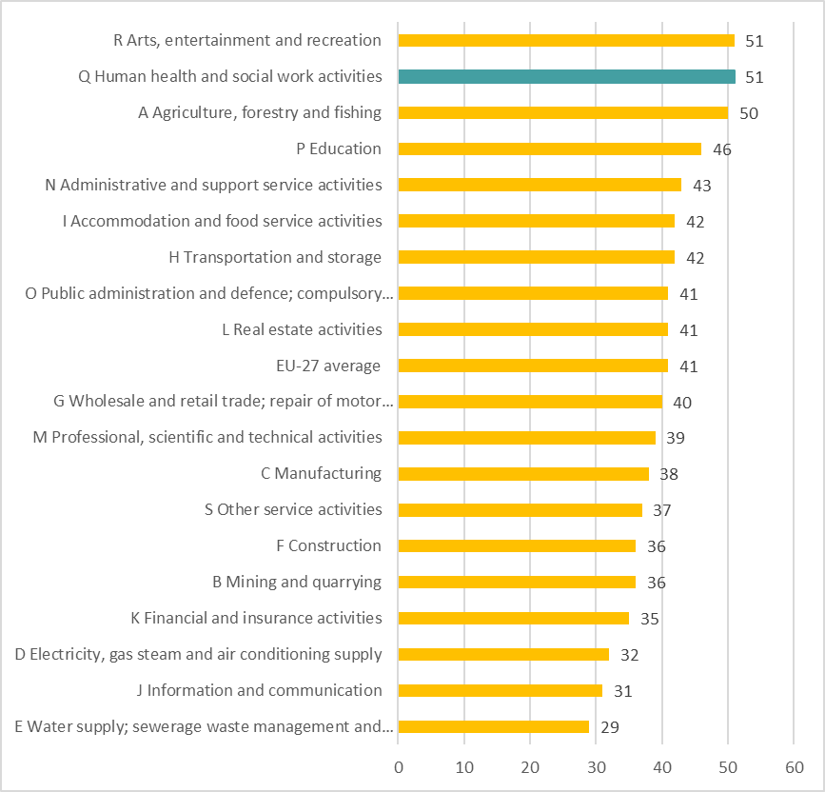
Percentage of workers experiencing low payments for achievements; effort-reward imbalance, by sector, EU-27, 2021 (%)
Source: TNO based on the EWCTS-2021
Base: All workers in the EU-27.

Slide 22
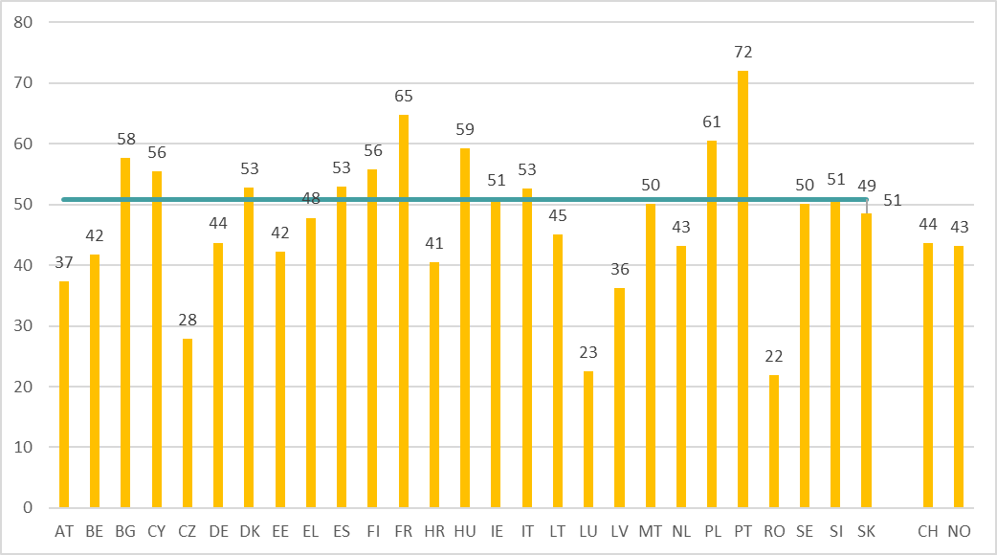
Percentage of HeSCare workers experiencing low payments for achievements; effort-reward imbalance, by country, EU-27 (+ CH and NO), 2021 (%)
Source: TNO based on the EWCTS-2021
Base: All HeSCare workers in the EU-27, Switzerland and Norway.
The horizontal line indicates the HeSCare (NACE Q) EU-27 average.

Slide 23
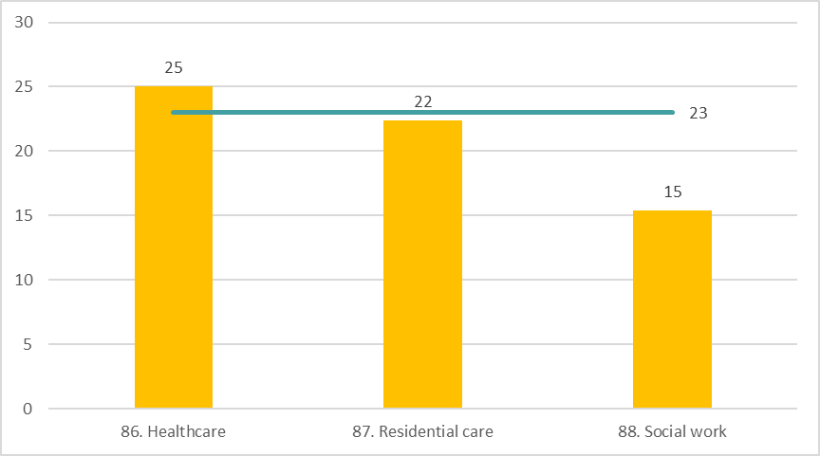
Percentage of HeSCare workers reporting a “not very well/not at all well” work-life balance, by subsector, EU-27, 2021 (%)
Source: TNO based on the EWCTS-2021
Base: All HeSCare workers in the EU-27.
The horizontal line indicates the HeSCare (NACE Q) EU-27 average.

Slide 24
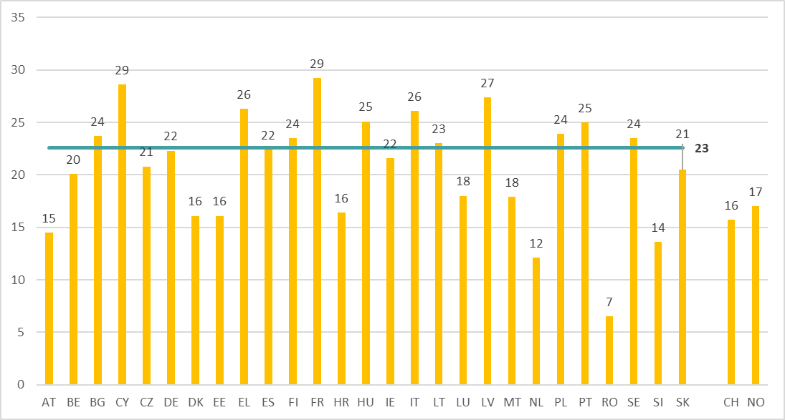
Percentage of HeSCare workers reporting a “not very well/not at all well” work-life balance, by country, EU-27 (+ CH and NO), 2021 (%)
Source: TNO based on the EWCTS-2021
Base: All HeSCare workers in the EU-27, Switzerland and Norway.
The horizontal line indicates the HeSCare (NACE Q) EU-27 average.

Slide 25
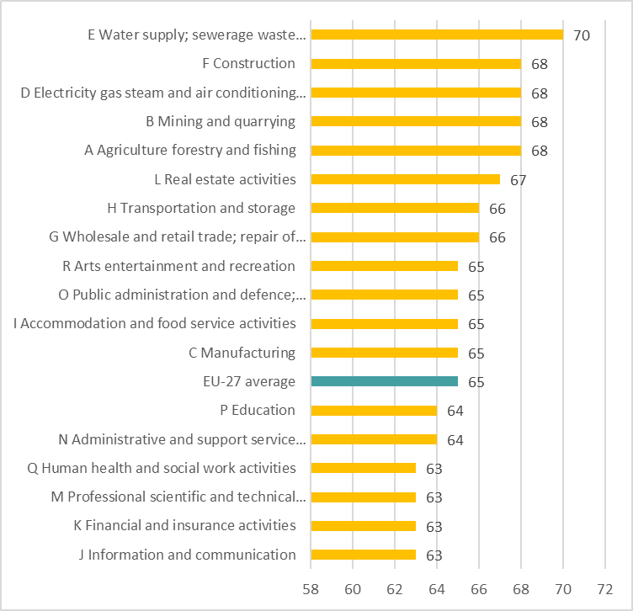
Workers’ mean scores on the WHO-5 Well-Being Index* by sector, EU-27, 2021 (%)
Source: TNO based on the EWCTS-2021
Base: All workers in the EU-27.
(*) 0=worst imaginable well-being – 100=most imaginable well-being; 5-item scale.
Notes:
The 5 questions in the well-being index are: (1) 'I have felt cheerful and in good spirits', (2) 'I have felt calm and relaxed', (3) 'I have felt active and vigorous', (4) 'I woke up feeling fresh and rested' and (5) 'My daily life has been filled with things that interest me'.

Slide 26
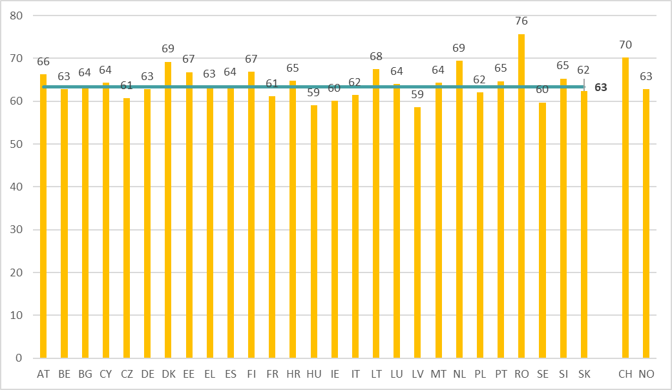
HeSCare workers’ mean scores on the WHO-5 Well-Being Index* by country, EU-27, 2021 (%)
Source: TNO based on the EWCTS-2021
Source: TNO based on the EWCTS-2021
Base: All HeSCare workers in the EU-27, Switzerland and Norway.
(*) 0=worst imaginable well-being – 100=most imaginable well-being; 5-item scale.
The horizontal line indicates the HeSCare (NACE Q) EU-27 average.
Notes:
The 5 questions in the well-being index are: (1) 'I have felt cheerful and in good spirits', (2) 'I have felt calm and relaxed', (3) 'I have felt active and vigorous', (4) 'I woke up feeling fresh and rested' and (5) 'My daily life has been filled with things that interest me'.

Slide 27
Share of women in employment, HeSCare sector and subsectors versus all the sectors, EU-27 economy, 2022 (%)
Source: Panteia based on Eurostat, EU Labour Force Survey, 2022
Notes:
The 5 questions in the well-being index are: (1) 'I have felt cheerful and in good spirits', (2) 'I have felt calm and relaxed', (3) 'I have felt active and vigorous', (4) 'I woke up feeling fresh and rested' and (5) 'My daily life has been filled with things that interest me'.

Slide 28
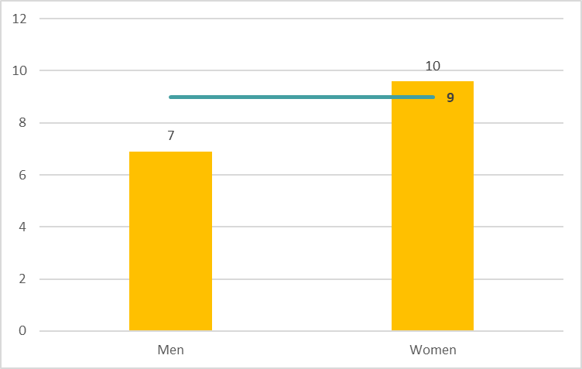
Percentage of workers with precarious employment conditions (*) in the HeSCare sector, by gender, EU-27, 2021 (%)
Source: TNO based on the EWCTS-2021
Base: All HeSCare workers in the EU-27.
(*) Precariousness defined as: parttime or fixed-term job, and difficulty making ends meet or multiple jobs.
The horizontal line indicates the HeSCare (NACE Q) EU-27 average.

Slide 29
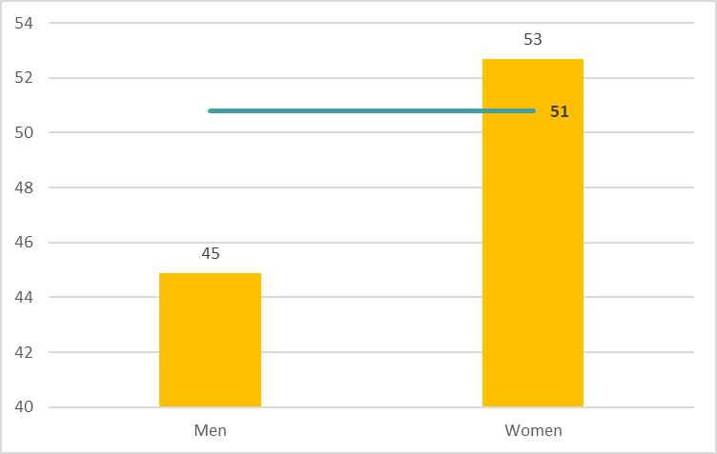
Percentage of HeSCare workers experiencing low payment for achievements; effort-reward imbalance, by gender, EU-27, 2021 (%)
Source: TNO based on the EWCTS-2021
Base: All HeSCare workers in the EU-27.
The horizontal line indicates the HeSCare (NACE Q) EU-27 average.

Slide 30
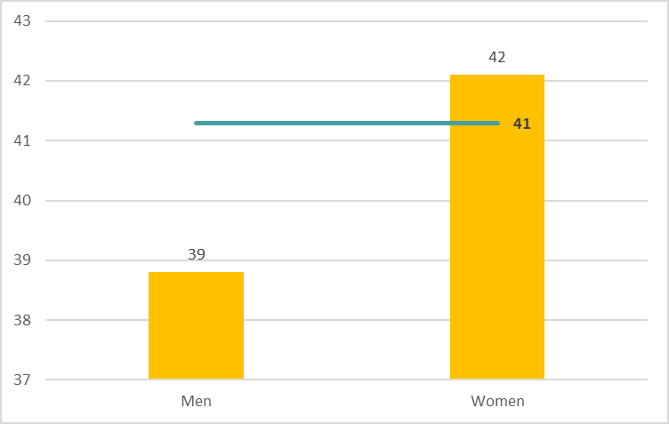
Mean scores of HeSCare workers on high work intensity* by gender, EU-27, 2021 (%)
Source: TNO based on the EWCTS-2021
Base: All HeSCare workers in the EU-27.
(*) Working often/always ‘at very high speed’; ‘to tight deadlines’.
The horizontal line indicates the HeSCare (NACE Q) EU-27 average

Slide 31
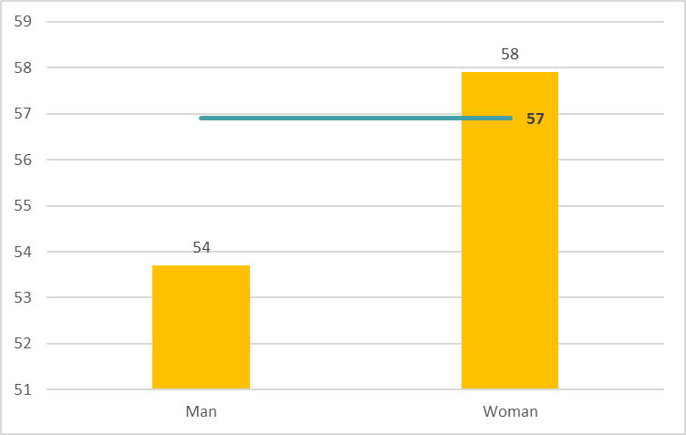
Mean scores of HeSCare workers on low task autonomy* by gender, EU-27, 2021 (%)
Source: TNO based on the EWCTS-2021
Base: All HeSCare workers in the EU-27.
(*) Deciding never/rarely/sometimes yourself on ‘order of tasks’; ‘methods’; ‘speed or rate of work’.
The horizontal line indicates the HeSCare (NACE Q) EU-27 average.

Slide 32

Mean scores of HeSCare workers on organisational participation* by gender, EU-27, 2021 (%)
Source: TNO based on the EWCTS-2021
Base: All HeSCare workers in the EU-27.
(*) Never/rarely/sometimes ‘can influence decisions’; ‘consulted about objectives’; ‘involved in improving work organisation/processes’.
The horizontal line indicates the HeSCare (NACE Q) EU-27 average.

Slide 33
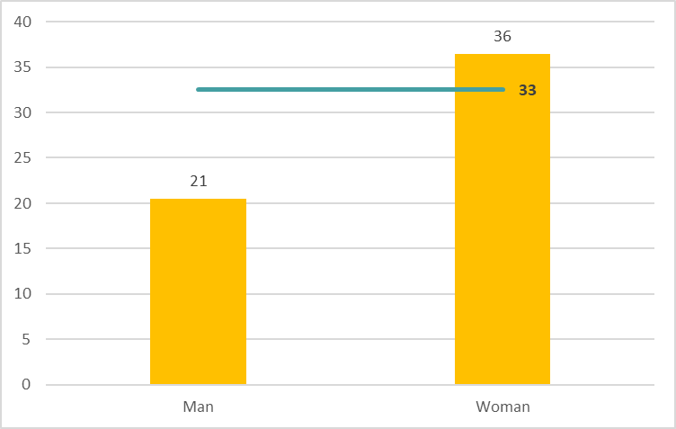
Percentage of part-time in the HeSCare sector (less than 35 hours per week) by gender, EU-27, 2021 (%)
Source: TNO based on the EWCTS-2021
Base: All HeSCare workers in the EU-27.
The horizontal line indicates the HeSCare (NACE Q) EU-27 average.

Slide 34
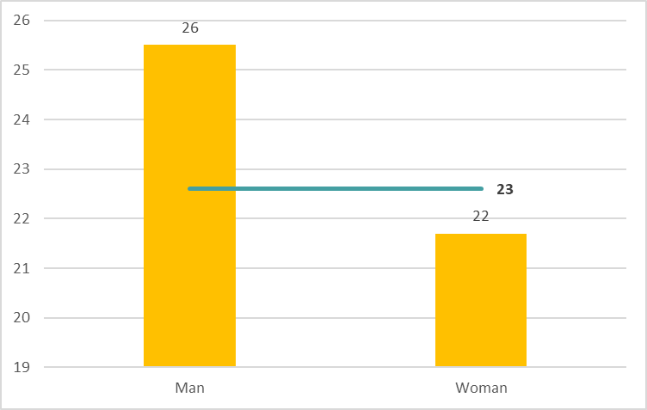
Percentage of HeSCare workers reporting a “not very well/not at all well” work-life balance, by gender, EU-27, 2021 (%)
Source: TNO based on the EWCTS-2021
Base: All HeSCare workers in the EU-27.
The horizontal line indicates the HeSCare (NACE Q) EU-27 average.

Slide 35
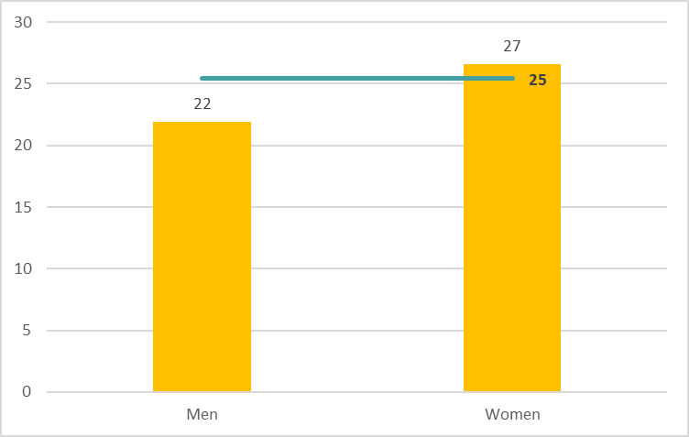
Percentage of HeSCare workers experiencing some/great difficulty to make ends meet financially, by gender, EU-27, 2021 (%)
Source: TNO based on the EWCTS-2021
Base: All HeSCare workers in the EU-27.
The horizontal line indicates the HeSCare (NACE Q) EU-27 average.

Slide 36
Age structure in employment, HeSCare sector and subsectors versus all the sectors, EU-27, 2022 (%)
Source: Eurostat, EU Labour Force Survey, 2022

Slide 37
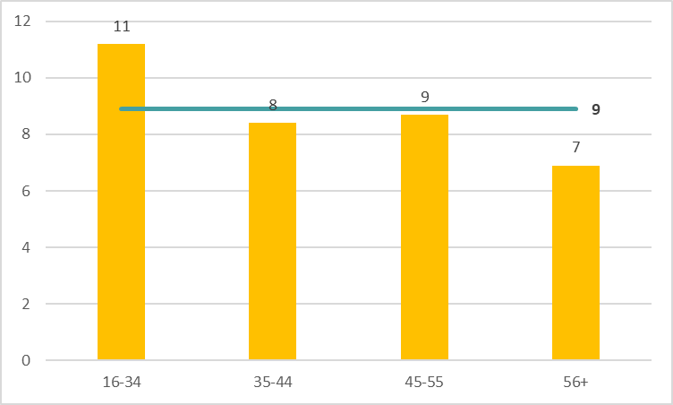
Percentage of HeSCare workers with precarious employment conditions* by age, EU-27, 2021 (%)
Source: TNO based on the EWCTS-2021
Base: All HeSCare workers in the EU-27.
(*) Precariousness defined as: parttime or fixed-term job, and difficulty making ends meet or multiple jobs.
The horizontal line indicates the HeSCare (NACE Q) EU-27 average.

Slide 38
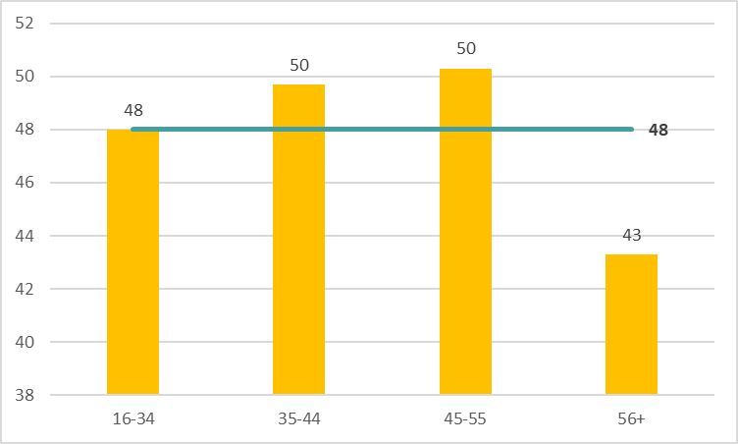
Percentage of HeSCare workers reporting that their health or safety is at risk because of work, by age, EU-27, 2021 (%)
Source: TNO based on the EWCTS-2021
Base: All HeSCare workers in the EU-27.
The horizontal line indicates the HeSCare (NACE Q) EU-27 average.

Slide 40
Authors: Paul Vroonhof, Martin Clarke, Jacqueline Snijders, Jan de Kok, Marijke Beulen (Panteia), Peter van Scheijndel, Pim van Dorst (vhp Human Performance), Iñigo Isusi, Jessica Duran (IKEI Research and Consultancy), Swenneke van den Heuvel (TNO).
Project management: Lorenzo Munar, Kate Palmer – European Agency for Safety and Health at Work (EU-OSHA).
Neither the European Agency for Safety and Health at Work nor any person acting on behalf of the Agency is responsible for the use that might be made of the following information.
© European Agency for Safety and Health at Work, 2024
Reproduction is authorised provided the source is acknowledged.
For any use or reproduction of photos or other material that is not under the copyright of the European Agency for Safety and Health at Work, permission must be sought directly from the copyright holders.

