Slide 1
Alert and sentinel approaches for the identification of work-related diseases in the EU
Presentation for expert audience
Authors: Jelena Bakusic, Annet Lenderink, Charlotte Lambreghts, Sofie Vandenbroeck, Jos Verbeek, Stefania Curti, Stefano Mattioli, Lode Godderis

Slide 2
INTRODUCTION
Continuous changes in work and working conditions may lead to new/emerging work-related diseases (WRDs)
A ‘new occupational safety and health risk’ defined by EU-OSHA as any occupational risk that:
Was previously unknown and is caused by new processes, new technologies, new types of workplaces, or social organisational change; or
Is a long-standing issue that is newly considered a risk as a result of a change in social or public perceptions; or
Is a longstanding issue that new scientific knowledge allows to be identified as a risk.

Slide 3
WHAT ARE ALERT AND SENTINEL SYSTEMS?
Additional instruments to those already used for monitoring known occupational diseases (ODs)
Early warning systems with a comprehensive approach for signal management: detecting, strengthening and alerting of new WRDs
Provide tools to detect events and the output
Discern an event from background information
Support decision-making and strengthen the signal
Generate signal to different stakeholders
SENSORS
EVENT DETECTION
DECISION SUPPORT
MESSAGE - BROKER

Slide 4
OBJECTIVES OF THE PROJECT
Provide more insight into alert and sentinel approaches to identify emerging health problems at work and WRDs
Provide recommendations for policy-makers and OSH actors to implement alert and sentinel approaches for prevention of WRDs
Beneficiaries of the results of this project include:
Policy-makers at national and EU levels
Social partners
Researchers
Actors in occupational disease recognition, workers’ compensation schemes and statistical data collection

Slide 5





OVERVIEW OF THE PROJECT
Task 1.
Literature review
Task 2.
In-depth description of 12 selected systems through interviews and qualitative analysis
Task 3.
Seminar to discuss outcomes of tasks 1 and 2
Task 4.
Final report including analysis and recommendations
Task 5.
Workshop to disseminate findings to stakeholders

Slide 6
METHODOLOGY OF THE LITERATURE REVIEW
Scientific literature
Databases:
MEDLINE (PUBMED)
Embase
Web of Science
Grey literature
Databases: OpenGrey,
OSH-update
Existing data from 3 surveys
Websites
Contact authors to retrieve the missing information

Slide 7
METHODOLOGY OF THE LITERATURE REVIEW
Data extraction:
General information: country, organisation/institution maintaining the system, website
Aim of data collection, coverage
Reporting mechanism
Evaluation of work-relatedness, follow-up
Dissemination, link with prevention

Slide 8
METHODOLOGY OF THE IN-DEPTH STUDY
6 systems described through in-depth desk research:
6 systems described through interviews with stakeholders:
Information describing the development, outline and results of the systems was gathered from websites, grey literature and scientific publications
Owner of the sentinel or alert system
Workplace actor who reports to the system
Researcher or other stakeholder using the system for monitoring, OD recognition or workplace prevention

Slide 9

Expert workshop to discuss outcomes of the literature review and the in-depth description of systems
Held in Brussels on 18 May 2017
The workshop gathered systems’ owners and users, researchers and actors in the disease recognition area
Objective: to gain more insight on the drivers and obstacles to the implementation of alert and sentinel systems with a view to improving the identification of WRDs and timely evidence-based prevention
The morning session: presentation of findings derived from the literature review and the in-depth description of systems
The afternoon session: discussions in small groups
Image source: http://freecliparty.com/free-image-clip-art/358524/general-meeting-clipart-images-urda6gb-image-clip-art

Slide 10
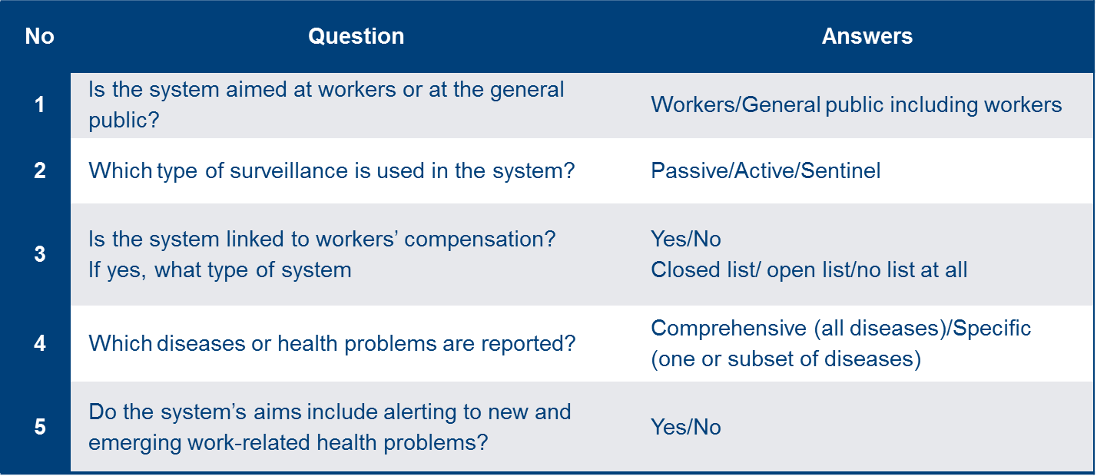
RESULTS
75 systems identified from EU countries, as well as outside Europe (USA, Canada, Australia, Singapore, Taiwan etc.)
Algorithm - typology

Slide 11
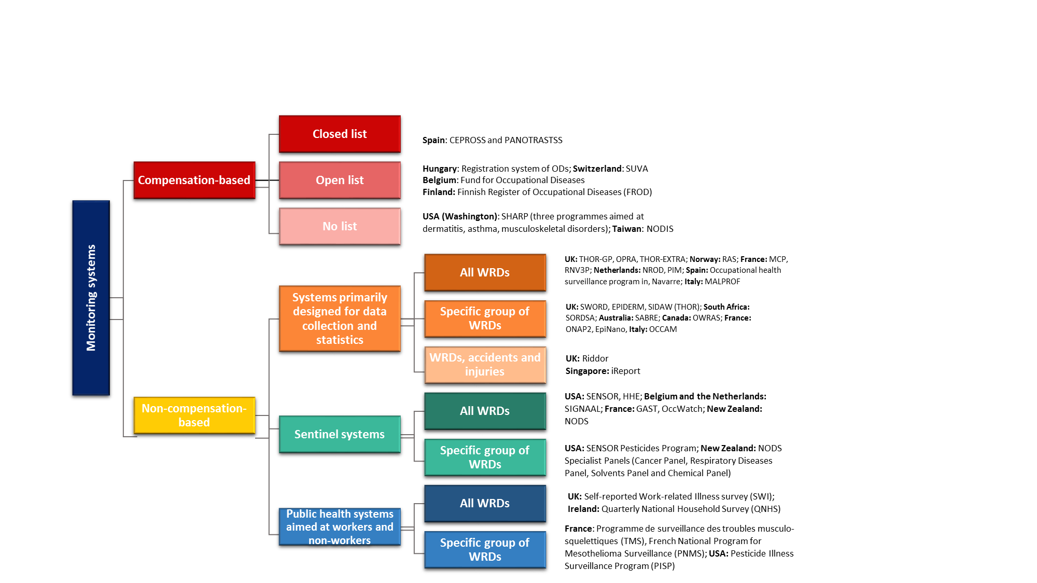
RESULTS

Slide 12
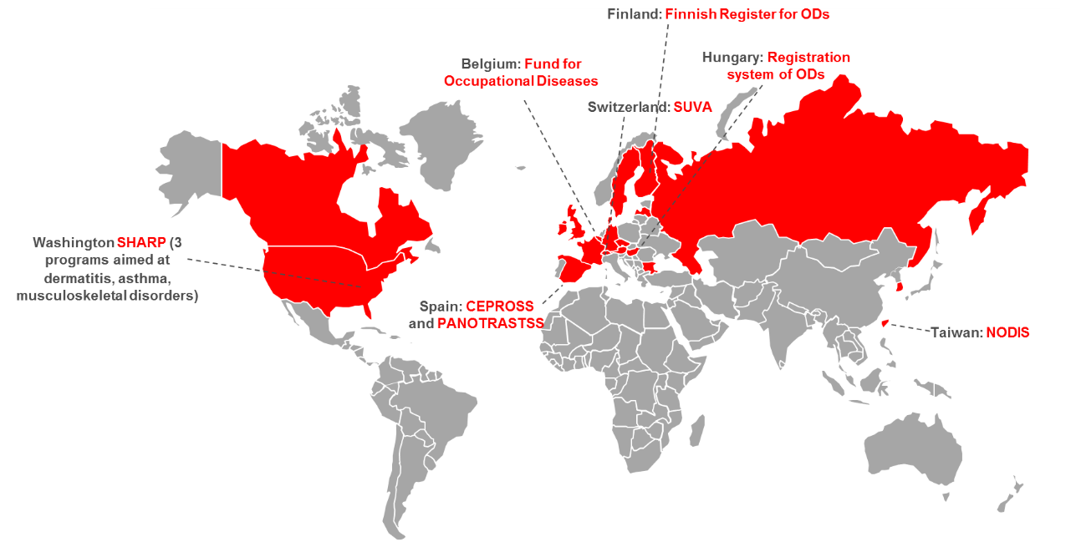
Compensation-based systems

Slide 13
Compensation-based systems
Collect data for compensation purposes reporting is driven by insurance and mostly mandatory by law
Cases are mainly reported by physicians; some systems also allow employees, employers, trade union delegates, etc., to make a claim
Conditions for capturing new WRDs:
Swiss SUVA and Taiwanese NODIS: additional data set for WRDs that will not be compensated independence from compensation in terms of reporting and possibility of implementing preventive actions regardless of compensation
Closed list / open list / no list
Independence from compensation in terms of reporting

Slide 14
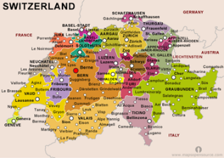
Swiss National Accident Insurance Fund SUVA (Switzerland)
Initially directed towards occupational accidents, ODs gradually introduced
Created to provide insurance to workers
Over time expanded to include preventive workplace activities and
publication of national OSH statistical data
Reporting based on voluntary participation of all types of physicians
Data mainly from two sources: compensation claims and medical examinations (screening) of workers
Work-relatedness evaluation is performed by SUVA’s occupational health (OH) experts
Possible to include detailed workplace inspections with exposure assessments
Even though the criteria for recognising an OD and its compensation are strict, preventive actions triggered by a reported case are implemented regardless of fulfilment of these criteria
Strong point: direct link between the collected data and prevention aimed at individual workers at their workplace, or at specific groups of workers at high risk
Image source: https://tse4.mm.bing.net/th?id=OIP.X_xACz880V2y3UnM_yTnNAHaFP

Slide 15
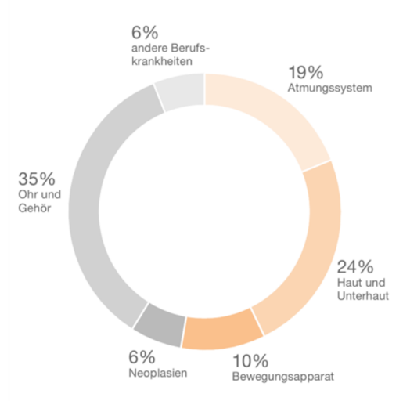
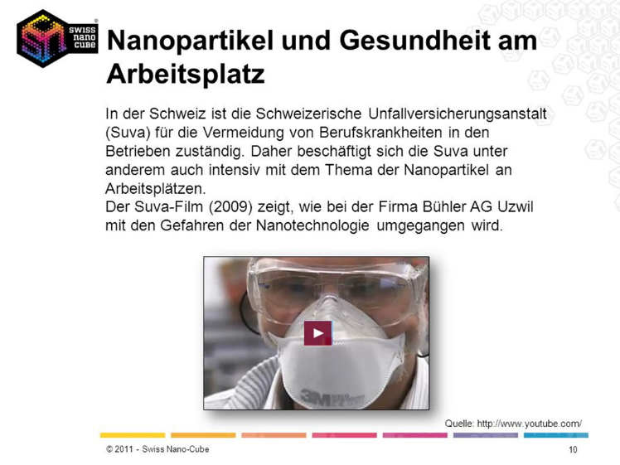
SUVA (Switzerland)
Total number of occupational disease in 2014: 2,152
Source: SSUV Unfallstatistik 2016
Data source: http://www.swissnanocube.ch/sicherheit-risiko/nano-sicherheit/nano-am-arbeitsplatz/

Slide 16
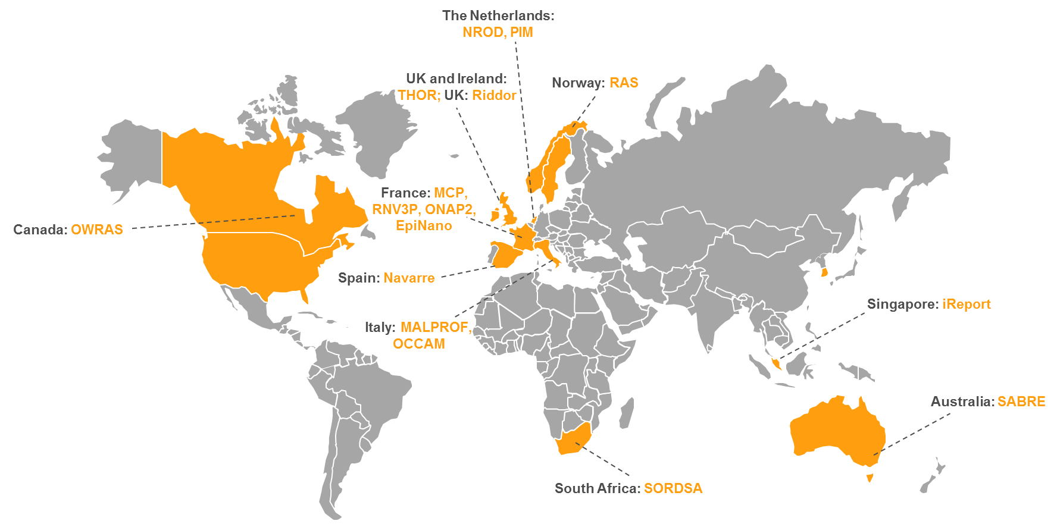
Systems for data collection and statistics

Slide 17
Systems for data collection and statistics
Aim: data collection and analysis to measure incidences and trends in OSH
Based on voluntary participation of physicians
Disease-specific systems:
Final decision made by reporter versus work-relatedness evaluation by experts
Scarce exposure assessment
Prevention implemented at a wider level, in communication with governing bodies (statistical input for national preventive strategies and policies)
  respiratory diseases
  skin diseases
  occupational cancer
  infectious diseases
  WRDs related to nanomaterials exposure
!
Motivation of reporters

Slide 18
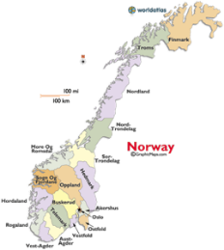
Register for Arbeidsrelaterte Sykdommer (RAS)
Norwegian national registry run by the Norwegian Labour Inspectorate (NLI)
Non-compensation-related system, developed for sentinel surveillance
Main purpose: data collection and analysis for all WRDs
Suitable for sentinel surveillance: reports signal to the NLI for workplace interventions and prevention of hazardous exposures
Covers all sectors including SMEs, except offshore petroleum, aviation and marine sector
All physicians can report cases they suspect of being work-related and advise further investigation; participation rate is low (3-5%)
Final decision on work-relatedness is made by occupational physicians from the NLI
Reporter gets feedback
NLI can take appropriate preventive and remedial action based on reported cases
Image source: https://thompsonholmberg.files.wordpress.com/2017/06/map-norway-jpg.png?w=640

Slide 19
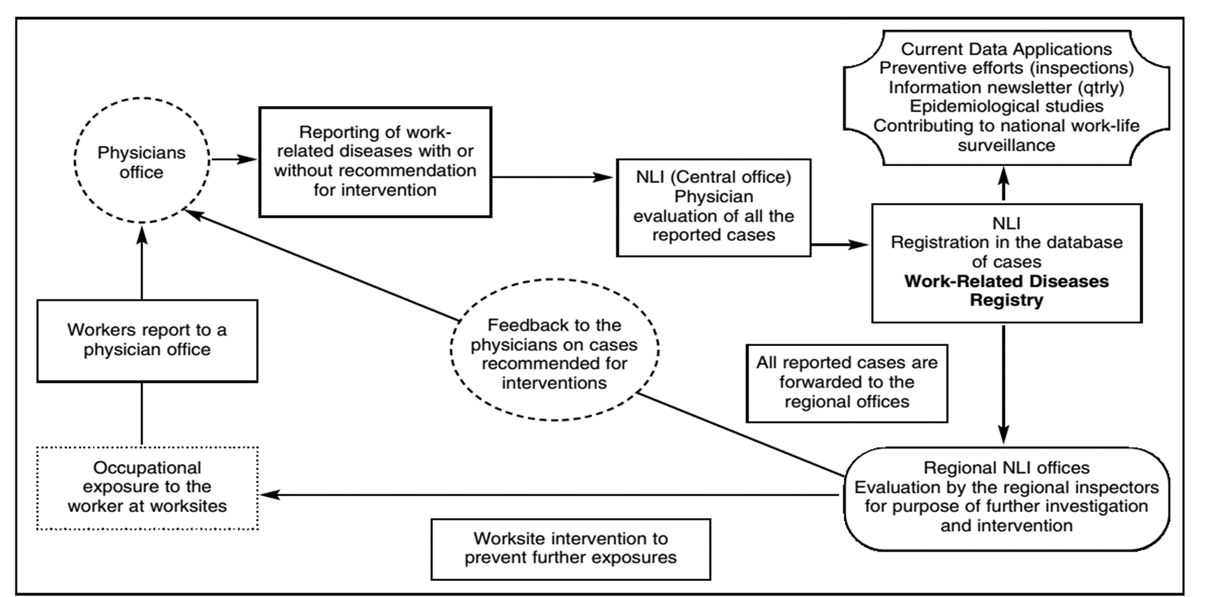
Register for Arbeidsrelaterte Sykdommer (RAS)
Source: Samant Y, Parker D, Wergeland E, Wannag A, 2008. The Norwegian Labour Inspectorate’s Registry for Work-Related Diseases: data from 2006. International Journal of Occupational and Environmental Health, 14(4): 272–9.
Source:

Slide 20
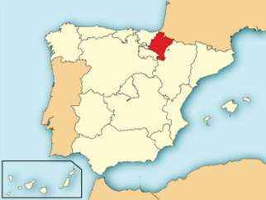
Occupational Health Surveillance Programme in Navarre (Spain)
Regional system run by Institute of Public and Occupational Health of Navarra
Non-compensation-related system for 7 diseases based on sentinel surveillance
Initially 5 diseases: elbow and wrist tendinitis, carpal tunnel syndrome (CTS),
occupational asthma, reactive airways dysfunction syndrome (RADS), and dermatitis
Since 2013, shoulder disorders and voice disorders are included
Voluntary reporting mainly by public health physicians through a computer application
Cases are investigated by an OH physician who can contact the employer and its OHS
If necessary initiate preventive measures and refer cases to the appropriate institutions to claim workers’ compensation for occupational disease
Reporters get feedback on their cases and in annual meetings assessment is discussed
Recorded incidence of WRDs in Navarra is six times higher than the average incidence in the Spanish state (2009)
Image source: https://upload.wikimedia.org/wikipedia/commons/thumb/e/e4/Localizaci%C3%B3n_de_Navarra.svg/1280px-Localizaci%C3%B3n_de_Navarra.svg.png

Slide 21
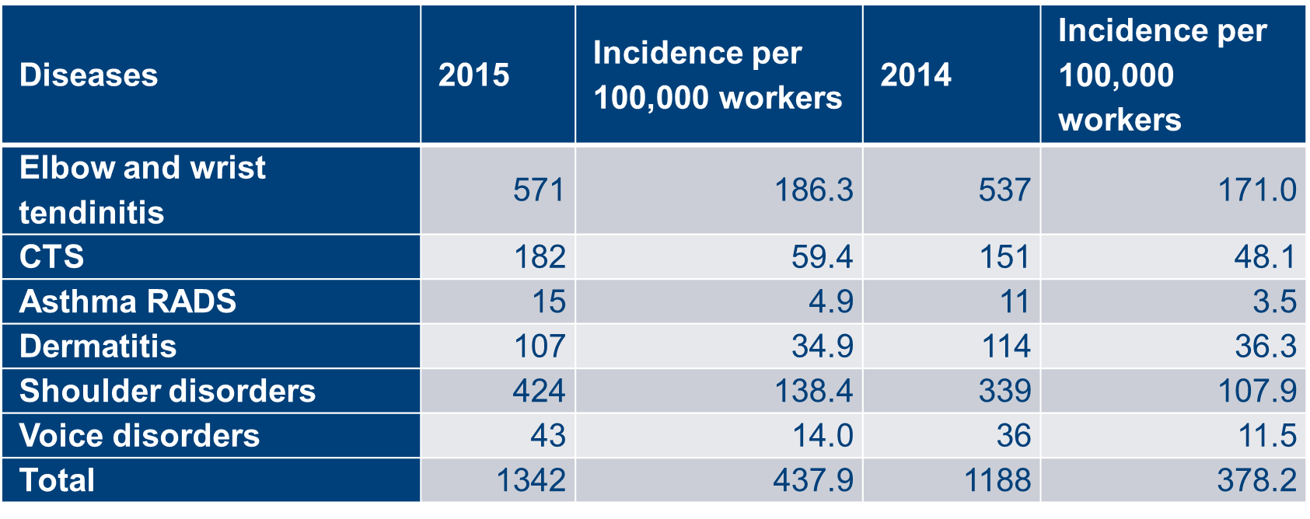
Occupational Health Surveillance Programme in Navarre (Spain)
Spain: Overview of incidences of reported work-related diseases in Navarre, 2014 and 2015
Source: I.S.P.L.N. Sección de Medicina del Trabajo y Epidemiología Laboral

Slide 22
The Health and Occupation Research network THOR (UK)
THOR is maintained by the University of Manchester
Currently presents the main national OSH data source
Experts at the University of Manchester constantly assess and analyse the data
In addition, THOR-EXTRA allows all reporting physicians to report interesting cases or WRDs with a potentially novel cause
Data quality is constantly improved through the system’s various innovative features
In addition to identifying incidences and trends in work-related ill health in the UK, the collected data are used in numerous other ways:
  dissemination to stakeholders
  informing policies and links with prevention
  identification of new/emerging WRDs
  evaluation of preventive actions in place, etc.

Slide 23
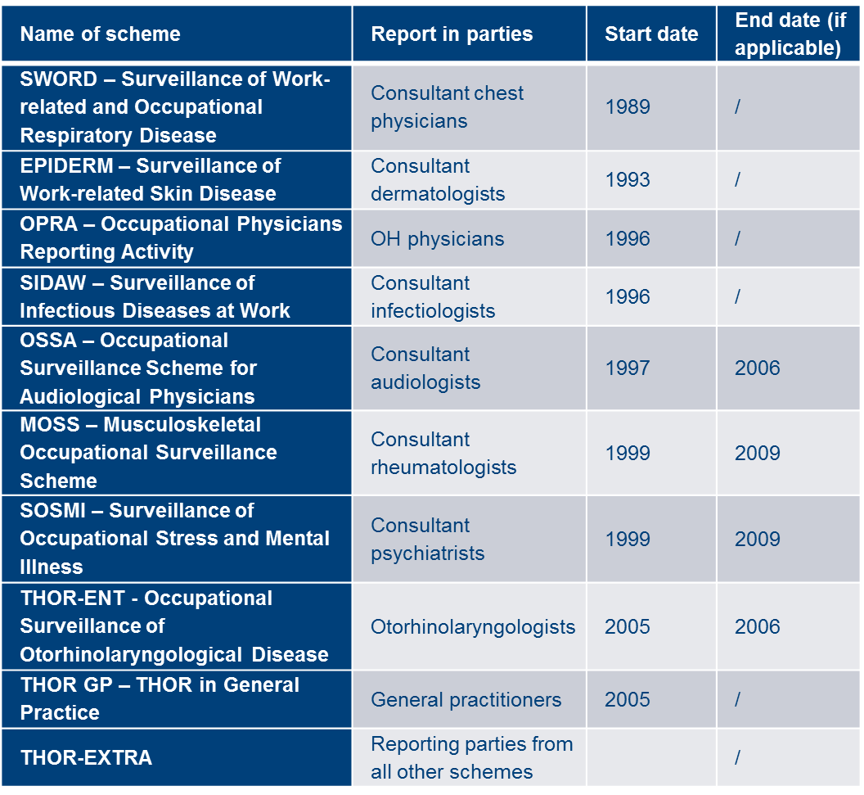
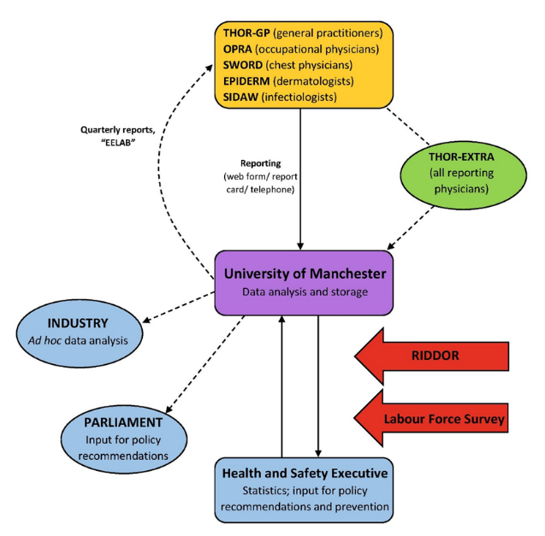
The Health and Occupation Research network THOR (UK)

Slide 24


The Health and Occupation Research network THOR (UK)
Occupational skin disease reported to THOR 2002-2005
Data source: Turner S, Carder M, van Tongeren M, McNamee R, Lines S, Hussey L, et al. The incidence of occupational skin disease as reported to The Health and Occupation Reporting (THOR) network between 2002 and 2005. Br J Dermatol. 2007;157:713–722.; Image source: http://www.hse.gov.uk/hairdressing/bad-hand.htm
Source: Health and Safety Executive, Work-related skin disease in Great Britain, 2017.

Slide 25
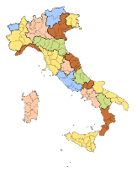
MALPROF (Italy)
Non-compensation-based system maintained by the National Institute for Insurance against Accidents at Work (Istituto nazionale Assicurazione Infortuni sul Lavoro (INAIL))
Built on the mandatory reporting of WRDs required by Italian legislation
A wide network of local prevention centres (Aziende Sanitarie Locali (ASLs)) oversees
the collection of data on any type of work-related health complaints
Physicians in the ASLs perform a thorough work-relatedness evaluation of cases and transfer the data into a national database maintained by the INAIL
Strong point: in-depth analysis of each reported case, not only in terms of causal relationship with work but also with regard to the quality of the collected data, which often indirectly affects the certainty of the work-relatedness evaluation
MALPROF data are used to guide national and local preventive actions, develop OSH policies, identify high-risk groups of workers and identify new/emerging risks and WRDs
Image source: http://www.comune.torino.it/pass/informadisabile/files/2017/12/regioni.png

Slide 26

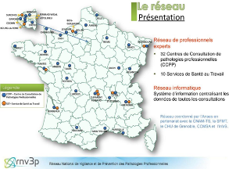
RNV3P (France)
The National Network for Monitoring and Prevention of Occupational Diseases (RNV3P) is a network for monitoring and prevention in OH
It groups together the 30 Occupational Disease Consultation Centres (CCPPs) in mainland France and a sample of 9 OH services associated with the network
The network aims to collect data from each consultation in a permanent national database on ODs (including patient demographic data, diseases, exposures, business sector and profession)
It is up to the network’s university hospital experts to investigate the diseases and attribute them, if necessary, to an occupational origin (this ‘expert’ causality is also registered in the database)
The RNV3P is not only a platform for dialogue between clinicians and other OH professionals but also a system that coordinates knowledge for the purposes of monitoring, improving knowledge and preventing occupational risks
Image source: http://docplayer.fr/16930181-Presentation-du-reseau-national-de-vigilance-et-de-prevention-des-pathologies-professionnelles-rnv3p.html

Slide 27
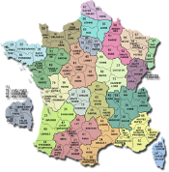
EpiNano (France)
Non-compensation-related system aimed at one type of exposure (nanoparticles)
Developed by the former French Institute for Public Health Surveillance
(Institut de Veille Sanitaire (InVS)), which is now part of Santé Publique France
Aims to develop an epidemiological surveillance system of workers likely to be exposed to engineered nanomaterials
    Collection of all the information necessary to identify and characterise workstations that might cause occupational exposure to carbon nanotubes or titanium dioxide (TiO₂) nanoparticles, aggregates and agglomerates
    Validated semi-quantitative method to characterise potential exposure (the on-site technical logbook)
    Researchers who perform on-site visits are epidemiologists and industrial hygienists
The objectives of the prospective cohort study are to monitor the medium- and long-term possible health effects of nanomaterial exposure and to enable further research
Image source: http://projets.cotemaison.fr/uploads/projects/3349/project_514127_pic_1.png

Slide 28
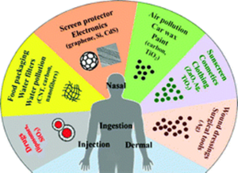
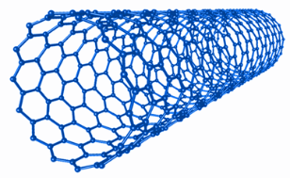

EpiNano (France)
Distribution of workstations in percentages according to the type of operation performed: workstations classified as concerned with exposure to carbon nanotubes or TiO₂ nanoparticles, aggregates and agglomerates (n=30)
Source: Teow Y, Asharani PV, Prakash H, Valiyaveettil S, 2011. Health impact and safety of engineered nanomaterials. Chemical Communications, 47: 7025-7038.
Source: Guseva Canu I, Ducros C, Ducamp S, Delabre L, Audignon-Durand S, Durand C, et al. A standardized non-instrumental tool for characterizing workstations concerned with exposure to engineered nanomaterials. Journal Physics Conference Series, 617: 012036.
Image sources: https://c.mobilegeeks.de/wp-content/uploads/2018/10/Kohlenstoffnanor%C3%B6hre-1200x627.png?x74386, http://www.nanotechnology.com.vn/images/category/Nano-TiO2.jpg

Slide 29
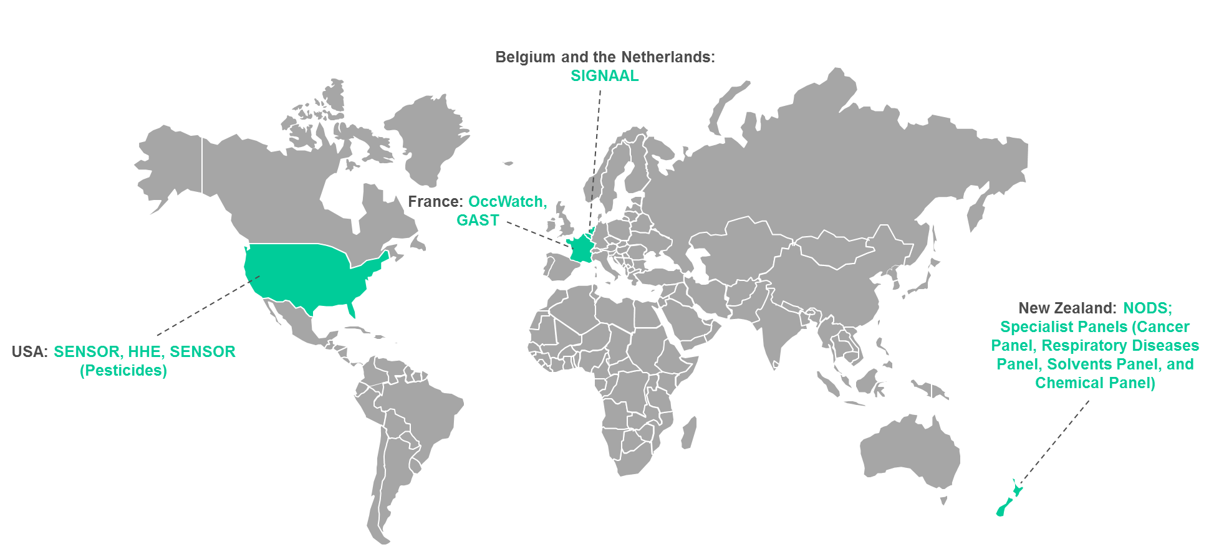
Sentinel systems

Slide 30
Sentinel systems
Sentinel surveillance: each case is seen as a signal
Based on voluntary participation of physicians
Mainly monitor all types of WRDs; some have additional schemes for specific WRDs
Information on exposure: a more thorough description
while reporting/workplace inspections with data gathering
Low reporting threshold + work-relatedness evaluation by experts
Strong link with prevention by sending an alert signal to stakeholders
Enough data
Reporting fatigue

Slide 31
GAST - Groupe d’Alerte en Santé Travail (France)
Occupational Health Warning Groups, run by Santé Publique France (formerly Institut de veille sanitaire (InVS))
Covers all economic sectors in France including SMEs in 10 regions (2016)
Aims to provide an epidemiologic response to unusual health events at workplaces and to detect and alert new/emerging work-related health risks and diseases
Enables reporting of any type of unusual health event at workplaces (clusters of
cancers or other diseases, non-typical exposures, etc.) to the regional platform
for monitoring and health emergencies, the Agences régionales de santé (ARS)
Reporters: any OH actor in charge of prevention or a witness of the event; about 80% of cases are reported by OH physicians; cases have also been reported by health and safety committees, workers, unions, managers, medical specialists, GPs and industrial hygienists
ARS will carry out a validation and evaluation
If the signal seems unusual, it is directed to the Regional Epidemiological Units (Cellules interrégionales d’épidémiologie (CIRE)), which mobilise the GAST group of experts
Experts have one month to confirm the signal, raise an alert, initiate an investigation if necessary and make a decision, if necessary, regarding any prevention measures to be implemented

Slide 32
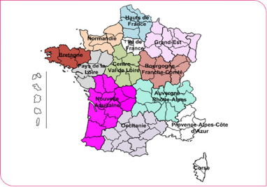
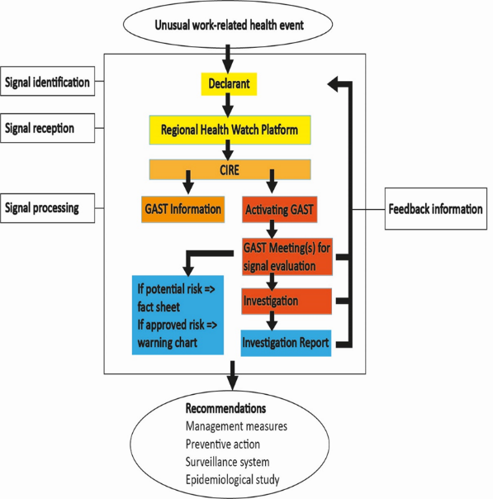
GAST - Groupe d’Alerte en Santé Travail (France)
Source: http://invs.santepubliquefrance.fr/var/ezflow_site/storage/images/media/images/carte-du-deploiement-des-gast-au-1er-novembre-2016/479999-1-fre-FR/Carte-du-deploiement-des-Gast-au-1er-novembre-2016.jpg
No of reports
Source: http://invs.santepubliquefrance.fr/ %20fr/Dossiers-thematiques/Travail-et-sante/Alertes-en-sante-travail/Traitement-des-signalements
Source: http://invs.santepubliquefrance.fr/fr../Dossiers-thematiques/Travail-et-sante/Alertes-en-sante-travail/Bulletin-des-reseaux-de-surveillance

Slide 33
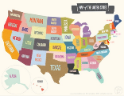
NIOSH Health Hazard Evaluations (HHE) (USA)
HHE programme identifies chemical, biological or physical hazards at the workplace
Run by the National Institute of Occupational Safety and Health (NIOSH)
A priority of the programme is to evaluate and identify new and emerging hazards
The programme operates from two locations in the USA and acts upon the request of employers, employees or employee representatives, and other public-sector agencies
Multidisciplinary teams investigate cases; depending on the subject they comprise industrial hygienists, physicians and other OH specialists (including epidemiologists, psychologists, engineers and statisticians)
Responses to requests: written or oral consultations on technical matters, full-scale onsite investigations
Written reports containing recommendations of evaluations are shared with employer and employee representatives at the worksite that is the subject of the investigation
Image sources: https://print.myscres.com/images/free-printable-wall-art-travel/free-printable-wall-art-travel-21.png

Slide 34
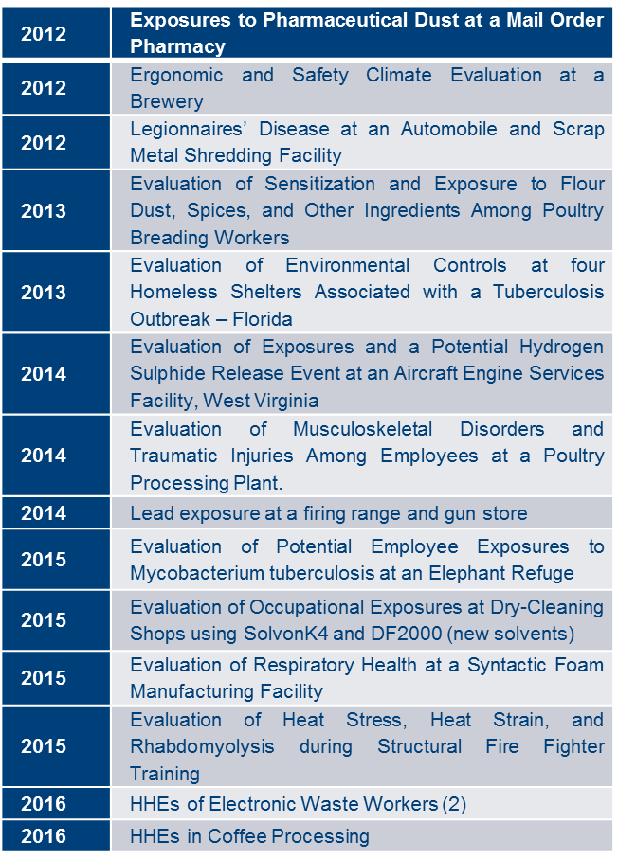
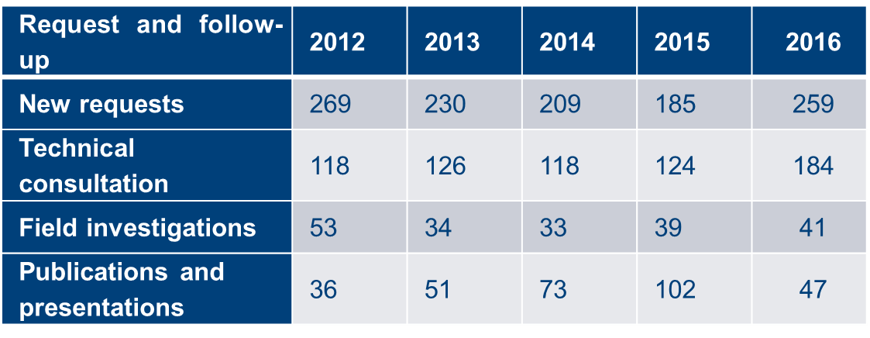

NIOSH Health Hazard Evaluations (HHE) (USA)
Image sources: https://www.cdc.gov/spanish/niosh/hhe/images/banner.jpg

Slide 35

SIGNAAL (Belgium and the Netherlands)
SIGNAAL is an online non-compensation-based sentinel system in place since July 2013
Result of cooperation between the Netherlands Centre for Occupational Diseases (NCvB), the Centre of Environment and Health of KU Leuven (Belgium) and Group IDEWE (a Belgian external service for prevention and protection at work)
Main goal is to detect new OH risks and new ODs
OH physicians mainly report diseases they suspect to be caused by an employee’s occupation
Strong point: every reported case is evaluated in a structured manner by at least two independent OH experts who assess if the case could be a WRD and if it is a new OH problem
After the assessment, the reporting physician receives an expanded report that contains supportive literary research, the relevance to the job in question and suggestions regarding the next steps in the course of action
Image sources: https://ilpallonenellarete.files.wordpress.com/2016/07/countrieseuro2000.png

Slide 36
SIGNAAL (Belgium and the Netherlands)
Some of the reports since July 2013 | Country | Work-related? | New combination?
Open angle glaucoma and playing saxophone (teacher) | NL | Yes | Not new, relatively unknown
Achilles tendon rupture in the assembly, dismantling and maintenance of cranes | NL | Yes | Not new, relatively unknown
Back pain in the care of dementia patients without available lifting aids | NL | Possible | Not new
Endotoxin fever after cleaning a polluted drain with high pressure air | NL | Yes | Not new, not described in this work setting
Nosebleeds and formaldehyde exposure in aluminimum production | B | Yes | New
Pulmonary alveolar proteinosis and exposure to hairspray in a hairdresser | B | Yes | Not completely new, but rarely described

Slide 37
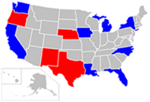

SENSOR Pesticides (USA)
SENSOR: first OSH surveillance system designed according to the sentinel approach
Initial goal: provide information on any identified work-related health problems
Main reporting parties were physicians across the USA
SENSOR-Pesticides programme: only remaining system of the initial SENSOR with its original name
Three main sources of data information:
  State Department of Agriculture
  Poison control centers
  Workers’ compensation system
Main strong points of the SENSOR-Pesticides programme:
  clear case definition
  detailed description of cases through numerous standardised variables
  thorough assessment procedure of the reported cases, including classification of cases, determination of case severity, case investigation and follow-up
Usage of SENSOR data is closely related to the activities of the Environmental Protection Agency (EPA), which enables the necessary link with prevention and pesticide-related policy
Image source: https://upload.wikimedia.org/wikipedia/commons/2/26/SENSOR-Pesticides_state_participation_2011.png, https://upload.wikimedia.org/wikipedia/commons/thumb/9/92/SENSOR_logo.jpg/300px-SENSOR_logo.jpg

Slide 38
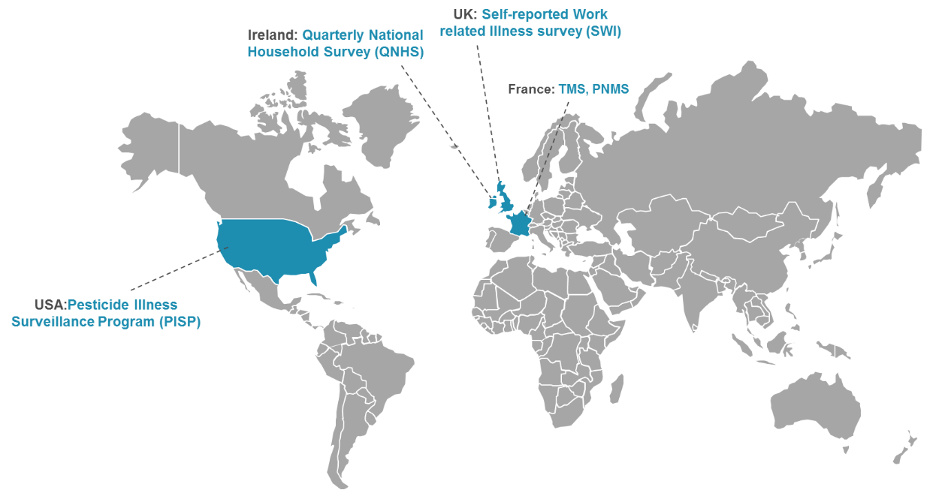
Public health systems

Slide 39
Public health systems
Aimed at health surveillance of workers and general population
All types of WRDs
Specific type of WRDs
Survey-based systems: QNHS (Ireland), SWI (UK)
A special module for work-related health problems
Focused on specific diseases, but both work-related and non-work-related cases can be reported
  France TMS — musculoskeletal disorders;
  PNMS — pleural mesothelioma
  USA PISP — diseases related to pesticide exposure

Slide 40
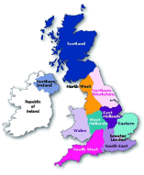
Labour Force Surveys (Ireland and UK)
Active surveillance systems
Main purpose: estimate incidence and prevalence of work-related injuries and WRDs
The Irish and UK systems have similar designs, with data collection in three-month periods through interviews with (randomly selected) workers in households.
Both Labour Force Surveys have modules that collect information on work-related ill health
Ireland: QNHS survey (Quarterly National Household Survey) is carried out by the Central Statistics Office (CSO) of Ireland, covering 26,000 households each quarter
UK: Self-Reported Work-Related Illness (SWI), is carried out by the Office for National Statistics (ONS), covering 50,000 households each quarter
Individuals are asked if they suffered from any illness or disability in the past 12 months that they believe were caused or aggravated by their work and about factors at work that may adversely affect mental well-being or physical health
No further evaluation of work-relatedness of the health problems
The Labour Force Surveys provide information on WRDs from the workers' perspective
Image source: https://www.picswe.com/pics/great-britain-ireland-a7.html

Slide 41
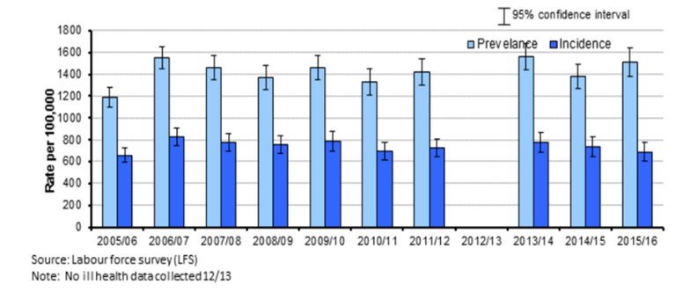
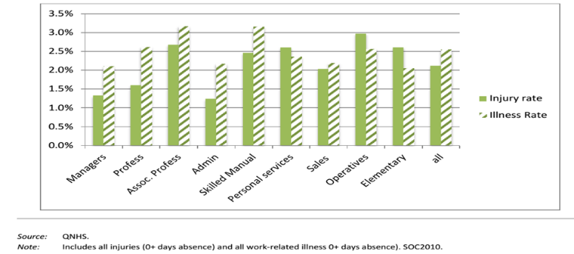
Labour Force Surveys (Ireland and UK)
United Kingdom
Estimated rates of prevalence (total cases) and incidence (new cases) of stress, depression or anxiety caused or made worse by work among working people in last 12 months
Ireland
Work-related injury and illness (%) by occupational group, 2010–2012 (pooled)

Slide 42
DRIVERS AND OBSTACLES OF THE SYSTEMS
Drivers/obstacles | Recommendations
Visibility of the system: some systems are poorly described in the literature | Raise awareness about the existence of the system Publish results derived from the system Share success stories, make the ‘business case’
Motivation of reporting parties: difficulties in engaging physicians to report due to increased demands in their clinical practice | Simplification/automation of reporting Two-way communication and feedback Legal obligation Provide a reward for reporting
Exposure assessment: lack of adequate exposure assessment seen as one of the major drawbacks by most of the interviewees; crucial for establishment of causal relation with work | Include exposure description in reporting Exposure assessment during the evaluation procedure of reported cases Use tools for more standardised reporting of exposure (such as hierarchical codes for all types of exposures)
Standardisation and quality control: important for data quality improvement and also to enable the comparison of data collected at national and international levels | Clear case definitions Sensitivity versus specificity Clear coding system Training and guiding in coding Code control

Slide 43
DRIVERS AND OBSTACLES OF THE SYSTEMS
Drivers/obstacles | Recommendations
Awareness and detection on new/emerging WRDs: one of the main conditions for capturing new WRDs is that the reporting parties who can identify them and the experts who assess work-relatedness are aware of these diseases and reporting lines are clear | Raise awareness and expertise Publish on new/emerging health risks Offer expert help with establishing work-relatedness Low reporting threshold Data mining in existing databases
Different levels of links with prevention: prevention can be established at several different levels, which involves different groups of stakeholders and could be linked to the typology of the systems | Collaboration with governmental bodies Contact with companies/sectors/workers’ representatives/labour inspectorate Follow-up and followback activities Enable link with policies
Political and financial support and resources: stable, long-term funding is crucial for maintenance of a system; linked to the issue of human resources and data quality; depends on the level of importance given to OSH by the government | Raise awareness Publish case reports in journals Constantly demonstrate the significance of the work performed by these systems Develop smaller projects that target specific areas of OSH

Slide 44
Recommendations for improvement of sentinel surveillance in the EU — General Recommendations
Implementation of sentinel and alert systems in Member States:
1) De novo development of a sentinel system designed specifically to detect new/emerging work-related diseases
2) Integration of a sentinel aspect into an existing system, primarily designed for other purposes (e.g. compensation, statistics, public health surveillance)
In countries where these systems already exist:
Improvement of their sentinel function
Provide useful tools to enhance the quality of the different steps in the data flow: from identification and reporting of cases to the link with prevention and policies

Slide 45
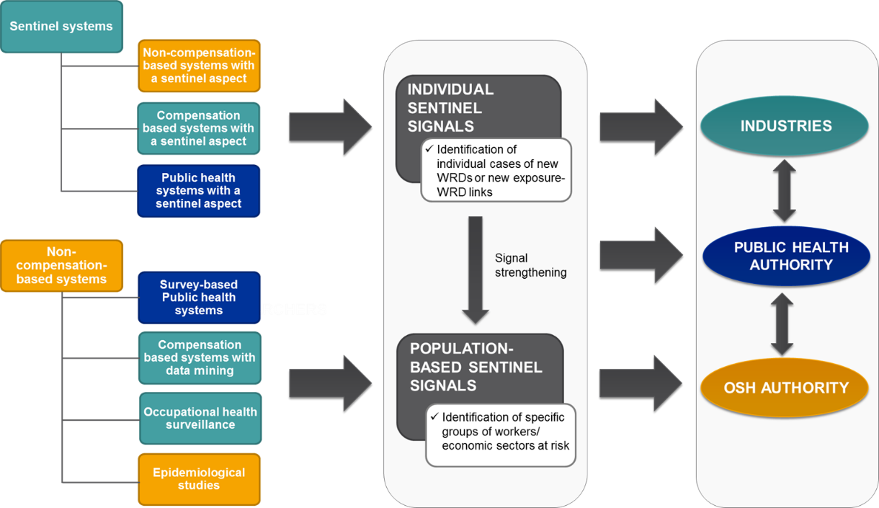
Setting up a sentinel approach recommendations for owners

Slide 46
Setting up a sentinel approach recommendations for DEVELOPERS
Clearly define the position of a system in the national OH context
(organisation of OH service, coverage and number of OH providers, accessibility of the OH service to different groups of workers, economic sectors and SMEs)
Design the system in cooperation with OSH/public health authorities and owners of other monitoring systems already in place
Use already tested systems from other countries with a similar organisation of OH
Most preferably, reporters of a sentinel system should be occupational physicians.
They have the necessary expertise in the field of WRDs and safety at work and are more likely to be aware of new WRDs; general practitioners can be a good supporting source
Implement actions to motivate reporting physicians to participate and keep participating
Balance between data quality control and a ‘low threshold’ approach
Too strict systematisation, such as clear case definition, can lead to a loss of sensitivity and a risk of missing cases of new WRDs
When determining the most suitable approach, experts should look at the existing data sources in the country to ensure that signals provided by these systems are complementary

Slide 47
Setting up a sentinel approach recommendations for DEVELOPERS
Complementary signals are:
‘Individual sentinel signals’ — individual cases of new WRDs and new exposure-WRD correlations
Systems designed to detect these signals capture a smaller number of cases and therefore can afford a more sensitive approach and high expertise in terms of work-relatedness evaluation (such as systems termed ‘Sentinel systems’ in the final report)
‘Population-based sentinel signals’ — allow the identification of new exposure-WRD links, but rely on a more comprehensive approach by focusing on the identification of groups of workers or economic sectors at risk
These signals can be captured by different approaches (non-compensation-based systems for data collection and statistics; survey-based public health systems; compensation-based systems with data mining). Some of these approaches are described in the final report; others are out of the scope of the research (epidemiological studies, occupational health surveillance, registries)
These two types of signals should be integrated at the national level

Slide 48
Assessment of the signals recommendations for researchers
Request a clear exposure description from the reporters, by including in the reporting form the minimum of requested information necessary for establishment of exposure-WRD correlation (suspected exposure, duration of exposure, steps taken to quantify it, other possible exposures, etc.)
Assessment of exposure in sentinel systems can be enhanced by its clear structuration (a clear definition of exposure variables that should be reported as well as the coding procedure; use of a specific thesaurus that provides hierarchical codes for all types of exposures)
Natures and characteristics of certain groups of exposures and diseases make their monitoring more or less difficult (diseases related to exposure to chemical substances versus musculoskeletal and psychosocial ill health); in the cases of WRDs that are multifactorial or have a long latency, the establishment of clearer assessment criteria could be of particular importance, especially in the case of work-related mental health problems, which seem to be on the increase

Slide 49
Assessment of the signals recommendations for researchers
Signal strengthening of
‘Individual sentinel signals’
Work-relatedness evaluation performed by (a group of) experts
Can take place parallel to secondary prevention (medical interventions to stop further progression of the medical condition affecting the worker whose case has been reported)
Based on characteristics of the signals, different levels of alert should be triggered
Level 1 is the lowest level of alert and refers to disseminating the warning signals to an internal group of experts
Level 2 involves a wider dissemination of warning signals, possibly to a larger group of experts or industries at risk
Level 3 refers to the highest level of alert and includes an input for occupational health and public health authorities

Slide 50
Assessment of the captured signal recommendations for researchers
Signal strengthening of
‘Population-based sentinel signals’
No work-relatedness evaluation of individual cases
More suitable to produce Level 2 and Level 3 alerts
Level 2: perform investigation on emerging work-related health risks in specific industries and prioritise preventive actions; communicate directly with industries in such a way that industries can request obtaining some specific data gathered by the systems
Level 3: support long-term policies and prevention plans by identifying emerging trends in WRDs

Slide 51
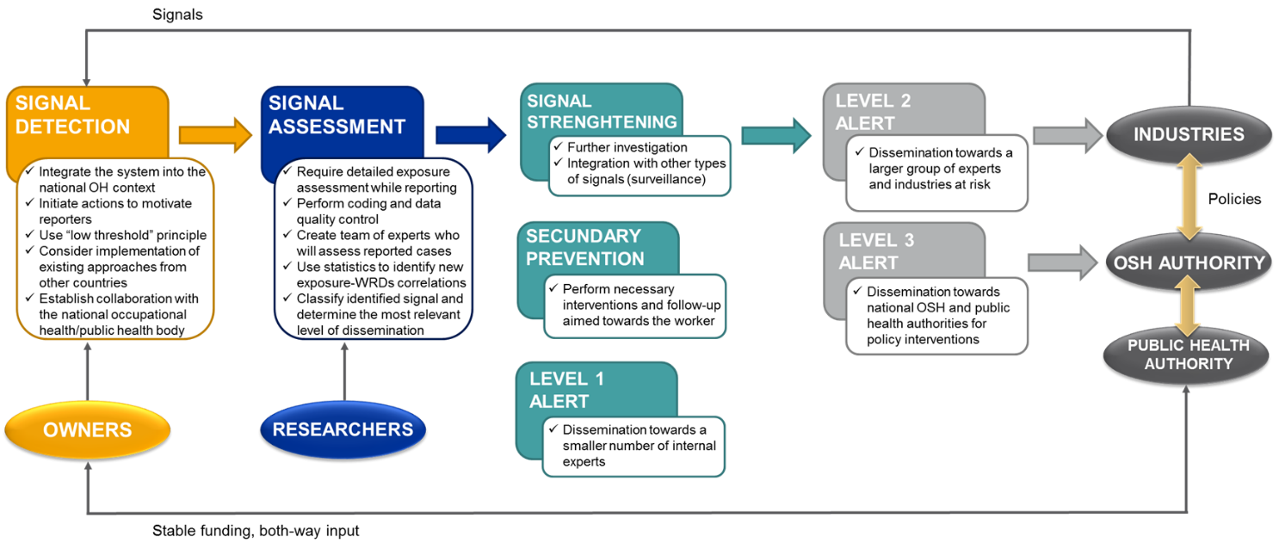
Recommendations for improvement of sentinel surveillance in EUROPE — General Recommendations

Slide 52

Visions for THE future — development of sentinel surveillance in EUROPE
Harmonisation of data on the European level
Option 1: Development of sentinel system in Europe (not on the current political agenda)
Option 2: Establishment of better cooperation and exchange of data between the existing systems from European countries
(more realistic)
Image source: https://tse1.mm.bing.net/th?id=OIP.Q8fKwG-mM12sYAZ-2IJlzgHaHa&pid=Api&P=0&w=300&h=300

Slide 53
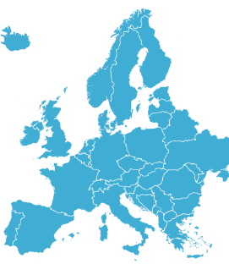
Visions for THE future — development of sentinel surveillance in EUROPE
Benefits:
Helping strengthen the existing sentinel systems in place or develop new sentinel approaches in the countries where these are still to be implemented:
Harmonisation of recorded data:
Produce guidance documents on how to implement these approaches (based on the existing good practice examples)
Support collaboration between the national occupational health authorities and developers of systems
Implementation of a uniform thesaurus to create hierarchical codes for different types of variables (exposure)
Harmonisation of case definitions and work-relatedness evaluation procedure
Image source: https://www.mendikat.net/images/europe/an-europe.png

Slide 54

Visions for THE future — development of sentinel surveillance in europe
Benefits:
Forming a group of international experts on new/emerging WRDs who can aid assessment of cases reported on the national level:
Enhancement of alert function of systems:
Modernet network and OccWatch platform could be used as a starting point, and be further supported and internationalised
Development of an European-wide database for reported cases
Particularly important for new WRDs with a small incidence (higher chances to identify similar cases at the European level)
Promote guidance for a systematic determination of an adequate level of alert based on reported data
Level 2 and Level 3 alerts at the European level: promote actions aimed at employers and workers, development of long-term policy plans
Image source: https://static.wixstatic.com/media/f8572a_492f3ee649d149099028ea75836aec4b~mv2.jpeg/v1/fill/w_302,h_302,al_c,lg_1,q_80/f8572a_492f3ee649d149099028ea75836aec4b~mv2.webp

Slide 55

CONCLUSIONS
No ideal surveillance system for new/emerging WRDs. Several different approaches have been described in the final report and each has its strong points and disadvantages. The approach to be implemented depends on the national OH context and the systems already in place.
Some of the systems described in the final report are designed to generate ‘individual sentinel signals’, i.e. individual cases of potentially new WRDs or new exposure-WRD correlations. Real sentinel systems are specifically designed to capture this type of signal (e.g. SIGNAAL, GAST, HHE and EpiNano)
Alternative approaches to capture individual sentinel signals are:
Compensation-based systems with a sentinel aspect (SUVA)
Non-compensation-related systems with a sentinel aspect (RNV3P)
Public health systems with a sentinel aspect (such as the Pesticide Illness Surveillance Program in the US derived from SENSOR-Pesticides)
Image source: https://www.kissclipart.com/hiring-process-recruitment-clipart-recruitment-org-h9wy75/

Slide 56

CONCLUSIONS
Some systems can provide ‘population-based sentinel signals’ that identify groups of workers at risk or economic sectors with an increased incidence of a WRD. Systems that are suitable to identify these signals are non-compensation-related systems, which use data for statistics and data mining (e.g. THOR and RNV3P)
Alternative approaches to identify population-based signals are:
Population-based signals are mainly used as an input for occupational health or public health authorities to support long-term policies and prevention plans, by identifying vulnerable groups of workers and emerging trends in WRDs
Data mining in databases of compensation-based systems (SHARP in Washington State)
Survey-based public health systems (LFS)
Occupational health surveillance and epidemiological studies (not studied here)
Image source: https://mariarubiom.files.wordpress.com/2014/01/los-diferentes-pc3bablicos-de-una-empresa.png

Slide 57
CONCLUSIONS
Some of the main common drivers are visibility of the system, motivation of reporting parties, systematic and detailed exposure assessment, standardisation and quality control of collected data, awareness and detection of new/emerging WRDs, communication with authorities to initiate prevention, financial support and resources
The main gap in terms of monitoring specific groups of WRDs is the monitoring of multifactorial WRDs, such as mental diseases and musculoskeletal diseases. Possible solution: establishment of additional, clearly defined assessment criteria
Two-way communication between key stakeholders is essential for long-term maintenance of sentinel systems and their link with prevention
Improvement of sentinel surveillance at EU level, in terms of collaboration on the exchange of reported data, assessment of cases and raising alerts between the systems and Member States, would be a significant achievement harmonisation of reported data in Member States, increasing awareness and recognition of new WRDs, complementing existing official figures for monitoring ODs

