Slide 1
Alert and sentinel approaches for the identification of work-related diseases in the EU
Presentation for a non-expert audience
Authors: Jelena Bakusic, Annet Lenderink, Charlotte Lambreghts, Sofie Vandenbroeck, Jos Verbeek, Stefania Curti, Stefano Mattioli, Lode Godderis

Slide 2
INTRODUCTION
Continuous changes in work and working conditions may give rise to new work-related diseases (WRDs)
Previously unknown exposure-disease combinations in a specific work setting
e.g. night shift and breast cancer

Slide 3

INTRODUCTION
Sentinel and alert systems
Collect information on new WRDs
Raise alert to stakeholders
Use collected data to trigger timely preventive actions
SIGNAL DETECTION
SIGNAL ASSESSMENT
SIGNAL STRENGTHENING
ALERT TO STAKEHOLDERS
Image source:

Slide 4
OBJECTIVES OF THE PROJECT
Provide insight into the existing sentinel and alert approaches to identify new WRDs
Provide recommendations for policy-makers and OSH actors to implement sentinel and alert systems for prevention
Beneficiaries of the results of this project include:
Policy-makers at national and EU levels
Social partners
Researchers
Actors in occupational diseases recognition, workers’ compensation schemes and statistical data collection

Slide 5





OVERVIEW OF THE PROJECT
Task 1.
Literature review
Task 2.
In-depth description of 12 selected systems through interviews and qualitative analysis
Task 3.
Workshop to discuss outcomes of
tasks 1 and 2
Task 4.
Final report including analysis and recommendations
Task 5.
Workshop to disseminate findings to stakeholders

Slide 6

LITERATURE REVIEW
Scientific literature
Grey literature
Databases:
MEDLINE (PUBMED)
Embase
Web of Science
Databases: OpenGrey, OSH-update
Existing data from 3 surveys
Websites
Extracted data on each system: general aspects (country, organisation/institution maintaining the system, website), aim of data collection, coverage, reporting mechanism, evaluation of work-relatedness, alert on new WRDs, link with prevention
Image source: https://www.flickr.com/photos/88687552@N02/8247017546

Slide 7
THE IN-DEPTH STUDY
6 systems described through in-depth desk research:
6 systems described through interviews with 3 stakeholders:
Information describing the development, outline and results of the systems was gathered from websites, grey literature and scientific publications
Owner of the sentinel or alert system
Workplace actor who reports to the system
Researcher or other stakeholder using the system for monitoring, occupational disease recognition, or workplace prevention

Slide 8

TWO workshopS
Expert workshop to discuss outcomes of Tasks 1 and 2 of the project
Gathered systems’ owners and users, researchers and actors in the disease recognition area
Objective: to gain more insight on the drivers and obstacles to the implementation of systems
Policy workshop to discuss and consolidate results of the project
Gathered representatives of ministries of health and labour, national insurance bodies, institutes of public health, etc.
Objective: disseminate findings and recommendations derived from the project
Image source: http://freecliparty.com/free-image-clip-art/358524/general-meeting-clipart-images-urda6gb-image-clip-art

Slide 9
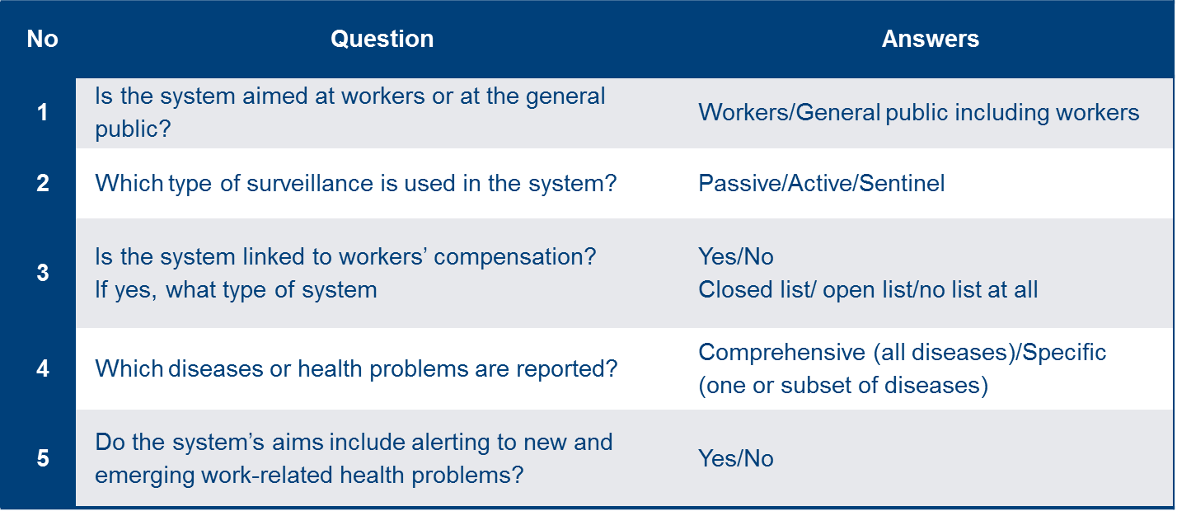
RESULTS LITERATURE REVIEW
75 systems/approaches identified from EU countries as well as outside Europe (USA, Canada, Australia, Singapore, Taiwan etc.)
Typology with algorithm to determine type

Slide 10
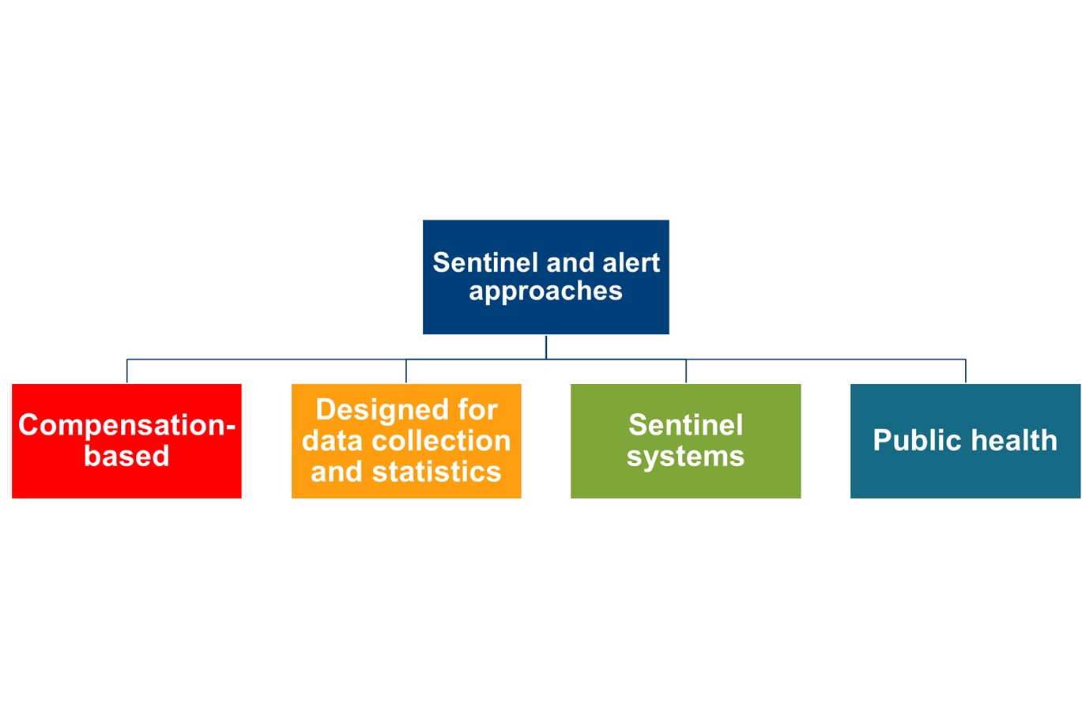
BASIC TYPOLOGY DEFINED

Slide 11
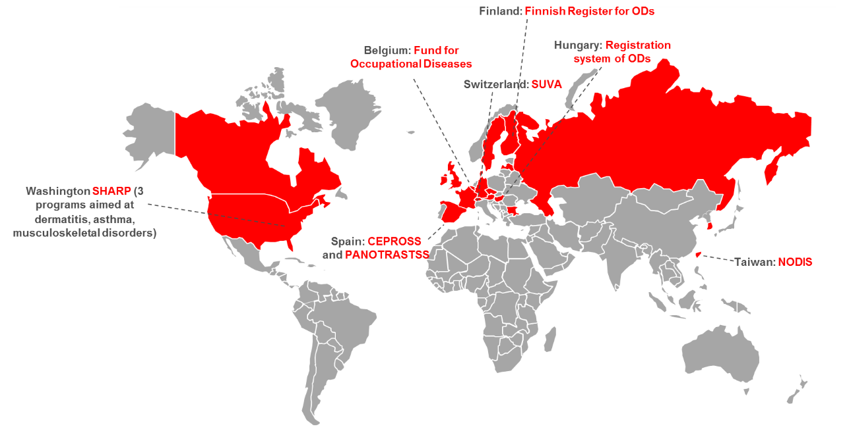
Compensation-based systems

Slide 12



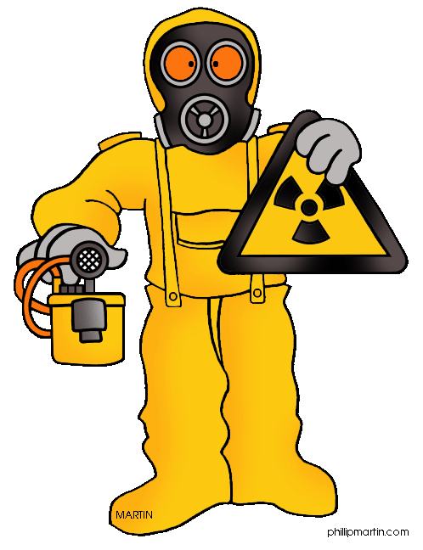

Compensation-based systems
Case reported for compensation
Alert to new WRD
Workplace interventions
Evaluation by experts
Image sources: https://www.iconspng.com/images/Ke-png/40, https://carwad.net/free-cli, http://clipart-library.com/safety-equipment-cliparts.html, https://www.clipartmax.com/middle/m2i8G6A0K9b1N4K9_monitoring-evaluation-and-impact-assessment-of-food-evaluation-assessment-graphics/

Slide 13


Swiss National Accident Insurance Fund SUVA (Switzerland)
Created to provide insurance to workers
Over time expanded to include preventive workplace activities and
publication of national OSH statistical data
Reporting based on voluntary participation of all types of physicians
Data mainly from two sources: compensation claims and medical examinations (screening) of workers
Work-relatedness evaluation is performed by SUVA’s occupational health (OH) experts
Possible to include detailed workplace inspections with exposure assessments
OPEN LIST APPROACH
Even though the criteria for compensation are strict, all suspected WRDs can be reported and can trigger alert and preventive actions, e.g. burnout preventive campaigns
Image source: https://www.nbboaonline.com/single-post/2023/08/19/This-is-the-title-of-your-second-post, https://fx-forexshop.com/wp-content/uploads/2017/12/swiss-2700775_1920.png

Slide 14
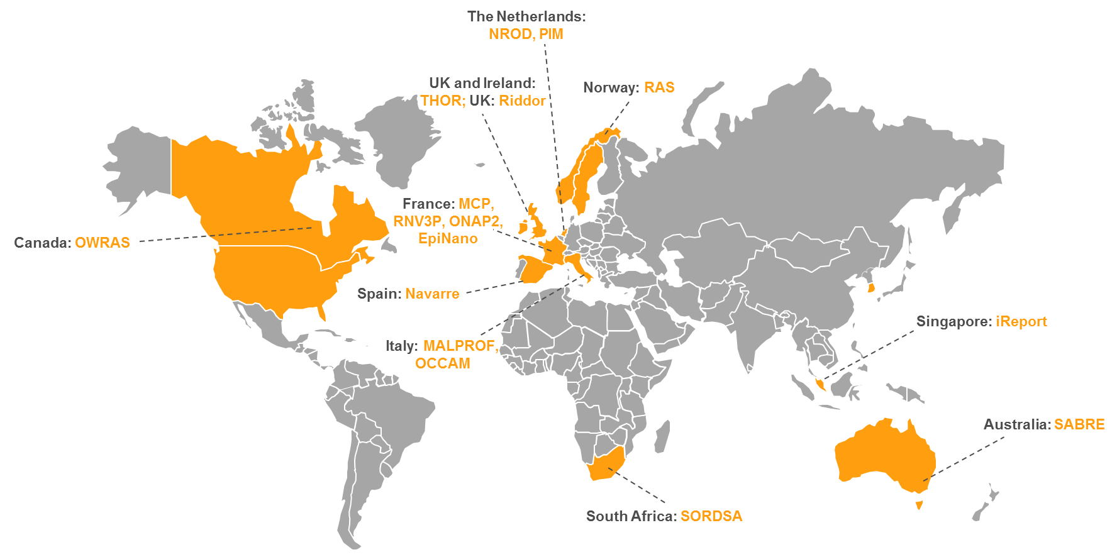
Systems for data collection and statistics

Slide 15




Systems for data collection and statistics
Physicians report cases seen in their practice
DATABASE
Motivation of reporters
Statistics/data mining
Alert to new WRD
Preventive strategies and policies
Image sources: https://pixabay.com/en/folder-office-files-corporate-23609, https://www.gograph.com/vector-clip-art/growth-chart.html/http://www.haydanhthoigian.net/lawyer-clipart/clipart-lawyers-collection-lawyer-scale-best-png-4983-2800-9/

Slide 16
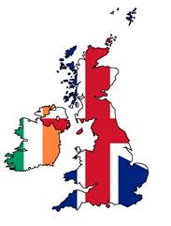
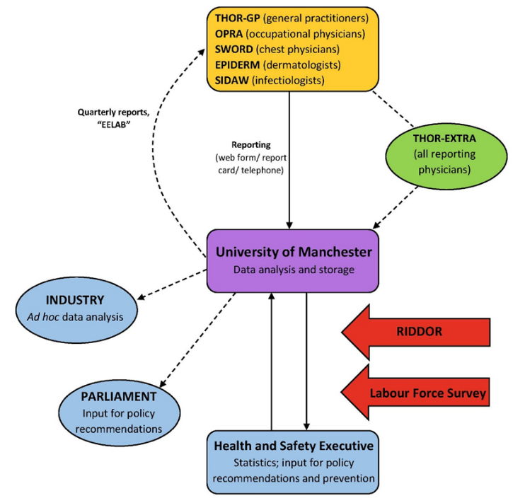
The Health and Occupation Research network THOR (UK)
Maintained by the University of Manchester
Different reporting schemes for different types of WRDs
THOR-EXTRA — scheme for reporting interesting cases or WRDs with a potentially novel cause
Sophisticated statistical methods for determination of incidences and trends in WRDs
Data quality constantly improved
Strong link with authorities
Image source: https://www.kissclipart.com/free/relations,14.html

Slide 17


The Health and Occupation Research network THOR (UK)
Occupational skin disease reported to THOR 2002-2005
Data source: Turner S, Carder M, van Tongeren M, McNamee R, Lines S, Hussey L, et al. The incidence of occupational skin disease as reported to The Health and Occupation Reporting (THOR) network between 2002 and 2005. Br J Dermatol. 2007;157:713–722.; Image source: http://www.hse.gov.uk/hairdressing/bad-hand.htm
Source: Health and Safety Executive, Work-related skin disease in Great Britain, 2017.

Slide 18
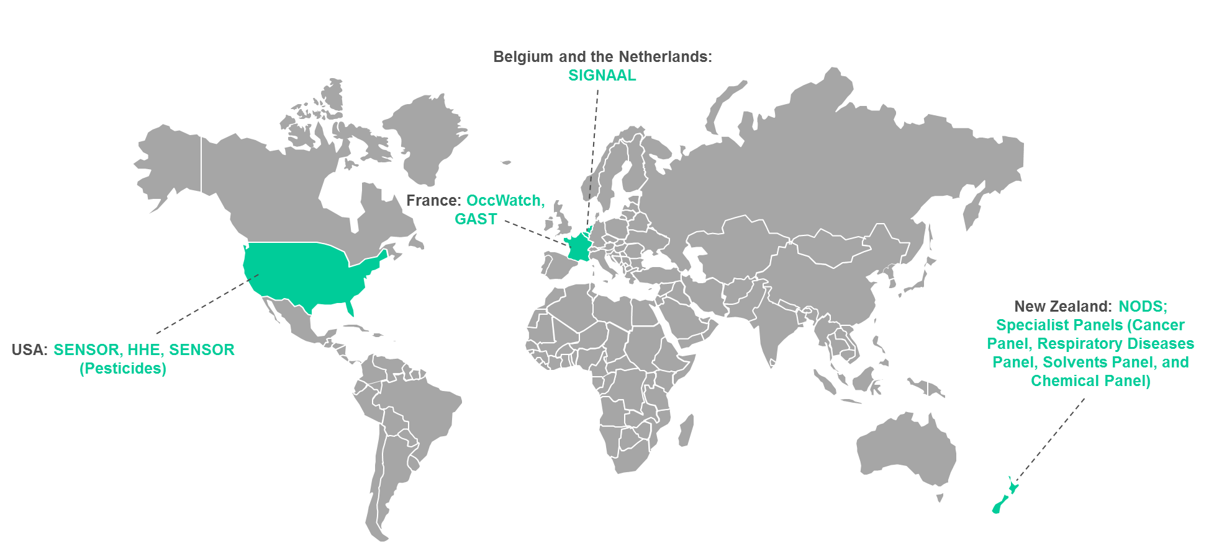
Sentinel systems

Slide 19


Sentinel systems
Suspected case of new WRDs
Detailed investigation of each case
Network of occupational physicians
Alert to new WRD
Workplace interventions
Evaluation by experts
Image sources: https://www.kissclipart.com/network-clipart-computer-network-clip-art-l2qn92/download-clipart.html, http://clipart-library.com/magnifying-glass-vector.html

Slide 20


SIGNAAL (Belgium and the Netherlands)
Maintained by the Netherlands Centre for Occupational Diseases (NCvB) and the Centre of Environment and Health of KU Leuven (Belgium)
Main goal is to detect new OH risks and new WRDs
OH physicians report diseases they suspect to be caused by an employee’s occupation to an online platform
Every reported case is evaluated in a structured manner by at least two independent OH experts
After the assessment, the reporting physician receives an expanded report. This report contains supportive literary research, the relevance to the job in question and suggestions regarding the next steps in the course of action.
Image sources: https://ilpallonenellarete.files.wordpress.com/2016/07/countrieseuro2000.png, https://www.mysignal.be/

Slide 21
SIGNAAL (Belgium and the Netherlands)
Some of the reports since July 2013 | Country | Work-related? | New combination?
Open angle glaucoma and playing saxophone (teacher) | NL | Yes | Not new, relatively unknown
Achilles tendon rupture in the assembly, dismantling and maintenance of cranes | NL | Yes | Not new, relatively unknown
Back pain in the care of dementia patients without available lifting aids | NL | Possible | Not new
Endotoxin fever after cleaning a polluted drain with high pressure air | NL | Yes | Not new, not described in this work setting
Nosebleeds and formaldehyde exposure in aluminimum production | B | Yes | New
Pulmonary alveolar proteinosis and exposure to hairspray in a hairdresser | B | Yes | Not completely new, but rarely described

Slide 22
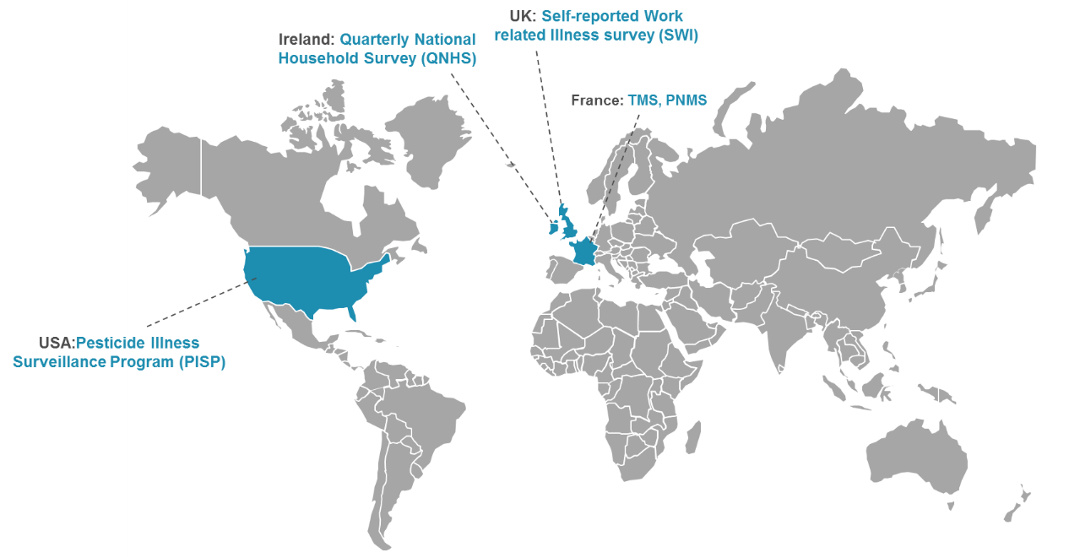
Public health systems

Slide 23


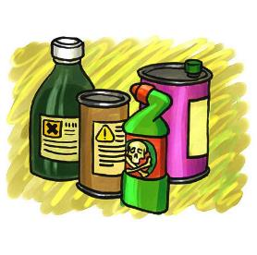

Public health systems
Extract work-related data
Monitoring health of general population
Alert to new WRD
Preventive strategies at the public health level
Public health authority
Image sources: https://www.emaze.com/@AORCZWQWF, https://cliparts.zone/column-cliparts, http://www.home-air-purifier-expert.com/

Slide 24
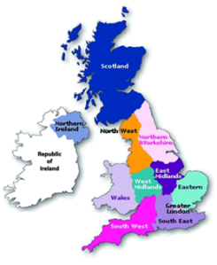

Labour Force Surveys (Ireland and UK)
Collect data in three-month periods, through interviews with workers (randomly selected) in households
Main purpose: estimate incidence and prevalence of work-related injuries and WRDs
Ireland: QNHS survey (Quarterly National Household Survey) is carried out by the Central Statistics Office (CSO) of Ireland, covering 26,000 households each quarter
UK: Self-Reported Work-Related Illness (SWI), is carried out by the Office for National Statistics (ONS), covering 50,000 households each quarter
Individuals are asked if they have suffered any illnesses or disabilities in the past 12 months that they believe were caused or aggravated by their work and about factors at work that may adversely affect mental well-being or physical health
The Labour Force Surveys provide information on WRDs from the workers' perspective
Data is triangulated with other systems in the UK and used for prevention
Image sources: https://www.uihere.com/free-cliparts/telephone-telephony-orange-telefono-rotary-telephone-illustration-963060, https://www.picswe.com/pics/great-britain-ireland-a7.html

Slide 25
DRIVERS AND OBSTACLES OF THE SYSTEMS
Drivers/obstacles | Recommendations
Visibility of the system: some systems are poorly described in the literature | Raise awareness about the existence of the system Publish results derived from the system Share success stories, make the ‘business case’
Motivation of reporting parties: difficulties in engaging physicians to report due to increased demands in their clinical practice | Simplification/automation of reporting Two-way communication and feedback Legal obligation Provide a reward for reporting
Exposure assessment: lack of adequate exposure assessment seen as one of the major drawbacks by most of the interviewees; crucial for establishment of causal relation with work | Include exposure description in reporting Exposure assessment during the evaluation procedure of reported cases Use tools for more standardised reporting of exposure (such as hierarchical codes for all types of exposures)
Standardisation and quality control: important for data quality improvement, but also to enable the comparison of data collected at national and international levels | Clear case definitions, Sensitivity versus specificity Clear coding system, Training and guiding in coding Code control

Slide 26
DRIVERS AND OBSTACLES OF THE SYSTEMS
Drivers/obstacles | Recommendations
Awareness and detection on new/emerging WRDs: one of the main conditions for capturing new WRDs is that the reporting parties who can identify them and experts who assess work-relatedness are aware of these diseases and reporting lines are clear | Raise awareness and expertise Publish on new/emerging health risks Offer expert help with establishing work-relatedness Low reporting threshold Data mining in existing databases
Different levels of links with prevention: prevention can be established at several different levels, which involves different groups of stakeholders and could be linked to the typology of the systems | Collaboration with governmental bodies Contact with companies/sectors/workers’ representatives/labour inspectorate Follow-up and followback activities Enable link with policies
Political and financial support and resources: stable, long-term funding is crucial for maintenance of a system; linked to the issue of human resources and data quality; depends on the level of importance given to OSH by the government | Raise awareness Publish case reports in journals Constantly demonstrate the significance of the work performed by these systems Develop smaller projects that target specific areas of OSH

Slide 27



Setting up a sentinel approach recommendations for system developers
Place the system in the national OH context
Use already tested systems from other countries
Engage occupational physicians as reporters
Implement actions to motivate reporters
organisation of OH service
coverage and number of OH providers
accessibility of the OH service
(e.g. to different economic sectors/SMEs)
Image sources: http://bestmaths.net/online/files/9914/0045/9266/VectorMen.jpg, https://openclipart.org/image/2400px/svg_to_png/280633/World-Flags-Globe-3.png, https://rh.org.ru/wp-content/uploads/2017/02/doctor-icon-005-896x1024.png

Slide 28


Setting up a sentinel approach recommendations for system developers
Systems can primarily focus on one of two types of signals
‘Individual sentinel signals’
Focus on identifying individual cases of new WRDs and
new exposure-WRD links
Capture a smaller number of cases
More sensitive approach and high expertise in terms of work-relatedness evaluation
‘Population-based sentinel signals’
Focus on identifying groups of workers/economic sectors at risk
Use data to calculate incidences and trends
Look for groups of workers/sectors with an increased incidence or emerging trends
Image sources: https://mariarubiom.files.wordpress.com/2014/01/los-diferentes-pc3bablicos-de-una-empresa.png, https://www.kissclipart.com/hiring-process-recruitment-clipart-recruitment-org-h9wy75/

Slide 29
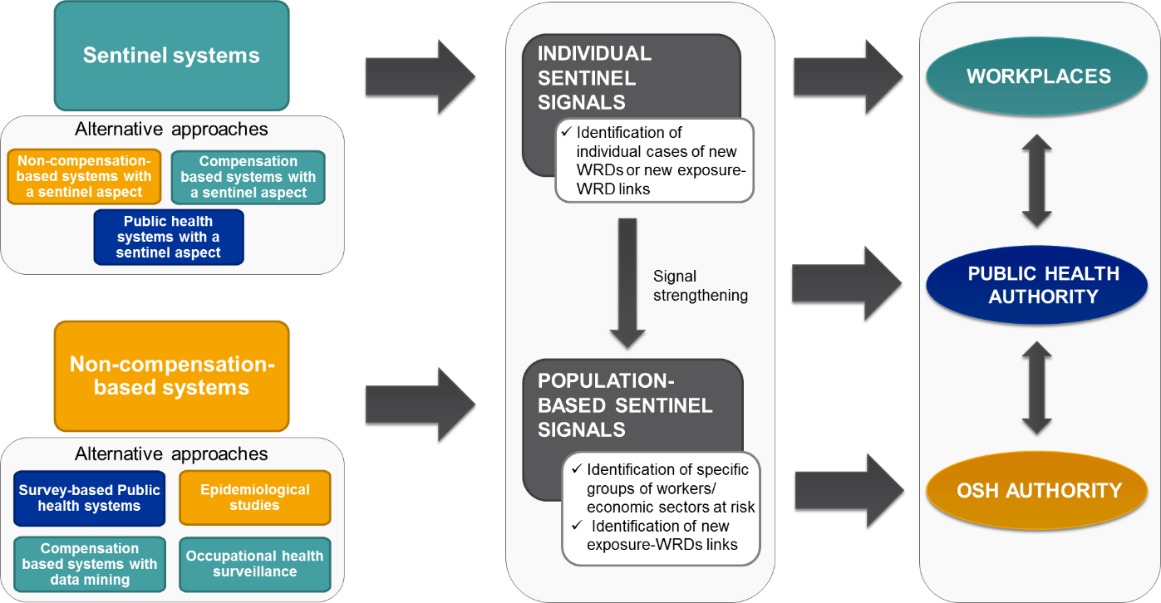
Setting up a sentinel approach recommendations for system developers

Slide 30

Assessment of the signals — recommendations
Improve exposure assessment
Adjust to specific groups of diseases
Clearer assessment criteria for mental diseases
Request exposure description from reporters
Structure on-site exposure assessment
Nature of certain groups of exposures and diseases makes their monitoring more difficult (e.g. multifactorial health issues such as musculoskeletal and psychosocial ill health)
Image source: https://wcvmtoday.usask.ca/images/2018/iStock-brain.mar.16.2018.jpg

Slide 31






Assessment of the signals — RECOMMENDATIONS
Improve signal strengthening and alert
Different levels of alert
Level 1 – internal experts
Level 2 – bigger groups of experts, industries at risk
Level 3 – OH and public health authorities
Work-relatedness evaluation by experts
Image source: http://clipartstation.com/wp-content/uploads/2017/11/industries-clipart-5-1.png

Slide 32
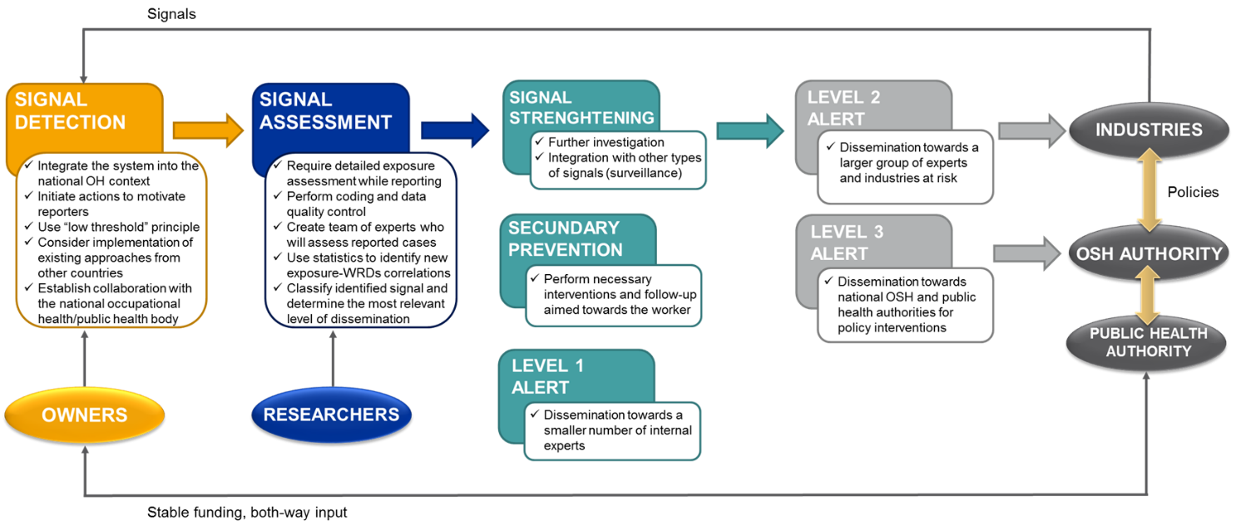
Recommendations for improvement of sentinel surveillance in the EU — General Recommendations

Slide 33



Visions for future — development of EU-wide sentinel surveillance
SIGNAL DETECTION
SIGNAL ASSESSMENT
SIGNAL STRENGTHENING
ALERT TO STAKEHOLDERS
National level
National level
EU level
National level
Promote guidance documents on how to implement sentinel approaches
Promote harmonisation of recorded data
Develop uniform criteria for assessment of work-relatedness
Form a group of international experts on new/emerging WRDs
Experts can help to assess cases reported at the national level
Level 1 alert
EU level
Levels 2 and 3 alerts
Image source: https://www.goethe.de/resources/files/jpg430/Intro_ETS-formatkey-jpg-w320m.jpg

