Slide 1
Healthy Workplaces Campaign 2020-22
LIGHTEN THE LOAD
Preventing musculoskeletal disorders (MSDs) through worker participation

Slide 2

Overview
Legal duties
What is active participation
Methods and tools
Practical examples
Success factors and basics for small businesses
Notes:
This PPT is aimed mainly at employers. It is based on the following report and information sheet:
EU-OSHA – European Agency for Safety and Health at Work. Worker participation in the prevention of musculoskeletal risks at work (report) https://osha.europa.eu/en/publications/worker-participation-prevention-musculoskeletal-risks-work)
EU-OSHA – European Agency for Safety and Health at Work. Preventing musculoskeletal disorders (MSDs) through active worker participation: good practice tips (information sheet) https://osha.europa.eu/en/publications/preventing-musculoskeletal-disorders-msds-through-active-worker-participation

Slide 3

Legal duties to consult and active worker participation

Slide 4
Legal duties to consult on safety and health
  Employers must:
    inform and consult workers and their representatives
    allow workers and their representatives to take part in discussions on all questions relating to safety and health at work
  National laws and/or practices set specific requirements – and may include additional obligations
4
Notes:
The OSH Framework directive: https://osha.europa.eu/en/legislation/directives/the-osh-framework-directive/1

Slide 5

Active worker participation
  Active participation goes beyond consultation
  Managers and workers working together to prevent risks
    Workers who do the jobs are involved in both determining the MSD risk factors and decisions on measures to solve the problems
  However, managers and employers have primary responsibility for carrying out risk assessments
5

Slide 6
Worker participation means:
Effective and open dialogue
Joint problem solving and decision making
Listening and acting on what is said
Participation in spotting hazards, assessing risks and devising solutions
Participation in implementing solutions, evaluating solutions and promoting safe working conditions
Workers fully cooperating with employers
Putting in place arrangements so these can happen in practice
6

Slide 7
Benefits of worker participation
  Identifying the most appropriate solutions because workers and their representatives:
      Know how the job is done and how it affects them
      Know the barriers
      Have ideas for change
      Will be the ones to apply change in practice
  Resulting in:
      Lower accident rates
      Cost-effective solutions
      Greater awareness and control of workplace risks
      Greater motivation and commitment
7

Slide 8

Methods and Tools

Slide 9
Some methods and tools
Comprehensive participatory ergonomics programmes covering the whole risk assessment process
Workshops, tool box talks
Brainstorming for innovative solutions
Techniques to support discussions such as
  Body mapping and hazard mapping
  Taking and discussing photos (‘photo safaris’)
Questionnaires for initial hazard identification or evaluation of results and suggestion schemes
Methods and tools can be combined in various ways and adapted to the needs and context of the workplace

Slide 10
Photo safaris
Workers take photos of risky tasks, situations, equipment etc.
  Over a 2 week period each person takes 2-3 photos with mobile phone of something they think is risky or causes them pain
Each person prints and displays their photos – e.g. on a notice board - with a short explanation
Photos are discussed in a group to look for causes and discuss solutions
  Photos can be grouped according to theme
  Photos of possible solutions can also be taken
Photos can also be used to assess and discuss work hazards at weekly meetings in an on-going way

Slide 11
Brainstorming for action
Everyone proposes ideas that can then be tested and prioritised for action
Example of structuring a session:
  Ask workers to suggest actions targeting workplace layout, equipment, work organisation, psychosocial factors etc.
    The ideas are discussed and written down, for example, on a flip chart.
    To facilitate creativeness, participants are instructed not to consider any barriers
  Consider as a group what actions are needed for each
  As an aid, provide participants with a list of tips for managing risk factors and examples of solutions (e.g. from a prevention guide)

Slide 12
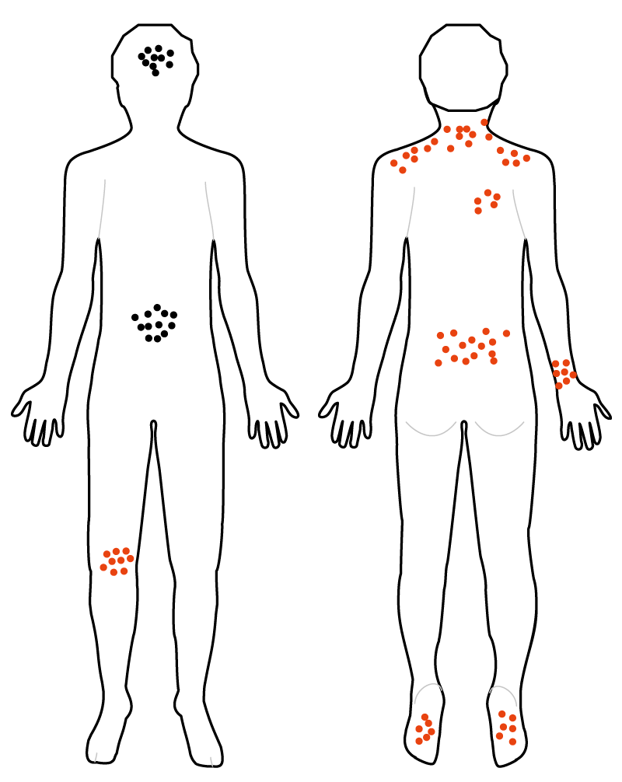
Body mapping
Front
Back
Workers pool information on health problems
Uses a body map showing front and back view
Using coloured pens/stickers workers mark on the map where they suffer pain while working
In a group workers discuss
  the patterns that emerged
  the possible causes and ideas for solutions
Stress symptoms
Aches and pains
Notes:
EU-OSHA – European Agency for Safety and Health at Work. Body and hazard mapping in the prevention of musculoskeletal disorders (MSDs) https://osha.europa.eu/en/publications/body-and-hazard-mapping-prevention-musculoskeletal-disorders-msds
EU-OSHA – European Agency for Safety and Health at Work. Body mapping for MSDs - using individual body maps https://oshwiki.eu/wiki/Body_mapping_for_MSDs_-_using_individual_body_maps

Slide 13
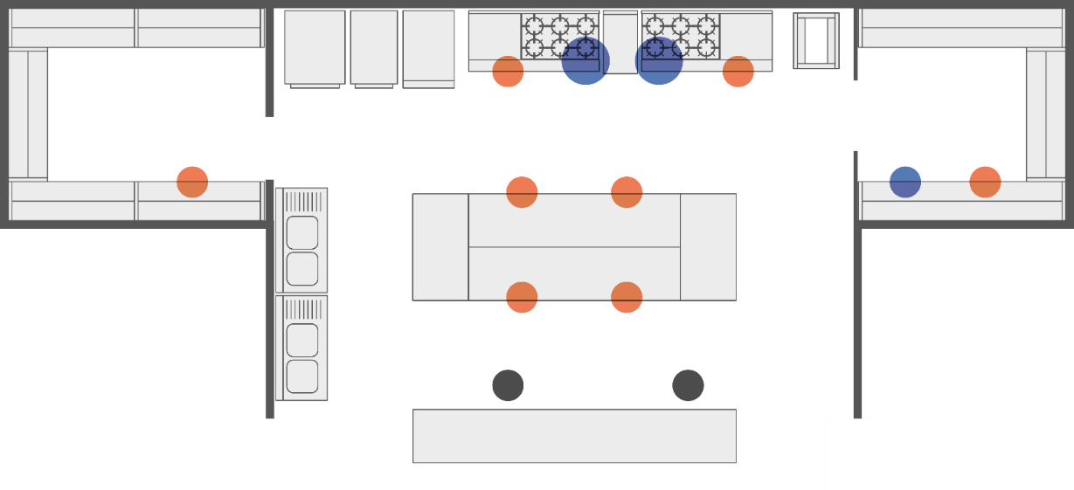
Hazard mapping
  Red – Work design/ ergonomics
  Blue – Physical hazards
  Black - Psychosocial
  Green – Chemical
  Brown - Biological
STORAGE
WALK-IN FREEZER
Awkward posture
Cold
Cold
Awkward posture
Lifting
Chopping
Chopping
Cold
Lifting
Chopping
Chopping
Stress
Fast-paced work
WAITING STAFF FOOD COLLECTION
On a plan of the workplace or a map drawn by workers, groups of workers mark work hazards
The facilitator leads a discussion on the hazards, their causes and ideas for solutions
Notes:
EU-OSHA – European Agency for Safety and Health at Work. Body and hazard mapping in the prevention of musculoskeletal disorders (MSDs) https://osha.europa.eu/en/publications/body-and-hazard-mapping-prevention-musculoskeletal-disorders-msds
EU-OSHA – European Agency for Safety and Health at Work. Hazard mapping and MSDs https://oshwiki.eu/wiki/Hazard_mapping_and_MSDs

Slide 14
Conversation starters: Use a scenario and a set of questions to start a group discussion about a topic
Example: prolonged sitting
Scenario
Discussion questions
Your work involves a lot of time sitting and you don't take many breaks
You have noticed that at work you have started to get aches and pains in your neck and shoulders
Stretching would help, but you feel embarrassed to walk around and stretch at work
What opportunities do you have to introduce exercise into your working day?
How could your workplace encourage you to be more active?
How can the way tasks are planned and carried out be changed to combine sitting, standing and moving options as much as possible?
Notes:
EU-OSHA – European Agency for Safety and Health at Work. Conversation starters for workplace discussions about musculoskeletal disorders https://osha.europa.eu/en/publications/conversation-starters-workplace-discussions-about-musculoskeletal-disorders/view
EU-OSHA – European Agency for Safety and Health at Work. Napo in the workplace
https://www.napofilm.net/en/learning-with-napo/napo-in-the-workplace?search=&page=1

Slide 15

Practical examples and success factors

Slide 16

Example: Training hotel service workers as prevention coordinators to work with colleagues
Volunteers from the hotel’s cleaners and linen and catering staff were trained as prevention coordinators and trained about MSDs and basic risk assessment
Bringing their own experience of work tasks, the coordinators looked at problematic day-to-day activities to find practical solutions using observation and discussion with co-workers
Staff surveys and other communication methods were also used with all the workers
External suppliers and their workers were also involved
Solutions included:
  a re-designed trolley
  raising hotel beds

Slide 17
Example: Workshops with childcare workers to reduce musculoskeletal disorders
3 workshops were carried out with all workers using participatory ergonomics methods
The workshops followed a systematic approach covering identification and analysis of work-related risks, solution generation, prioritisation and implementation
Key elements of the approach were the workers’ prioritisation of the most important child-caring tasks and the focus on integration of solutions with these tasks
Solutions included:
  Helping the children to become more independent
  Changed work routines
  Purchase of low-cost equipment to raise work heights

Slide 18
Example: Involving workers to prevent manual handling risks in a PVC plant (1)
Loading 3-metre long planks into containers and moving those caused MSD risks due to manual handling. A robotic system reduced the manual handling risks but introduced new safety risks
Collaborative work teams investigated the risks, supervised by the safety committee and the external regional health insurance fund
This resulted in adaptations to the machines and putting the loading containers on wheeled trolleys
Workers were involved in developing and the testing trolleys

Slide 19
Example: Involving workers to prevent manual handling risks in a PVC plant (2)
Changes were made gradually, looking at different options and amending those that proved unsuccessful
The process was supported by a commitment from the plant director to continuous improvements in working conditions, such as delegation of responsibility to teams and a suggestion scheme
The management used the successful experience to continue with more worker participation activities

Slide 20
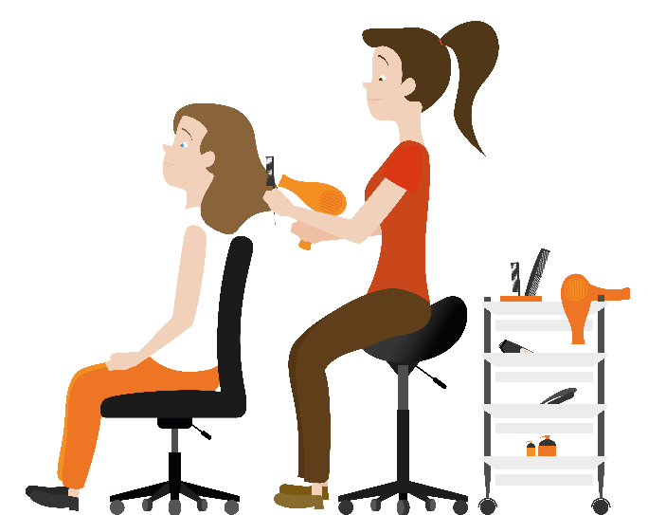
Success factors and basics for small businesses

Slide 21
Success factors for worker participation in MSD prevention from EU-OSHA research include:
Managerial commitment to MSD prevention and worker participation
  Allocation of sufficient time and budgetary resources
Worker participation in all phases of the intervention
  Identification and inclusion of all workers concerned
Clear roles and responsibilities
Competences - in MSDs, risk assessment, the participatory method, the role of working groups and its members
Adapting and combining methods and tools to fit the workplace context
Effective communication at all stages
Implementation and follow-up in practice

Slide 22
Success factors for choosing and implementing prevention measures
Brainstorm ideas and options with workers
  Avoids overlooking a less obvious option
Involve:
  workers directly affected, supervisors, maintenance, safety personal, etc.
  other workers whose work may also be affected by changes, e.g. working in other areas of a production line process
Involve workers in:
  reviewing and deciding which solutions to select for implementation
  deciding the action plan for implementation
  piloting prevention measures
Train workers and supervisors in the use of the new measures

Slide 23

The basics for small businesses
Involving workers need not be complicated, e.g. simple dialogues or workshops
Small organisations have closer social relations, speaking with workers daily. They should:
  Listen to workers’ concerns related to MSDs
  Organise meetings for problem identification and solutions generation
  Identify the most important suggestions
  Allocate responsibility for implementation
  Test and refine solutions
  Embed changes in daily operations and check that they are applied in practice
  Seek advice when necessary
  Keep workers fully informed and involved at all stages - through daily contact and other communication means

Slide 24
EU-OSHA resources include:
Worker participation in the prevention of musculoskeletal risks at work (report)
Preventing musculoskeletal disorders (MSDs) through active worker participation: good practice tips (information sheet)
OSHwiki article - Carrying out participatory ergonomics
Worker participation in occupational safety and health — A practical guide
Body and hazard mapping in the prevention of musculoskeletal disorders (MSDs)
Hazard mapping and MSDs
Conversation starters for workplace discussions about musculoskeletal disorders
Notes:
Worker participation in the prevention of musculoskeletal risks at work https://osha.europa.eu/en/publications/worker-participation-prevention-musculoskeletal-risks-work
Preventing musculoskeletal disorders (MSDs) through active worker participation: good practice tips (information sheet), https://osha.europa.eu/en/publications/preventing-musculoskeletal-disorders-msds-through-active-worker-participation
OSHwiki article, Carrying out participatory ergonomics https://oshwiki.eu/wiki/Carrying_out_participatory_ergonomics
Worker participation in occupational safety and health — A practical guide (https://osha.europa.eu/en/publications/worker-participation-occupational-safety-and-health-practical-guide/view
Body and hazard mapping in the prevention of musculoskeletal disorders (MSDs) https://osha.europa.eu/en/publications/body-and-hazard-mapping-prevention-musculoskeletal-disorders-msds/view
Hazard mapping and MSDs https://oshwiki.eu/wiki/Hazard_mapping_and_MSDs
Conversation starters for workplace discussions about musculoskeletal disorders https://osha.europa.eu/en/publications/conversation-starters-workplace-discussions-about-musculoskeletal-disorders/view

Slide 25






Join us and lighten the load!
Find out more on the campaign website:
  healthy-workplaces.eu
Subscribe to our campaign newsletter:
  https://healthy-workplaces.eu/en/healthy-workplaces-newsletter
Keep up to date with activities and events through social media:
#EUhealthyworkplaces
Notes:
© European Agency for Safety and Health at Work, 2020
Reproduction is authorised provided the source is acknowledged.
For any use or reproduction of photos or other material that is not under the copyright of EU-OSHA, permission must be sought directly from the copyright holders.

