Slide 1
Occupational safety and health in Europe: state and trends 2023

Slide 2
Objectives of the 2023 report
Describe the current state of OSH in Europe
(data from OSH Barometer)
Describe the development of OSH in Europe
Identify trends relevant to OSH
Define areas where action and policy are most needed

Slide 3
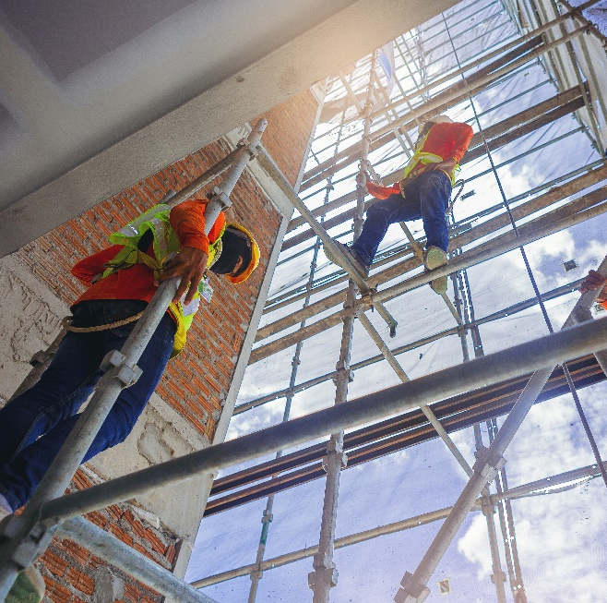
Structure of the 2023 report
Main findings
1) Status of working conditions
2) Trends in outcomes – safety, health and wellbeing
3) Major context developments and their influence on working conditions
4) OSH legislation and OSH infrastructures in the EU
Conclusions
1) Improvements
2) Stagnating or ambiguous developments
3) Areas of concern
© Panumas/Adobe Stock

Slide 4
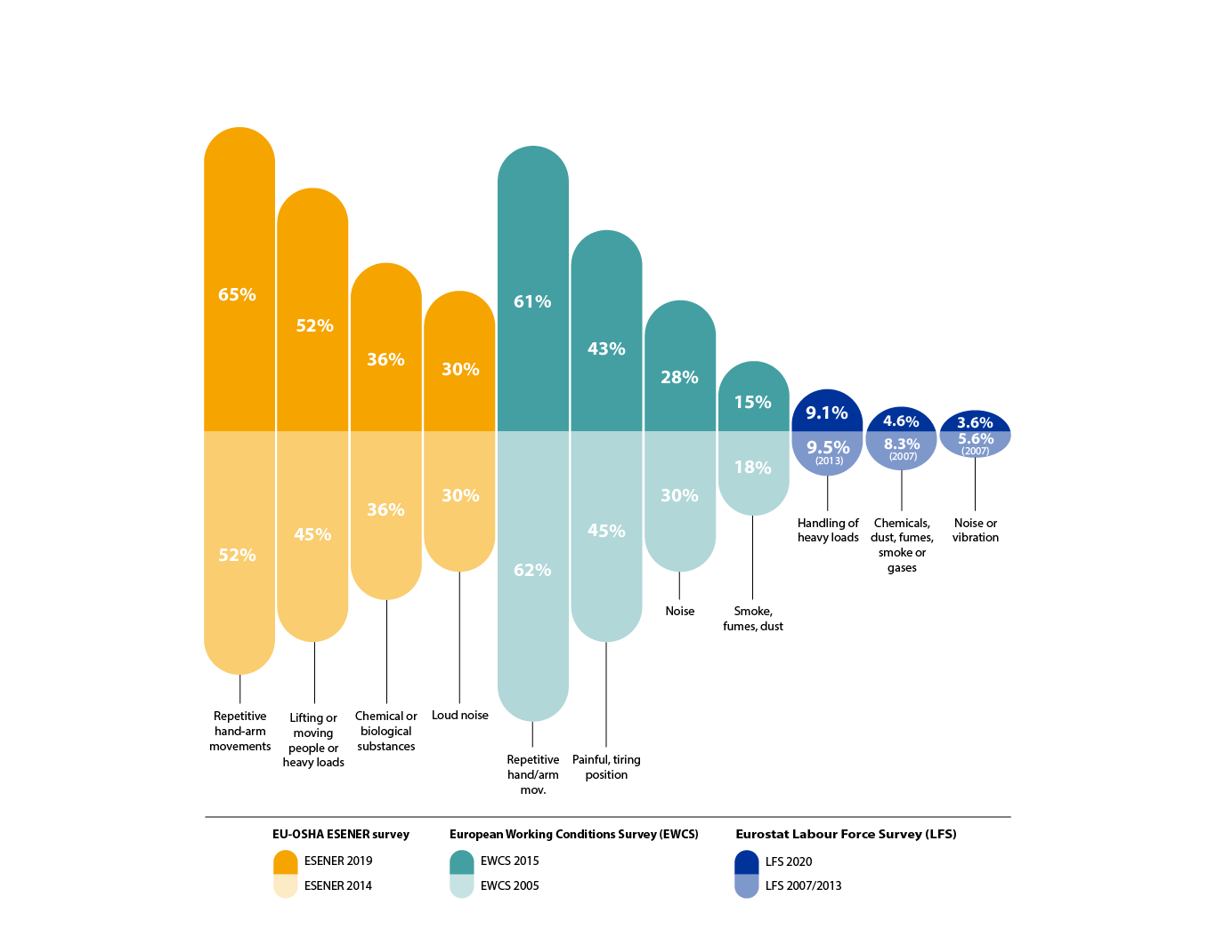
State of working conditions: physical health risks
Exposure to physical risks – ESENER, EWCS and LFS
Notes:
Sources:
Data for 2015: Eurofound: Sixth European Working Conditions Survey 2015;
https://www.eurofound.europa.eu/surveys/european-working-conditions-surveys/sixth-european-working-conditions-survey-2015
Data for 2005: Eurofound: Fourth European Working Conditions Survey 2005, Office for Official Publications of the European Communities, 2007.
https://www.eurofound.europa.eu/surveys/european-working-conditions-surveys/fourth-european-working-conditions-survey-2005
EU-OSHA– European Agency for Safety and Health at Work: ESENER Data Visualisation, Comparisons 2014 and 2019.
https://visualisation.osha.europa.eu/esener/en/survey/comparisons/2014/osh-management/en_1/company-size/E3Q200_5/EU27_2020/1
Eurostat, data of the LFS ad hoc modules 2007, 2013, 2020: Persons reporting exposure to risk factors that can adversely affect physical health by sex, age and factor
https://ec.europa.eu/eurostat/databrowser/view/hsw_exp4/default/table?lang=en

Slide 5
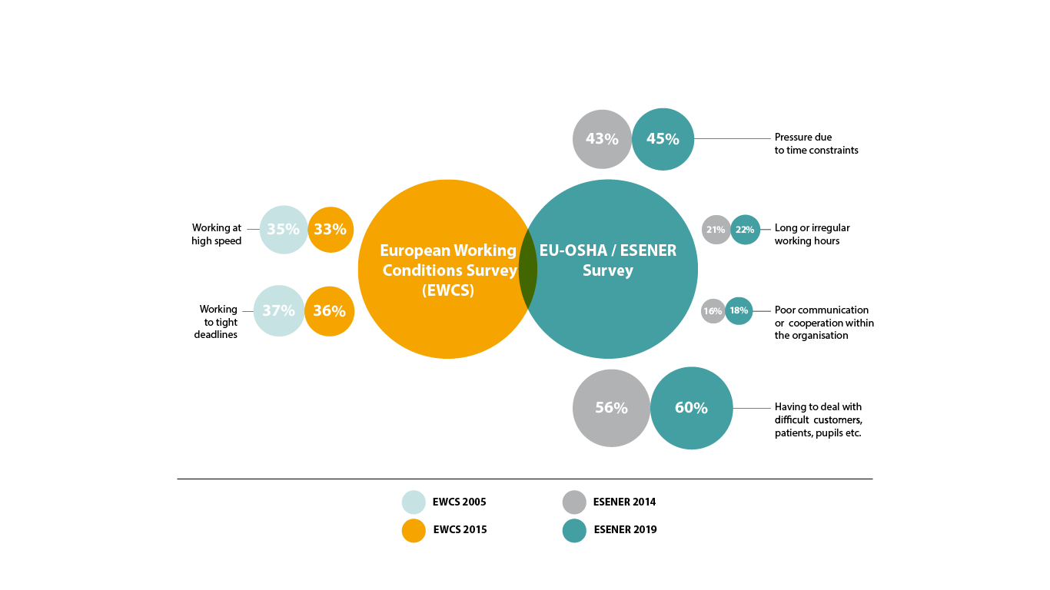
State of working conditions: psychosocial risks
Risk factors that can adversely affect mental wellbeing – EWCS and ESENER
Notes:
Sources:
Data for 2015: Eurofound Fifth European Working Conditions Survey – Data Visualisation;
https://www.eurofound.europa.eu/data/european-working-conditions-survey
Data for 2005: Eurofound: Fourth European Working Conditions Survey, Office for Official Publications of the European Communities, 2007.
https://www.eurofound.europa.eu/surveys/european-working-conditions-surveys/fourth-european-working-conditions-survey-2005
EU-OSHA – European Agency for Safety and Health at Work- ESENER Data Visualisation, Comparisons 2014 and 2019.
https://visualisation.osha.europa.eu/esener/en/survey/comparisons/2014/osh-management/en_1/company-size/E3Q200_5/EU27_2020/1

Slide 6
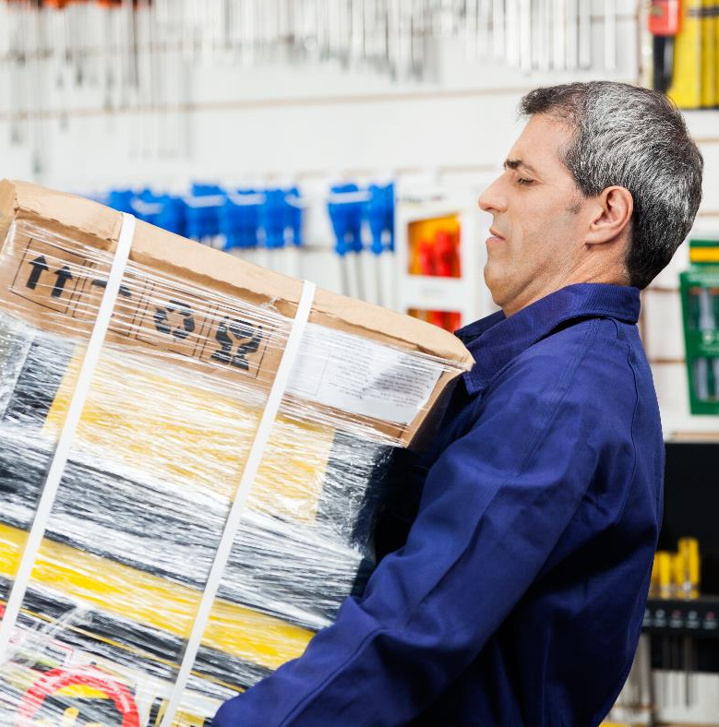
State of working conditions
Increase of work intensity from 1990 to 2005:
‘Working at high speed’ or ‘Working to tight deadlines’
Stagnation of work intensity between 2005 and 2015
Legislation, international supply chains, technology, other types of contracts
Other aspects: ageing, gender
Combined risks: Time pressure plus heavy loads plus work insecurity
© Tyler Olson/Adobe Stock
Notes:
Other types of contracts: i.e. to subcontractors, self-employed and other forms of non-standard work contracts

Slide 7
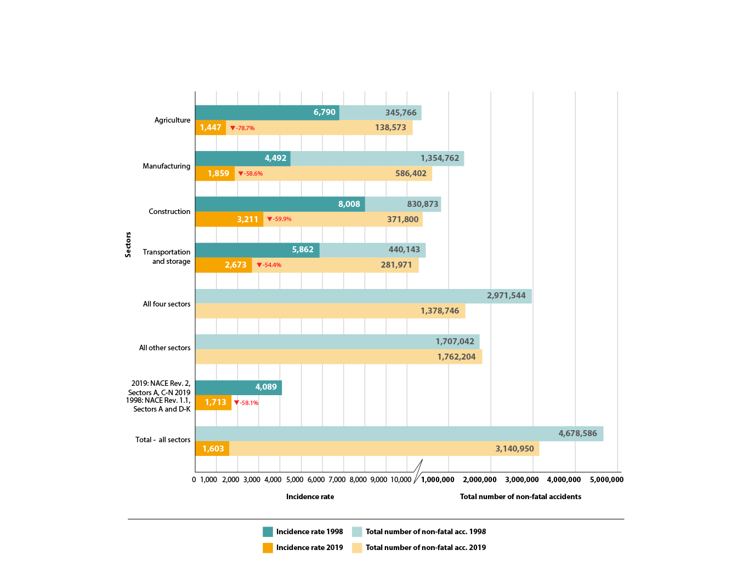
Trends in outcomes: safety, health and wellbeing
Development of the total number of non-fatal accidents at work and incidence rates
(accidents per 100,000 workers), 1998 and 2019 – Eurostat
Notes:
Sources:
Data for 1998: Statistics in focus, Theme 3-16/2001: Eurostat: Accidents at work in the EU 1998-1999.
https://ec.europa.eu/eurostat/documents/3433488/5407173/KS-NK-01-016-EN.PDF.pdf/5897dcf4-ae26-45c8-9d10-7e54dce5efed
Data for 2019: Eurostat: Accidents at work by sex and severity (NACE Rev. 2 activity Total);
https://ec.europa.eu/eurostat/databrowser/view/hsw_mi08/default/table?lang=en
Non-fatal accidents at work by NACE Rev. 2 activity and sex
https://ec.europa.eu/eurostat/databrowser/view/HSW_N2_01__custom_3359490/default/table?lang=en

Slide 8
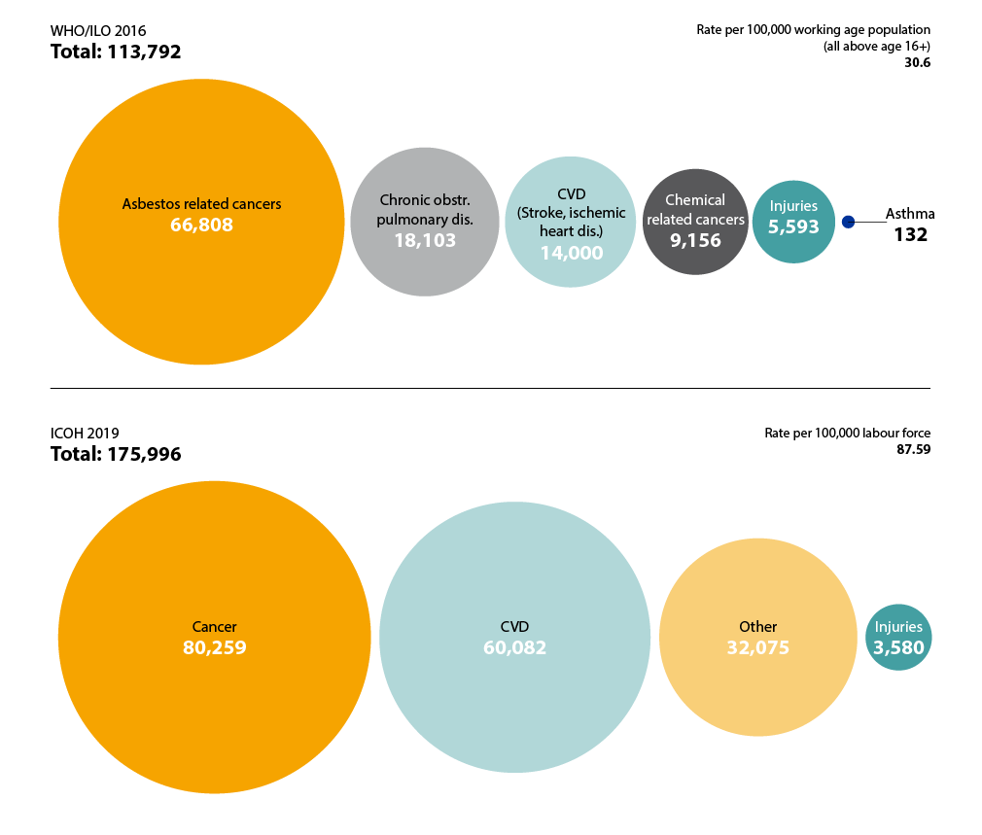
Health outcome: work-related diseases
Work-related deaths – estimates by WHO/ILO and ICOH for EU27
Notes:
Sources:
WHO, Occupational Burden of Disease Application: https://who-ilo-joint-estimates.shinyapps.io/OccupationalBurdenOfDisease/ and EU-OSHA calculations
Takala, J., Hamalainen, P., Neupane, S., Sauni, R., & Nygard, C.-H.: Comparative Global Estimates on the Work-related Burden of Accidents and Diseases. (Preprint from the Scandinavian Journal of Work, Environment & Health, https://www.sjweh.fi/).

Slide 9
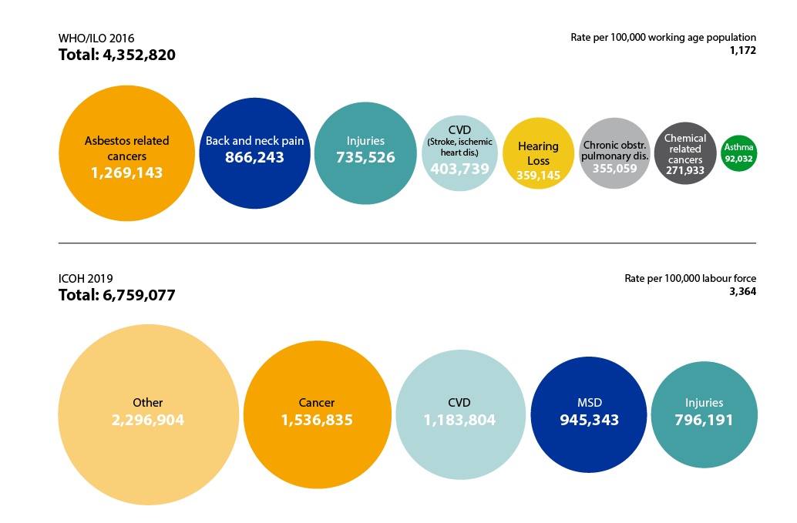
Health outcome: work-related diseases
Work-related DALYs – estimates by WHO/ILO and ICOH for the EU27
Notes:
Sources:
WHO, Occupational Burden of Disease Application: https://who-ilo-joint-estimates.shinyapps.io/OccupationalBurdenOfDisease/ and EU-OSHA calculations
Takala, J., Hamalainen, P., Neupane, S., Sauni, R., & Nygard, C.-H.: Comparative Global Estimates on the Work-related Burden of Accidents and Diseases. (Preprint from the Scandinavian Journal of Work, Environment & Health, https://www.sjweh.fi/).

Slide 10
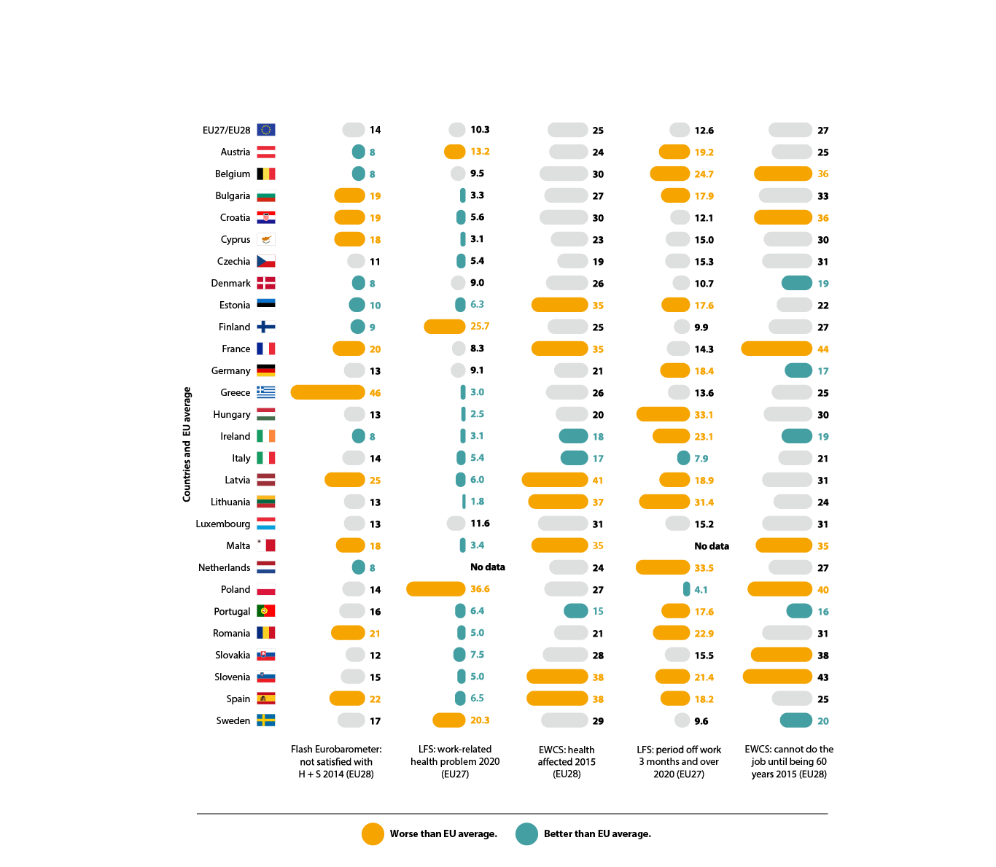
Work satisfaction, health risks and working life perspectives
Comparison of responses to self-rated work satisfaction, health risks and working life perspectives – Flash Eurobarometer, LFS and EWCS
Notes:
Sources:
Column 1: Flash Eurobarometer 398: Working conditions, 2014, p 58 Available at: https://europa.eu/eurobarometer/surveys/detail/2044.
Column 2: Eurostat: Persons reporting a work-related health problem by sex, age and educational attainment level.
https://ec.europa.eu/eurostat/databrowser/view/hsw_pb1/default/table?lang=en
Column 3: Eurofound: Sixth European Working Conditions Survey 2015.
https://www.eurofound.europa.eu/surveys/european-working-conditions-surveys/sixth-european-working-conditions-survey-2015
Column 4: Eurostat: Persons reporting a work-related health problem resulting in time off work by period off.
https://ec.europa.eu/eurostat/databrowser/view/HSW_PB3__custom_1488436/default/table?lang=en
Column 5: Eurofound: Sixth European Working Conditions Survey 2015 The exact question was: Do you think you will be able to do your current job or a similar one until you are 60 years old?
https://www.eurofound.europa.eu/surveys/european-working-conditions-surveys/sixth-european-working-conditions-survey-2015

Slide 11
Work satisfaction, health risks and working life perspectives
Comparison of responses to self-rated work satisfaction, health risks and working life perspectives – Flash Eurobarometer, LFS and EWCS
Notes:
Sources:
Column 1: Flash Eurobarometer 398: Working conditions, 2014, p 58 Available at: https://europa.eu/eurobarometer/surveys/detail/2044.
Column 2: Eurostat: Persons reporting a work-related health problem by sex, age and educational attainment level.
https://ec.europa.eu/eurostat/databrowser/view/hsw_pb1/default/table?lang=en
Column 3: Eurofound: Sixth European Working Conditions Survey 2015.
https://www.eurofound.europa.eu/surveys/european-working-conditions-surveys/sixth-european-working-conditions-survey-2015
Column 4: Eurostat: Persons reporting a work-related health problem resulting in time off work by period off.
https://ec.europa.eu/eurostat/databrowser/view/HSW_PB3__custom_1488436/default/table?lang=en
Column 5: Eurofound: Sixth European Working Conditions Survey 2015 The exact question was: Do you think you will be able to do your current job or a similar one until you are 60 years old?
https://www.eurofound.europa.eu/surveys/european-working-conditions-surveys/sixth-european-working-conditions-survey-2015

Slide 12

Major contextual developments: connection with OSH
Changes from industrial to service sectors
Technological developments (digitalisation, materials, biotechnology, circular economy, process and chemical)
Workforce structure
Shift of required skills (higher skills are needed)
Ageing of workers
Globalisation
Greater variety of non-standard contractual relations
Types of work not bound to the premises of the employer
Less clear employer–worker relationship
© agcreativelab/Adobe Stock

Slide 13
Improvements
Improvement in major areas:
Comprehensive, up-to-date legislation
Guidance and training
Application of OSH Management systems
Technological developments
Psychosocial risks
Organisational progress
Medical treatment
Financial incentives
60%
approx. less fatal and non-fatal accidents at work since the mid-nineties

Slide 14
Improvements
The awareness and the amount and quality of preventive information and guidance has significantly increased and widened.
Recognised occupational diseases (e.g.: hearing loss, skin diseases, cancer from certain chemical substances): data show a similar decrease as work accidents.
International OSH efforts (ILO, WHO, ICOH, IALI), and voluntary efforts by enterprises and NGOs in global supply chains.

Slide 15
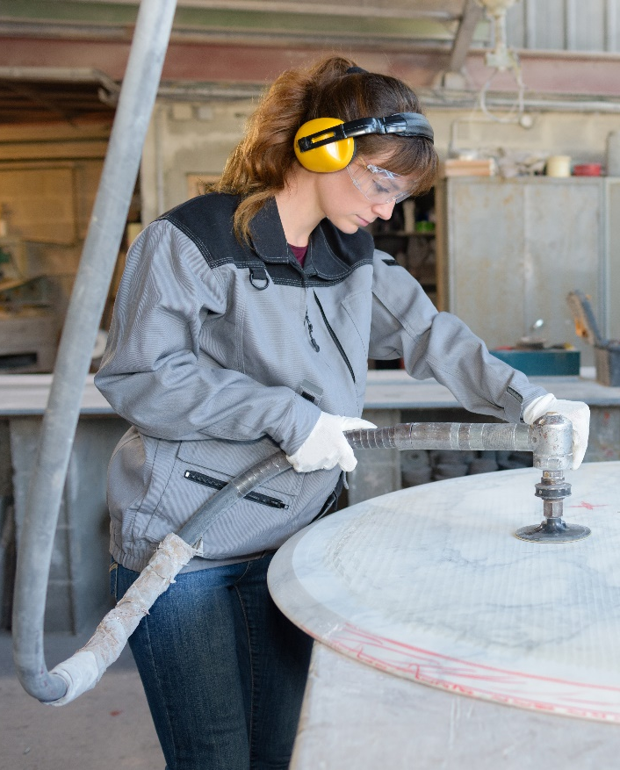
Stagnation or ambiguous developments
Share of workers exposed to physical safety and health risks (noise, vibrations, dust, chemical and biological agents, high or low temperatures, electrical shock, etc.).
Ergonomic risks such as repetitive hand arm movements, tiring and painful positions, lifting and carrying and prolonged sitting.
Work intensity seems to stagnate between 2005 and 2015 (supply chains, shift quite a relevant part of work to other types of contracts, etc.).
OSH in some forms of work, e.g.: self-employed, seasonal work, mobile work, work from home and platform work becomes challenging, legislation to keep-up with developments.
© auremar/Adobe Stock

Slide 16

Stagnation or ambiguous developments
Precarious work has an impact on overall health (morbidity, mortality)
Lack of resources or expertise can prevent enterprises from addressing complex risk prevention tasks (e.g., psychosocial, chemical, biological, electromagnetic)
Contribution of work to disease is still under discussion
Shift to administrative and emotionally demanding sectors (e.g.: education, human health) means increased psychosocial and emotional challenges (e.g.: tight timelines, difficult clients, long working hours) combined with lower physical activity.
© Quality Stock Arts/Adobe Stock

Slide 17

Areas of concern
Incomplete compliance with OSH regulation in certain sectors/types of work
(e.g.: mobile/homework, domestic work, care work, seasonal, platform work)
A new definition of 'work' may be necessary, along with better information, safety culture, and stronger self-responsibility
Undeclared/illegal employment is not accurately reflected in statistics
A growing share of work tasks go along with physical inactivity (e.g.: offices, drivers, etc.), characterised by permanent sitting combined with high requirements for visual and mental focusing during work
© Kzenon/Adobe Stock

Slide 18

Areas of concern
Significant differences between Member States
Eastern EU Member States show the worst status for self-reported physical risks, wellbeing, and expectations to do the job until 60
Central, Western, and Northern Member States have a higher presence of psychosocial risks
Ethical considerations for work in globalised supply chains have led to increased activities on decent work in developing countries and global supply chains
© APchanel/Adobe Stock

Slide 19
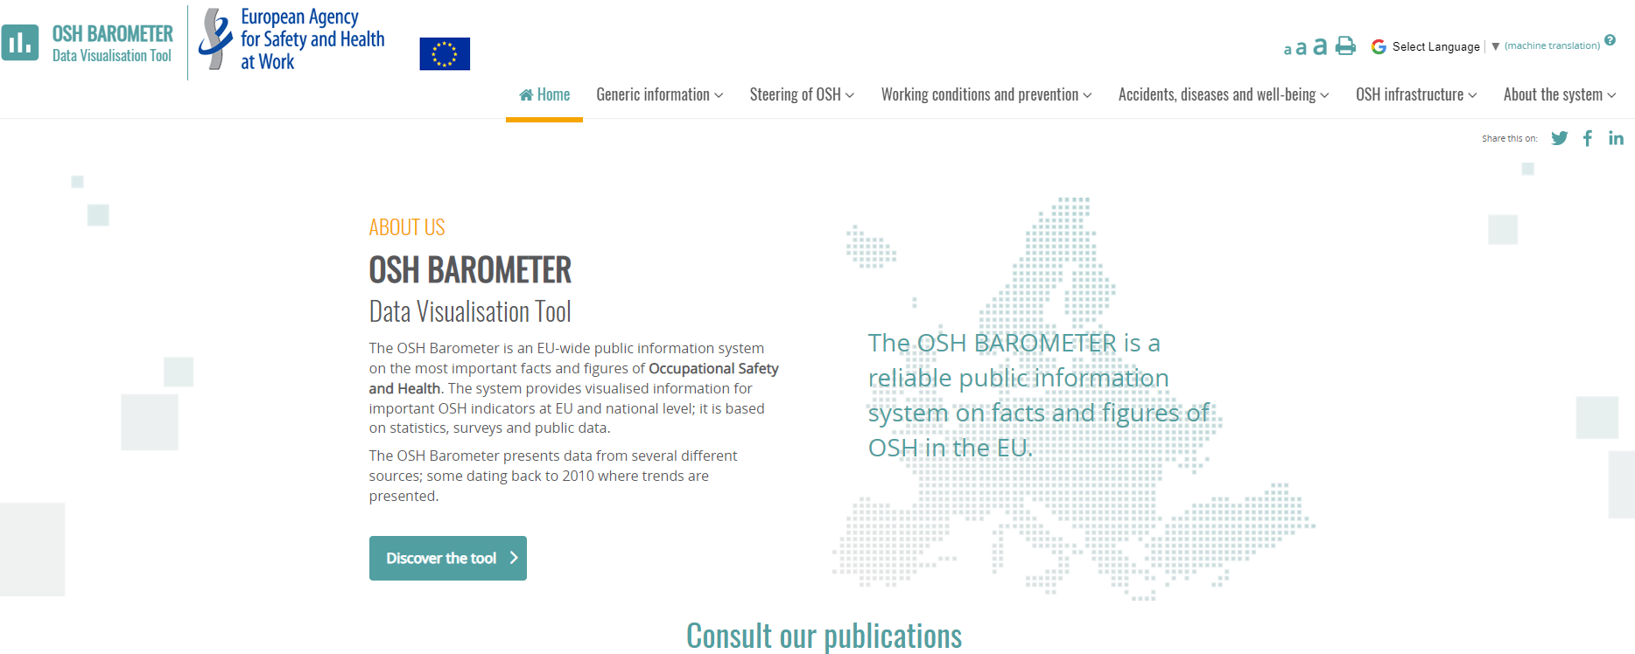
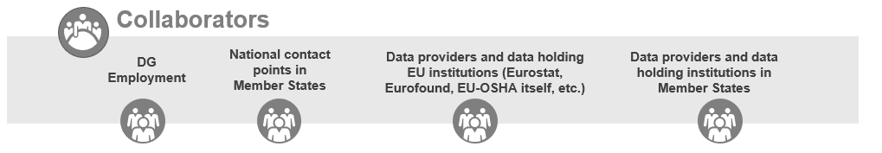
EU OSH INFO System: OSH Barometer data visualisation tool
https://visualisation.osha.europa.eu/osh-barometer

Slide 20
‘OSH in Europe – state and trends 2023’: What’s available?
Report and summary ‘Occupational safety and health in Europe: state and trends 2023’
Policy brief
OSH Barometer data visualisation platform

