Slide 1
Healthy Workplaces Campaign 2020-22
LIGHTEN THE LOAD
Working with chronic musculoskeletal disorders

Slide 2
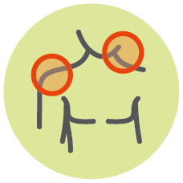


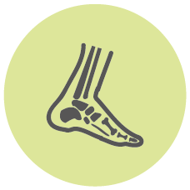
Rheumatic and chronic musculoskeletal conditions
Are long-term, chronic problems affecting
  Muscles, bones, joints, tendons and the tissues that connect them

Slide 3

Rheumatic and chronic musculoskeletal conditions
They include
  Rheumatism, arthritis, osteoarthritis, osteoporosis, fibromyalgia, gout, sciatica…
  Disorders without a precise cause (back pain, shoulder pain etc.)
© CC0 Creative Commons (Pexels, Karolina Grabowska)

Slide 4

Rheumatic and chronic musculoskeletal conditions
Conditions caused or aggravated by work are known as work-related musculoskeletal disorders (work-related MSDs)

Slide 5





What impact do chronic MSDs have on individuals?
Difficulty doing some tasks
Can limit everyday chores, work and leisure activities
Often stiffness
Tiredness and fatigue if sleep is disturbed
Pain is not visible

Slide 6



What impact do chronic MSDs have on individuals?
Less severe pain may still be persistent and wearing
Pain can be unpredictable and some conditions are variable, with flare-ups, meaning good and bad days
The sufferer is frustrated by disbelief of others
Fear about the future: Will it get worse? Will I lose my job?
Stress, anxiety or depression make it harder to ignore the pain

Slide 7
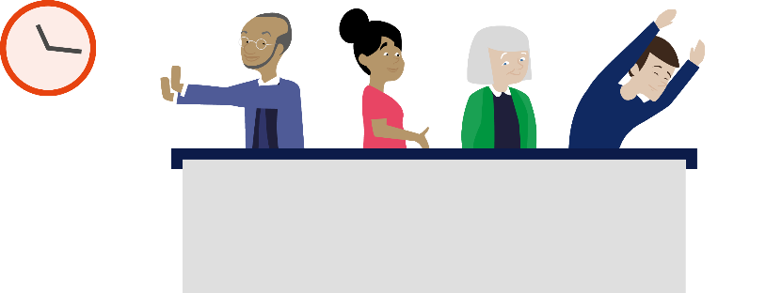
Chronic MSDs can affect people’s ability to work, but...
People do not need to be 100 % fit to work.
Workers with chronic MSDs:
Work around their problems
Are productive and motivated
Can continue to work with the right adjustments
Notes:
People do not have to be 100 % fit to work
Those with chronic MSDs learn to work around their problems and manage their pain, at home or at work. For example, by avoiding repetitive movements or prolonged sitting without a break or prolonged standing
People with chronic conditions are often productive, motivated and try to avoid missing work. Older workers have valuable skills and experience. Younger workers with conditions have much to offer.
With the right adjustments, they can usually continue to work. Often only simple and inexpensive measures are needed

Slide 8

Early intervention
Hiding the problem makes it worse
The earlier the better
Enable workers to talk
Act on the outcome
Early access to professional support
Notes:
Early intervention is “taking measures — such as providing professional support, rapid referral and diagnosis, adjusting the work environment — as soon as the symptoms appear.”
A musculoskeletal condition that is affecting work should be managed as soon as possible. This is good for the worker and good for business.
Workers may try to hide their problem, allowing it to worsen which affects their work performance. (This is known as presenteeism). This means that they do not get any support from the workplace
The earlier a problem is reported
The easier it is to deal with
The less likely it is to become a long-term problem
The less likely there will be long-term work loss.
Workers need to be enabled and encouraged to talk to their employer as soon as an MSD problem arises or causes difficulties
Employers need to act on the outcome of the conversation
Employers can encourage early access to professional support. They can enable it, for example by providing access to physiotherapy.
Early intervention significantly lowers the worker’s chance of experiencing long-term absence from work. It can reduce absenteeism and lead to real savings in national health care and social welfare systems.

Slide 9


Key principles for addressing chronic MSDs
People with chronic MSDs need to be able to minimise, manage and work around their problems. This needs:
1. Understanding
3. Support
2. Awareness
4. Workplace
action
Notes:
People with chronic MSDs need to be able to minimise, manage and work around their problems.
This needs:
A comprehensive approach to understanding their needs, including through open conversations
Being aware of the risks and the problems in the workplace for a worker with a musculoskeletal problem
Supporting the worker with a chronic condition to manage their own health proactively
Action to create a workplace that prevents MSD risks, encourages early intervention for a musculoskeletal problem and promotes good musculoskeletal health

Slide 10

Health and safety regulations
Health and safety regulations require risk assessment and reduction
  Principles of avoiding risk at source and adapting work to workers
  Take account of any workers who are particularly ‘sensitive’
  Workplace requirements for disabled workers
Notes:
The European Framework directive on Safety and Health at Work (Directive 89/391 EEC), which is enacted in Member State legislation, requires employers to carry out risk assessments and prevent and manage MSDs based on the results of the risk assessment.
A hierocracy of prevention measures should be applied, which include avoiding MSD risks at source, prioritising collective measures over individual measures and also adapting work to workers to help make work easier.
This means that the priority is on making work safer and easier for all workers. This is important because measures that make work easier for all the workforce can enable an individual with reduced work capacity to remain in employment.
In addition, particularly sensitive risk groups must be protected against the dangers which specifically affect them. This could include an older worker who is having problems with physical work or someone with rheumatism or arthritis whose work affects their symptoms.
Legislation setting out minimum requirements for workplaces requires employers to take account of disabled workers, in particular regarding doors, passageways and staircases, washbasins and lavatories etc. and workstations used or occupied directly by disabled persons. (Directive 89/654/EEC)

Slide 11

Work equality regulations
Work equality legislation requires making accommodations for workers with a disability
  Some countries have more detailed requirements on return-to-work and support programmes
Notes:
Employment equality legislation requires employers to make accommodations for workers with a disability. This compliments employers’ health and safety duties to protect ‘sensitive’ workers.
Risk assessment can be used to help determine what accommodations an individual may need.
Not all workers with a chronic MSD will have a formally recognised disability. Early intervention should be the principle, with all ‘sensitive’ workers provided with accommodations to prevent work from making their condition worse, not only those whose conditions are so severe that they are classified as having a disability.
(Directive 2000/78/EC establishing a general framework for equal treatment in employment and occupation)

Slide 12
Some success factors for ensuring the safety and health of a diverse workforce
Consider diversity at the design and planning stages
Worker consultation and participation
Coordination between occupational health and equality/human resources
Training on diversity
Seeking advice when necessary
Notes:
The way to determine the collective and individual risk prevention measures is by being sensitive to diversity in the workforce when carrying out risk assessments.
Success factors for ensuring the health and safety of a diverse work force include
Considering diversity at the design and planning stages, to achieve workplaces which are as inclusive as possible. This is known as universal design. It includes factors such as adjustability of equipment.
Worker consultation and participation – to ensure that the issues, needs and suggestions of everyone are considered
Coordination between occupational health and equality and human resources
Training on diversity
Seeking expert advice when necessary
Preventing risks effectively and making a workplace more inclusive reduces the need to make specific accommodations for individuals.

Slide 13

Making accommodations
Involve worker,
health care team,
supervisor
Worker´s
capabilities
Open
conversation
Support
Sufficient
time
Different
measures
External info
and support
Review
measures
Notes:
Success factors for making accommodations include the following:
Show that you are supportive and want to help
Focus on the worker’s capabilities, not disabilities
Have an open conversation with the worker about their symptoms and how they vary, what tasks they find challenging, and what support they need
Involve the worker, their health care team and supervisor
- Medical advice helps with knowing what support is needed
- Medical information can only be shared with permission. The employer does not need to know the diagnosis, but will need to know how symptoms affect an individual’s ability to work in order to provide support
Allow sufficient time for the process and try out different measures to see what will be most helpful
Find out what external information and support is available
Review measures and make any additional changes if the worker’s condition changes in the future

Slide 14
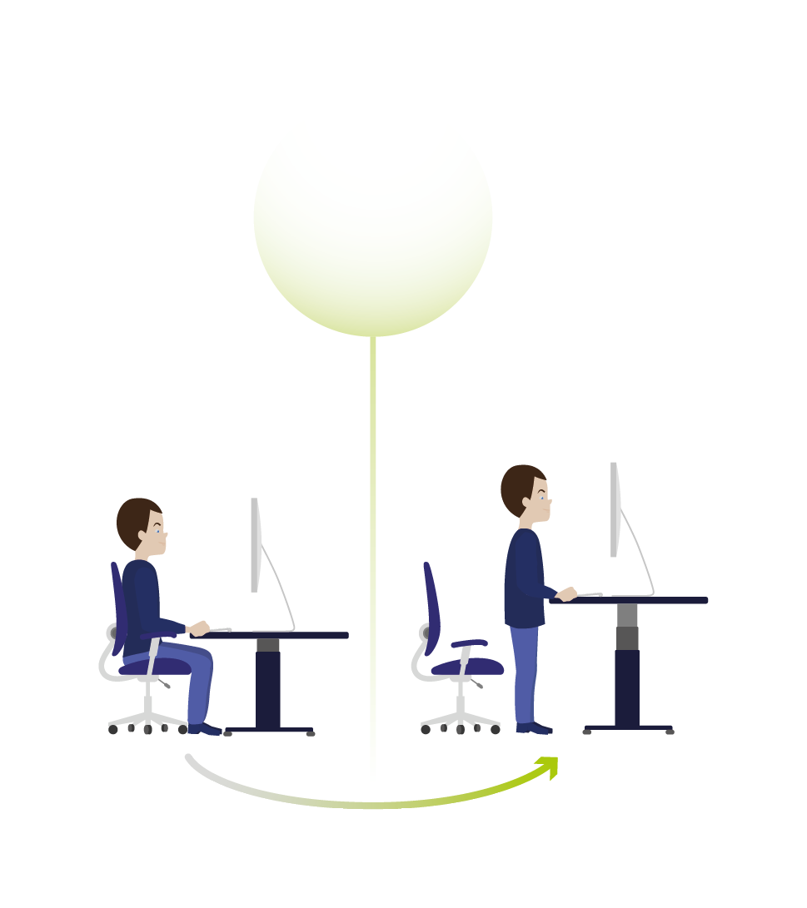
Some simple measures to continue working*
An ergonomic mouse
Voice-dictation software
Wireless headset for answering the phone
A foldable perching stool for site visits
A special cushion to relieve pressure when sitting
An adjustable height desk/ sit-stand desk
Swapping physical tasks with colleagues
Try out different measures to find what works
Equipment and
workplace adaptation
*EU-OSHA case studies on working with chronic MSDs, 2020
Notes:
Most workers with a chronic MSD are able to continue to work provided some allowance is made for their condition. These measures have all supported a worker with a chronic MSD to continue to work. None of these measures are complicated or expensive.

Slide 15
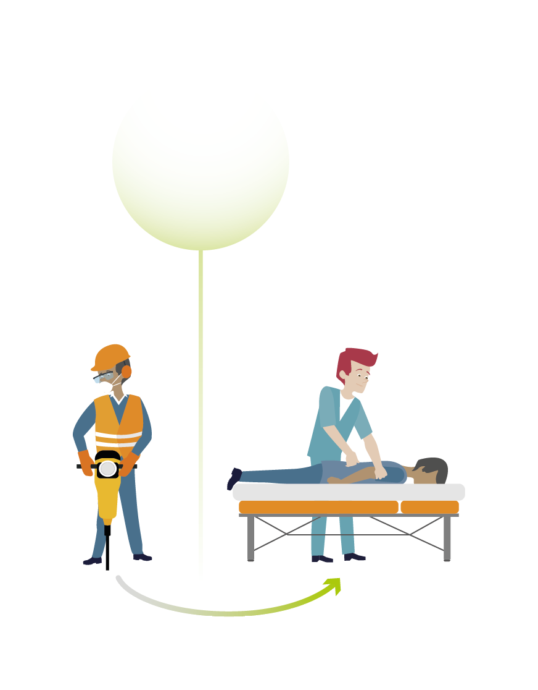
More simple measures
A gradual return-to-work and reduced hours
Flexible working to accommodate medical appointments
Teleworking on ‘bad days’
Later start time to avoid standing on the metro
Allowance to take more frequent breaks to move
and stretch
Access to a rest room
Swapping physical tasks with colleagues
Usually a combination of several measures is needed
Support
Notes:
Some of these measures, such as flexible working and teleworking, can benefit all workers. Offering such measures to all workers makes a workplace more inclusive and reduces the need for individual adjustments. This also helps avoid singling out a worker with a chronic MSD for ‘special treatment’.

Slide 16

Promote all workers’ musculoskeletal health
Assess
Avoid
Recognise
Encourage
Rehabilitate
Promote
Notes:
The aim is for workplaces to have a pro-active approach to prevent MSD risk factors and promote all workers’ musculoskeletal health. This includes:
Assessing and preventing MSD risks
Avoiding static and awkward postures, heavy lifting and repetitive movements
Recognising that some workers may be more susceptible
Encouraging early reporting of problems and consulting workers
Providing support to return-to-work and having a return-to-work policy
Promoting MSD health, for example, promoting healthy backs, promoting ways to reduce prolonged sitting, e.g. through mini-breaks, and static postures, promoting physical activity

Slide 17
Finally
Health and safety measures which make work easier for all the workforce can enable an individual with reduced work capacity to remain in employment
Simple measures to support an individual can often benefit the whole workforce
Aim to design inclusive workplaces for a diverse workforce. This is called Universal Design

Slide 18
Practical resources available
Analysis of case studies on working with chronic musculoskeletal disorders https://osha.europa.eu/en/publications/analysis-case-studies-working-chronic-musculoskeletal-disorders/view
OSHWiki article: Working with rheumatic and musculoskeletal diseases (RMDs) https://oshwiki.eu/wiki/Working_with_rheumatic_and_musculoskeletal_diseases_(RMDs)
OSHWiki article: Managing low back conditions and low back pain https://oshwiki.eu/wiki/Managing_low_back_conditions_and_low_back_pain
Conversation starters for workplace discussions about musculoskeletal disorders https://osha.europa.eu/en/publications/conversation-starters-workplace-discussions-about-musculoskeletal-disorders/view
EU-OSHA website – MSDs theme : https://osha.europa.eu/en/themes/musculoskeletal-disorders
Practical tools and guidance: https://healthy-workplaces.eu/en/tools-and-publications/practical-tools
HWC 20-22 website : https://healthy-workplaces.eu/

Slide 19






Join us and lighten the load!
Find out more on the campaign website:
  healthy-workplaces.eu
Subscribe to our campaign newsletter:
  https://healthy-workplaces.eu/en/healthy-workplaces-newsletter
Keep up to date with activities and events through social media:
#EUhealthyworkplaces
Notes:
© European Agency for Safety and Health at Work, 2020
Reproduction is authorised provided the source is acknowledged.
For any use or reproduction of photos or other material that is not under the copyright of EU-OSHA, permission must be sought directly from the copyright holders.

