Slide 1
Healthy Workplaces Campaign 2020-22
LIGHTEN THE LOAD
Musculoskeletal disorders related to telework – Tips for teleworkers
Notes:
Tips in this PPT are good practice examples mainly intended to teleworkers. They are not necessarily mandatory or relevant to all teleworkers. Their relevance will depend on the specificities of each teleworker / home-based telework environment / company and the outcomes of risk assessments.

Slide 2

Overview
Introduction: MSDs related to teleworking
Risk assessment
Main work-related MSD risk factors related to telework
Preventive / protective approaches to address MSD risk factors related to telework

Slide 3
Introduction - Home-based telework
Telework is defined as the use of information and communication technologies (such as smartphones, tablets, laptops and desktop computers) for work that is performed outside the employer’s premises
This PPT focuses on working from home (home-based telework) and is intended for teleworkers
  Links to practical resources are included in the “Notes page”
  Practical tools and guidance related to teleworking are also available here
Notes:
EU-OSHA – European Agency for Safety and Health at Work. Practical tools and guidance MSDs database. Teleworking resources. https://healthy-workplaces.eu/en/tools-and-publications/practical-tools?f%5B0%5D=field_msd_priority_area%3A4986

Slide 4
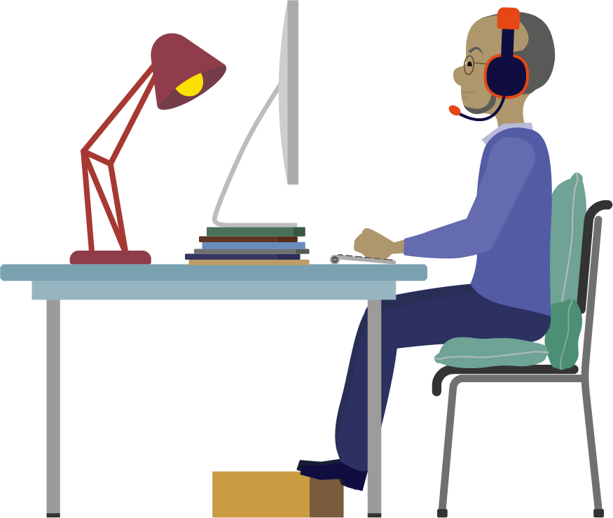
Introduction - Home-based telework and MSDs
Teleworking has gained importance in recent years.
Although home-based teleworking has potential advantages, it could also be detrimental to teleworkers’ health and contribute to the development or exacerbation of Musculoskeletal Disorders (MSDs).

Slide 5
Risk Assessment
Telework has to be included in the employer’s mandatory risk assessment (RA)
To be clarified (based on legal provisions / enterprise policy):
  Who (when / how) assesses the risks;
  Risks are assessed by the employer based on information provided by the worker;
  Individual RA for each teleworker (self-assessment based on the tool / guide / checklist provided by the employer);
  The employer / prevention specialist may visit the home with the worker’s permission. If permission is not granted, RA should be carried out on the basis of the information collected from the teleworker.
Notes:
EU-OSHA – European Agency for Safety and Health at Work. Musculoskeletal disorders and telework. https://oshwiki.eu/wiki/Musculoskeletal_disorders_and_telework
EU-OSHA – European Agency for Safety and Health at Work. E-fact 33 Risk assessment for teleworkers. https://osha.europa.eu/en/publications/e-fact-33-risk-assessment-teleworkers/view.
EU-OSHA – European Agency for Safety and Health at Work. Body and Hazard mapping in prevention of musculoskeletal disorders (MSDs). https://osha.europa.eu/en/publications/body-and-hazard-mapping-prevention-musculoskeletal-disorders-msds.
EU-OSHA – European Agency for Safety and Health at Work. Risk Assessment for Musculoskeletal Disorders (MSDs). https://osha.europa.eu/sites/default/files/publications/documents/HWC20-22_RA-MSDs.pptx
EU-OSHA – European Agency for Safety and Health at Work. Introduction to Musculoskeletal Disorders (MSDs) prevention. https://osha.europa.eu/sites/default/files/publications/documents/HWC20-22_IntroductiontoMSDsprevention.pptx
EU-OSHA – European Agency for Safety and Health at Work. Practical tips to make home-based telework as healthy, safe and effective as possible. https://oshwiki.eu/wiki/Practical_tips_to_make_home-based_telework_as_healthy,_safe_and_effective_as_possible

Slide 6
Main work-related MSD risk factors related to telework
Workstation ergonomic and related body postures
Work environment factors
Sedentary behaviour and physical (in)activity
Work organisation factors
Psychosocial risk factors
Individual factors

Slide 7
1. Workstation ergonomics and body postures
Computer work involves repetitive movements that are mostly performed in a sustained static, mainly seated, position.
This can result in MSDs, particularly when it is accompanied by poor ergonomics and lack of breaks
Many teleworkers use laptop computers and makeshift home workstations, that result in non-neutral body postures and, hence, increased musculoskeletal complaints.
Inappropriate location of the screen, keyboard or mouse and lack of forearm support lead to discomfort and muscle loading of the upper extremity and back.
Notes:
EU-OSHA – European Agency for Safety and Health at Work. Risk factors for musculoskeletal disorders development: hand-arm tasks, repetitive work. https://oshwiki.eu/wiki/Risk_factors_for_musculoskeletal_disorders_development:_hand-arm_tasks,_repetitive_work
EU-OSHA – European Agency for Safety and Health at Work. Risk factors for musculoskeletal disorders – working postures. https://ohttps//oshwiki.eu/wiki/Risk_factors_for_musculoskeletal_disorders_%E2%80%94_working_postures

Slide 8
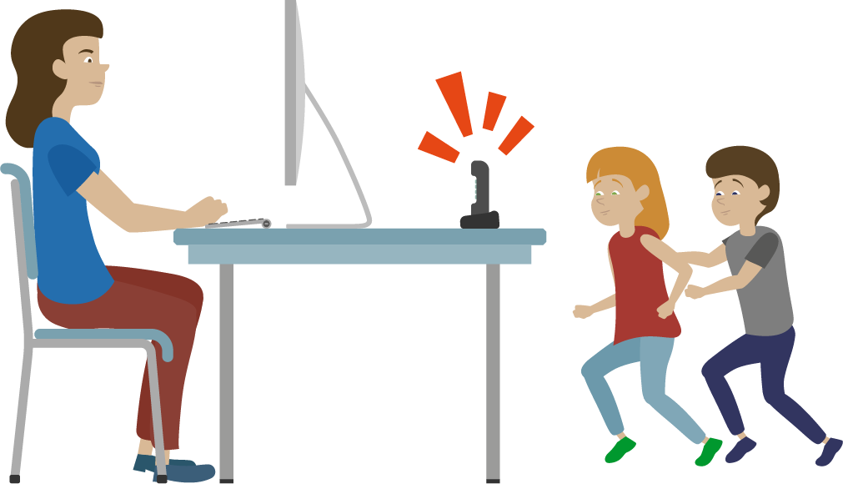
2. Work environment
There is evidence that work environmental factors such as being disturbed by glare or reflection, draught, noise and poor air quality are related to MSDs at the neck and shoulder.
Although environmental factors are given due consideration in an office design, they are likely to be overlooked in home-based teleworking.

Slide 9
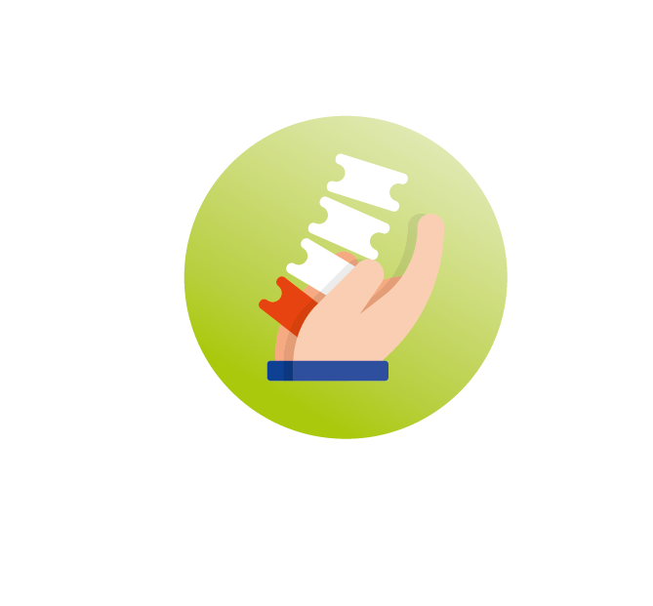
3. Sedentary behaviour and physical activity
Home-based teleworking involves longer periods of sitting with fewer work interruptions than in the office.
This in combination with poor ergonomic workstations may lead to an increase in MSDs.
The lack of movement during sitting leads to a higher load on the vertebral discs and reduces circulation of the blood and the supply of oxygen to the muscles.
Health risks associated with sedentary behaviour cannot be fully compensated by physical exercise during leisure time.

Slide 10

4. Work organisation
Another risk factor of home-based teleworking is the blurred boundaries between work and home.
Teleworkers often work longer hours at home to ensure that they meet or exceed employer’s expectations.
Teleworkers have fewer opportunities to socialise with colleagues.
Extended work hours associated with longer periods of sitting may result in an increased risk of MSDs.

Slide 11

5. Psychosocial factors 1 – negative factors
Excessive workload, increased social isolation from colleagues, lack of face-to-face interaction and support, and anxiety can have an impact on workers’ wellbeing, which in turn can increase the risk of developing MSDs.
Extent of teleworking is negatively associated with social support from colleagues and line managers.
Lack of social support from colleagues and superiors, low autonomy, high job demands, and low job satisfaction seems to be related to an increased occurrence of MSDs.
The omnipresence of the work and the feeling of living in the ‘office’ day and night may provoke stress, contributing to MSDs.
Notes:
EU-OSHA – European Agency for Safety and Health at Work. Psychosocial risk factors for musculoskeletal disorders. https://oshwiki.eu/wiki/Psychosocial_risk_factors_for_musculoskeletal_disorders_(MSDs)

Slide 12
5. Psychosocial factors 2 – positive factors
Positive psychosocial aspects of home-based teleworking (e.g. greater autonomy and higher job satisfaction) would have a beneficial effect on health problems such as MSDs and, potentially delay the onset of symptoms.

Slide 13
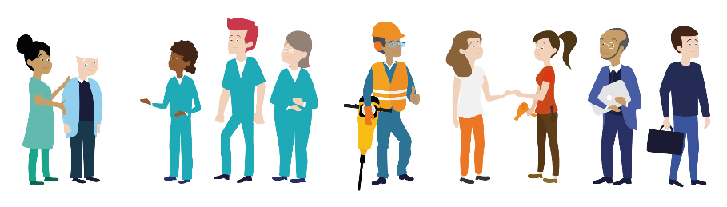
6. Individual factors
Workers' characteristics can also be MSD risk factors
(if risks aren't managed properly):
  age
  gender
  condition of health (if they already suffer from an MSD or have done so in the past)
  lack of knowledge of work techniques and safety procedures
  …
Notes:
EU-OSHA – European Agency for Safety and Health at Work. Workforce diversity and risk assessment: ensuring everyone is covered. Summary of an Agency report. Facts 87. https://osha.europa.eu/en/publications/factsheets/87
SLIC – Senior Labour Inspectors´ Committee. Principles for Labour Inspectors. With Regard to Diversity-Sensitive Risk Assessment, Particularly as regards Age, Gender and other demographic characteristics. Non-binding publication for EU Labour Inspectors.
https://circabc.europa.eu/ui/group/fea534f4-2590-4490-bca6-504782b47c79/library/341d5e56-dc0c-41ce-ba77-be660f3cf810/details
EU-OSHA – European Agency for Safety and Health at Work. Including gender issues in risk assessment. Facts 43. https://osha.europa.eu/en/publications/factsheet-43-including-gender-issues-risk-assessment

Slide 14
Preventive / protective approaches to address MSD risk factors related to telework at home
Workplace design and ergonomics
Work environment
Sedentary behaviour
Work organisation
Psychosocial factors

Slide 15
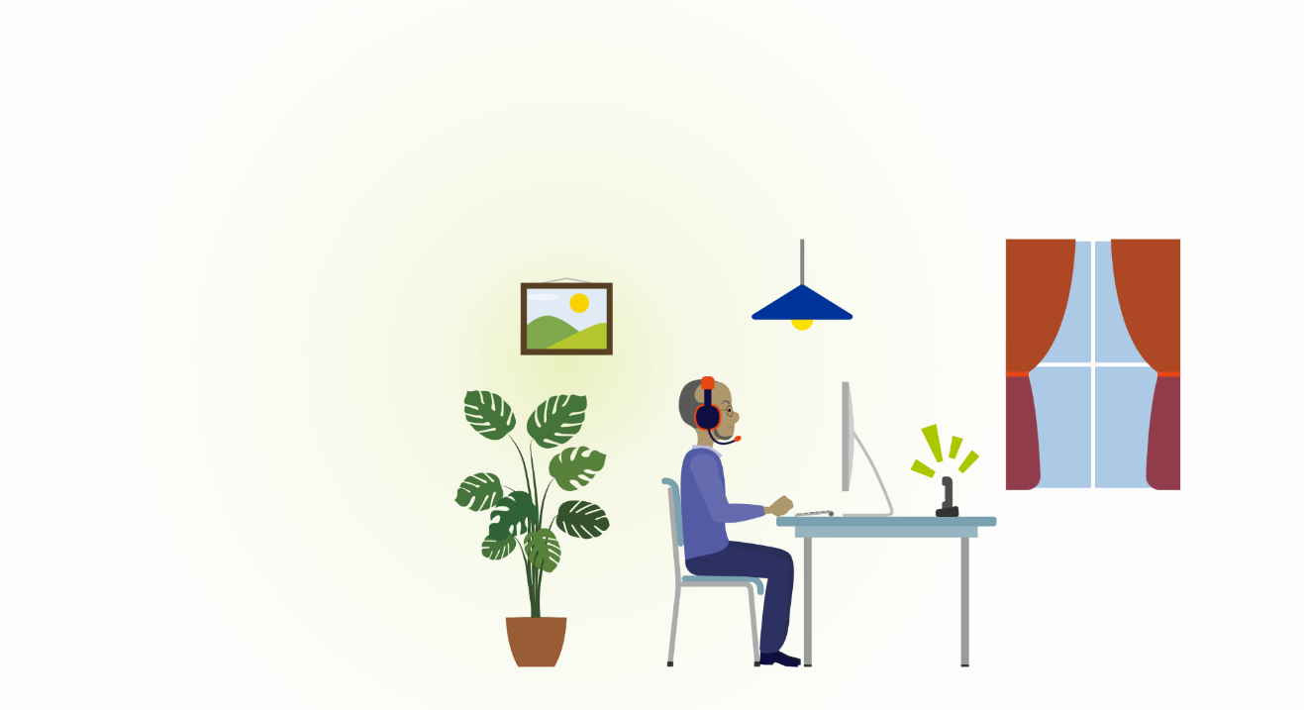
1. Workplace design and ergonomics
Teleworkers do not always have the same resources and possibilities at home as they do at the office.
To make the home office a comfortable and healthy workplace, here are some tips related to:
  Office chair
  Office desk
  Monitor
  Mouse and keyboard
  Document stand

Slide 16
1. Workplace design and ergonomics – Office chair
The chair is preferably adjustable in height, back rest, seat depth, arm rests and dynamic tilt (to create movement).
For a neutral sitting posture, make sure that the chair is correctly adjusted.
If the chair is non-adjustable:
  adapt the seat height so that the hips are slightly higher than the knees and the thighs are sloped slightly downwards. If the seat is too low, use a cushion (or two). That helps to maintain a comfortable body posture (with the back natural aligned).
  ensure that the feet are in good contact with the floor. If this is not the case, take a stable object and place it under the feet to improve contact with the floor.
  use an additional support (e.g. thin cushion) behind the lower back, when the lower back is not well-supported.
Notes:
Canadian Centre for Occupational Health and Safety. OSH Answer Fact Sheets: How to Adjust Office Chairs. https://www.ccohs.ca/oshanswers/ergonomics/office/chair_adjusting.html.
Institute for Work & Health. Setting up a temporary home office. https://www.iwh.on.ca/newsletters/at-work/100/setting-up-temporary-home-office?utm_source=iwhnews&utm_medium=email&utm_campaign=iwhnews-2020-04

Slide 17
1. Workplace design and ergonomics – Office desk
Make sure that the desk is large enough and there is sufficient legroom. Preferably at least a depth of 80cm and a thickness less than 5cm.
If the height of the desk is adjustable, adapt the height to elbow height (note that the shoulders are relaxed). Before doing that, make sure of a correct body posture while sitting (see office chair).
If the desk height is non-adjustable:
  The desk is too high: raise the sitting height of the chair (e.g. by using cushions in case of a non-adjustable chair) so that the elbows are at the same height as the desk.
  The desk is too low: raise the desk height (e.g. by using blocks) so that the elbows are at the same height as the desk. But keep it stable and safe.

Slide 18
1. Workplace design and ergonomics – Monitor
To avoid muscle strain at the neck and shoulder, it is important to position the screen at the correct height (i.e. at eye level or just below). Therefore, use a laptop stand or, if not available, a box or a stack of books to the exact height.
Preferably, use an external screen (that is large enough, at least 19 inch).
When using two screens, place them in a V-shape directly in front of you (by using both screens equally) or the primary screen directly in front and the secondary screen on one side of you (by using one screen more than the other).
Place the screen(s) at the correct height and an arm’s length from the eyes.
To avoid eye fatigue, use the 20-20-20 rule (i.e. look every 20 minutes for at least 20 seconds at a distance of at least 20 feet).
Increase readability by using full width of screen, non-colors (e.g. dark font on light background) and sufficiently large font size and line spacing.
Notes:
Canadian Centre for Occupational Health and Safety. OSH Answers Fact Sheets. Computer Monitors and Display Colours. https://www.ccohs.ca/oshanswers/ergonomics/office/vdtcolor.html.

Slide 19
1. Workplace design and ergonomics – Mouse and keyboard
While working on the laptop, it is recommended to use a separate mouse and keyboard. This allows to adopt a more comfortable body posture and prevents muscle strain at the neck and shoulder.
Preferably use a flat keyboard (or fold in the keyboard feet).
Position the keyboard directly in front of the screen, approximately 5-10cm from the edge of the desk.
Place the mouse as close as possible to the keyboard.
Use the mouse correctly. Make sure that the arm is well supported by the desk (or armrest) and that the side of the hand rests on the desk.
Avoid resting the hand on the mouse while not using it.
Reduce mouse clicks by using keyboard short cuts where possible.
A vertical or roller mouse could be appropriate for employees already suffering from MSDs
Notes:
Canadian Centre for Occupational Health and Safety. OSH Answers Fact Sheets. Computer Mouse – Selection and Use. https://www.ccohs.ca/oshanswers/ergonomics/office/mouse/mouse_selection.html.

Slide 20
1. Workplace design and ergonomics – Document stand
Use a document stand when typing up notes or text from paper documents. It helps to maintain a neutral posture at the neck and back.
Position the document stand behind the (external) keyboard and beneath the monitor, directly between the monitor and keyboard.
Arrange it at a slight angle (approximately 45°) so that the documents are clearly legible.
In case of touch typing, place the document stand at the same height and distance as the monitor (so the eyes do not have to focus each time and the neck remain in a comfortable position).

Slide 21
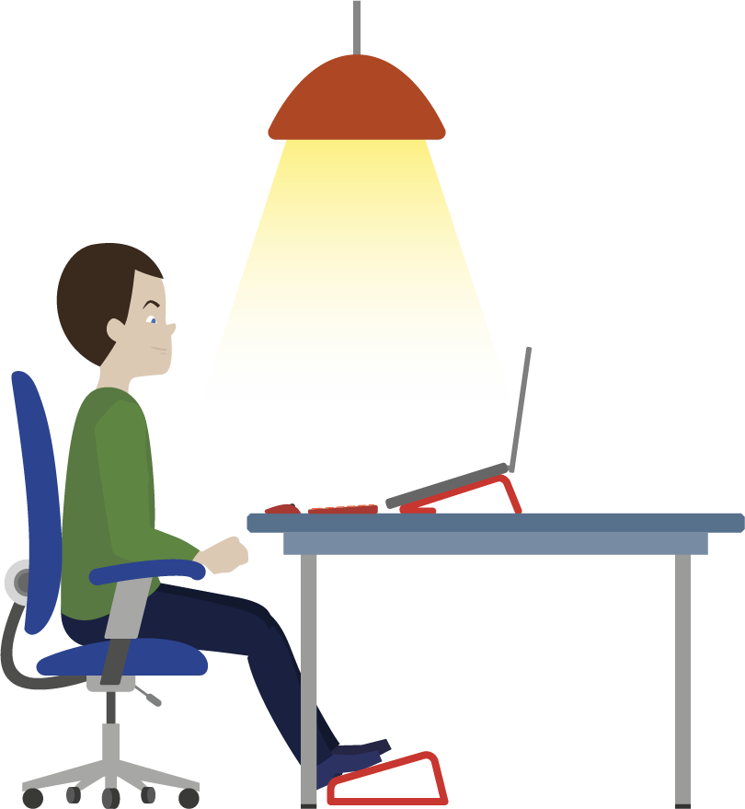
2. Work environment – Lighting
Adequate lighting (preferable a minimum of 500 lux) is also important at the home office.
Avoid extreme light contrasts (e.g. working in a dark room while staring at the screen, the screen surrounded by dark walls) and prevent glare from sunlight or bright lighting on the screen.
Therefore, sit across the window (do not sit with the face or back to the window) and use blinds if necessary.
Notes:
Canadian Centre for Occupational Health and Safety. OSH Answers Fact Sheets. Lighting Ergonomics – General. https://www.ccohs.ca/oshanswers/ergonomics/lighting_general.html.
EU-OSHA – European Agency for Safety and Health at Work, Lighting. https://oshwiki.eu/wiki/Lighting

Slide 22
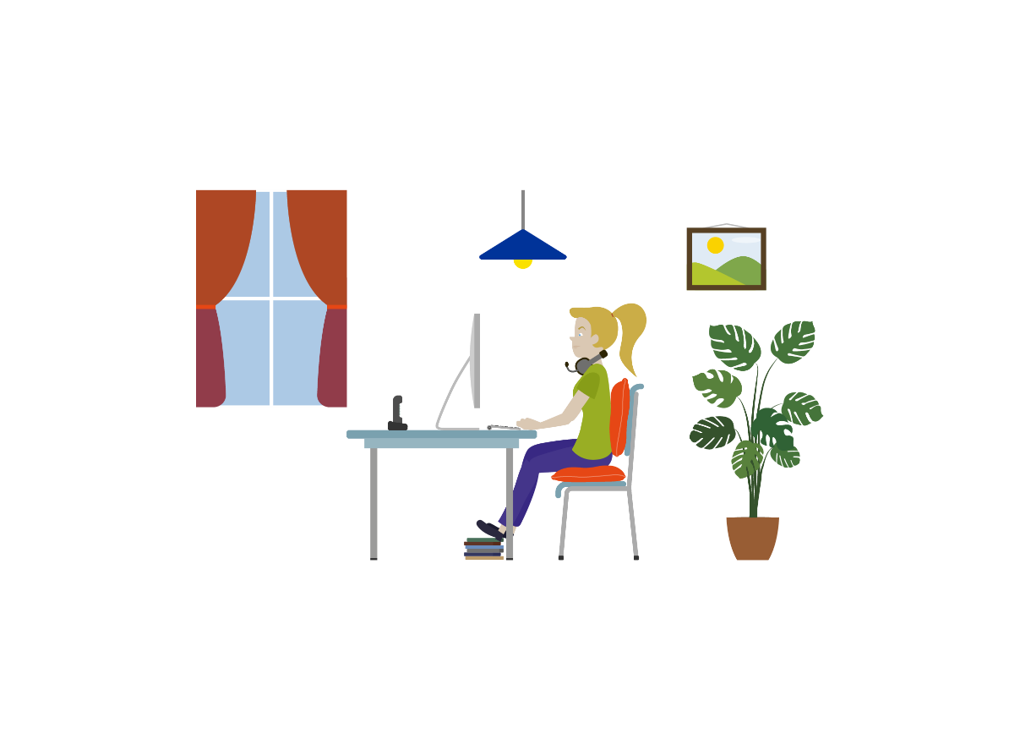
2. Work environment – Air and temperature
Open windows and doors regularly, e.g. before starting the teleworking day or when taking a break.
The optimum temperature for computer work is between 22°C and 24,5°C depending on the season.
Adjust clothing to the temperature of the workplace.
Dress in such a way that easily put on or take off a layer if it is too hot or too cold. Lose clothing allows you to stretch too.
Notes:
Canadian Centre for Occupational Health and Safety. OSH Answers Fact Sheets. Thermal Comfort for Office Work. https://www.ccohs.ca/oshanswers/phys_agents/thermal_comfort.html.

Slide 23
2. Work environment – Background noise
It is appropriate to work in a separate room to minimise interference from music, television, housemates, etc.
Make good arrangements with housemates, especially when concentration tasks need to be performed.
In addition, a noise reducing headset may be helpful to reduce annoying background noise.
Preferably place the printer in a different room.

Slide 24
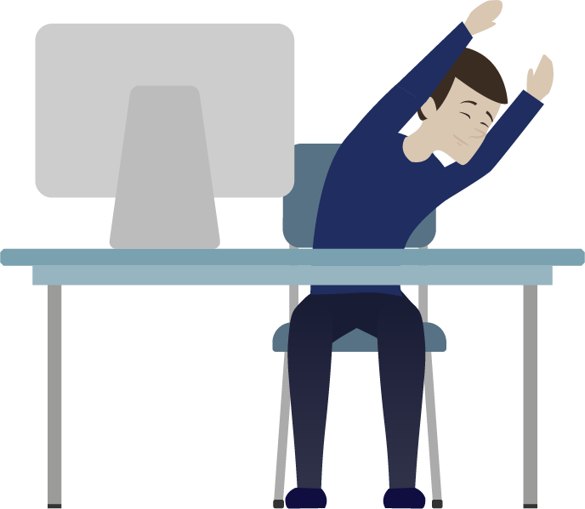
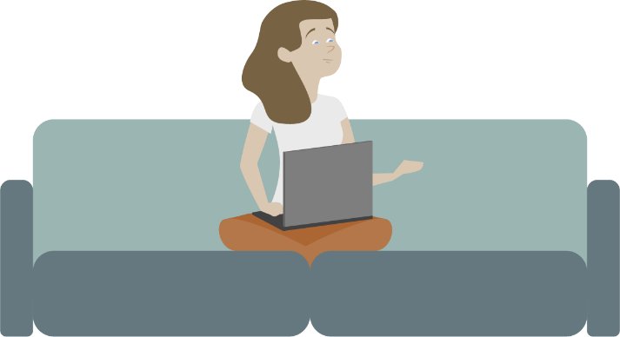
3. Sedentary behaviour
A combination of 3 elements are needed for mental and physical health:
  1) sit fewer hours a day,
  2) change posture as much as possible,
  3) be aware of a good sitting posture.
Notes:
EU-OSHA – European Agency for Safety and Health at Work. Promoting moving and exercise at work to avoid prolonged standing and sitting. https://oshwiki.eu/wiki/Promoting_moving_and_exercise_at_work_to_avoid_prolonged_standing_and_sitting
EU-OSHA – European Agency for Safety and Health at Work. Recommendations and interventions to decrease physical inactivity at work. https://oshwiki.eu/wiki/Recommendations_and_interventions_to_decrease_physical_inactivity_at_work

Slide 25
3. Sedentary behaviour – Tips to move
    Start the day with a short walk or a quick workout (e.g. stretching, strength exercises, …).
    Alternate between tasks and change posture at least every hour by standing up, taking a (coffee) break, going to the toilet, etc.
    Regularly stand up during online meetings or walk during phone calls.
    Alternate between sitting (maximum one hour) and standing (maximum 30 minutes) work. Ideally, use a sit-stand desk. If not available, position the laptop on a platform on the table or a cabinet.
    Take a microbreak to stand for 30 seconds and stretch every 20-30 minutes
    Change posture when sitting, e.g shifting weight from side to side or leaning back (dynamic sitting)
    Lunch break is the ideal time for a walk, 15 minutes of exercise, garden work or other outdoor activities.
Notes:
EU-OSHA – European Agency for Safety and Health at Work. Promoting moving and exercise at work to avoid prolonged standing and sitting. https://oshwiki.eu/wiki/Promoting_moving_and_exercise_at_work_to_avoid_prolonged_standing_and_sitting
EU-OSHA – European Agency for Safety and Health at Work. Recommendations and interventions to decrease physical inactivity at work. https://oshwiki.eu/wiki/Recommendations_and_interventions_to_decrease_physical_inactivity_at_work

Slide 26
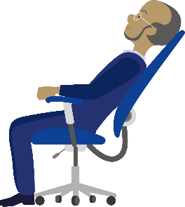
3. Sedentary behaviour – Tips to move 2
    Regularly do some quick exercises to improve blood circulation and release muscle tension:
      Turn your head to the left and right.
      Tilt your head forward and gently shake your head from side to side.
      Let your arms and shoulders hang loosely.
      Then lean your shoulders towards your feet.
      Roll your shoulders backwards and then forwards.
      Extend your arms forward to shoulder height. Put your hands together (with palms facing outward) and stretch your arms.
      Spread out your arms sideways and backwards.
      Plant your heels on the floor and raise your toes.
      Plant your toes on the floor and raise your heels
Notes:
Canadian Centre for Occupational Health and Safety. OSH Answers Fact Sheets. Stretching – At the Workstation. https://www.ccohs.ca/oshanswers/ergonomics/office/stretching.html.
EU-OSHA – European Agency for Safety and Health at Work. Promoting moving and exercise at work to avoid prolonged standing and sitting. https://oshwiki.eu/wiki/Promoting_moving_and_exercise_at_work_to_avoid_prolonged_standing_and_sitting
EU-OSHA – European Agency for Safety and Health at Work. Recommendations and interventions to decrease physical inactivity at work. https://oshwiki.eu/wiki/Recommendations_and_interventions_to_decrease_physical_inactivity_at_work

Slide 27
4. Work organisation
Here are some practical tips to improve work-life balance and work organisation while working from home:
  Provide a separate home-office where you can work without being disturbed. This helps to maintain a clear separation between work and home.
  Schedule the workday (including lunch and short breaks).
  Respect ‘normal’ office working hours.
  Take care of a good routine: get up and start at the same time as you would for a ‘normal’ workday.
  Make plans for the after-work hours. If you have to be somewhere at the end of the workday, it is more likely that you log off and stop working.
  Ensure that work tasks are varied to avoid monotony.
Notes:
EU-OSHA – European Agency for Safety and Health at Work. Practical tips to make home-based telework as healthy, safe and effective as possible. https://oshwiki.eu/wiki/Practical_tips_to_make_home-based_telework_as_healthy,_safe_and_effective_as_possible
EU-OSHA – European Agency for Safety and Health at Work. Work-life balance – Managing the interface between family and working life. https://oshwiki.eu/wiki/Work-life_balance_%E2%80%93_Managing_the_interface_between_family_and_working_life

Slide 28
5. Psychosocial factors
Job support (i.e. social support, autonomy, decision-making) is an important element for employees’ psychosocial and physical health.
Job satisfaction increases when employees feel sufficiently guided and supported during their (tele)work.
Here are some practical tips to reduce MSD-related psychosocial risk factors of teleworking:
  Social isolation / social support
  Workload

Slide 29
5. Psychosocial factors – Social isolation / support
Stay connected with colleagues and supervisor by scheduling regular phone calls or virtual meetings.
Team meetings are best alternated with one-on-one talks with colleagues and supervisor.
Make time for informal talks and hearing friendly voices. Reserve the first part of the meeting for a check-in, to discuss how everyone is doing and talk about non-work-related issues.
Take virtual coffee breaks with colleagues.
Provide teleworking buddies that allow employees to voice their concerns and potential difficulties to be detected more quickly.
Notes:
EU-OSHA – European Agency for Safety and Health at Work. Practical tips to make home-based telework as healthy, safe and effective as possible. https://oshwiki.eu/wiki/Practical_tips_to_make_home-based_telework_as_healthy,_safe_and_effective_as_possible

Slide 30
5. Psychosocial factors – Workload
Do not ignore the high pace of work. In case of (persistent) high workload, make an appointment to talk with your supervisor.
Take enough breaks during the day in order to break up periods of intense work, and do not skip lunch break.
Go off-line!
Do you sometimes forget to take a break? Consider working in blocks of 25 minutes, with 5 minutes break between the blocks.
Focus on one task and avoid distraction by working in a quiet room, put on a headphone and close mailbox.

Slide 31






Join us and lighten the load!
Find out more on the campaign website:
  healthy-workplaces.eu
Subscribe to our campaign newsletter:
  https://healthy-workplaces.eu/en/healthy-workplaces-newsletter
Keep up to date with activities and events through social media:
#EUhealthyworkplaces
Notes:
© European Agency for Safety and Health at Work, 2020
Reproduction is authorised provided the source is acknowledged.
For any use or reproduction of photos or other material that is not under the copyright of EU-OSHA, permission must be sought directly from the copyright holders.

